Slide 1
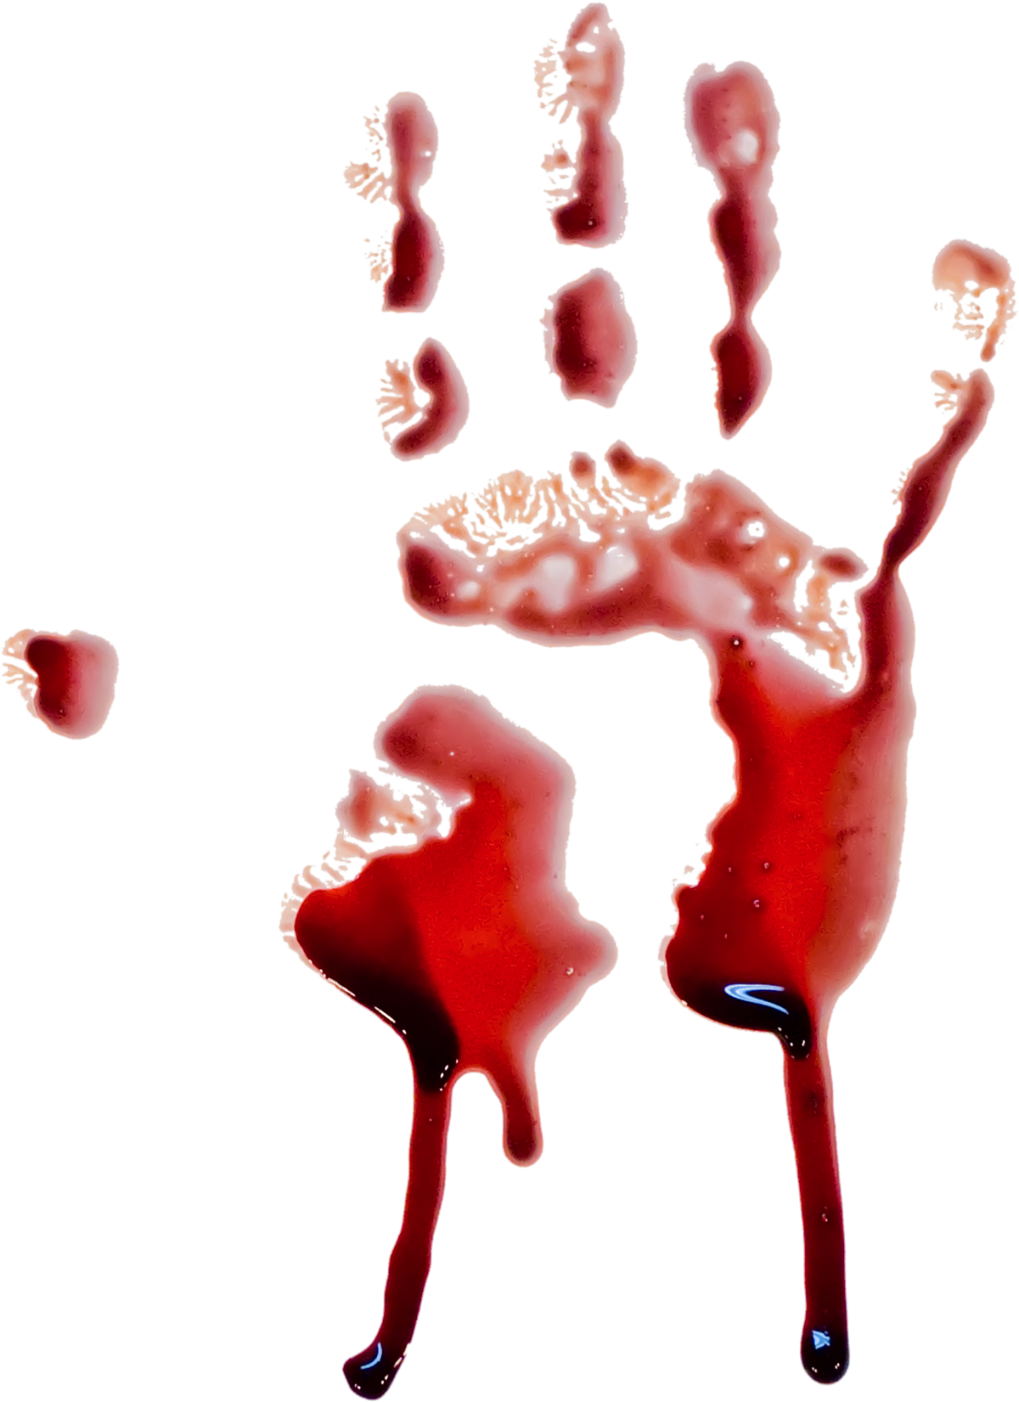
Zombification of Disability
Dr. Anne Jackson

Slide 2
Disclaimer
To be clear, I am not saying the disabled are zombies
I am saying that we abled bodied, supposedly normal people, treat people with disabilities as apart from societal normal to be shunned, rather than as a positive one.
Some of us view the other, the marginalized, socially excluded and apart from mainstream society, with an us vs them binary mentality
Why such a huge growth in the entertainment world of zombies? Is it an unconscious bias towards people with disabilities?
Fear, as displayed by shows like “The Walking Dead’ are how we see, feel and interact at times with those amongst us classed as the other, the disabled, the homeless, the supposedly mentally ill.
Notes:
My thesis will explore how zombies are an embodiment of unconscious bias towards people with physical and mental disabilities.

Slide 3
Who am I?
I am Dr. Anne Jackson
PhD from at York University, with a Masters in Inclusive Design from OCADU
I have a long career in IT Accessibility
I make documentary films to reduce the US and THEM divide in disability
I am an Handicapped Scuba Association (HSA) Divemaster
I am an officiant with Humanist Canada
My thesis - From the “Living Dead” to the “Walking Dead”: How Modern Zombie Culture Reflects, Challenges and Perpetuates Implicit Negative Bias towards People with Disabilities.
Notes:
SLOW

Slide 4
Why?

Slide 5
Why Zombies and Disability?
I have always been horrified, yet fascinated by zombies
Watching “The Walking Dead” I tried to intellectualize why they are both fascinating and repellant
They have a restless moving, no social norms, yet a strong group mentality
Unstoppable and yet sometimes slow moving like in a nightmare
A dragging walk akin to some manifestations of cerebral palsy , unpleasant, unwashed
Typically physically deformed, revolting and seemingly smelly
They come in both fast and slow presentations
Notes:
Why a fear of zombies? Fear of homeless? Fear of disability.
My father with his crocodile crawl, I felt terrified as I knew he would just keep coming, speed had nothing to do with it
Nightmares about running in water not able to move quickly enough

Slide 6
Why Continued
You don’t want to go near them
A slow death if bitten, knowing what you will become after “Death”
You don’t want to catch what they have
We may have to face a fate worse than death
They are a step in between life and death
They are quiet until noise attracts and wakes them, like waking young kids
Notes:
Once kids are awake you know you are now on duty
it is not how powerful they are that makes zombies frightening; it is how dismal it would be to become one yourself (Barber, 2014).

Slide 7
Disability vs Zombie
I have observed people physically avoid the homeless on the streets, avoid those with visible mental challenges, avoid people in wheelchairs, avoid people who are not magazine airbrushed perfect.
Our general tendency is avoidance and to not seek to have any physical contact or discourse with them, as if out of fear that their disability might be contagious, infection - virus based. We might catch what they have...
Disabilities can be caused by infection or malnutrition. And similarly, zombieness is transmitted by contact.
Notes:
Disability does come from disease some times, mal nutrition.
Diabetes can cause blindness and amputations
Mumps causes deafness and encephalitis causing permanent brain damage
Polio
Disability cooties
Tom at the scuba swap, an engineer and people would not talk to him, help him try on gear, they ignored him.

Slide 8
Disability vs Zombie vs Dehumanization
When faced with people with disabilities or other perceived imperfections, we are forced to evaluate our own vulnerabilities, and this could get uncomfortable.
Zombies are not immortal, but just not alive in the manner we perceive life. In transition, as risen from the dead, they represent the step in-between life and death.
Is this easier then to ignore and dehumanize hordes? The nameless Faceless Hordes of people all with lives and a story, so much easier to just dismiss the humanity

Slide 9
Comparison to Original Slow Zombie Representations
Zombie/Zombi
Slow moving
Disfigured
Exploited for unpaid labour
We don’t want to be one
Actively avoid becoming bitten or infected
Is being an undead zombie a worse fate than death?
Disability
Slow Moving
Often Disfigured
Poor and often underemployed
We don’t want to be one
Avoid ‘disability cooties’ as you might catch their disability
Avoid disability at all costs as it makes you face your own mortality and frailty
Notes:
Disability cooties – how you may catch a disability if you go near people who have a disability - confirmed by majority of my friends who have a physical disability
general tendency is to avoid people with disabilities and to not seek to have any physical contact or discourse with them, as if out of fear that their disability might be contagious. When faced with people with disabilities or other perceived imperfections, we are forced to evaluate our own vulnerabilities, and this could get uncomfortable

Slide 10
A little History

Slide 11
Zombie vs Werewolves and Vampires
Zombies are slow moving and disfigured, akin to some disabilities, with the zombie shuffle much like the walk of a typical person with cerebral palsy.
Other fictional creatures such as vampires and werewolves are fast moving, mythical creatures of modern fiction, sexual and predatory; also based on a literature but not so the zombie.
Zombies could be likened to people with disabilities who tend to be slower moving and sometimes physically disfigured as well.
Unlike with vampires and werewolves, it is not how powerful they are that makes zombies frightening; ‘it is how dismal it would be to become one yourself’ (Barber 2014)
Notes:
Why are Zombies Still So Popular? Web. http://www.bbc.com/culture/story/20131025-zombie-nation. Last accessed on October 21, 2016.
‘To compare zombies to their rivals in the monster-movie pantheon, vampires and werewolves symbolise the thrill and the romance of having superhuman strength and no conscience − hence the Twilight and True Blood franchises. But there’s nothing glamorous about being a zombie. Unlike vampires and werewolves, they’re not frightening because of how powerful they are. They’re frightening because of how dismal it would be to become one yourself. ‘
‘They might tuck into the odd innocent bystander, but Dracula and the Wolfman don’t threaten our way of life. “ By Nicholas Barber, a writer who writes about popular culture, 21 October 2014
Imagine Lou Gerick's disease.
My friend Elizabeth loves her disability of deafness.

Slide 12
Zombi to Zombie
The original zombi tales are more religion based, the religion of voodoo, and have an air of mystery about them, which makes them more scary and unexplainable, like many religions.
There is a great lack of control over who is a zombi and who is not in Haiti, where they are supposed to have originated from
This is controlled by religious incantations and secret holders of knowledge or medicines that are not readily understood by lay persons in the local society.
Notes:
To trace the rise of the Zombi to the Zombie

Slide 13
First recorded incidences
Lazarus was risen from the dead, and first recorded reawakening from a dead state, from the bible, followed quickly by Jesus.
Voodoo is also religion based
  Martinique and Haiti – voodoo, was supposedly used to create the living dead who were created to work for no money
  Haiti voodoo and zombies, brought to us in the book The Magic Island- Seabrook 1929
  Reality – in 1864 Article 249 in the Penal Code of Haiti states that even if the dead return to life that it is considered murder.
Notes:
Colonialization caused a need to low paid workers in the colonized countries to make money for the imperialist over seers, The French overseers. He observed revenant corpses working in the fields for their masters for no money.
Seabrook, an American, wrote a book about the island of Haiti and its voodoo along with sightings of zombies. He was the first to bring these living dead tales to the western world.
Penal Code:
“Also shall be qualified as attempted murder the employment which may be against any person of substances which, without causing actual death, produces a lethargic coma more or less prolonged. If after administering of such substances, the person has been buries, the act shall be considered murder no matter what result follows”
From Zombies by Professor Roger Luckhurst, University of London
BA (Hull), MA (Sussex), PhD (Hull)
Professor in Modern and Contemporary Literature

Slide 14
Religion and Disability
Old testament – disability is attributed to god who brings it as a punishment for sin or disobedience
New Testament – Jesus is companionate to disabilities and the marginalized in society
Lazarus and Jesus both risen from the dead
Jehovah witness bible talks about a dead army rising at Jehovah's command and the dead are only sleeping (John 11.)
Notes:
OLD TESTAMENT
Disability is attributed to God. The general view of the Old Testament writers is that God brings disability as punishment for transgressions for sin or as an expression of God's wrath for people's disobedience. It is seen as a curse and as a result of unbelief and ignorance (Jewish Encyclopaedia, 1920; The Talmud of Jerusalem, 1956; and Encyclopaedia Judaica, 1972).
Leviticus 21: 17–19 states thus:
Say this to Aaron; for generations to come none of your descendants who has a defect may come near to offer the food of his God. No man who has any defect may come near, no man who is blind or lame, disfigured or deformed. No man with a crippled foot or hand.
NEW TESTAMENT
Luke 4:18–19: The Spirit of the Lord is on me, because he has anointed me to proclaim good news to the poor. He has sent me to proclaim freedom for the prisoners and recovery of sight for the blind, to set the oppressed free.
Luke 7: 22: So he replied to the messengers, “go back and report to John what you have seen and heard: the blind receive sight, the lame walk, those who have leprosy are cleansed, the deaf hear, the dead are raised, and the good news is proclaimed to the poor.”
John 9: 1–3: As he went along, he saw a man blind from birth. His disciples asked him, “Rabbi, who sinned, this man or his parents, that he was born blind?” “Neither this man nor his parents sinned,” said Jesus, “but this happened so that the work of God might be displayed in his life.”

Slide 15
Modern Zombie
Post World War II Survivalist mentality
Horrors of Hiroshima, brings to us human capability for violence
Television and internet images, along with constructed reality of film and later video games show us these atrocities
George Romero made the “Night of the living Dead” film in 1968, without a mention of the word zombie
Pulp fiction were sensational stories, with many zombie references
Zombie overload, games depicting zombies means we distance ourselves from the horror, have control over our fears, remove ourselves from the human capability for violence. We can stop a video game, not so the horrors of the world
The modern zombie phenomenon created new word to describe something already dead like a company no longer financially viable but still operating
Apocalyptic narratives accompany the zombie revival
Notes:
Hiroshima:
Images of the dreadful human victims widely available
TV Images:
Constructed reality of film and TV
George Romero:
Did not use the word Zombie. Children eating their parents, last survivor shot by police
Pulp Fiction:
Printed on cheap paper and widely read, comics and shock books
Zombie Overload:
Distance, control, we can turn off if it gets too frightening – disabled people can’t do that.
Apocalyptic:
Zombie manual in the Pentagon - battle plan against zombie apocalypse. Return to the unregulated days away from money, governments, stock market dependence of our lives.

Slide 16
Zombies vs Reality

Slide 17
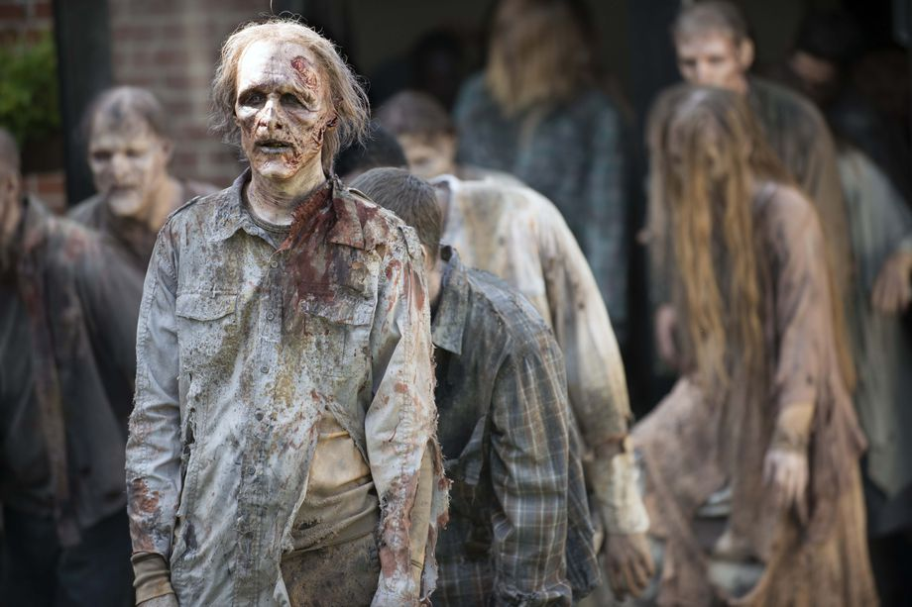
The Horde
Notes:
From “The Walking Dead”

Slide 18
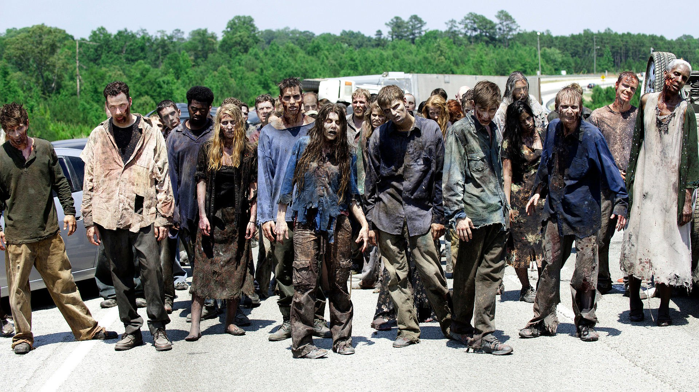
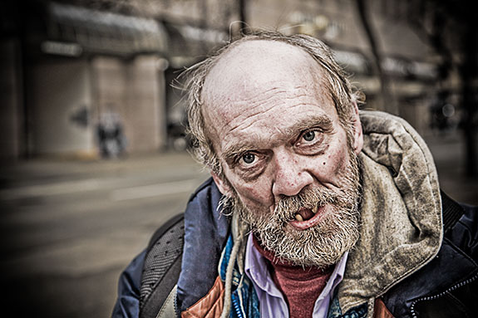
The Reality

Slide 19
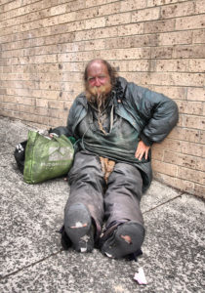
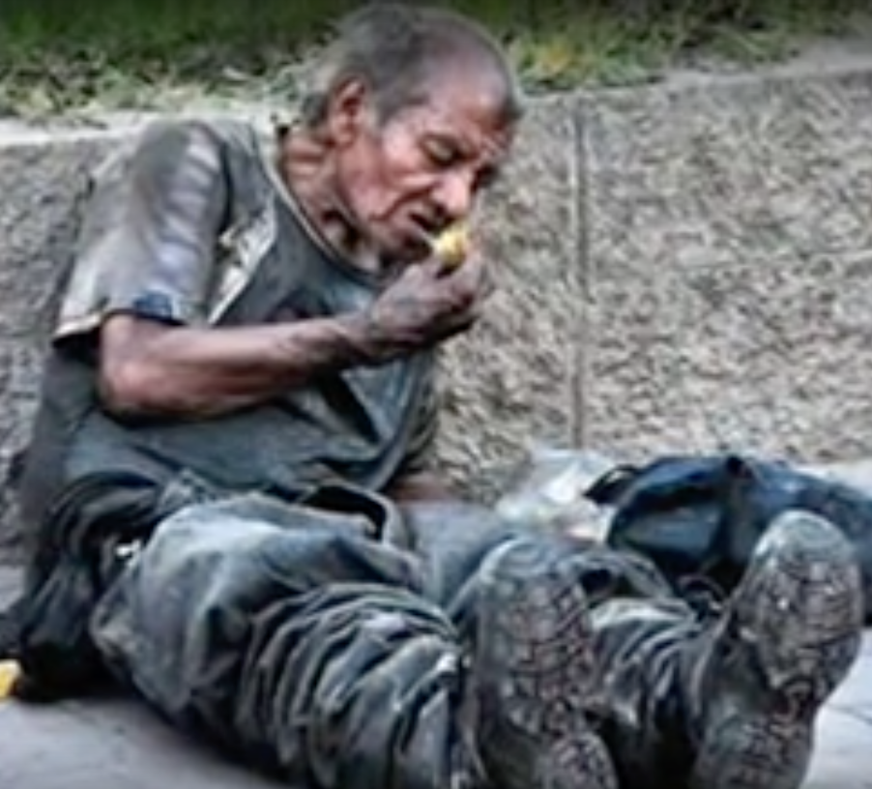
More reality…

Slide 20
Current Zombie Culture
Modern zombie culture is different to the original zombi stories, mainly because it is a virus-based concept.
This give us hope that there is a cure to be found, or at least that zombies are “man made” so controllable in some way.
Books have been written on avoidance strategies, such as The Zombie Survival Guide by Brooks, printed in 2003.
US Military has a plan at the Pentagon for the zombie apocalypse - CONOP 8888 unclassified.
Zombie stories start to take on a survivalist viewpoint
Notes:
US military has also devised an elaborate plan should a zombie apocalypse befall the country, according to a Defense Department document obtained by CNN.
In an unclassified document titled "CONOP 8888," officials from U.S. Strategic Command used the specter of a planet-wide attack by the walking dead as a training template for how to plan for real-life, large-scale operations, emergencies and catastrophes.
http://i2.cdn.turner.com/cnn/2014/images/05/16/dod.zombie.apocalypse.plan.pdf

Slide 21
Survivalists
According to Stanford researcher Vidergar, our modern obsession with zombies is connected with the survivalist mentality that developed after World War II
The fascination with the end of the world as we know it, can be traced to the advent of nuclear warfare during World War II and the concentration camps.
With horrendous events like the Hiroshima bombing, we are faced with another unspeakable fact of the human capacity for violence, which got more public with our modern communication methods, not available in earlier times.
Concentration camps filled with people starving to death
We got to see awful, actual footage of the atrocities on television and internet. These images once seen, can not be unseen.
Our fascination for zombies could be because their decaying bodies affirm our mortality, the inherent disability of human embodiment
Notes:
Survivalist:
Having been told how unique we are we find we are not and zombies make us see how fragile we are
Look out for yourself, no time to look after the weaker in society
Primo Levi, on the concentration camps (Primo Michele Levi was an Italian Jewish chemist, writer, and Holocaust survivor.)
“the Muselmanner, the drowned, form the backbone of the camp, an anonymous mass...of non-men who march and labor in silence, the divine spark dead in them.... One hesitates to call them living: one hesitates to call their death death, in the face of which they have no fear, as they are too tired to understand”

Slide 22
Dehumanization
It is so much easier to dehumanize things that make us uncomfortable , for example war refugees who try desperately to be seen as viable human beings and we turn them into things rather than people.
“we are all equally complicit in the murder of others” Dahlia Schweitzer 2018
The Nameless Faceless Horde
Are zombies without a soul, therefore still not human? Do we dehumanize others like refugees in this way also?
As a society we are scared for our future, things are changing, do we actually desire the apocalypse?
Notes:
‘we are all equally complicit in the murder of others – whether real, symbolic or social murder – to save ourselves and our way of life. Neoliberalism is a regime that fosters self discipline, self control and self protection; in other words, it involves a competition for survival’ Dahlia Schweitzer, Adjunct professor at ArtCentre College of Design in Pasedena California
I ran this thought, Nameless Faceless Horde, by my friends who have physical disability and they were enthusiastically agreeing with being thought of as a “nameless faceless horde”
People in wheelchairs tend to be ignored as they are below our eye level – Tom Scuba Swap.
Stephen Hawkins physically disabled but a huge contributor to society
Sean of the dead – TV watching zombies

Slide 23
Apocalypse
Conspiracy theories actually make us feel better as there must be someone in charge somewhere
In the apocalypse, there is no time for looking after anyone else, yet groups matter and are successful
Few are concerned with our appearance as if for Instagram, but worry about survival and where our next meal is coming from
Government interference is no longer there as there are no governments, internet, television
People with disabilities, weakness, pregnancy, illness are the first to go in zombie movies
Do we actually want to return to a simpler time when money and stock markets were not driving forces and we could take care of each other, talk with each other, grow food ourselves.
Notes:
As a TA I asked who could grow their own food and only 1 person out of a class of 300 in the lecture said yes.
Corinne Duyvis autistic and an author
‘there’s no room for political correctness in matters of survival. Supporting —even tolerating — disabled people is thought to be an example of modern generosity, so it makes sense to assume that, once society breaks down, we’ll revert to treating disabled people with the same brutality and pragmatism as in the past.’ Corinne Duyvis autistic and an author upset at disabled people being killed off first in stories
Living while disabled is seen as an act of luxury.
And when the situation gets tough, luxuries are the first to go.
https://www.theguardian.com/childrens-books-site/2016/mar/14/disability-autism-sci-fi-corinne-duyvis

Slide 24
Can we Catch a Disability?
In fact we can

Slide 25
Germaphobia and other fears
Can you catch a disability virus? Mumps, Polio, Leprosy.
Malnutrition, inadequate health care and poverty all cause disability
Do people believe that they can catch a disability?
  Is disability given by god as punishment?
We are so obsessed with cleanliness we are making ourselves and our immune systems weak.
Notes:
Mumps causes deafness and encephalitis causing permanent brain damage
Polio
Leprocy

Slide 26
Death
Is there life after death?

Slide 27
Thanatophobia
Fear of death
Medical Hippocratic oath – life at all costs
First definition of death was an none beating heart
Now it is lack of brain function, hence zombies are killed by a blow to the head
Notes:
Interesting to me that medical profession keep someone alive even if they are in great pain and suffering in life, like my mum.
In 1968 a group of Harvard doctors changed the definition of dead to brain dead.

Slide 28
Bias
And how we can understand and combat illogical bias

Slide 29
Narrative Prothesis
It has been used in some contexts to discuss the representation of disability in literature and media. It refers to the way narratives incorporate disability as a plot device or a metaphor, often reinforcing stereotypes or societal perceptions about disability.
The concept underscores the idea that disabled characters are often used as a literary device rather than fully developed individuals within a story
This is a form of dehumanization and perpetuates the negative bias of disability

Slide 30
Bias as a Positive Trait
Stereotyping means your brain is working properly, noticing patterns, and making generalizations is normal and implicit bias.
Becoming aware of our biases will allow us to understand them and modify our thoughts based on new information
Notes:
Looking at someone we can quickly judge and sum up who we think they are. We categorize as a survival technique but we are often wrong, so we need to redefine bias, especially in my opinion, regarding disability.
To define Implicit Bias. Also known as implicit social cognition, implicit bias refers to the attitudes or stereotypes that affect our understanding, actions, and decisions in an unconscious manner

Slide 31
Bias
Disability can be seen by people who have little contact with disability, as a fate worse than death
Being turned into a zombie is considered to be a fate worse than death
Coping with this fear of death and disability has given rise to a great deal of zombie media including television shows, films, comics, pulp fiction stories, games and books
Therefore it may be considered valid that the zombie phenomenon can be linked to an unconscious bias towards people with disabilities
Notes:
Judith Butler we need to mourn efficiently and effectively and we don’t always get to do this.

Slide 32
Understanding Bias
When we know what the unconscious bias is, we can confront and understand it and combat the divide more effectively

Slide 33
Survival of the Fittest?
In “The Walking Dead” there are a few depictions of disability (Loss of leg, eyepatch) and a lot of PTSD
A character, Connie, was introduced in Walking Dead who was a signer and she taught the tribe sign language so their verbal communication did not alert the undead
A character Wendell had his wheelchair that was brilliantly adapted to fight and defend from zombies
There are many other positive representations of disability and the characters are played by actors with their specific portrayed disability
These characters are positive aspects of disability and shows how we can become stronger as a group when we are inclusive.
Notes:
Most survivors in The Walking Dead have PTSD of some kind, few have a physical disability. Carol especially could not kill anymore, for almost a whole season.
Joe Mohammed states he is better off in a wheelchair as he can move faster “Shit, if I couldn’t roll myself faster than a walking zombie, how could I have lasted so long?” In fact in a further recounting his wheelchair saves him when attached by a ‘dragger’ – zombie who lost its legs – if standing it might have grabbed his ankle.

Slide 34
Methods
And how I conducted my research

Slide 35
Critical Theory
Using feminist and feminist film theory, along with gender, race and critical disability theories I performed analysis of how disability is perceived and portrayed in modern film and television offerings today
These theories were used as they are all based the bodily presentations

Slide 36
Methods Used
I used a Canadian company to store my data from a survey of 100 people across the world
The survey was put on facebook on specific groups related to preppers, horror fans and specifically the zombie sub genre
Additionally the survey was sent to the UK and the US to a selection of university students willing to participate
From the survey participants I selected 5 for video interviews

Slide 37
Results
At the intersection of religion, disability and zombies

Slide 38
Results of Research - Religion
Research done at the intersection of religion, disability and zombies
Surprising result, Religion was not considered important in the post apocalyptic world. Only 5 of the 100 responses suggested it would be helpful and 25% did identify with a religion
  I would like to do the survey again using only religious groups although 25% identified with a religious group (attending a service at least once a month) but none as satanists or satanic temple
  Many commented on the resurrection narratives of some religious beliefs which they suggested did not align with zombification

Slide 39
Religion
Seven out of seven said their faith was NOT important
Two out of seven said religion should make us more compassionate
  Three said the compassion was dependant upon the religious belief
This was surprising as religion has become more defining, binary and prevalent, yet it did not play a big role in the post apocalyptic scenarios

Slide 40
Results for Disability vs Zombies
We are all biased as to be biased is to be human and it is a survival mechanism
Zombies and some disabilities have much in common and if they were all united, would become and unstoppable ‘herd’ as a force for good
Many beliefs are based in religion rather than cultures so the rejection of religion in the post apocalyptic world would bring a new enlightenment era where all are accepted as they are in all manifestations of the human condition

Slide 41
Conclusions
“Once a capitalist bites you, in other words, you’ve had it – you’ve caught the bug. And we capitalists do in fact infect others, despite our best intentions” Webb and Brynand

Slide 42
Community
The need for community is paramount for survival both now and in the zombie narratives
Zombies are a unified horde and are frightening in their group thinking and drives to survive
Religion used to offer this community but it seems to have lost its way in many cultures and sects

Slide 43
Contribution to Society
The zombie as a catalyst for positive change
By removing capitalism (shareholder), humanity can re-evolve into a more inclusive society
Zombies do not need things so are the enemy of shareholder capitalism
Does this rise in zombie offerings suggest a reset of society to one more compassionate and inclusive?

Slide 44
Apocalypse from a different viewpoint
Learning to successfully live together would increase our chances of survival
The outliers in society have always been an early warning sign of troubles to come as ‘canaries in the mines’
Acceptance of all for whom they are, we don’t need to be fixed...
Could a societal reset like the apocalypse, result in a better human experience or would we just no longer be the dominant force in nature?
Notes:
I think learning how to more successfully cooperate will mean we’ll have a better chance at surviving anyways
“Apocalyptic fiction doesn’t just embrace the erasure of the disabled and medically compromised, it normalizes their obliteration’ Shoshana Kessock, WRITER, GAME DESIGNER AND UNREALITY Expert
Writer, speaker and activist Eli Clarke on body mind acceptance moments ‘They foster a matter of fact acceptance of our tics, tremors, stutters, seizures, knots, scars, pain, quirks. They encourage an appreciation for missing teeth and the smarts that stretch food stamps to the end of the month, for big bellies and wide hips, for the flash of hands signing American Sign Language and typing on assistive communication devices, for dark skin and kinky hair. They let us embrace our wild femmeness, our handsome butchness, our glorious androgyny. I want to live in a world where these moments are common and unremarkable.

Slide 45
Apocalypse Now
The word apocalypse is defined not only as a cataclysmic event, revelation or prophecy, but also where the forces of generally perceived good outcomes, is victorious over the forces for a generally perceived bad outcome.
Community is important and social media is not community
My research has hope that this reset of society where the flawed huma binary good and bad is still there but with the good overcoming bad.

