Slide 1
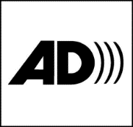
Audio Description Associates, LLC – “The Visual Made Verbal” and
the American Council of the Blind’s Audio Description Project
present
BUILDING IT IN: AUDIO DESCRIPTION
AT EVERY PRFORMANCE
with Joel Snyder, Ph.D.
President, Audio Description Associates, LLC
Founder / Senior Consultant, Audio Description Project, ACB
Accessible World – Accessible Canada
Montreal, CANADA
American Audio Description Symbol

Slide 3
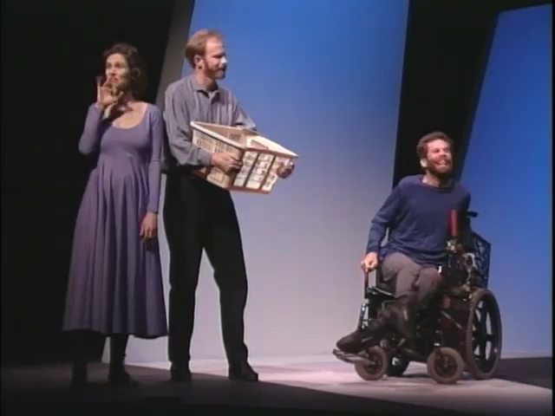

Slide 5


Slide 7
time was available to carefully observe the theatrical process and construct descriptive language that was more thorough and considered; and
people desiring the service could attend any performance with no advance notice and be assured of access to the visual aspects of the production.

Slide 9
JOEL SNYDER, Ph.D.
Audio Description Associates, LLC
jsnyder@audiodescribe.com
www.audiodescribe.com
301.920.0218
Audio Description Project of the
American Council of the Blind
https://adp.acb.org
24th Audio Description Institute - VIRTUAL
September 9-13, 2024

