Slide 1
Mentorship: Supporting the Future of Accessibility Through Connection
Dr. Ann Gagné

Slide 2
Outline
What is mentorship?
What is accessible mentorship?
How to mentor accessibly
Next steps

Slide 3
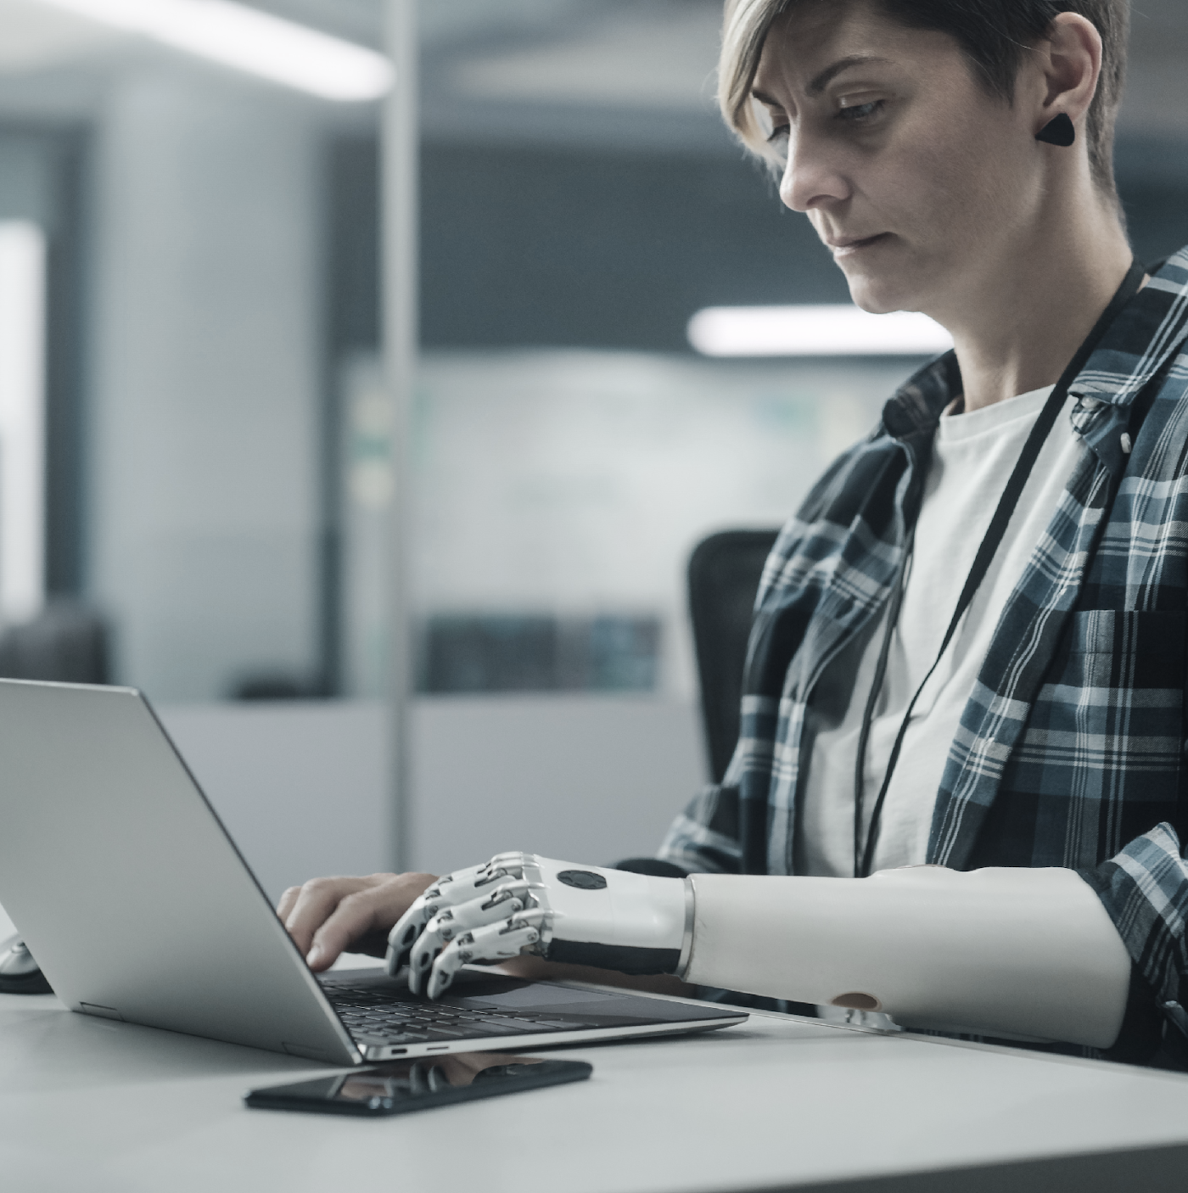
What is Mentorship?

Slide 4
Mentorship
Is a relationship
Mentorship is supporting others with guidance
Guiding through tasks, skills, or connecting to specific communities
It is about introducing new concepts
It is provided by someone with more experience or influence

Slide 5
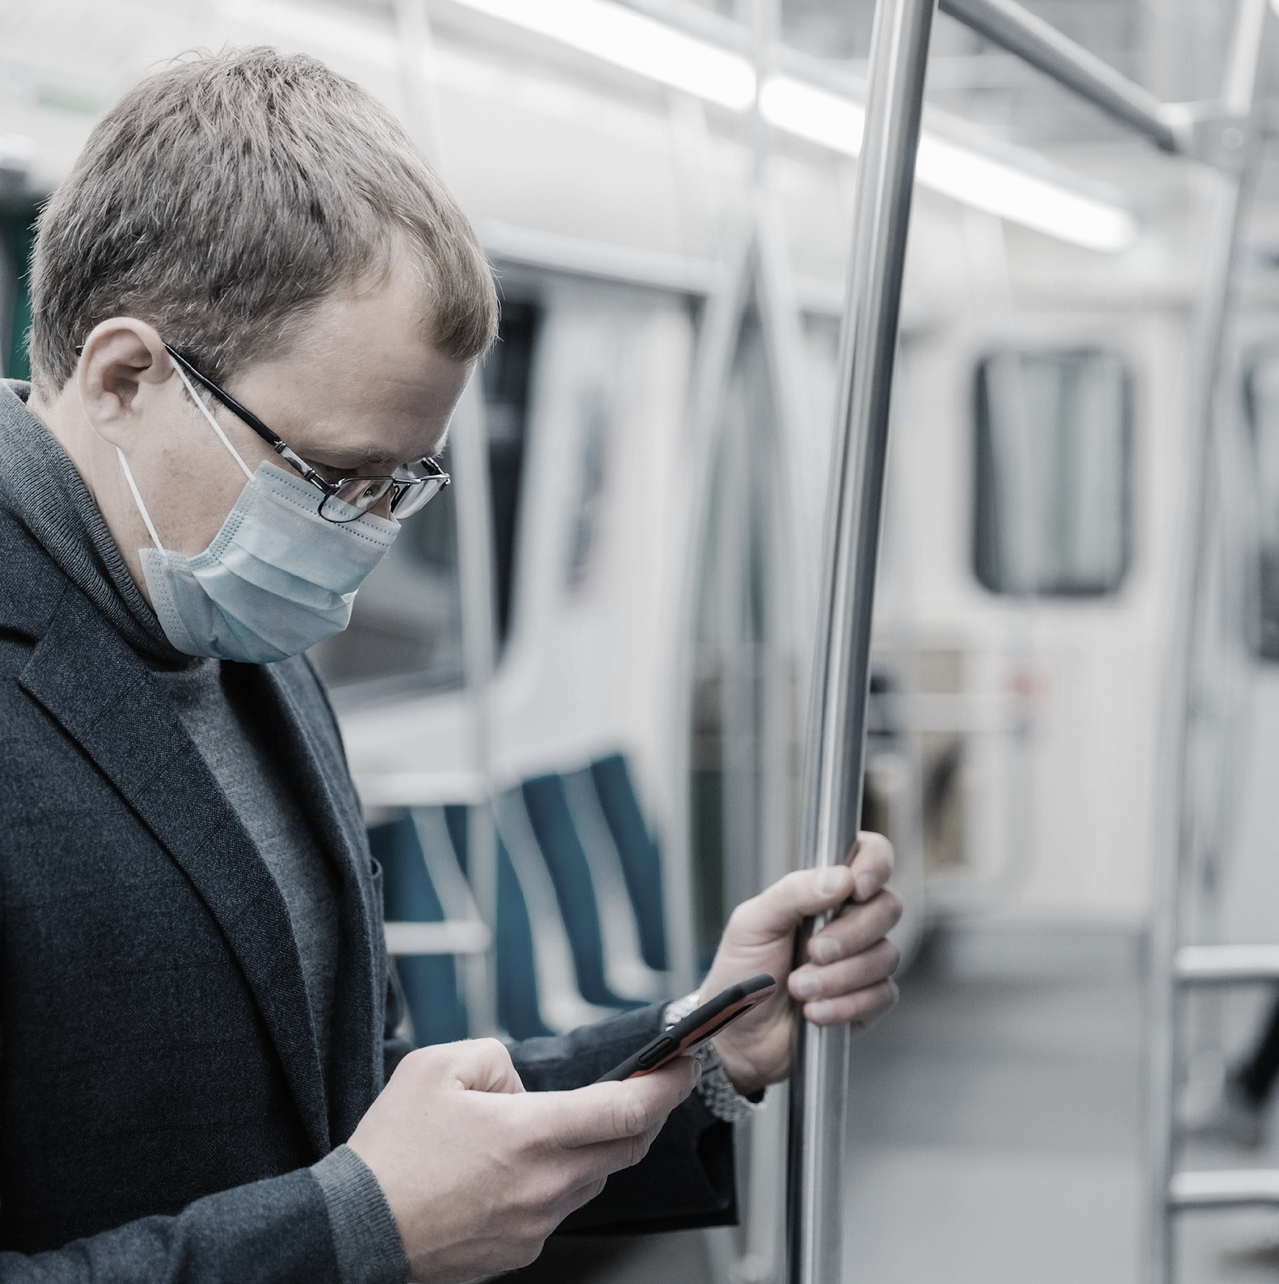
What is Accessible Mentorship?

Slide 6
Accessible Mentorship
Involves inclusive and meaningful communication and guidance
Starts with conversations about what mentorship models work best for those involved
Accessible mentorship has flexibility
Uses inclusive design and trauma-informed principles

Slide 7
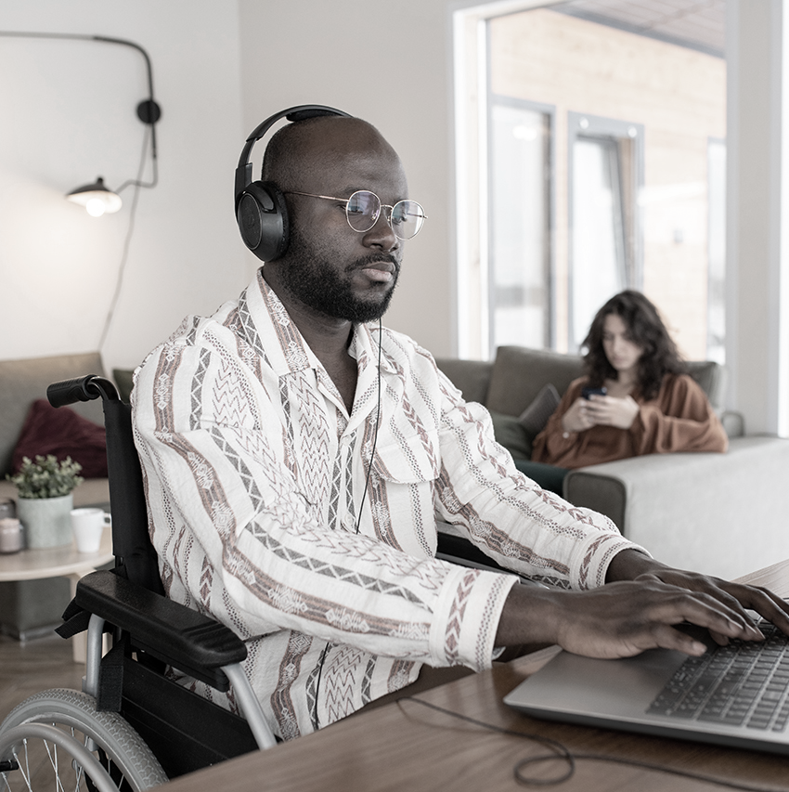
How to Mentor Accessibly

Slide 8
How to Mentor in an Accessible Way
Approach mentorship with belief in continuity
Listen to needs and experiences with an open mind
Have flexibility
Provide resources in meaningful ways

Slide 9
Next Steps
Who
How
When
Future
Reflect: who would be open to mentorship
  Students, colleagues, coworkers, community connections
Decide on accessible contact methods
  Zoom, In-person meetings, phone
What are time and ask boundaries
  Time per week, dates busy
Have plan for the future
  How can mentees become mentors?

Slide 10
Thank you!
Dr. Ann Gagné
Website: anngagne.ca
Email: accessagogy@gmail.com
Mastodon: @anngagne@mastodon.social

