Slide 1


Beyond the diploma: New graduates with disabilities, and the transition to the labour market
Preliminary findings from the Sourcing Understanding Through Research for Future Talent (SURF) Project

Slide 2
Background and Rationale: Critical Period for Opportunity
Gaps during education
Educational ‘achievement gap’ exists between students with disabilities and their peers without (Newman et al., 2011)
Gaps after graduation
People with disabilities continue to be underrepresented in the Canadian workforce, at rates of 59% compared to 80% for those without disabilities (Morris et al., 2018)

Slide 3
Research Questions
How long is the job search (‘gap’) between graduation and employment?
Do new graduates’ experiences align with their expectations?
Are new graduates finding high-quality jobs that align with their fields of study?
How can colleges and universities better prepare students with disabilities for the working world?

Slide 4
Methods
Inse
Participants: Target – 1000
Data collection timelines
Baseline survey – students in final year of study
Midpoint focus groups
Follow-up survey: 1 year post-graduation
  Comparing job search timeline, employment attainment and quality, satisfaction

Slide 5
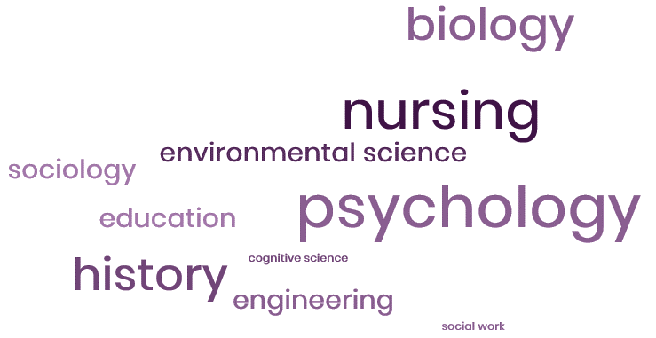
Preliminary
Results: Demographics
Student Profile
Average age 24 years old (range: 22-46)
4-year Bachelor’s Degree
Majority Domestic students, over half living in Suburban areas

Slide 6
Preliminary
Results:
Disability Type 1
Most Prevalent Disability Types

Slide 7
Preliminary
Results:
Disability Type 2
Most Prevalent Disability Types

Slide 8
Preliminary
Results:
Disability Type 3
Most Prevalent Disability Types

Slide 9
Preliminary Results SES Perceptions in Canada

Slide 10
Preliminary Results SES Perceptions in College/University

Slide 11
Preliminary
Results:
Job Search Expectations

Slide 12
Preliminary
Results:
Job Alignment

Slide 13
Preliminary
Results:
Expected Salary

Slide 14
Implications:
Mobilizing findings
Contribute more detailed data to address knowledge gaps about students/new graduates with disabilities
Produce recommendations to enhance accessibility of career prep supports
Inform policy and practice at institutional and governmental levels

Slide 15
Thank you!

