Slide 1

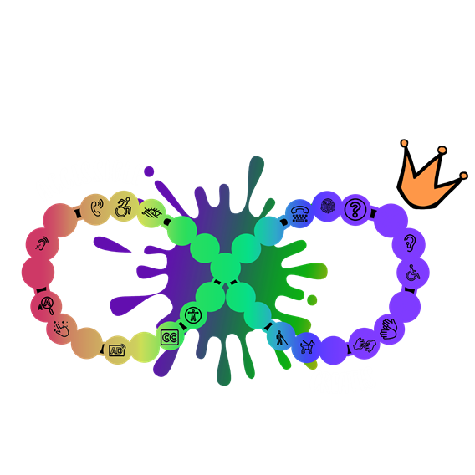
Hiring and Retaining Disabled and Neurodiverse Talent
Prepared by Sydney Elaine Butler
Founder of Accessible Creates

Slide 2
Agenda
Recruitment Strategies
Inclusive Interviewing
Onboarding
Retaining Strategies
Use of Policies and Procedures

Slide 3
So you want to hire a Neurodiverse or Disabled Candidate for a position?

Slide 4
Recruitment
Starts with an accessible recruitment, interviewing, and hiring process
Understanding barriers and then removing barriers in the hiring process
Ensuring website is up to WCAG Guidelines to ensure Accessibility
Accommodation Statement for candidates
Modify job postings to use more accessible and inclusive language
Make it clear that the company welcomes Neurodiverse and Disabled talent

Slide 5
Conducting an Inclusive Interview Process

Slide 6
Inclusive Interviewing
Asking if any accommodations are needed
“Do you have any accessibility needs?”
  “I require accessibility needs”
  “Yes”
No right to ask for disability, but say you will help.
Accommodations (Check-In, Provide more or less as needed)
Closed Captioning for ALL Virtual Interviews

Slide 7
Inclusive Interviewing
Providing questions when requesting for an interview
Rephrasing questions as needed
Provide adequate time to answer the question
Ensure the person understands the question being asked
  “Do you understand the question?”

Slide 8
Onboarding

Slide 9
Onboarding
Get Help with Auditing Processes and Onboarding Policies
Training on Disability and Neurodiversity for All Staff but especially managers and supervisors
Ensure Job Descriptions Accurately Reflect Job Responsibilities
Offer Multiple Modes of Communication
Examine and have current onboarding audited for people with disabilities and experience neurodiversity

Slide 10
Retaining Strategies

Slide 11
Retaining
  Have a conversation with your neurodiverse or disabled employee(s)
  Listen intently to neurodiverse or disabled employee(s) when they speak
  Evaluate your culture towards neurodiverse or disabled employee(s) by asking them how they feel about the culture
  Accommodate based on what the employee says they need not what you assume
  Give them the resources they need to be successful

Slide 12
How to Create Inclusive Policies and Procedures

Slide 13
Inclusive Policies and Procedures
  Evaluate your current Policies and Procedures
    Do they have any barriers or limitations or negative impacts on these employees?
  Having Diversity, Inclusion, and Equity Policies
  Diversity, equity, and inclusion (DEI) is a term used to describe policies that promote the representation and participation of different groups of individuals, including people of different ages, races and ethnicities, abilities and disabilities, genders, religions, cultures, and sexual orientations.

Slide 14
Inclusive Policies and Procedures
  Implement an Accommodation Policy
    An accommodation policy and procedure should include a clear statement.
    The organization's commitment to providing an environment that is inclusive and barrier-free, and to providing accommodation to the point of undue hardship.

Slide 15
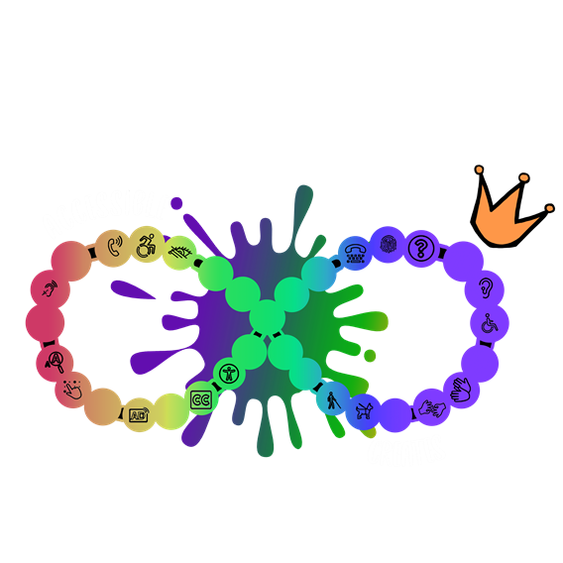
Contact Us
  Site Web (en): https://www.accessiblecreates.ca/
  LinkedIn: https://www.linkedin.com/company/accessible-creates/
  Instagram: https://www.instagram.com/accessiblecreates/

Slide 16
Thank you!

