Slide 1
Land acknowledgement
This event is taking place on land which has long served as a site of meeting and exchange amongst Indigenous peoples, including the Haudenosaunee and Anishinabeg nations. We acknowledge and thank the diverse Indigenous peoples whose presence marks this territory on which peoples of the world now gather.
Notes:
This event is taking place on land which has long served as a site of meeting and exchange amongst Indigenous peoples, including the Haudenosaunee and Anishinabeg nations. We acknowledge and thank the diverse Indigenous peoples whose presence marks this territory on which peoples of the world now gather.
In acknowledging the land and what that means in the context of my presentation, I’m recognizing our digital spaces should reflect commitments our institutions make in regard to acknowledging and respecting Indigenous Peoples.
As this presentation will be made available online, this acknowledgment extends to locations of online viewers and I encourage you to visit www.whose.land to learn about the Indigenous Peoples in your area.

Slide 2
Accessibility and inclusion best practices for websites
Accessible Canada – Accessible World
Slides: https://mcgill.ca/x/woS
Notes:
Thanks so much for attending our presentation today, Accessibility and inclusion best practices for websites.
When we talk about promoting accessibility and inclusion in our institutional environments, our digital spaces maybe aren’t always the first areas to come to mind.
And similarly, when we consider how to improve our online experiences for our audiences, applying accessibility and inclusion concepts isn’t always at the top of list of to-do items.
But recognizing the importance of accessibility and inclusion, and what our digital spaces mean to our communities I know many of us have started to take actions to make these aspects of the work we do a high priority and for some it’s become, the highest priority. But what exactly does this look like for us, communication professionals working in higher education?

Slide 3
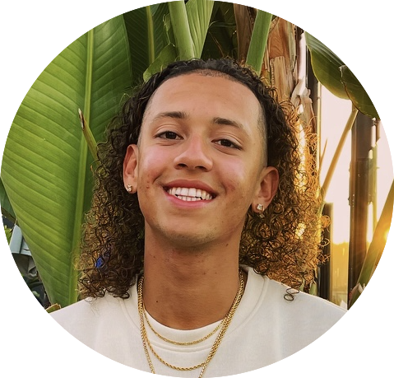

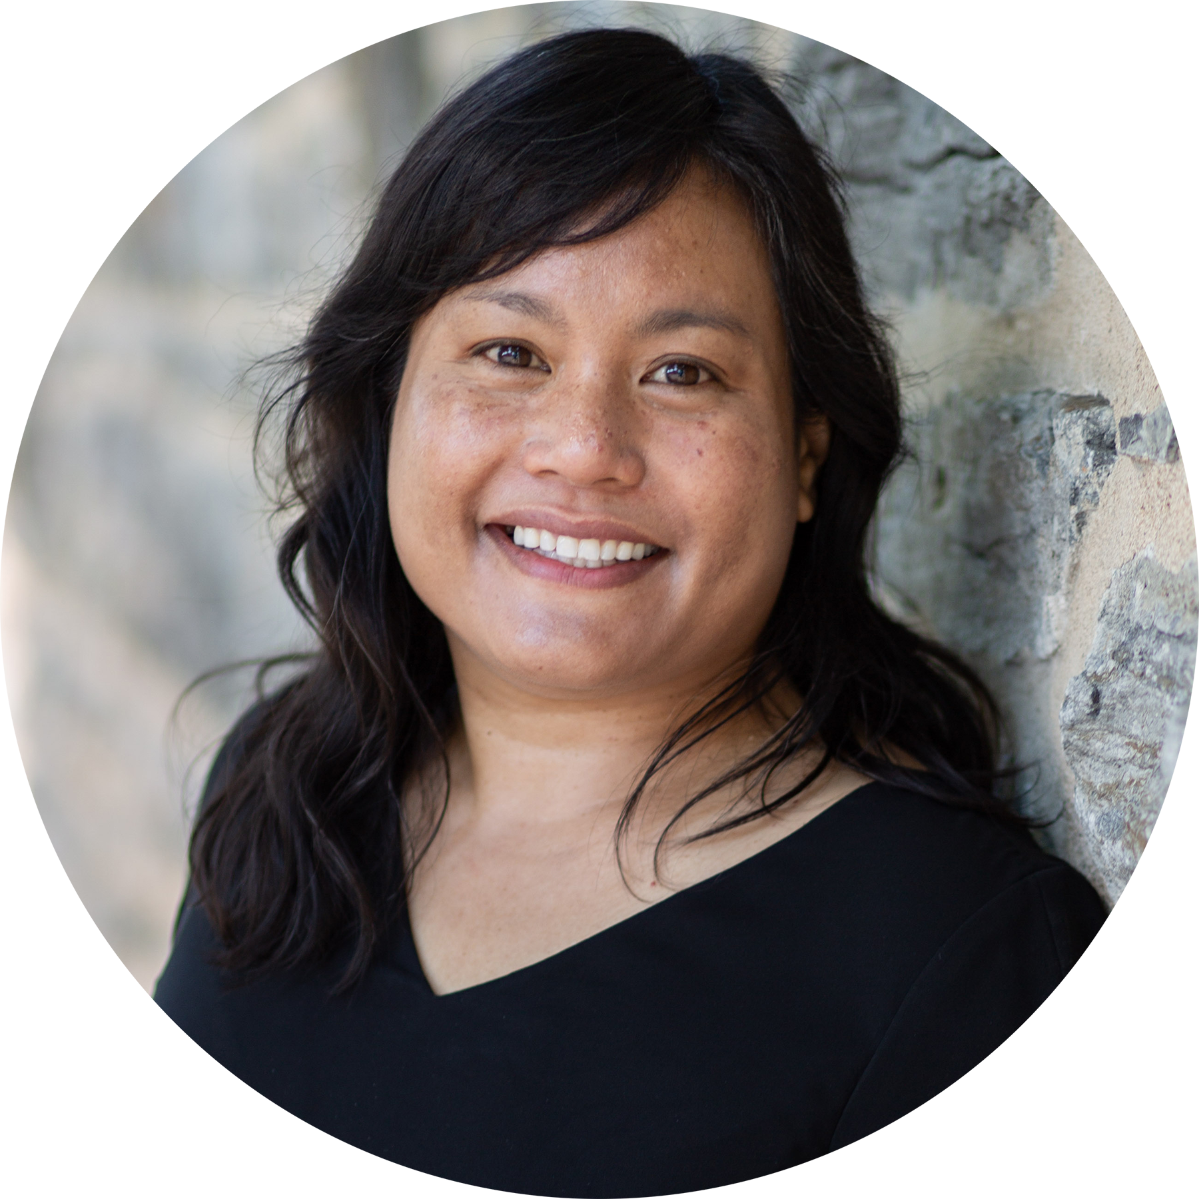
Jaylen Gordon
Digital Communications Associate
Communications and External Relations
McGill University
/in/jaylengordon-1d/
Joyce Peralta
Manager, Digital Communications
Communications and External Relations
McGill University
/in/joyceperalta
Notes:
My name is Joyce Peralta…
McGill is the 4th post secondary institution I’ve worked at.
And I’m pleased to be here today with my co-presenter…
Our team, Digital Communications, develops and executes McGill’s digital strategy which aims to promote and support our brand and mission. Our team has expertise in many areas related to web design and development, but we aren’t subject matter experts when it comes to EDI.
That’s why we really appreciate the opportunity to work closely with our Equity team. I’m not exactly sure how successful our efforts would have been if we hadn’t developed this connection.

Slide 4
McGill’s web landscape
1000 Drupal sites + 500 non-templated sites
1500+ site managers and editors
8-10 million page views per month
Notes:
And here’s a snapshot of what our web landscape looks like:
Similar to many of your own environments, McGill has a large, de-centralized network of websites comprised of about 1000 sites on our centrally supported CMS, and another 500 custom sites that are administrated and managed by 1500+ web professionals.

Slide 5
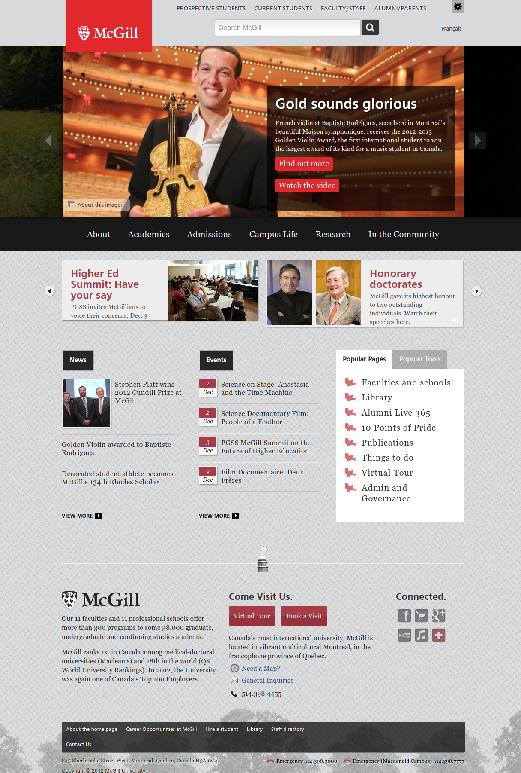
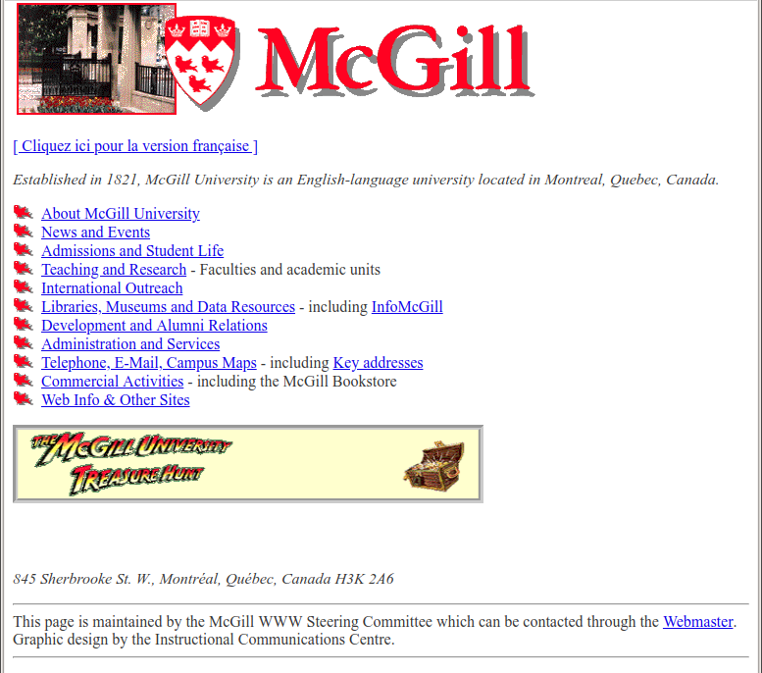
Before 2000
2010
Notes:
So how are best practices for accessibility and inclusion reflected in our websites in higher education? To start exploring the answer to that question, I thought it might be neat to start here, with a look at how our web pages have evolved over the years, and for us all to take a moment to reflect on how the focus of our work has changed.
On the left a screenshot of McGill’s home page in 1997, this is around the time that I started building websites – only 25 years ago. Not bad from an accessibility perspective, except for maybe the Indiana Jones-inspired treasure hunt graphic it’s mostly text and text links. At that time when we were planning sites we were thinking more about what we wanted to tell people and less about how to understand and connect.
And then on the right, that what’s the homepage looked in like to 2012 just after <McGill sites were migrated from the homegrown CMS into Drupal 6. What actions were we taking at this time to improve our sites?
I went back to school to learn about user experience design methodology – and started doing exercises like card sorting, focus groups, usability testing
There was also a bigger focus on web accessibility and SEO
I started learning about responsive design to and how to build mobile pages
But as we began to think more carefully about how people interact with our websites, to better understand their needs and requirements, many of our sites became less accessible.

Slide 6
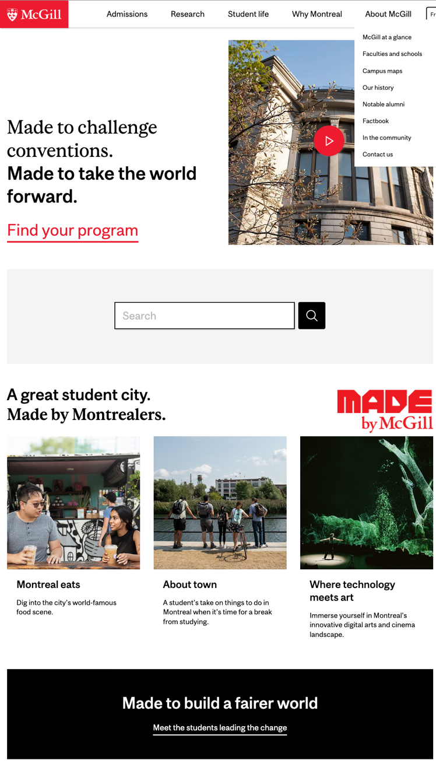
2023
Notes:
And that brings us to the present day. In my job, the actions I taking are much different than they’ve ever been in the past.
I’ve been thinking more about effective web governance strategies
How to foster a community of practice built about our digital standards
And growing skills related to user experience design methodology
Not so much from a questions of mechanics – the processes and tools have remained the basically same
And this is why I wanted to start with this timeline. I realized, in putting it together, that the skills I’ve been developing lately have a bit of a different focus than the skills I worked at developing in the past. So when I participate in building sites and online services, I find I’m reflecting on and asking question related to concepts I hadn’t considered in the past.

Slide 7
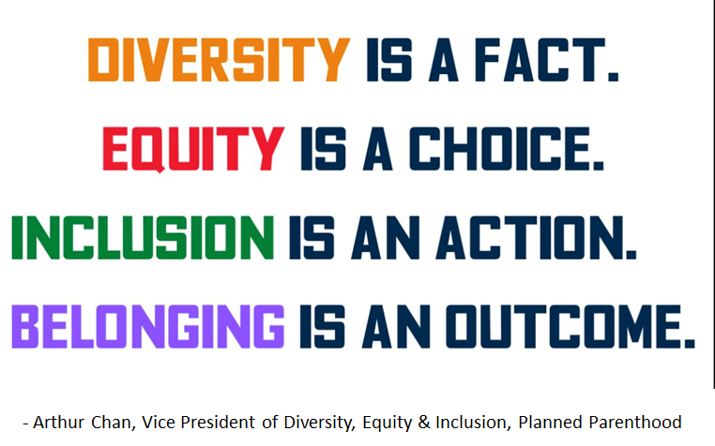
Diversity quote by Arthur Chan, Planned Parenthood
Notes:
And on the topic of consulting experts, I’m so glad we have the opportunity to partner closely with McGill’s Equity teams who collaborate with us and provide guidance for many initiatives. It was our Senior Employment Equity Advisor, Andrea Clegg who first pointed out this quote to me. It’s a quote by Arthur Chan, Vice President of Diversity, Equity and Inclusion for Planned Parenthood.
It’s a quote that summarizes our approach towards improving alignment with DEI best practices, including accessibility and inclusion, in our digital spaces.
Diversity is a fact, we’ll talk about the fact of diversity at our institution in the coming slides
Equity is a choice. Equity is a choice we make as an institution as stated in our mission statement and principles and in our equity strategies
Inclusion is an action – For inclusion to happen we must act in an inclusive manner, there’s no way around that.
And the outcome of our actions is belonging.
Jaylen next slide

Slide 8
Diversity is a fact
Notes:
Jaylen
We’ll start by looking at the facts concerning diversity at McGill. It's so important to recognize these facts
As you may be aware, Canada is often touted as one of the most diverse countries in the world and you may feel this is reflected in the student body stats that I’m about to share with you.
How do we convince stakeholders to commit to taking actions with us? With data.
Shelley Keith Punella – cozying up to the chaos presentation
Shelley spoke about making a case about the impact of the three ‘r’s – registration, reputation, or revenue. Here is where we’ll find the stats for these cases in areas related to DEI – for registration and reputation.

Slide 9
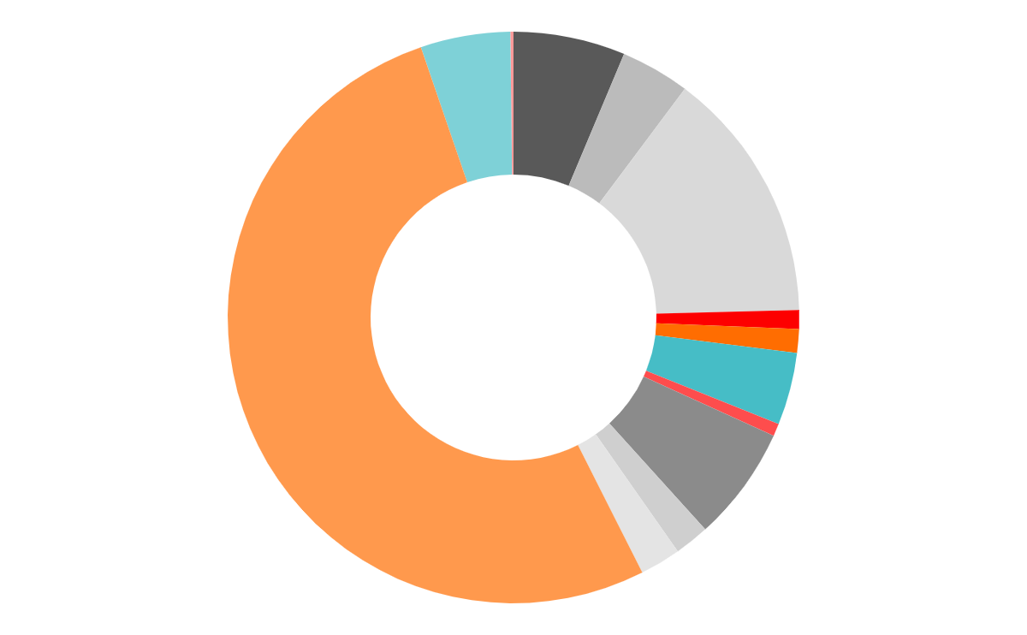
McGill Students – Racial / Ethnic Identity
(Fall) 2022
7.1%
Arab
Unsure
0.2%
4.4%
Black
Another racial and
/or ethnic identity
5.7%
16.1%
Chinese
1.2%
Filipino
58.6%
White
1.5%
Korean
4.6%
Latin American
0.8%
Japanese
7.3%
South Asian
2.2%
Southeast Asian
2.6%
West Asian
Notes:
As we know, Canada is considered one of the most diverse countries in the world and you might see that reflected in this slide. In addition McGill also has a very high international student enrolment, so that’s a contributing factor as well.
Canada’s population includes people from more than 450 ethnic or cultural origins.
Overall while these stats confirm diversity as a fact in our community, we know there is a gap between statistics in our student body and in our staff and faculty representation.
For example, 1.1% of our student body 0.5% of Faculty and staff identifying as being an Indigenous person in North America, compared with 5% of the broader Canadian population identifying as Indigenous Peoples according to the 2021 Canadian population census
So, though diversity is a fact within our community we’re also aware that we may have some work to do.

Slide 10
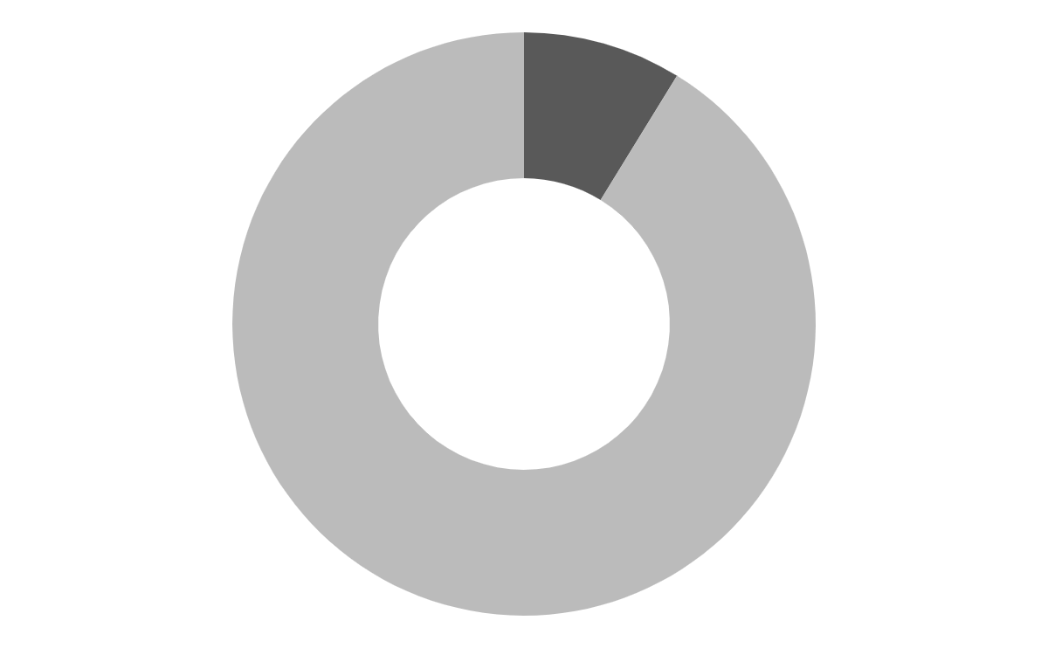
McGill Students – Disability
(Fall 2022)
8.8%
Yes, I identify as a person with a disability
91.2%
No, I do not identify as a person with a disability
Notes:
Like many universities, McGill has a sizeable and growing community of students with disabilities. As we all know, these students face many barriers that make their experience more difficult, both in the physical and digital realms.
However, we as digital communicators have tremendous opportunity to create spaces that are equitable and welcoming for all people – but it takes effort and dedication

Slide 11
Equity is a choice
Notes:
This brings us to the next section... Equity is a Choice.
How do our institutions make it a choice to prioritize Equity. How is this reflected in our institutional strategies?

Slide 12
McGill University Mission Statement and Principles
Mission
The mission of McGill University is the advancement of learning and the creation and dissemination of knowledge, by offering the best possible education, by carrying out research and scholarly activities judged to be excellent by the highest international standards, and by providing service to society.
Principles
In fulfilling its mission, McGill University embraces the principles of academic freedom, integrity, responsibility, equity, and inclusiveness.
Notes:
We can go all the way up to our mission statements and/or principals for our colleges and universities. You see here that McGill’s mission statement is supported by principals that include equity and inclusiveness.
And I did a quick look around at other institutions, and noticed that McGill is not unique in this approach. I noticed similar sentiments expressed in the mission statements of many other colleges and universities. Again, I’d love to see a quick show of hands: How many folks here are familiar with the wording of their college or university mission statements or principals?

Slide 13

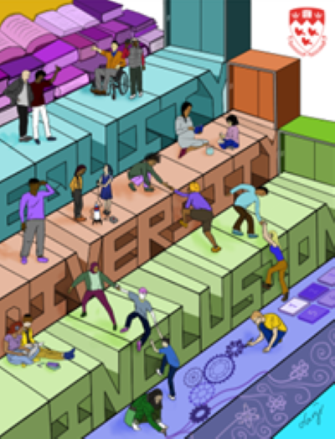

Equity strategic documents
Notes:
Beyond McGill’s mission statement and principals. McGill’s choice for equity is futher defined in strategic documents produced by teams in our university community. At McGill we currently have 3:
Our EDI strategic plan defines measures that will be taken to enhance diversity and ensure equitable opportunities and a sense of belonging for all within our community.
McGill’s action plan to address anti-Black racism establishes a process of acknowledgment of our University’s historic connections to the transatlantic slave trade and its enduring legacies.
And McGill University's Provost Task Force on Indigenous Studies and Indigenous Education set out a series of 52 Calls to Action for recognition and reconciliation with Indigenous peoples.

Slide 14

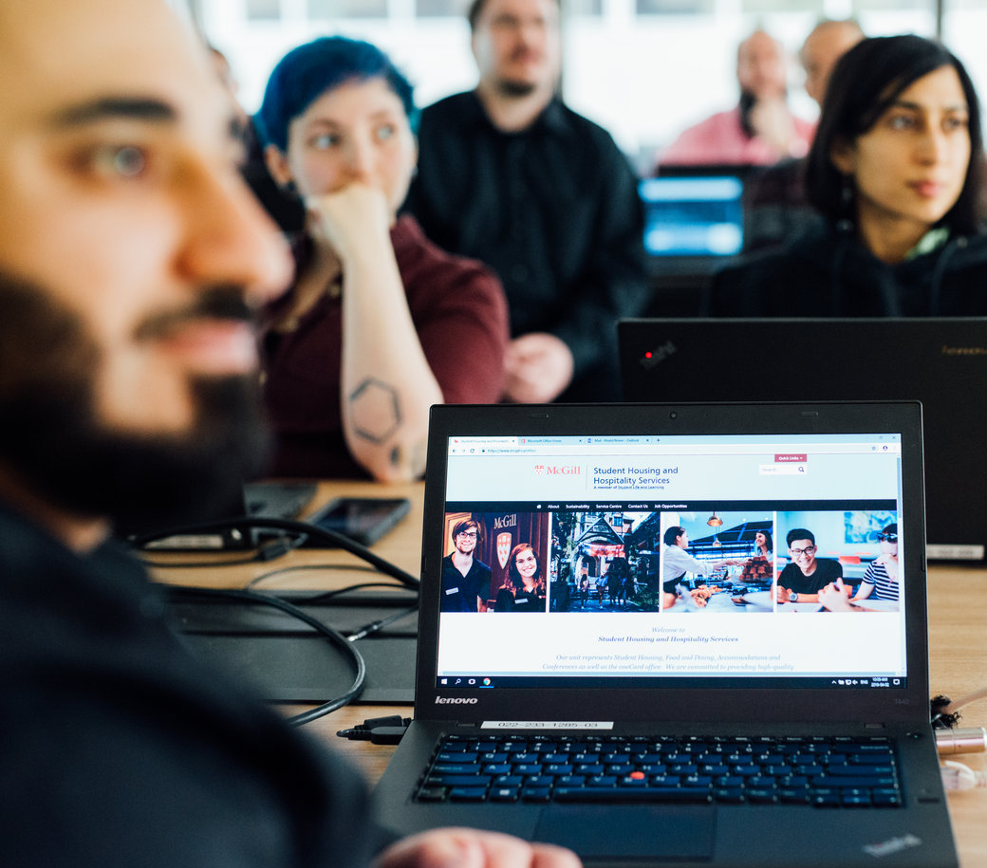
Promoting DEI best practices for websites
Notes:
What do our institutional best practices and documents say about how we should be building websites?
We know from surveys we’ve conducted that our strategic documents discuss our EDI strategies at a very broad level and for our site manager and editor network there isn’t much content that provides direct guidance for building websites.

Slide 15
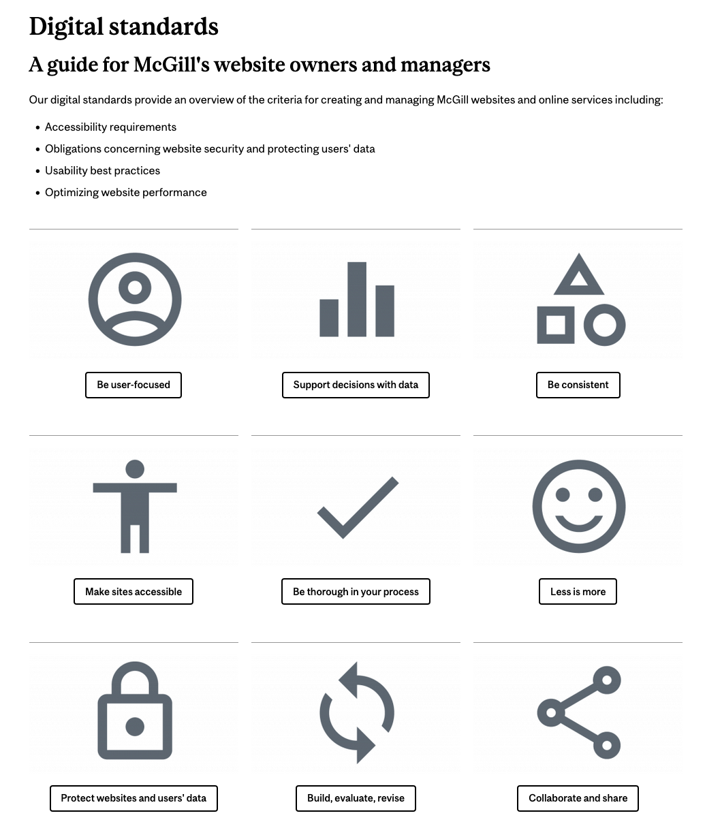
Our digital standards governance framework
Notes:
So we fill in some of these details by including information about DEI best practices for websites in our Digital Standards resource.
A topic that I present about often is our digital standards at McGill – 9 standards that outline criteria for creating and managing McGill websites. And as part of these guidelines we’ve worked with the Equity Office to develop resources for areas related to accessibility and inclusion.
Joyce next slide

Slide 16
Inclusion is an action
Notes:
Joyce
So we’ve talked about how Diversity is a fact at McGill.
We discussed how we as institutions make Equity a choice – through our institutional strategic documents and in defining our digital standards and best practices
Now we’ll move on to the steps we’re taking steps that we’re taking to create an inclusive environment for our diverse community, specifically in our digital spaces.

Slide 17
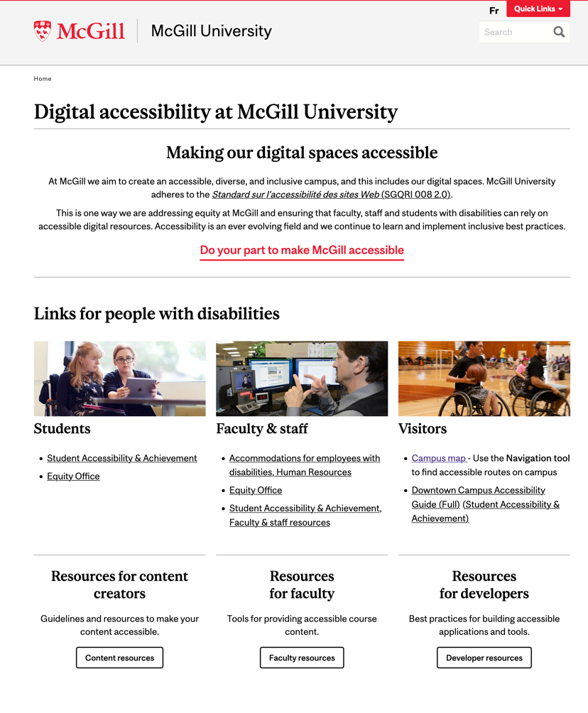
Inclusion is…
A community-wide initiative
Notes:
An important strategy we’ve been practicin to create inclusive environments is to partner with other departments in executing these initiatives rather than working on them solo.
For example, when we initially began pursuing ways to improve accessibility of our digital content, we were mainly focused on ensuring the sites we’re directly responsible for were accessible. And we produced resources for our audiences about how to create accessible content.
But, we eventually came to realize that many other departments were producing super helpful resources as well. Departments like our Sustainability Office who have guides explaining how digital accessibility and sustainability best practices are connected, and our Teaching and Learning Services team who have produced resources for creating accessible digital content specifically for instructors.

Slide 18
Student-led accessibility audits
Goals & objectives
Provide support for departments for reviewing and updating sites in areas related to web accessibility
Organize and execute a month-long update blitz for select sites
  Site evaluations and updates will be conducted by work study students
Audit team composition
Staffed and led by work-study students

Slide 19
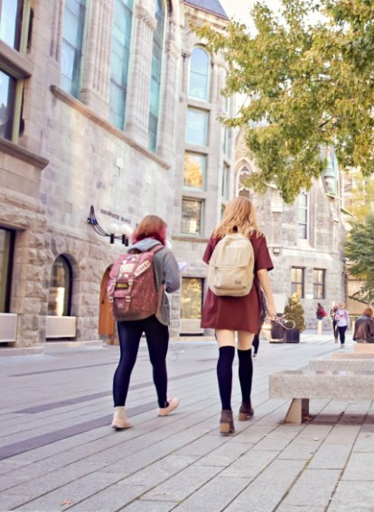
Student usability panel
Notes:
We also organize regular community events including…
These are pics from our recent EDI best practices for websites event that took place during Indigenous Awareness Week this past September
Our event included a panel discussion where we answered questions like:
What are some of the issues around representation in higher education?
And What impact do programs and experiences highlighted on our website have on peoples' experiences?
Afterwards our attendees participated in breakout rooms discussions facilitated by our panel members and Web Services team members. These discussions were centred on how we build our webpages. We discussed topics like how race and Indigeneity should be represented in our taxonomies. We also talked about providing context in our website land acknowledgements. And we discussed equity gaps and how we address these in our webpages.
These are allow topics that couldn’t be addressed Equity or our Web Services teams alone. To have a full discussion on these topics these experiences need to be a collaboration.
So our events and community get togethers are one way we promote the perspectives of our non-dominant audience members.

Slide 20
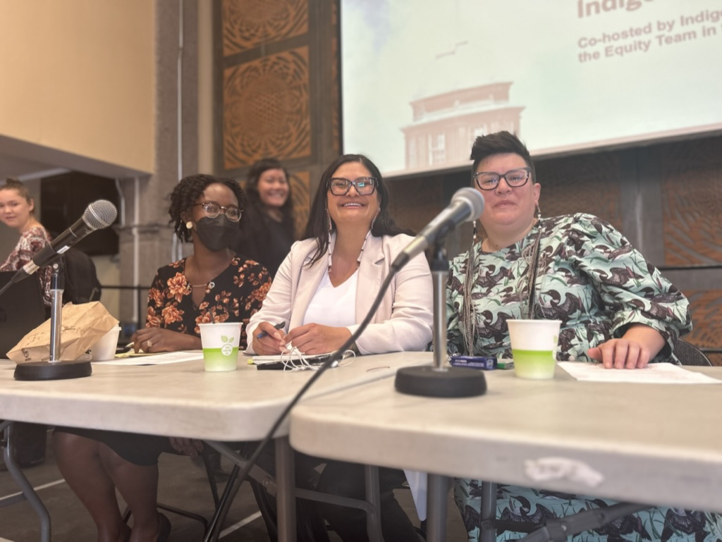
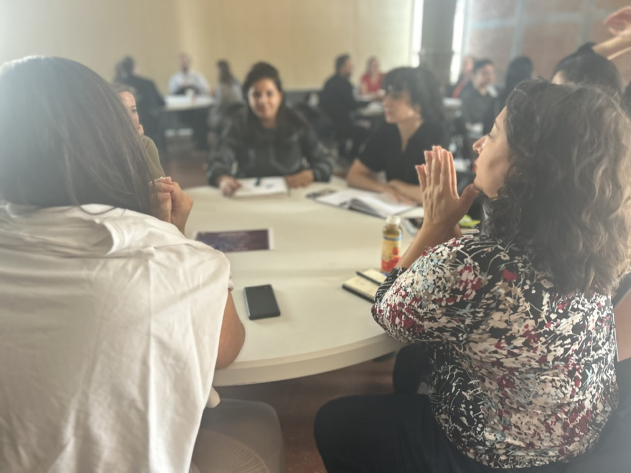
Inclusion is…
Having a voice
Notes:
We also organize regular community events including…
These are pics from our recent EDI best practices for websites event that took place during Indigenous Awareness Week this past September
Our event included a panel discussion where we answered questions like:
What are some of the issues around representation in higher education?
And What impact do programs and experiences highlighted on our website have on peoples' experiences?
Afterwards our attendees participated in breakout rooms discussions facilitated by our panel members and Web Services team members. These discussions were centred on how we build our webpages. We discussed topics like how race and Indigeneity should be represented in our taxonomies. We also talked about providing context in our website land acknowledgements. And we discussed equity gaps and how we address these in our webpages.
These are allow topics that couldn’t be addressed Equity or our Web Services teams alone. To have a full discussion on these topics these experiences need to be a collaboration.
So our events and community get togethers are one way we promote the perspectives of our non-dominant audience members.

Slide 21
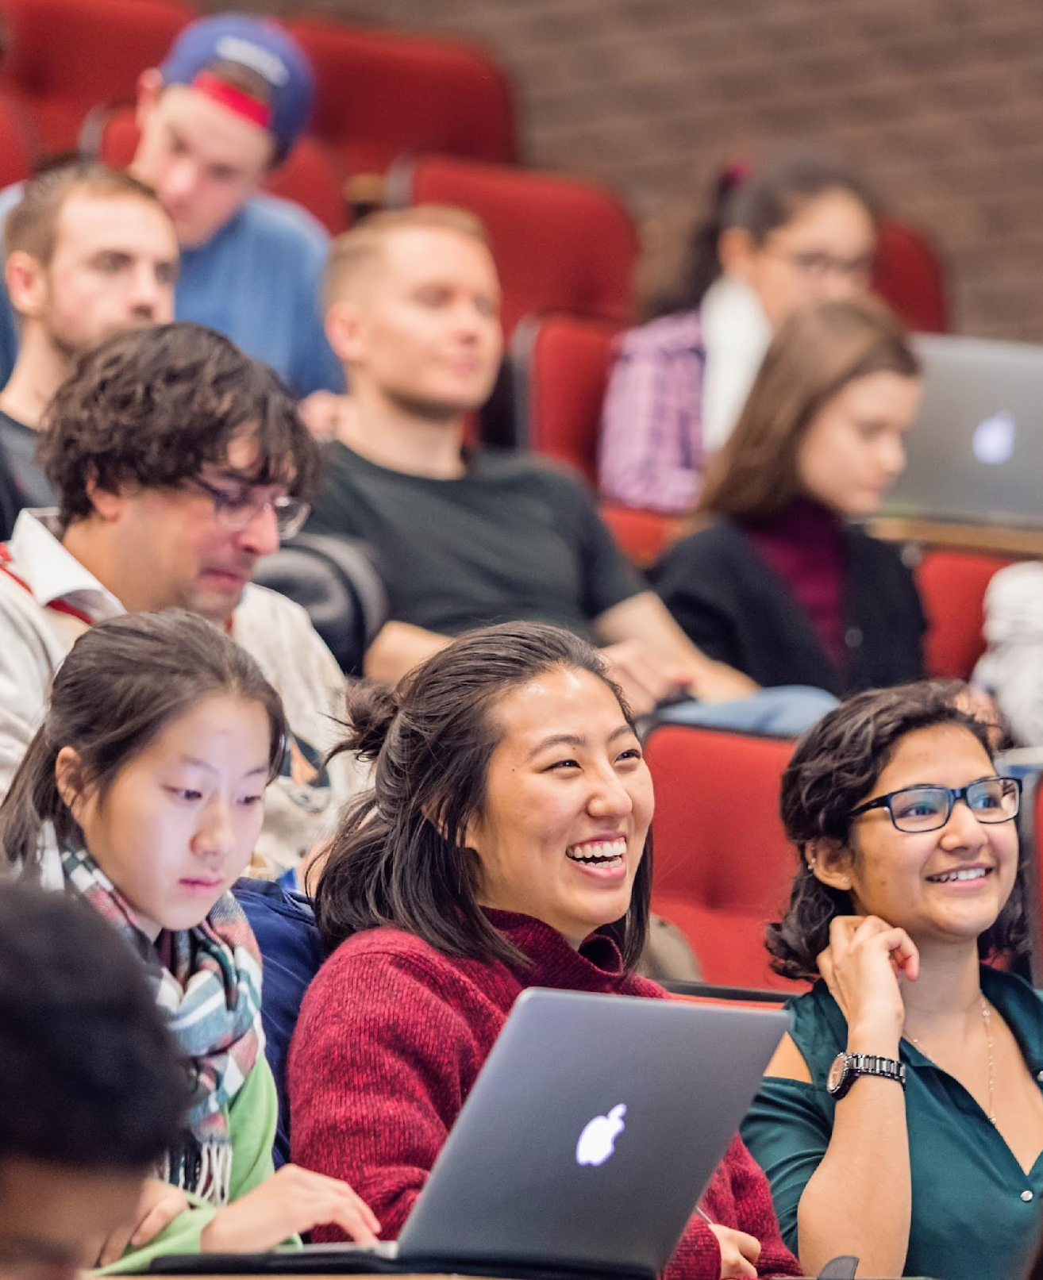
Inclusion is…
Being heard
Notes:
Jaylen -
And one final aspect of how we can facilitate peoples’ abilities to have a voice an be heard in our community is of course in our audience research exercises.
2018 was the last time we undertook a large journey map project. The resulting journey map and resources provided some great insights for our homepage redesign project and our revamped undergraduate admissions site, but in hindsight we realized that there were some improvements that could be made the next time around.
One area for improvement that we identified was to emphasize the experience of students from non-dominant groups including, Black, Indigenous, Francophone and students with Disabilities. We identified that these voices are important and need to be included. After all, we do journey mapping to identify barriers and challenges that students experience and we recognize that these groups may face challenges that have been left unacknowledged and unaddressed in the past.
So we connected with various groups, clubs and organizations across campus to ensure representation from these groups.

Slide 22
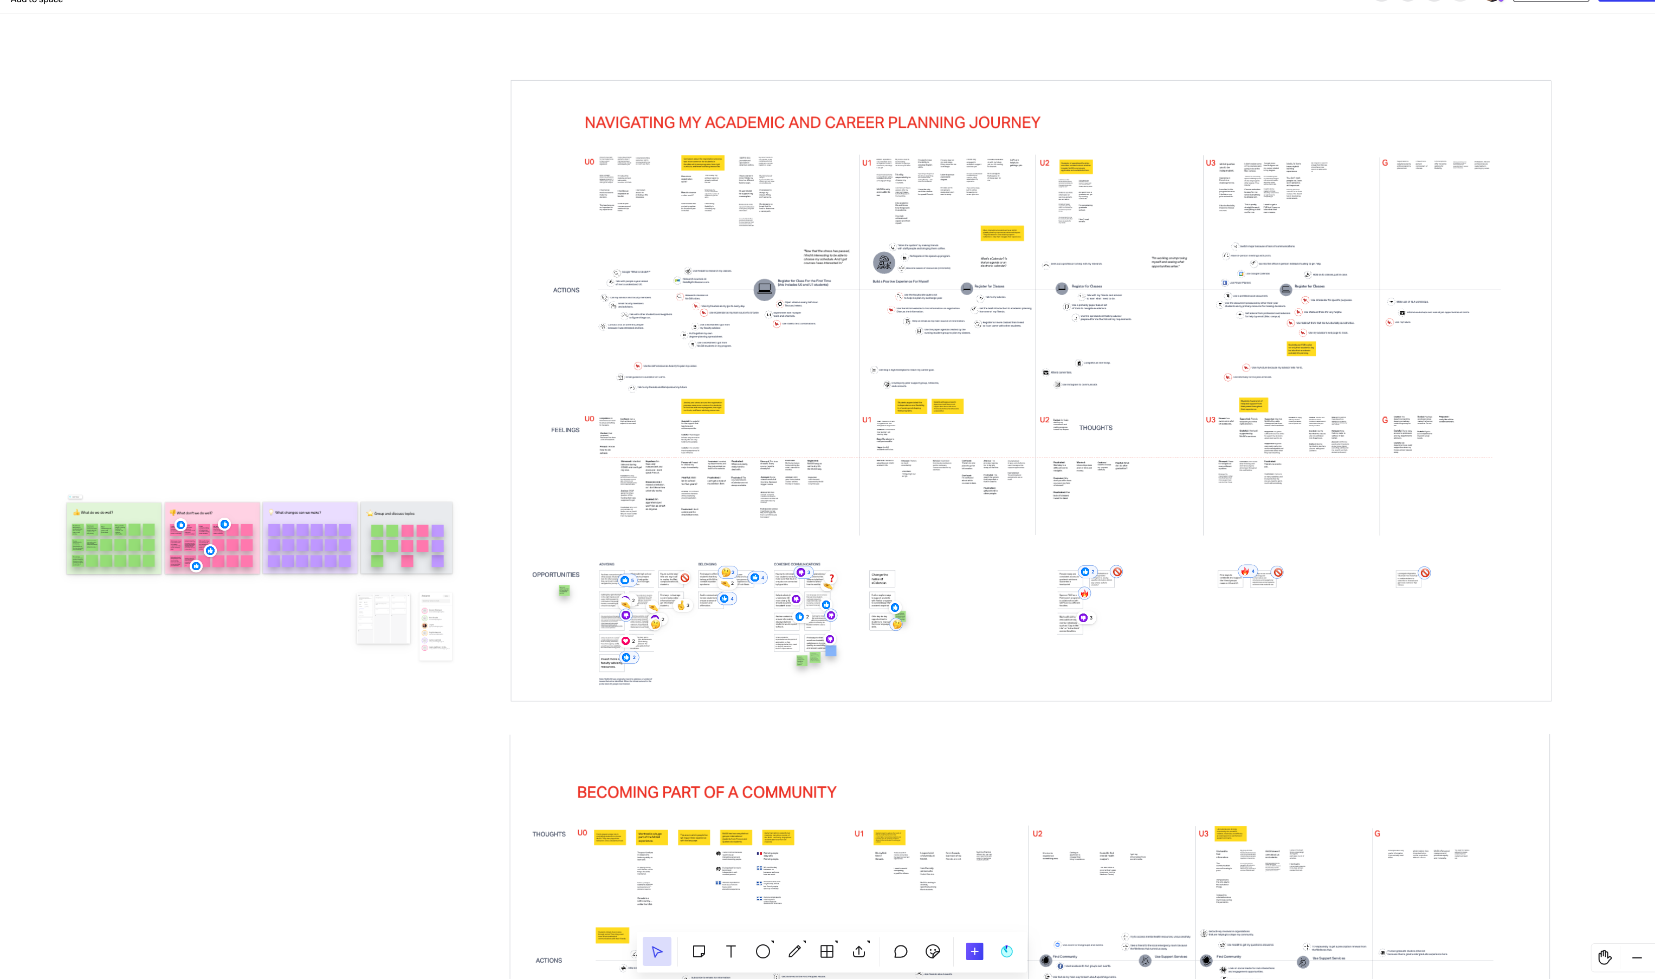
McGill student digital journey map
Notes:
Here’s a peek at our current students digital journey map by the way.
We’re also taking steps to engage stakeholders from key projects that could benefit from the related resources that will be produced such as the updates to our admissions system, online course calendar, career planning services to name a few.
Next slide Joyce

Slide 23
Take aways
Notes:
Joyce
So here are some takeaways and recommendations we’ve gained from our experiences promoting EDI best practices for websites. Some of the things we can do…

Slide 24
Diversity quote by Arthur Chan
Notes:
Diversity is a fact. We should all be familiar with the facts of diversity in the environments we interact in. Who are the people in your community? How do demographics within your community compare with those in your surrounding community? What are the inequalities?
Equity is a choice. Be cognizcent of how your institution has chosen to make Equity a choice – What are your institutional strategies? How do they relate to the work you do?
Inclusion is an action. What are some actions we can take to build inclusive digital spaces?

Slide 25
Education & outreach
Ensure people have a general knowledge of equity, diversity and inclusion (EDI) within your institutional context
Educate people on how webpages can be created with an attention to EDI
Create opportunities to develop skills on how to apply EDI concepts to work
Notes:
Jaylen
For education and outreach… highlight accessilibity
Ensure people have a general knowledge of how to create accessible content
Educate people on how webpages can be created with an attention to accessibility and inclusion - Provide opportunities for shared learning and interaction
In November, Joyce hoosted a series of chats with our Comms community on discussions --> one of the most impactful parts being a live demo of navigating our websites using a screen reader. Which was perhaps the biggest eye opener
Create opportunities to develop skills on how to apply accessibility and inclusion concepts to work -Encourage continual learning and self-study
We host regular workshops on the topic of "Web accessibility at McGill" Which are easy 1 hour sessions deigned to accommodate McGill's workforce
Lastly, Collaborate with your Equity team to develop resources and organize events

Slide 26
Belonging is an outcome
Notes:
And our end goal in all this is belonging. Creating a sense of belonging for our students, faculty, staff and all who are part of our community.

Slide 27
The impact of our actions
“Representations here and now have real consequences for real people, not just in the way they are treated [...] but in terms of the way representations delimit and enable what people can be in any given society. “
Richard Dyer (1993) as quoted in Locating Queerness in Media (2017)
Notes:
For our education and outreach to have meaningful outcomes we must help people understand the significance of their actions, or lack of actions. As summarized in this statement,

