Slide 1
Inclusive decision-making
Paving the way for equitable career progression
Spring 2024

Slide 2
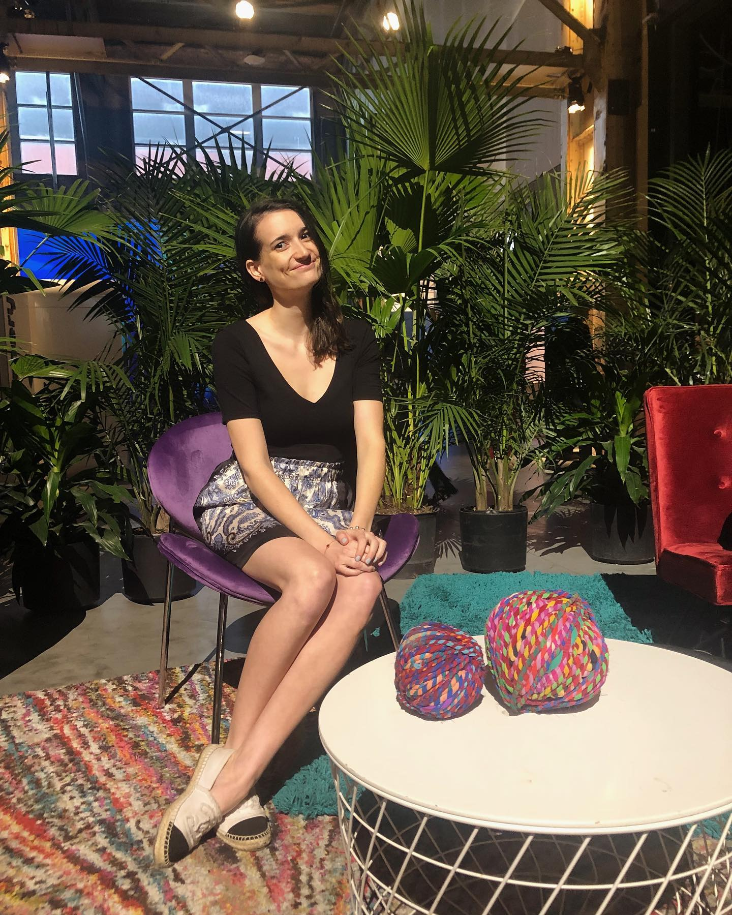
About me
Director of People at Fable
Diverse industry experience
Advocate for neurodiversity and disability inclusion
In my spare time, I read and review books (a lot of books!)

Slide 3






What is Fable
Digital accessibility, powered by people with disabilities.
The best digital teams work with Fable to make products more accessible for over 1 billion people who live with disabilities.
Fable Engage: Accessibility testing to inform product strategy
Fable Upskill: Accessibility training from experts and people with disabilities
Fable Pathways: Free skill development program for people with disabilities

Slide 4

Paving the way for equitable career progression
Meet Alex
First gen college graduate
Joins tech company
Invisible challenges
The struggle for recognition
A lost opportunity

Slide 5



The ripple effects on workplace culture
Benefits of an inclusive culture
Systemic barriers
Discrepancies in recognition
Employment gap
More discrimination
50% lower promotion rates
Limited acknowledgements
Tend to be less promoted
<2% leadership representation
Better retention
Transparent policies
Mentorship and training

Slide 6



Beyond Alex: performance reviews
Bias in feedback
Lack of transparency and equity
Inadequate feedback and development opportunities
Subjectivity in rating
Confirmation bias
Overlooked perspectives
Criteria ambiguity
Disparate opportunities
Inconsistent feedback
Sparse feedback cycles
Limited growth
Generic goal setting

Slide 7
Rethinking performance evaluations
A mere 14% of employees feel inspired by their performance reviews (Gallup)
Traditional performance reviews can often lead to decreased employee performance (Deloitte, 2022)
Managers spend on average 210 hours a year on performance review activities (CEB)

Slide 8
Fable’s performance evaluation introduction
Performance evaluation is at the basis of career progression
Clear goals and development
Alignment with one-on-ones
Development plans
OKR-based evaluations
Continuous improvement focus

Slide 9



The introduction of a dual track job levels at Fable
Dual career paths
Management vs. IC
Benefits and impact
Defining dual ladders
Management vs. IC
Inclusive progression system
Leadership role clarity
Specialized expertise focus
Milestones clarified
Equal value progression
Retention
Representation
Talent development

Slide 10
The impact of inclusivity on organizational growth
Increased innovation
Diverse perspectives drive new ideas
Improved retention
Employees feel valued and supported
Enhanced reputation
Inclusive culture attracts top talent

Slide 11
Creating a future of equitable opportunities
Reflecting on Alex’s journey
Merit-based progression
Inclusive metrics
Dual-paths honoured
Retention through recognition
Inclusion drives innovation

Slide 12
Thank you

