Slide 1

XAI: From Audio Descriptions to Audio Explanations for Individuals who are Blind and Partially-sighted
Chukwunonso Henry Nwokoye, Joelma Peixoto,
Peter Lewis, Mahadeo Sukhai
Trustworthy AI Lab, Ontario Tech University

Slide 2
Statement of the Problem
Problem:
Explainable Artificial Intelligence (XAI) has few implementations for the accessibility and disability perspective.
HOW DO WE KNOW THAT?
Proposed Solution:
Transition from AI-audio descriptions to AI-audio explanations.
Adopting XAI technologies for AI audio explanation.

Slide 3
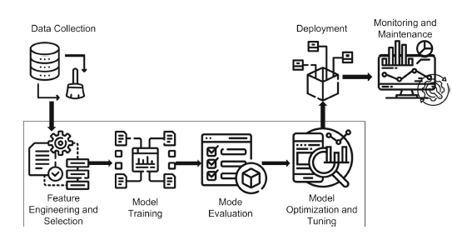
Standard Machine Learning Cycle (Hanif, et al., 2023)

Slide 4
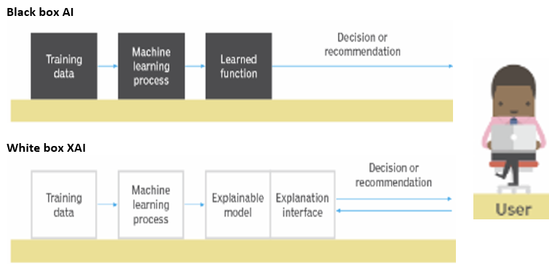
Background: Explainable AI (XAI)
Black box = Traditional AI
White box = Explainable AI
XAI – Has an explainable model to explain an AI model.
The model provides explanation on how the model made its decision.
Explainability – bridge the gap between the algorithm and human interpretation of the decision-making process.

Slide 5
Methodology & Search
Method: Searched literature for XAI implementations including accessibility and disability.
Sources searched: Scopus, Web of Science, IEEE Digital Library, Google Scholar, El Compendex, ACM Digital Library
Results =
1. Reflections or case studies on trust, inclusion, transparency (4)
2. Papers on video accessibility or audio description systems (3)

Slide 6
Video Accessibility & Human Centered Computing (HCC)
Found papers on video accessibility or Audio Description (ADs) Systems for Individuals who are blind and have low vision.
AI-based system = NarrationBot+InfoBot system
Actual Results: Stangl, et al. (2023); Ihorn, et al. (2022); Bodi, et
al. (2021).
XAI technologies identified: Attention; Minimum viable description; Image captioning (IC), Visual Questioning Answering (VQA)

Slide 7
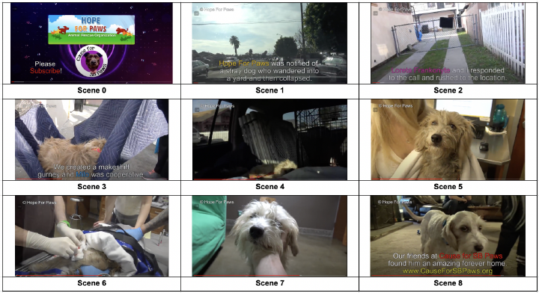
NarrationBot+InfoBot system with Scenes (Stangl, et al., 2023)

Slide 8
Video Accessibility & Human Centered Computing (HCC) Contd.
Matched these technologies with XAI taxonomies: Ali et al. (2023).
NarrationBot+InfoBot system functions: Scene Segmentation, Object Detection, Keyframe Selection, Image Caption Generation, Text Summarization, Text on Screen and Play text-to-speech.
Advantages of VQA:
Giving access to visual information in a non-visual manner.
Obtaining verbal answers (audio description).
Communicate the data, information or message contained in the images.

Slide 9
Proposed Solution:
Transition from AI-audio descriptions to AI-audio explanations?
Need for audio explanation technologies – Searched related literature.
Results: Paper by Akman & Schuller (2024) containing audio XAI methods.

Slide 10
Audio Explainable AI methods without Accessibility for Individuals with Disabilities
Layer-Wise Relevance Propagation (LRP)
DFT-LRP
LIME, Loudness/NMF decomposition
LIME, Spleeter
Surrogate self-explainable model NMF decomposition
LIME, SFL, Causal.
Click the link below to read more
Audio Explainable Artificial Intelligence: A Review
NB: These implementations did not consider accessibility or disability

Slide 11
Future Studies/Activities
Apply audio XAI methods in the context of accessibility and disability; learning lessons from necessary papers.
Conduct co-design sessions with individuals who have sight loss and are partially sighted.
If the audio explanations are not so helpful with the totally blind; implement the Human-in-the-loop approach.
Evaluate usability and accessibility using assessment methods in Ali, et al. (2023).

Slide 12

Conclusion & Questions
We hope this would be of help to people with various forms of visual disabilities.
THANK YOU

Slide 13
References
Ambreen Hanif, et al. A comprehensive survey of explainable artificial intelligence (xai) methods: Exploring transparency and interpretability. In International Conference on Web Information Systems Engineering, pages 915–925. Springer, 2023.
Abigale Stangl, et al. The potential of a visual dialogue agent in a tandem automated audio description system for videos. In Proceedings of the 25th International ACM SIGACCESS Conference on Computers and Accessibility, pages 1–17, 2023.
Shasta Ihorn, et al. Narrationbot and infobot: A hybrid system for automated video description. arXiv preprint arXiv:2111.03994, 2021
Aditya Bodi, et al. Automated video description for blind and low vision users. In Extended Abstracts of the 2021 CHI Conference on Human Factors in Computing Systems, pages 1–7, 2021.
Akman A, Schuller BW. Audio Explainable Artificial Intelligence: A Review. Intell. Comput.; 3:Article 0074. 2024. https://doi.org/10.34133/icomputing.0074.
Sajid Ali, et al. Explainable artificial intelligence (xai): What we know and what is left to attain trustworthy artificial intelligence. Information Fusion, 99:101805, 2023

