Slide 1
WebMoti 2.0: Supporting Virtual Neurodiverse Students in Hybrid Classes
Shazra Asmy (MScM Candidate)
Supervisors: Deb Fels and Amira Ghenai

Slide 2
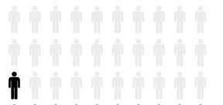
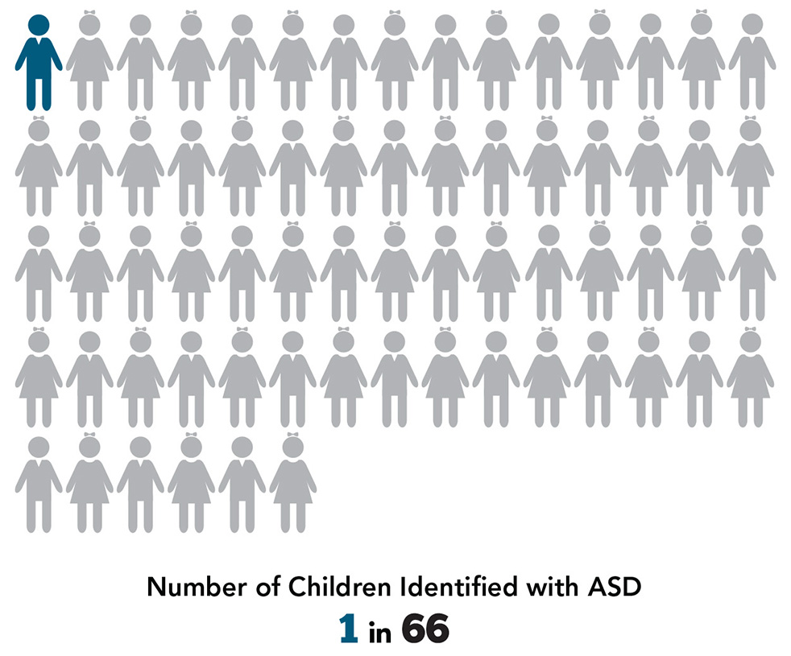
Introduction
The most common neurodevelopmental disorder is ADHD, which affects 1 in 21 people.
1 in 66 people between the ages 5-17 have been diagnosed with Autism
With so many neurodiverse individuals appropriate resources are needed to support higher quality of life through the use of inclusive design strategies

Slide 3
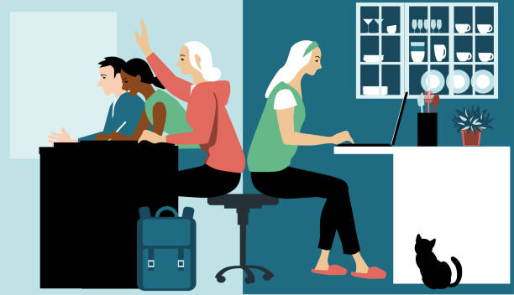
Issue
Universities often provide accommodation where students can attend class virtually
But, in hybrid classes they often get forgotten about, and can’t gain the instructors attention
Students lose sense of presence in the classroom

Slide 4
Research Question
What is the impact of WebMoti on neurodiverse students’ ability/opportunity to ask/answer questions, participate in class discussions, and balance sensory needs in university?

Slide 5
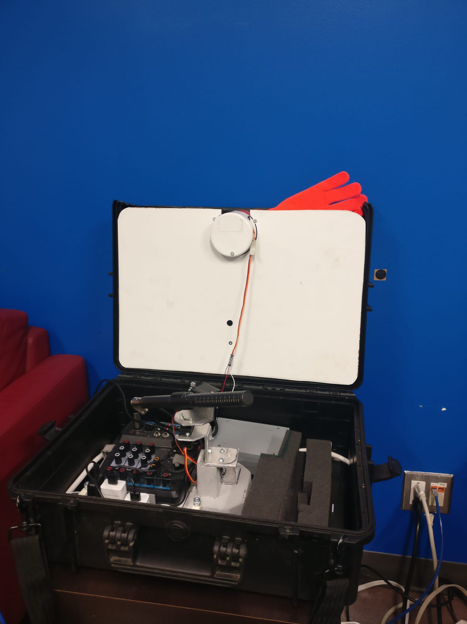
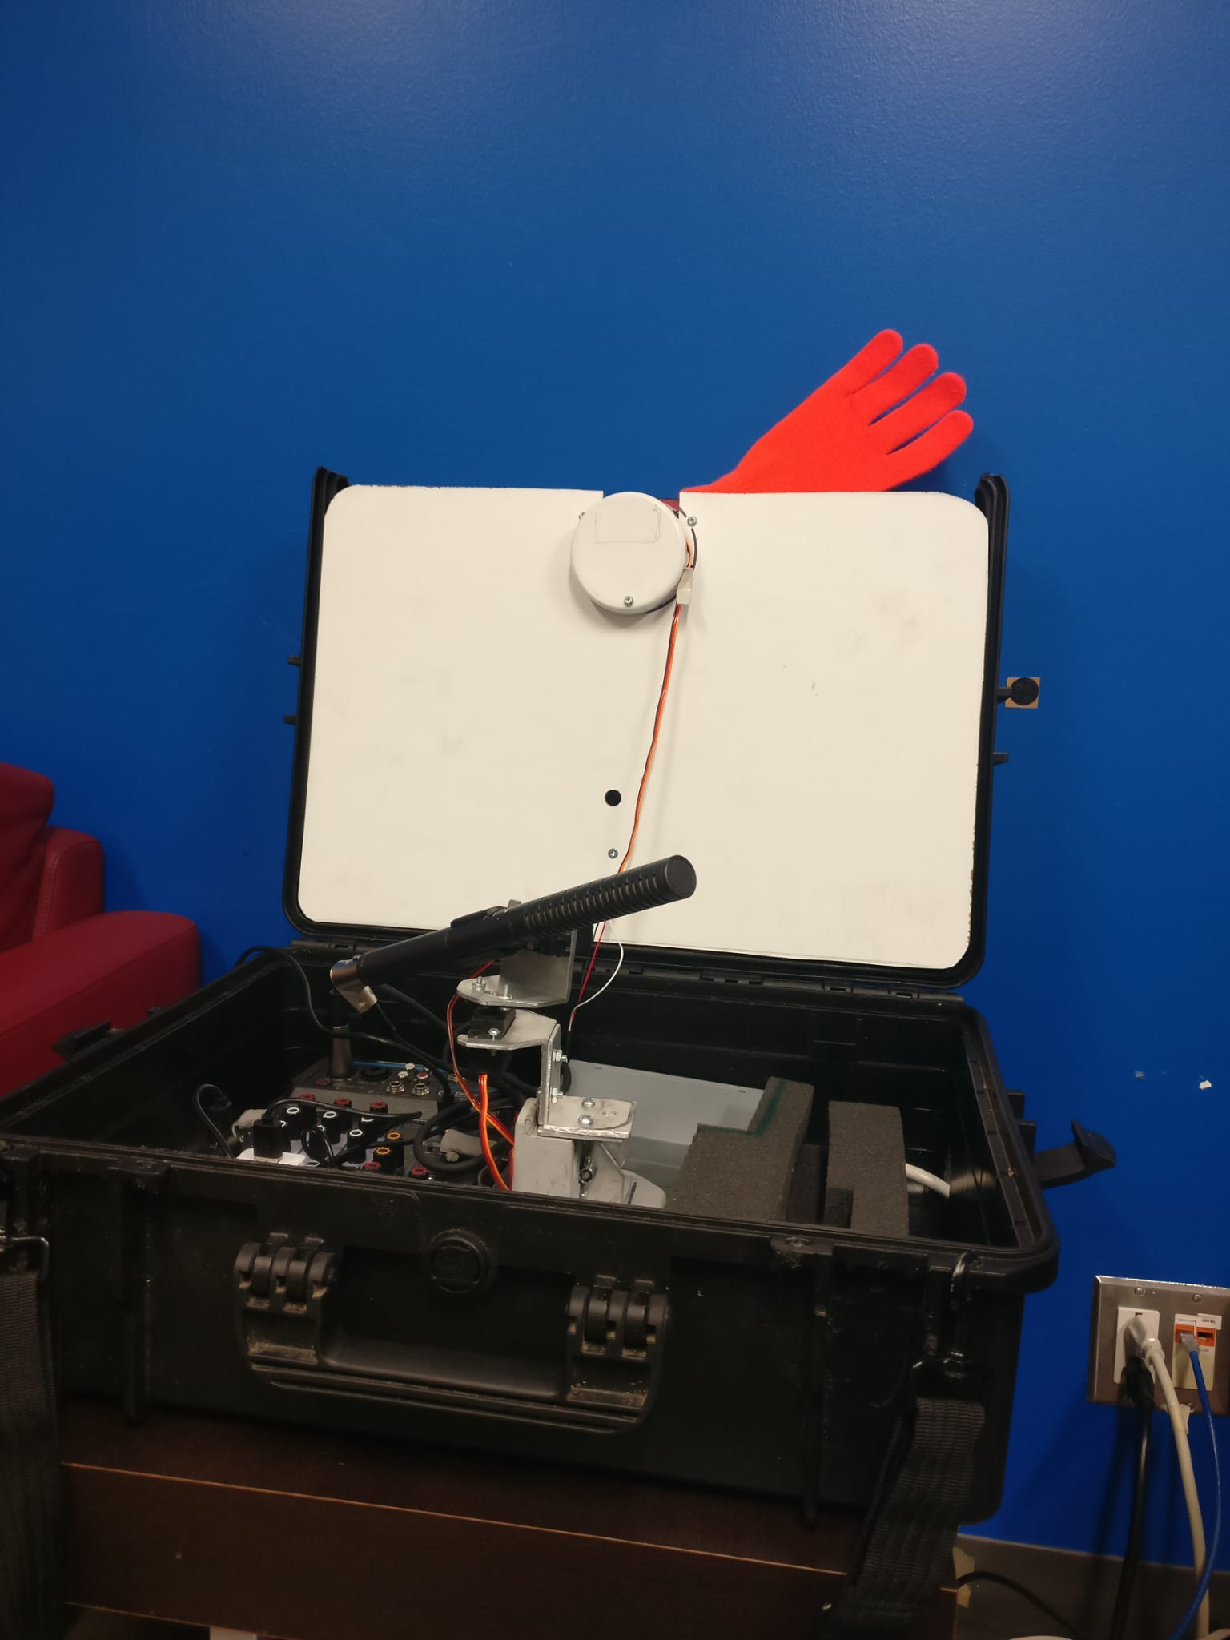
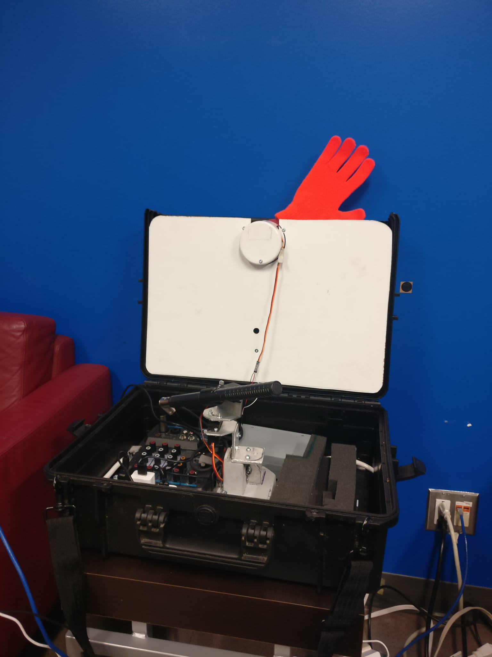
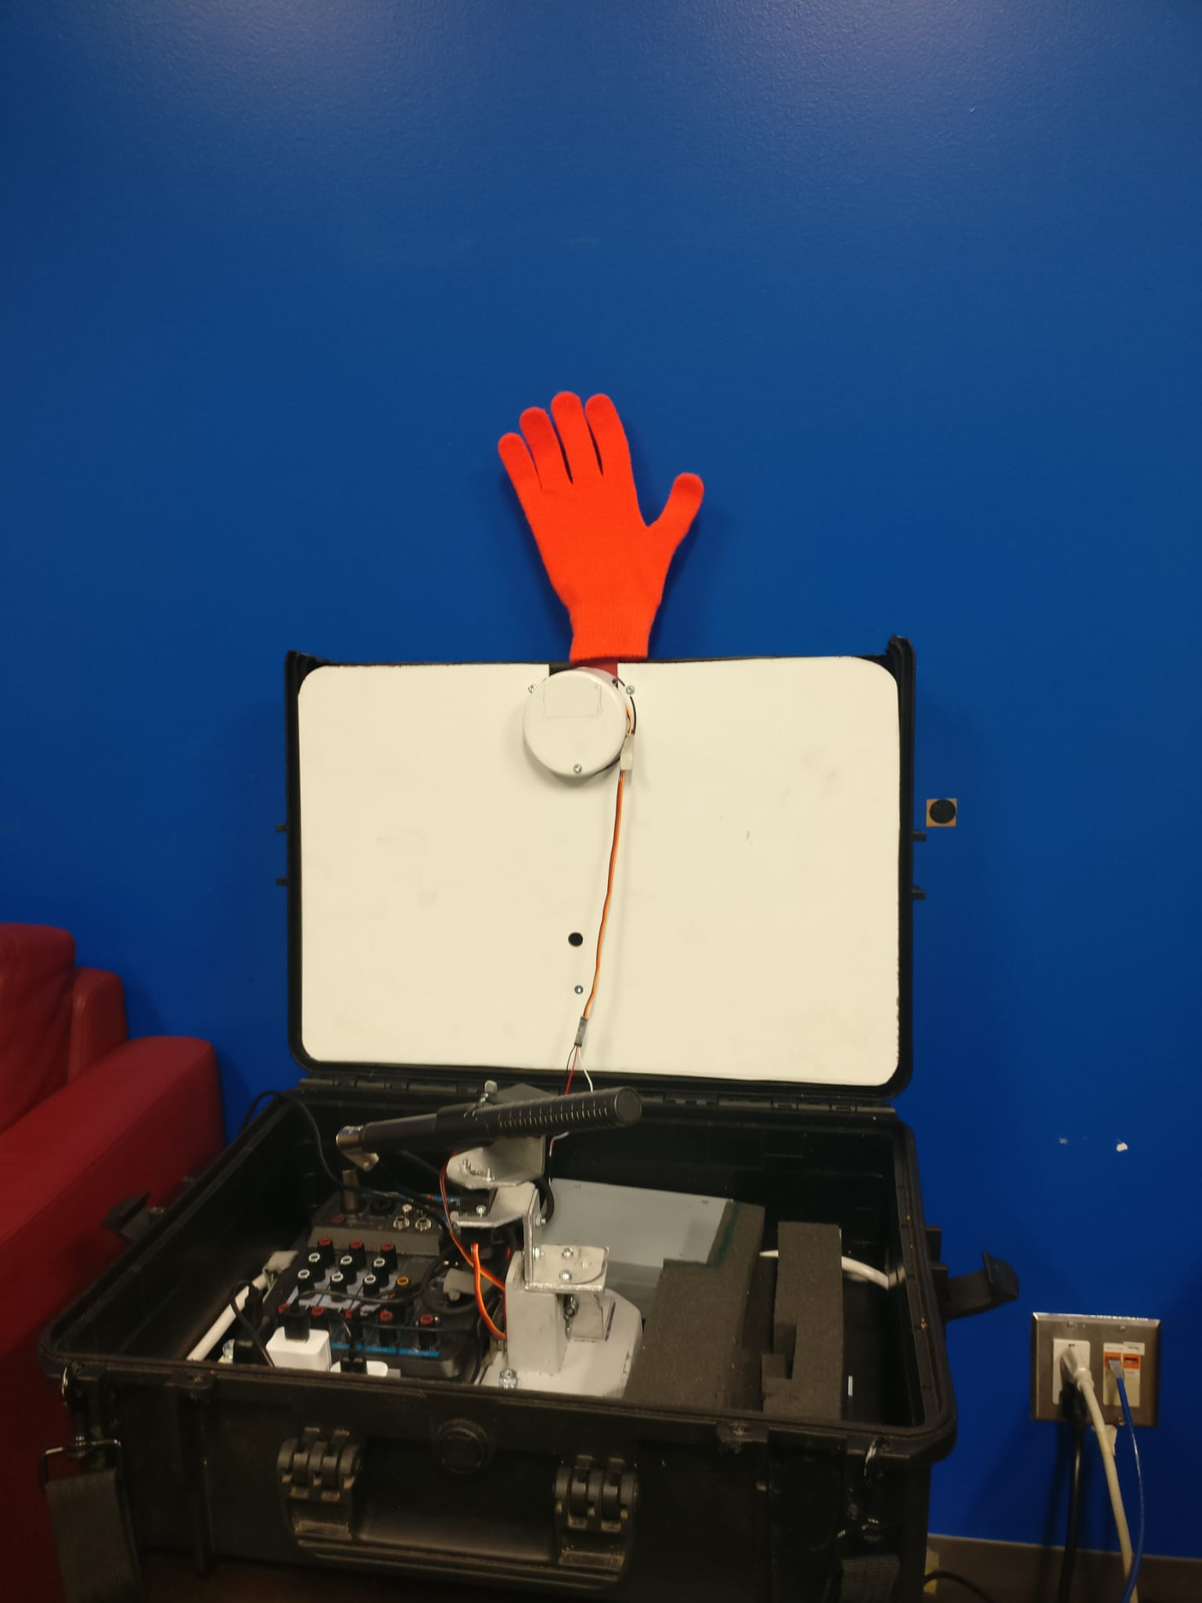
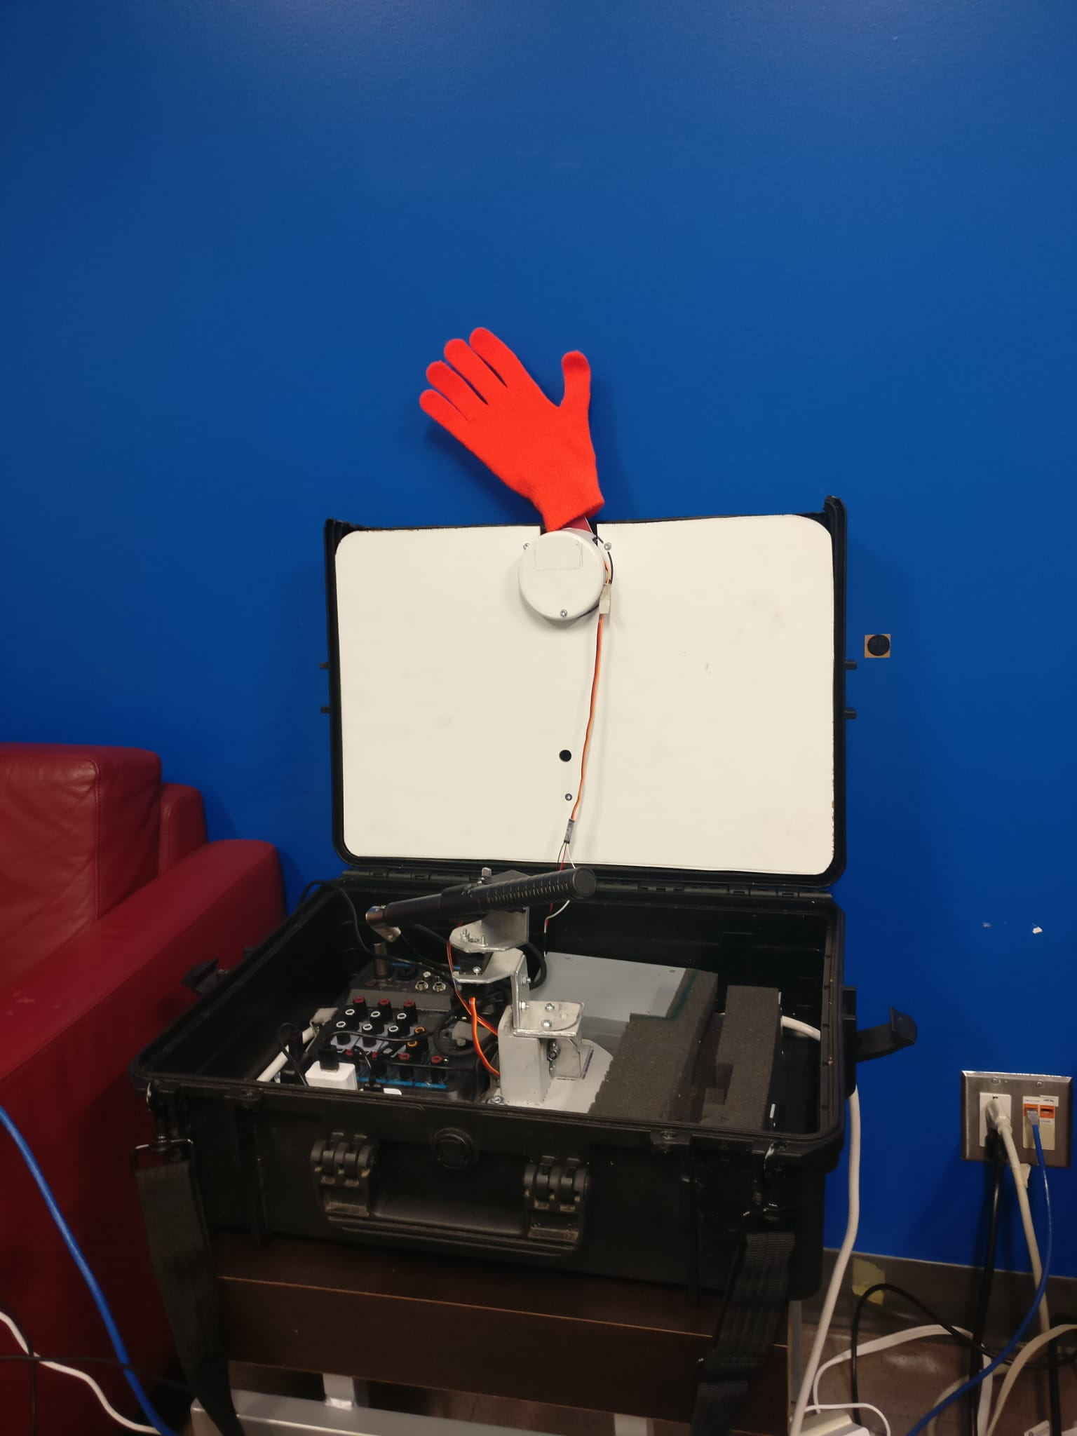
Proposed Solution - WebMoti 2.0
Robot hand controlled by the virtual student to gain the instructors attention
Directional mic controlled by the instructor to locate the student in class who asks a question so virtual student can hear

Slide 6
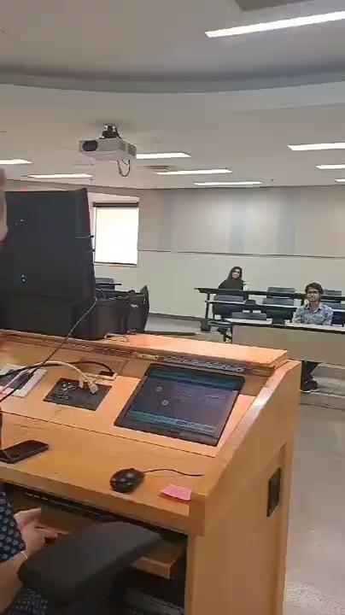
Video Demo
Notes:
Video script:
Instructor: Any questions today?
Student raises hand: I have a question.
Instructor: Yes, of course.
Student: When is the assignment due?
Instructor: It will be due this coming Friday.
Student: Alright
WebMoti hand waves
Instructor: Oh, we have a virtual question. Yes, Chris?
Virtual Student (Chris): When is the next assignment due?
Instructor: The following Friday.
Chris: Alright thank you.
Instructor: Your welcome
Scénario de la vidéo :
Enseignant : Des questions aujourd'hui ?
L'élève lève la main : J'ai une question.
L'enseignant : Oui, bien sûr.
L'élève : Quand le devoir doit-il être rendu ?
Le professeur : Vendredi prochain.
L'élève : D'accord
WebMoti fait un signe de la main
Le formateur : Oh, nous avons une question virtuelle. Oui, Chris ?
Élève virtuel (Chris) : Quand le prochain devoir doit-il être rendu ?
Le professeur : Le vendredi suivant.
Chris : D'accord, merci.
Professeur : Je vous en prie

Slide 7
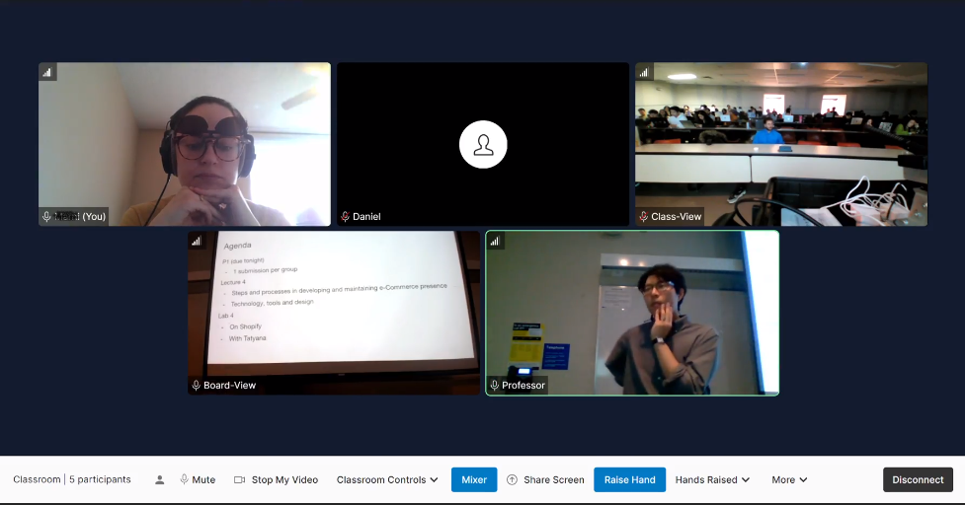
Methodology
Mixed methods study
Study duration is 3 classes (approximately 3 weeks)
Participants are recorded, to conduct a thematic analysis
Data collected though:
  Videos,
  Questionnaires and,
  Interviews

Slide 8

Early Results
Currently have 3 participants for this study
The student can gain instructor’s attention to ask questions
Helped students feel like they were apart of the class
Did not disrupt the students in the classroom
WebMoti 2.0 must be in the instructors line of sight for the hand to be noticed; need more sound options

Slide 9
Implications For Next Version
Implement sound feature while the hand raises to gain instructors attention
Detach the mic from the hand
  The hand can be placed in instructors line of sight
  With mic in the center of the class

Slide 10
Acknowledgements
Social Sciences and Humanities Research Council (SSRC), Inclusive Media Design Center (IMDC) Research Team, Toronto Metropolitan University

Slide 11
Contact Information:
Shazra Asmy
fasmy@torontomu.ca
Deb Fels
dfels@torontomu.ca
Amira Ghenai
aghenai@torontomu.ca

