Slide 1
Discovering Synergies between Design and Financial Literacy
Advaith Mani
OCAD University

Slide 2

I.Me.Myself
A designer with multiple backgrounds, learning as I go. Design to me is interdisciplinary, just like living. It flows between the lines, sometimes even blurring them. I look towards simplicity and clarity of thought in the work I do.
I come from a background in architecture and graphic design, with a keen interest in personal finance.

Slide 3

Commonly Uncommon
Even though we deal with finances almost everyday, how much do we know about money?
This study looks to examine the gaps in the vehicles that enable financial literacy.
This design-based MRP considers the point of view of someone who has zero or near-zero experience with the Canadian Financial System.

Slide 4

As simple as 1,2,3…
It starts with understanding core concepts of finances and its manifestations in the Canadian economy.
The design decisions are a result of the interaction and feedback with participants of this study and represent their pain-points.

Slide 5

Who is this really for?
The main target audience of the project is-
Youngsters entering the professional world.
Immigrants in a new financial system.
Anyone trying to manage their money.
All of us.
At what stage can one think of getting financially literate? The answer-anytime!

Slide 6
Formulating Research Methods
Autoethnography
Researcher is part of the process.
Grounded Theory
Attempting to unravel context.
Thematic Analysis
Discovering categories of design.
Informal Interview
Process of interaction.

Slide 7

Decoding the interviews
13 participants
A diverse combination of immigrants, Canadian locals, students, professionals were interviewed.
22 to 48 years old
Overall age range recorded among participants.
5 countries
Participants had experience from financial systems in Pakistan, Finland, USA, India and Canada.
30 to 50 minutes
Open-ended questions led to discussions of varied length regarding the subject.

Slide 8

Decoding the questions
The only specific parameter considered for the recruitment and the project overall is an understanding of spoken and written English, which thereby impacts the outputs as well.
The questions ranged across the following topics-
Professional and educational background.
Financial experience.
Past interactions with monetary systems.
Understanding and outlook towards money.
Lifecycle of money and desired financial goals.
Importance of financial literacy.
Learning mechanisms associated with the same.

Slide 9
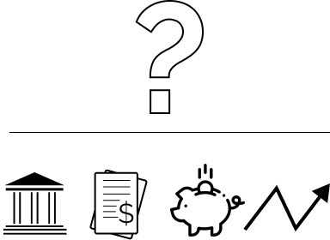
Emerging Themes
What are the first challenges that one faces?
By when do these doubts need to be addressed?
Is there a particular segment within the financial system that is potently challenging?
What measures are already in place and why are they falling short?
Does one method supersede the other?
Themes that emerged are as follows-
Banking.
Taxation.
Earning, spending, saving.
Investing.

Slide 10
Design outputs
Informal Interviews
These designs emerged from the responses given by the participants and represent their pain-points.
The idea is to visualize simple info-graphics to explain these financial concepts rather than relying on terminology and jargon.
The attempt is to uncover the journey that ensues upon their arrival in Canada / their initial interactions with the financial system.
Categorizing Themes
Scrutinizing Data
Infographic Development
Participant Feedback

Slide 11
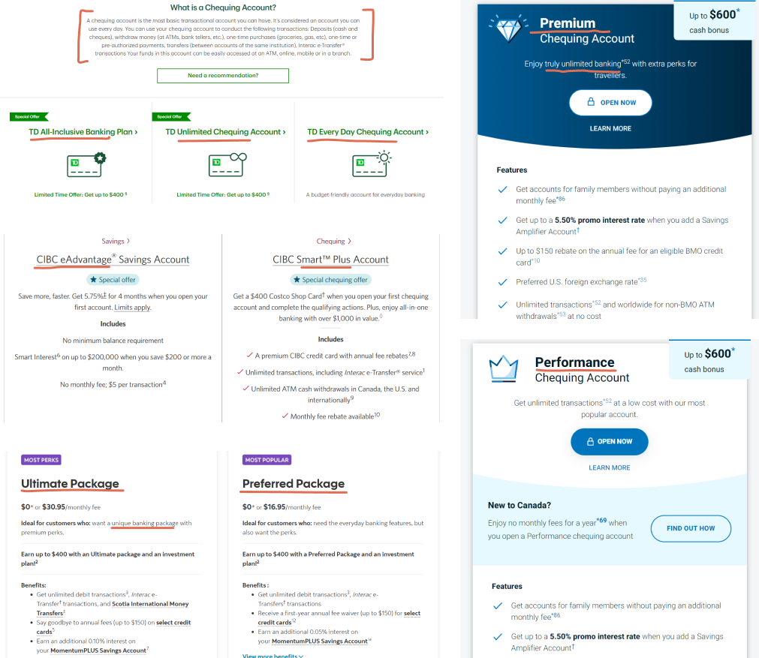
Banking
Banking is generally considered very jargon-heavy, making one satisfied if they know the bare minimum.
Most banking websites present a UI that is based on ‘limited time offers’ and a notion of urgency to avail of certain benefits.
Barring a few websites, there is no explanation of what these accounts are even meant for.
Source: TD Bank, CIBC, Scotiabank, Bank of Montreal

Slide 12
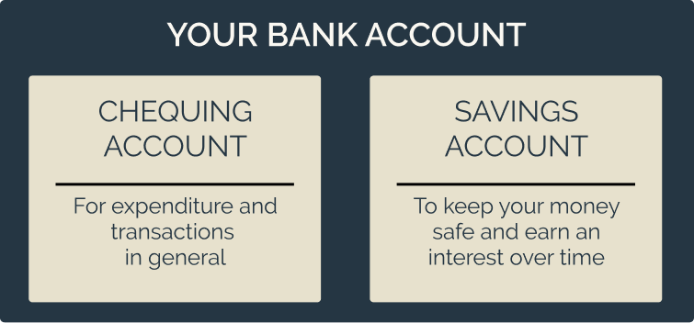
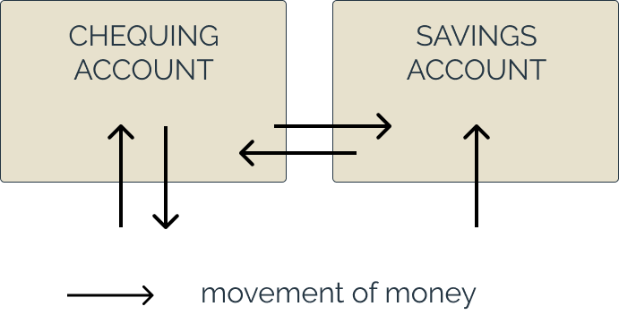
Banking Accounts
However, despite having a robust banking system, certain fundamental elements are not touched upon-
What are the basic accounts that one needs?
How should money move between accounts without accounting for any penalties?

Slide 13
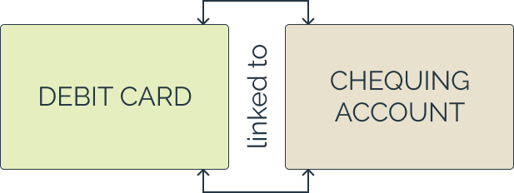
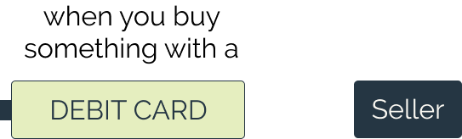
Banking-Debit Card
Banks generally issue credit and debit cards which allows one to spend and receive money electronically.
What they do not specify is how these mechanisms function or how money moves through the process.
Let us take the first instance of when you pay by a Debit Card.

Slide 14
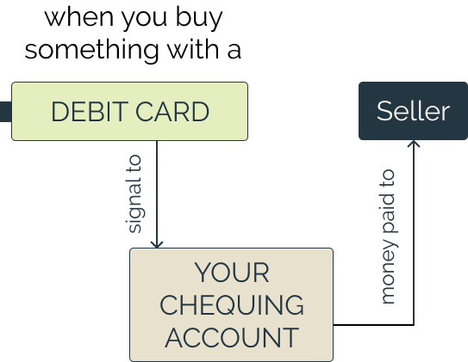
Banking-Debit Card 2
As soon as you tap/swipe your card on the machine, the bank receives an ‘OK’ signal to pay the seller the requested amount of money.
In some cases, usually when the amount is large (>$250), you are required to enter a 4-digit pin.

Slide 15
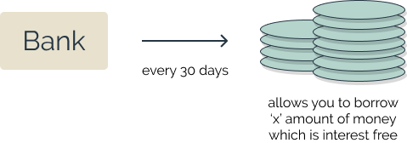
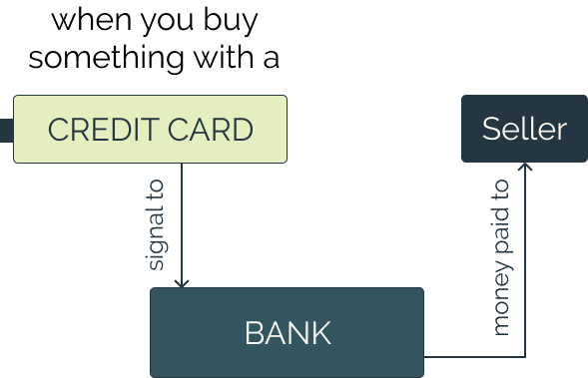
Banking-Credit Card 1
When you initiate payment through a credit card, the process is slightly different.
The general impression is that credit cards are mechanisms by which you pay immediately, but that is not the case.

Slide 16
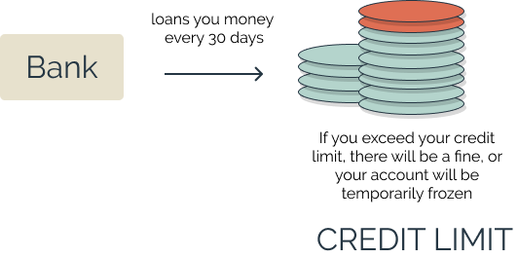
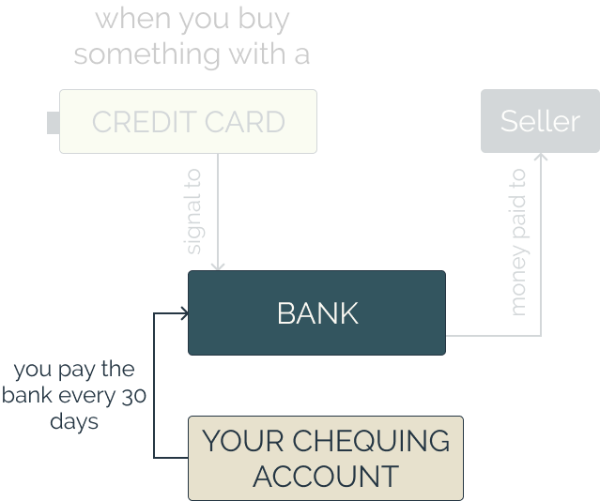
Banking-Credit Card 2
When you initiate payment through a credit card, the process is slightly different.
The general impression is that credit cards are mechanisms by which you pay immediately, but that is not the case.

Slide 17
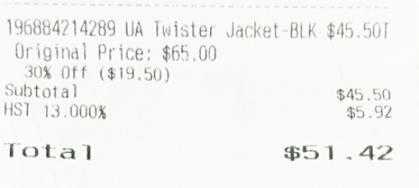

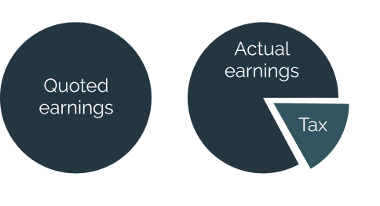
Taxation
While spending
A simple pay-slip is sometimes too technical to understand for some individuals.
The newcomer is often unaware of the tax implications that arise when they are spending or earning.
While earning

Slide 18
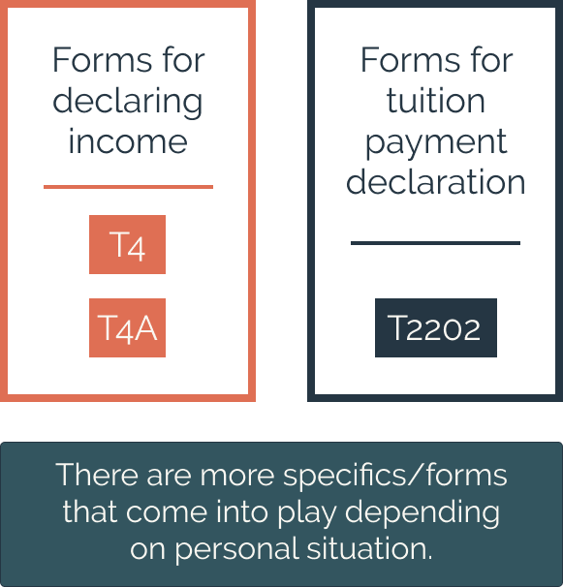
Taxation- income
If that was not enough, we are also expected to pay ‘income tax’ at the end of every financial year (usually runs from May-April).
The Canadian tax system is straightforward and yet has certain challenges associated with it.
There are various forms which one needs to utilize to file their income tax.

Slide 19
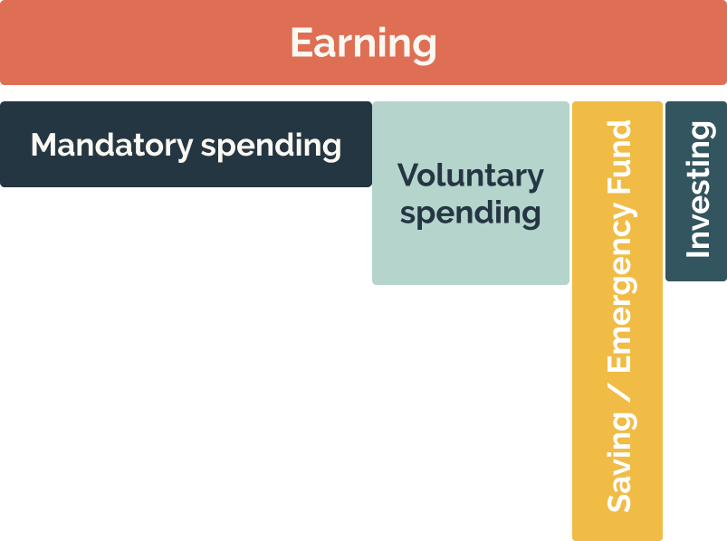
Earn, Spend, Save
It is important to uncover certain parts of this cycle before one can even imagine creating extensive excel sheets on budgeting.
For example, most people factor spending as an activity ‘post earning’ which might not really be the case.
Saving is a mechanism that helps during a rainy day or an emergency, but its value deteriorates over time.

Slide 20
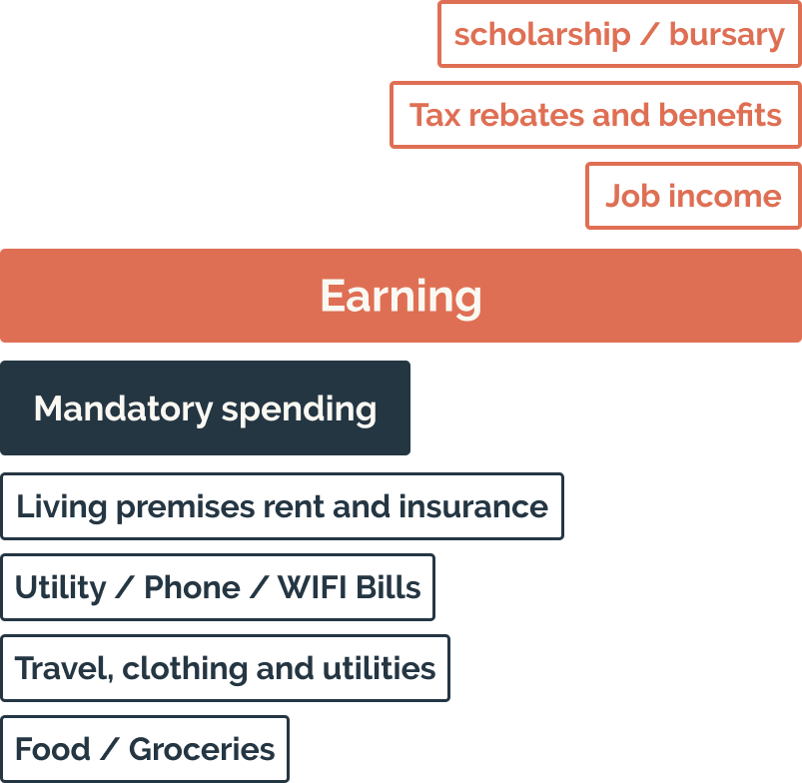
Budgeting
Rather than advising anyone on how to allocate their budgeting, it is more important to make one aware on what are the components that account for the lifecycle of their money on an everyday basis.

Slide 21
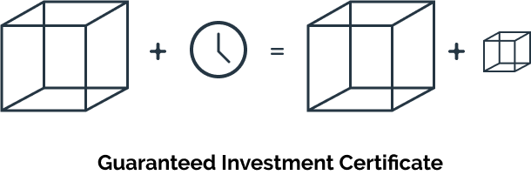
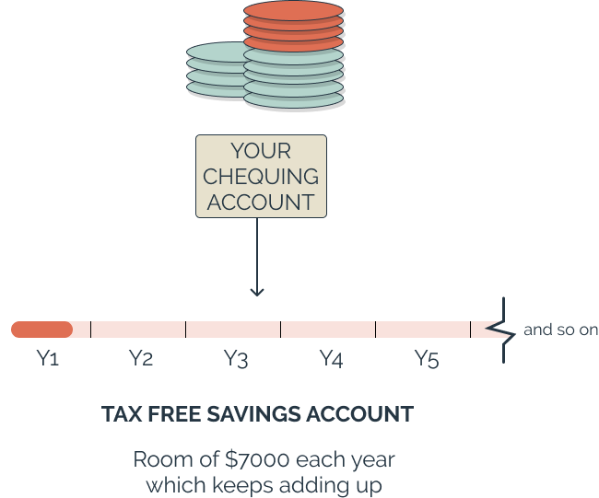
Investing
The communication around investing is one of risk and fear.
Instruments such as the Guaranteed Investment Certificates, Tax Free Savings Accounts (TFSA) etc, are not explained at its core, thereby seeming inaccessible.

Slide 22
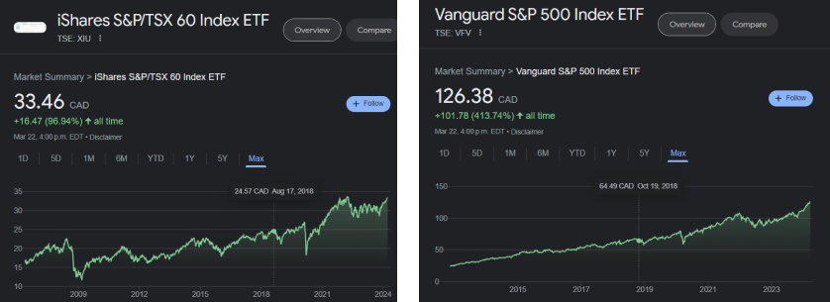
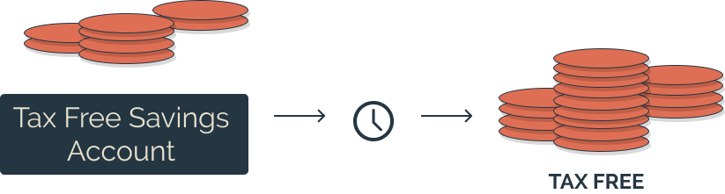
Investing- TFSA
Tax Free Savings Accounts allow one to invest their money in an instrument of their choice and get a tax-free return.
For those who find picking investments a risk, the best idea would be to invest in an Exchange Traded Fund (ETF),This can help combat inflation as well as build wealth to meet needs in the future.
Canadian stock market
Average annual return of 6.5% each year
US stock market
Average annual return of 8% each year

Slide 23


Investing- ETF 1
Toronto Stock Exchange
DRY FRUIT MARKET
Basket of top 60 companies
BEST DRY FRUITS
TFSA’s allow one to invest in ETFs, which essentially are a basket of the top traded companies on a stock exchange.
These companies are monitored continuously and reshuffled over time by the operators, which minimize risk and enable steady growth.

Slide 24
Investing- ETF 2
ETF’s are also designed based on the investment ethics of people.
For example, there is potential to invest in companies which practice ESG, are environmentally friendly, support equity and inclusion etc.
1 ETF- 7% RBC, 6% TD, 5.5% Enbridge, 4.3% Shopify, 3.7% Manulife, 4.1% BMO, 3.2% Canadian Tire, 2% Loblaw
100 gm packet= 16 gm Cashews, 12 gm almond, 20 gm walnuts, 15 gm pecans, 18 gm raisins, 19 gm pistachios
Risk is extremely low
Exposure diversified
Best of breed
Limited Fees

Slide 25
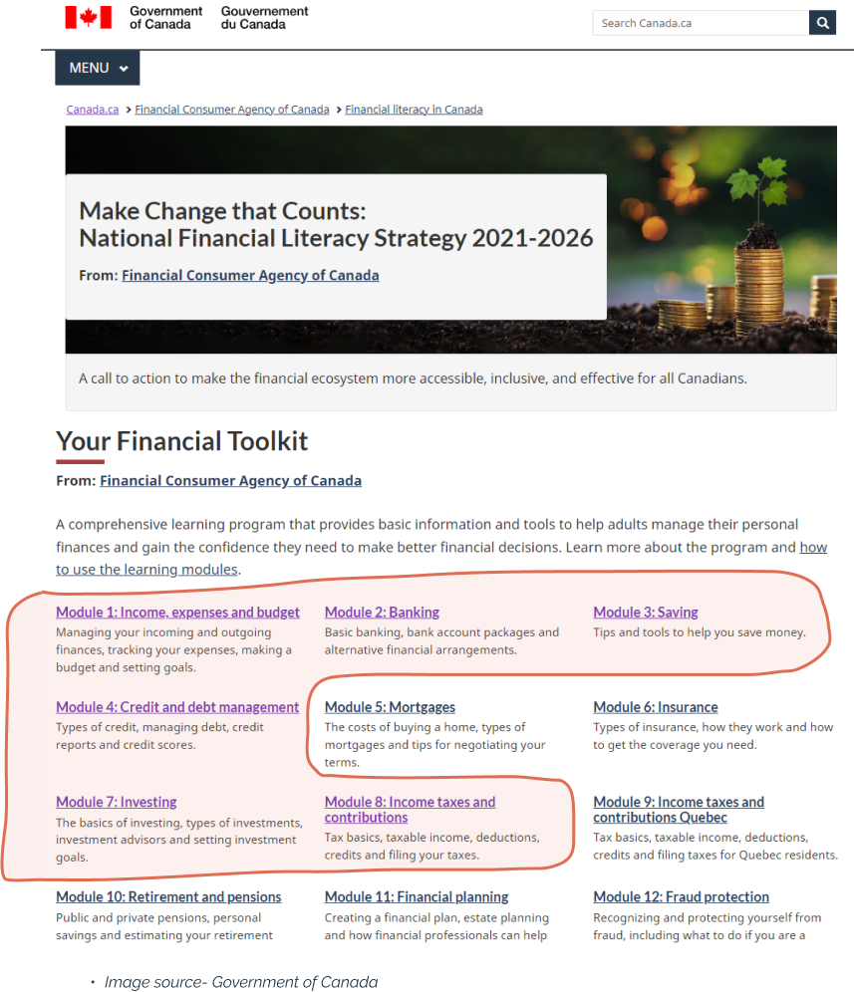
Where does this fit in?
The goal of the Government through the ‘National Financial Literacy Strategy 2021-2026’ is achieving financial resilience.
This research & design outputs fit into the modules prescribed under this initiative.
However, the ‘Financial Toolkit’ might not be the most conducive or convenient learning tool for a newcomer. It takes more than an hour to cover each module!

Slide 26
Strategic Implementation
Decision to come to Canada
Research / Speak to someone
Government Website
Financial Toolkit
Simplified Basics
Preferred Method of Data Collection

Slide 27
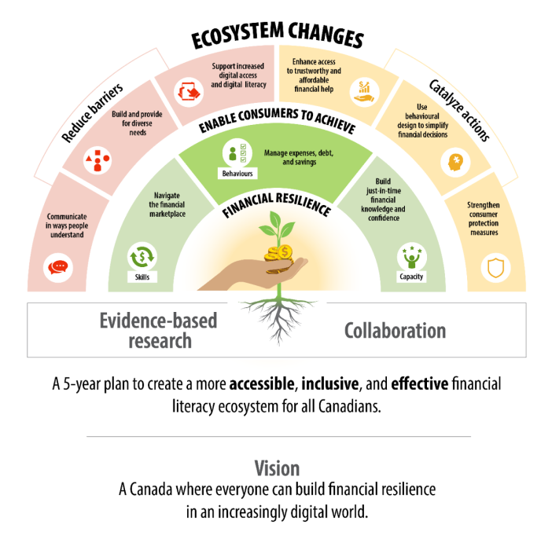
Towards resilience
The first step towards resilience is Financial Literacy, and hence this research fits right into the initiatives of the Government.
Financial literacy is a necessity towards a sustainable financial future of Canada.
Since this is a continuously evolving study, it gives me the opportunity to carry this project forward towards helping create a more robust financial system.

Slide 28
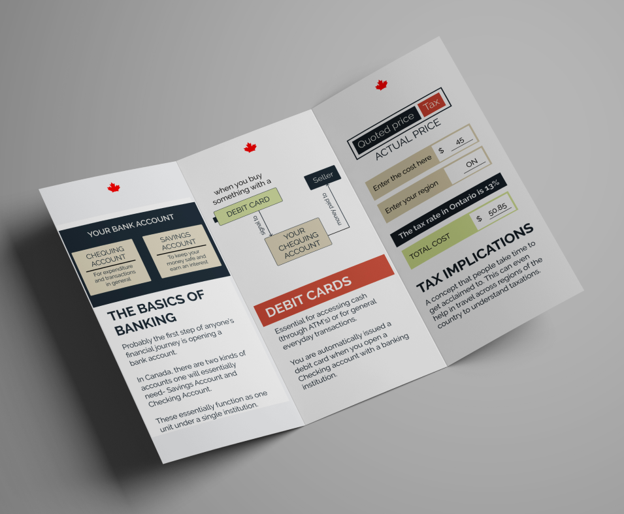
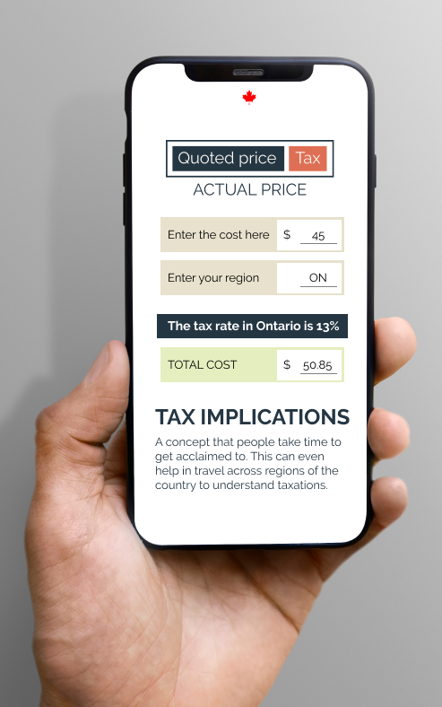
Mockups

Slide 29
Thank You.
Let us discuss.

