Slide 1
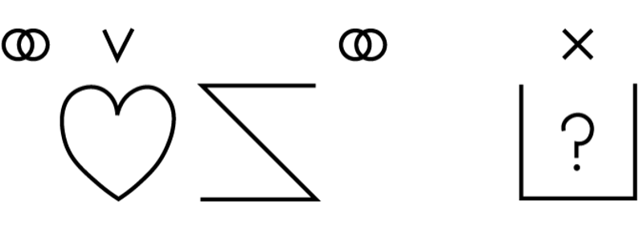
Welcome to
BLISSFUL QUESTIONS
In Conversation with Shirley McNaughton on Blissymbolics Today

Slide 2
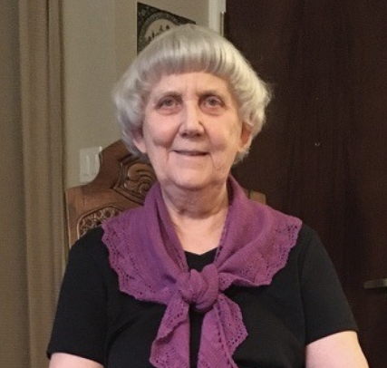
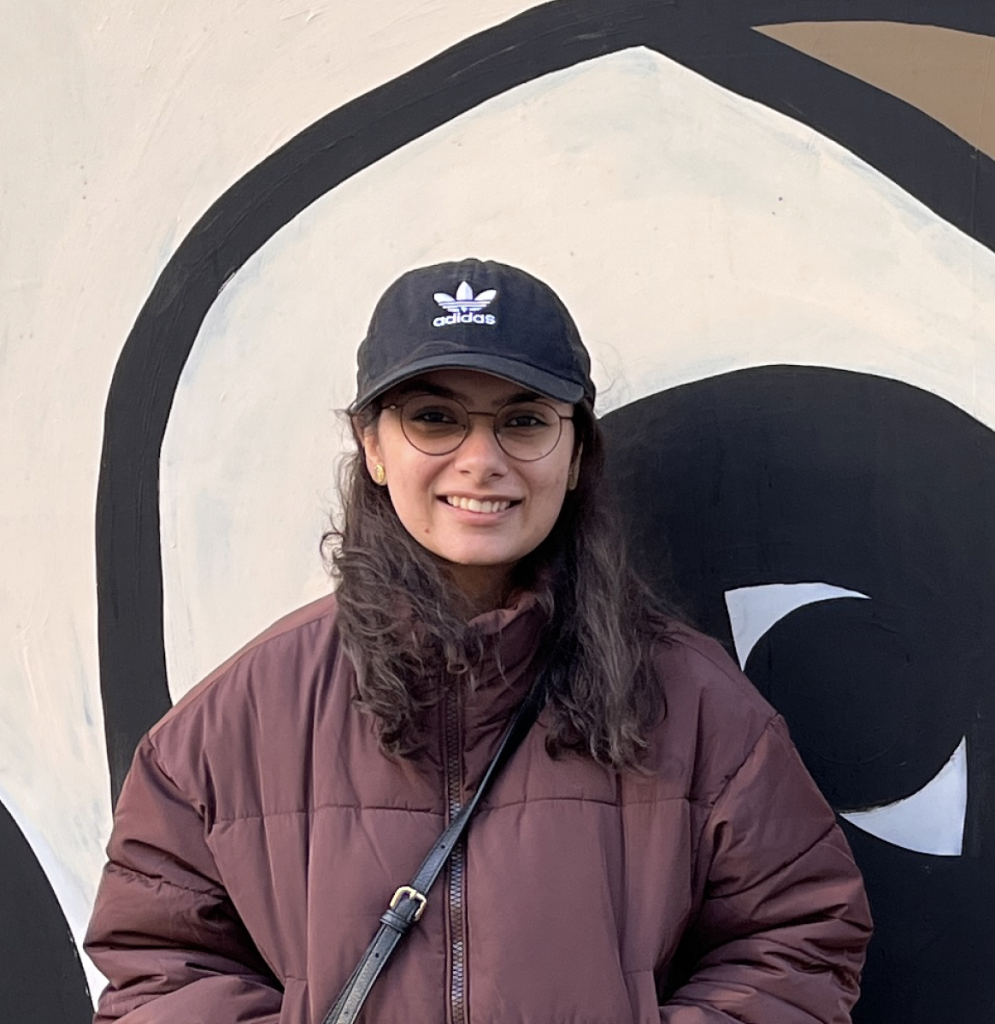
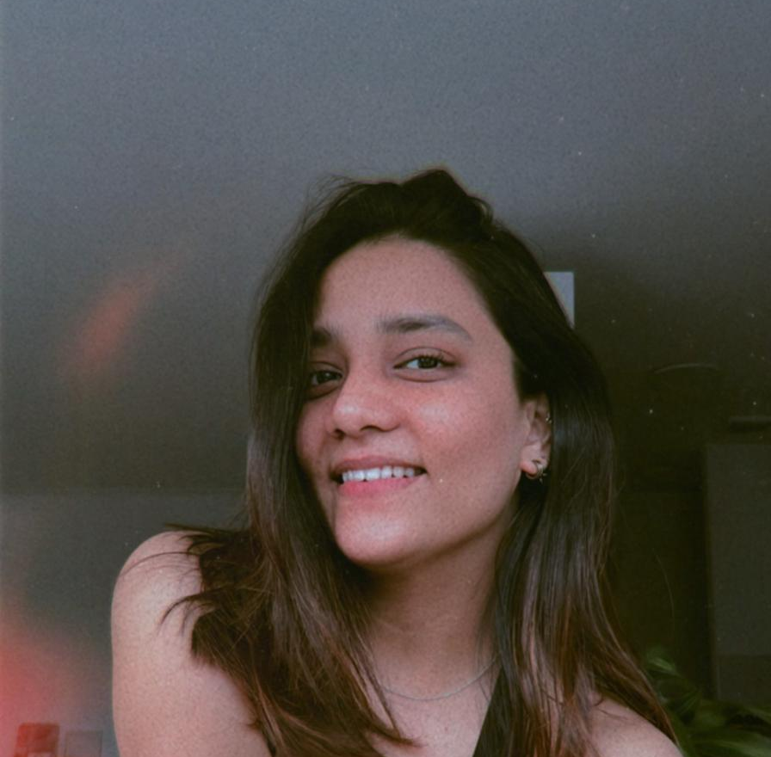
Meet the Authors
Shirley McNaughton
Gulay Syeda
Saee Tipnis
Product Designer.
Master in Inclusive Design, OCAD
University, Toronto, ON.
Graphic Designer.
Master in Inclusive Design, OCAD University, Toronto, ON.
C.M., Ph.D., ARCT.
President, Blissymbolics Communication Institute – Canada.

Slide 3
Question
Could you begin by telling us​ about the history of Blissymbolics?​

Slide 4
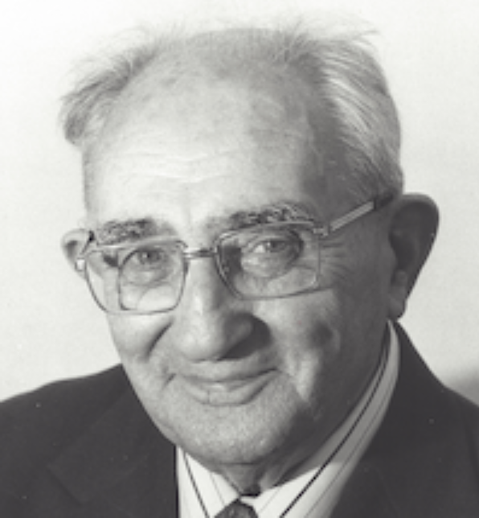
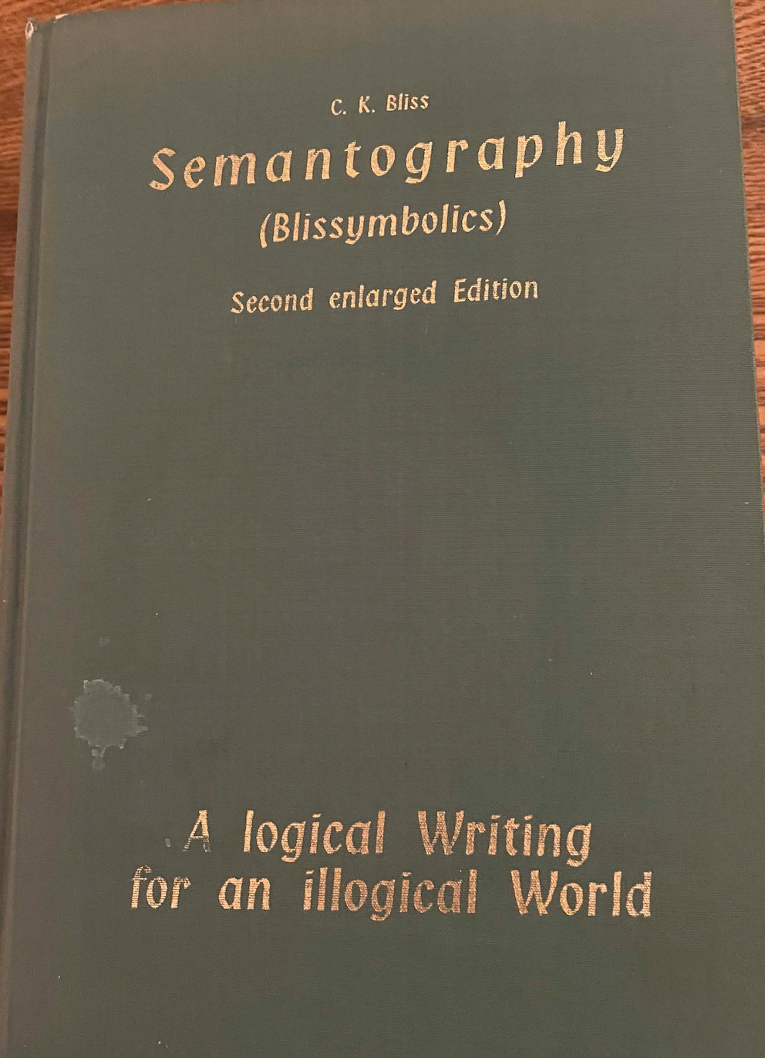
Blissymbolics
Semantic graphic language ​
Charles K. Bliss
(1897 - 1985)
Semantography​
(1942 – 1965)​
Notes:
Charles K Bliss worked on the development of the language of Blissymbolics from 1942 until 1965 when he published Semantography-Blissymbolics.
The limited response he received as he mailed free copies of his book to libraries around the world and his early relationship with the team in Toronto, is told by him in ‘Mr Symbol Man’ - a film, available on Youtube, produced by the National Film Board, Canada, and Film Australia, 1974.

Slide 5
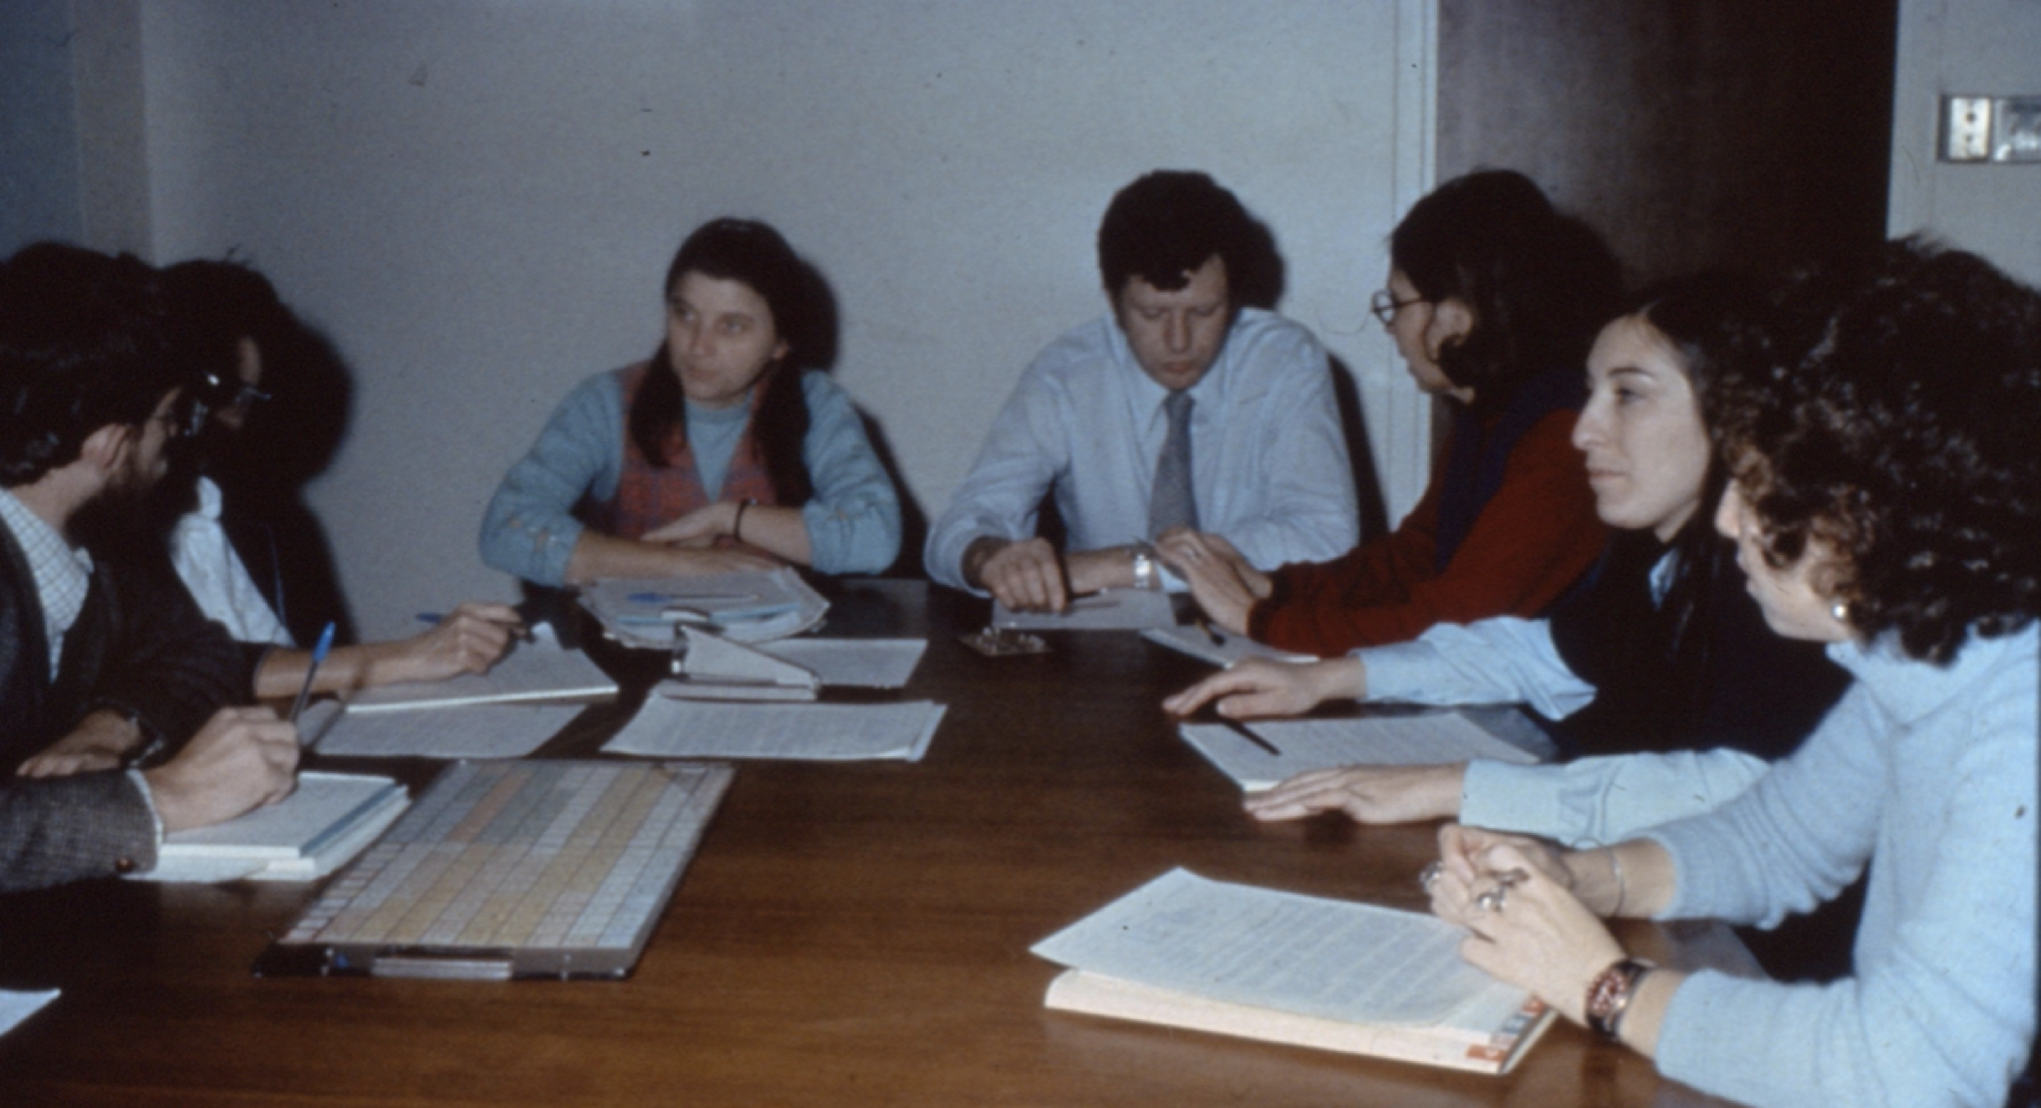
Inclusive Practices
1971-1972
Interdisciplinary Clinical team pioneered the use of “Bliss”for children who were non-speaking at the Ontario Crippled Children’s Centre, Toronto now Holland Bloorview Kids Rehabilitation Hospital.
Notes:
First application of the language by interdisciplinary team at OCCC in 1971
(An example of “inclusive design” approach before the term was known). It was new in the 70’s in the rehabilitation field that leadership to a program could involve the collaboration of different disciplines. Prior to this time - a medical model dominated, with the direction being given solely by doctors.
Little did the original team know that their program for children with cerebral palsy in Toronto would go around the world, would lead to the founding of the International Society for Augmentative and Alternative Communication (ISAAC) in 1983, would provide the example for Blissymbols being used around the world, and in the 70’s, provide the model for communication in the field of Augmentative and Alternative Communication (AAC). This history is provided in “Prelude to ISAAC”, video on Youtube, 2022.

Slide 6
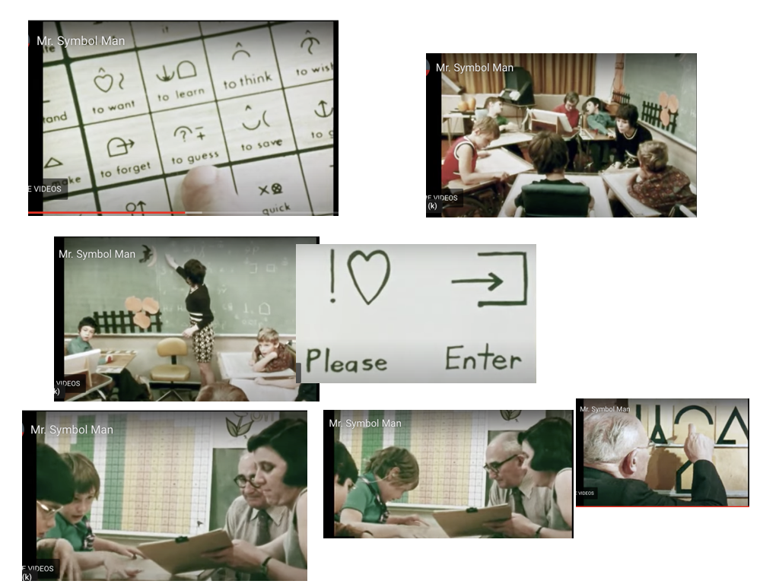
Collection of Images
Image Description:
Collection of Images from the film, “Mr. Symbol Man” that shows a classroom with early Bliss users.
Notes:
An exciting time in the 70’s, as 2 initial small groups of 4-6 year olds grew into 3 full time classes and an outreach program that went around the world. Sharon Coyle is shown in ‘Mr Symbol Man’ - one of the early teachers in Toronto.
Mr. Bliss visited Toronto from Australia each spring, beginning in 1972. His relationship with the early team was erratic - mostly positive when he was with them in Toronto, but stressful when he returned to Australia.

Slide 7

Blissymbolics Communication International (BCI)
Established in 1975 in Canada to support, worldwide, the use of Blissymbolics for those who were nonspeaking.
Notes:
1975 is a seminal date in the history of Blissymbolics. It was the year of the establishment of BCI (first name was “Foundation”).
There were several name changes over the years, but the mandate was the same:
(a) To promote, disseminate and encourage the use of symbols throughout the world as a vehicle to provide communication for verbally handicapped children and
other persons who might benefit from such a communications
system;
(b) To hold workshops for instructors and others for training
in methodology and to establish symbol instructional programs for children, parents and interested professionals;
(c) To develop, publish, produce and disseminate materials
with regard to the symbol system including symbol boards, electronic display trays, workbooks and other instructional materials;
(d) To establish a library of symbols, film video tapes, books and other learning devices with regard to symbol usage;
(e) To provide a clearing centre for a standardized symbol use and information;
(f) To offer suggestions to institutions for handicapped and other interested persons or groups with reference to directions of research and development;
(g) To carry out research and to fund research into symbol and symbol systems;
(h) To offer consultant services to institutions for the handicapped and other interested groups and persons for the implementation of symbol programs, symbols and materials;
(i) To operate, establish, maintain and own whatever
structures, works and undertakings are necessary to carry out the above objects and to generate revenue by way of
licences, royalties or agreements to finance the above objects;
(j) To receive and maintain a fund or funds and to apply from time to time all or part thereof and the income there for
charitable or educational purposes related to the use of or
potential use of symbols;
and devise, bequest or gift and to hold, possess and enjoy,
for the objects of the corporation, donations, gifts, grants, devises and bequests of real and personal property of all
kinds and upon such terms and conditions and upon such trusts as the donor or donors of any such property may prescribe

Slide 8
Granted Access
In 1982
Charles K Bliss granted BCI an “exclusive, non-cancelable and perpetual, world-wide license for the application of Blissymbols, for use by handicapped persons and persons having communication, language and learning difficulties.
Notes:
Another seminal date was 1982.

Slide 9
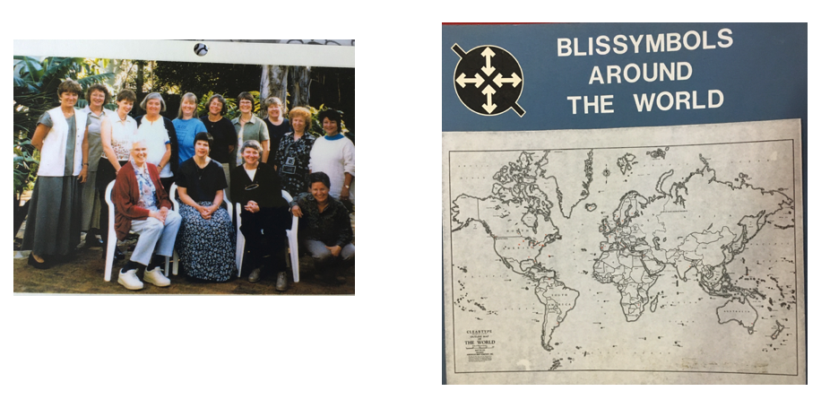
Blissymbolics Around the World
Image Description: (Image on the left): Example of one of the many international meetings to develop Blissymbolics. This one was held in South Africa in the 80’s.
(Image on the right) Shows a map demonstrating where Bliss has been used around the world.
During 70’s and 80’s,
Blissymbolics for Augmentative and Alternative Communication (AAC ) users spread to 33 countries, 17 languages.

Slide 10
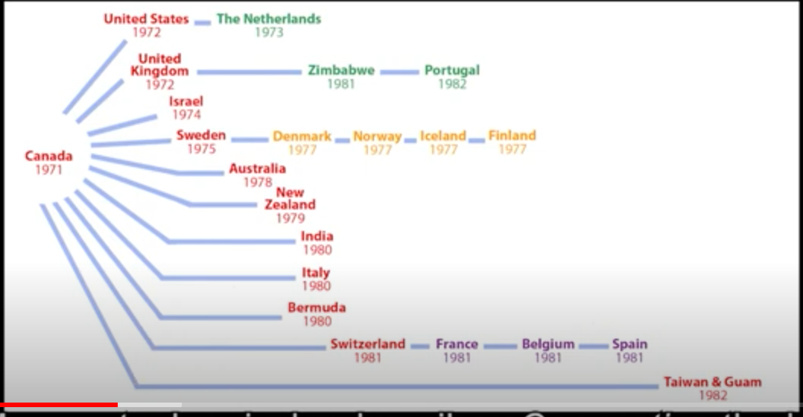
Image Description: Shows when and by which countries the Blissymbolics were introduced.
Notes:
This diagram, shows the years when Blissymbols were introduced to the countries of the world, and names the country that gave the introductory training workshop. As a country developed its Bliss program, it shared its experience with other countries. So the Bliss programs spread!

Slide 11
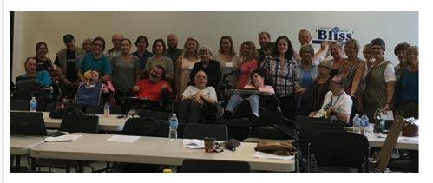
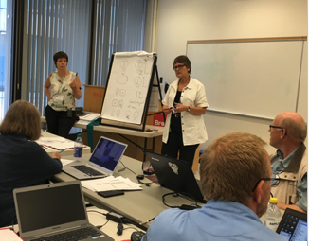
For over 50 years, workshops and international meetings have been held by BCI in Australia, Brazil, Canada, England, Finland, Germany, India, Ireland, Israel, Italy, New Zealand, Russia, Scotland, South Africa, Spain, Sweden, The Netherlands, United States, Wales.
Image Description: Blissymbolics International meeting in Canada in 2016.
Our most recent special occasion in Canada was the hosting of a meeting of the international Bliss community at
Brock University in 2016.

Slide 12
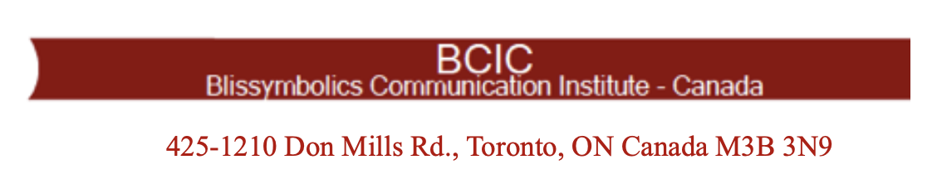
In 2011-
the responsibility for international leadership moved to Sweden, and
Blissymbolics Communication Institute Canada (BCIC) focused on serving the needs of Canadian Bliss Alumni.
Notes:
2011 was a memorable year for Bliss in Canada.

Slide 13
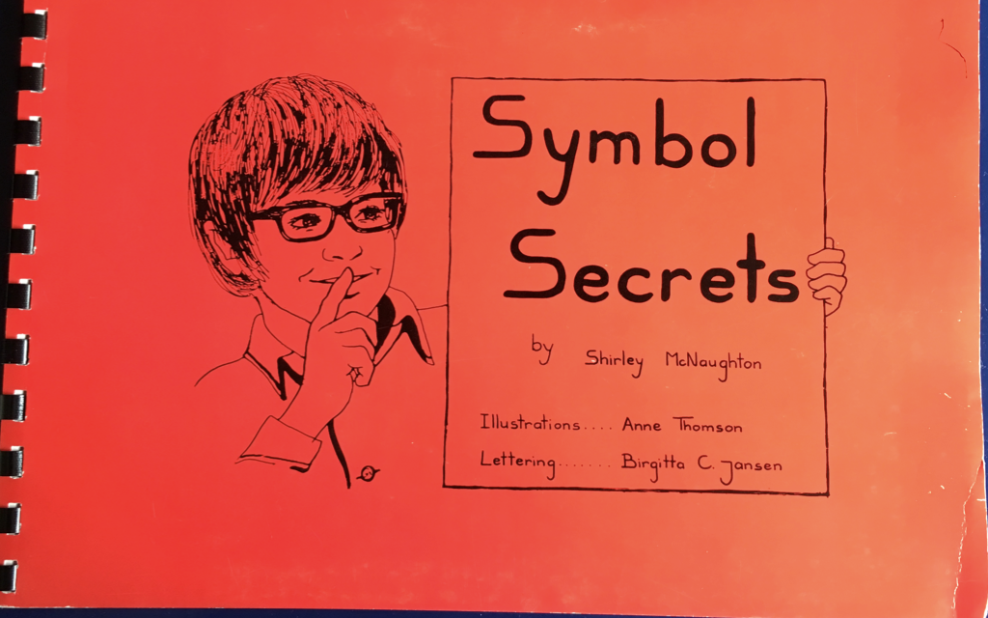
Three Sources for further information on Blissymbolics
1.
Mr. Symbol Man
1974 - National Film Board of Canada and Film Australia
2.
In the Land of Invented Languages
2009 - Arika Okrent, pp. 151-196
3.
Symbol Secrets
Image Description:
Book cover of ‘Symbol Secrets’
by Shirley McNaughton
Notes:
To learn more of the history of Blissymbolics as applied for AAC users…..

Slide 14
Question 1
Could you introduce Blissymbolics to our attendees and share your experience teaching children with cerebral palsy?
Please tell us how you believe Bliss can help children in their cognitive, language and social development, and in their literacy acquisition.

Slide 15
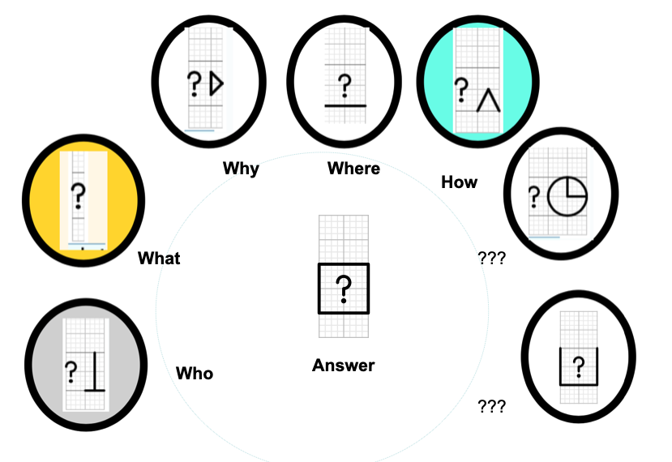
Understanding Basic Concepts

Slide 16



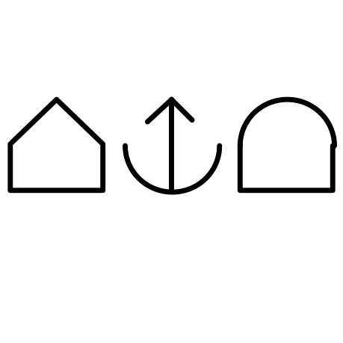
Here are the Bliss-characters in the
Bliss-word for school
Building
Giving
Knowledge
They spell :
School
Notes:
There are rules for the forming of Bliss-words. They are called Fundamental Rules and are found on the BCI website blissymbolics.org
Here are the sequenced Bliss-characters in ‘school’.

Slide 17


Forming Bliss Words
house
house + feeling = home
house + animal = barn
Notes:
Here is an example of Bliss characters providing the meaning of Bliss-words ‘home’ and ‘barn’.

Slide 18



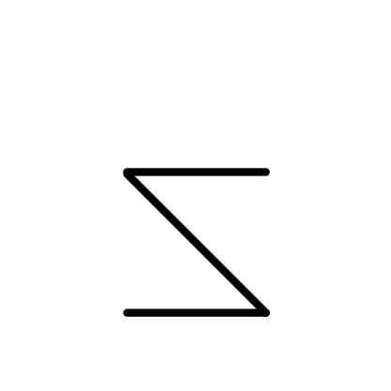



Understanding the Basics
language
mouth
ear
Blissymbol
sky
earth
world
writing tool
Notes:
Here the Bliss-characters that “spell” ‘language’ and ‘Blissymbol’ are demonstrated.

Slide 19
Blissymbolics Strategies
Notes:
Now I would like to introduce some Bliss strategies.

Slide 20
Learning the Basics
ADJECTIVE
ADVERB
NOUN
PLURAL
VERB
Notes:
First there are English grammar strategies

Slide 21
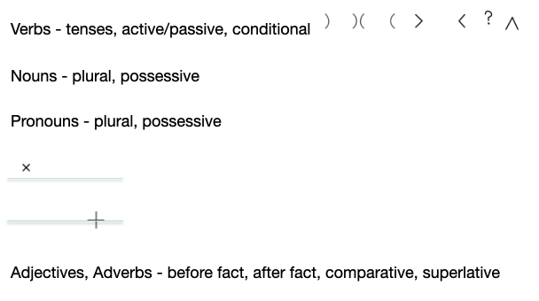
Blissymbol Grammar Strategies
(Based on spoken language - English)
As represented in Bliss
Notes:
A later slide will demonstrate the placement of the ‘word strategies’ on the BMW grid/keyboard.
Here, the basic English grammar strategies are applied to verbs, nouns, pronouns, adjectives and adverbs.
The main point is that the complexities of English or any spoken language can be accommodated in Blissymbolics.

Slide 22


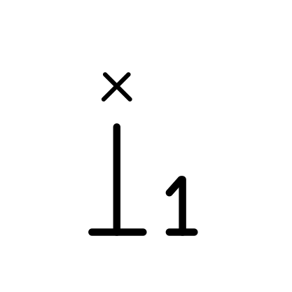
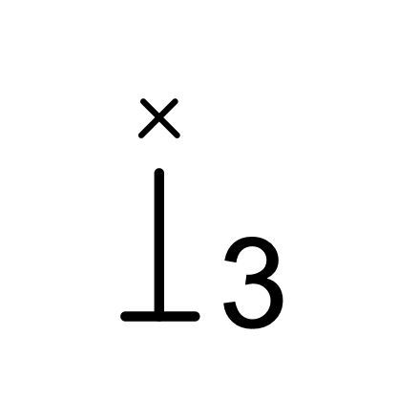
Plural
multiplication
plural indicator
we
they
Notes:
Each strategy has a semantic rationale.
The plural is related to the Blissymbol for multiplication

Slide 23



Time
PAST
PRESENT
FUTURE
Time is represented by parabolic mirrors and provides the reference for tenses.
Notes:
Here are the Bliss-characters to denote past, present and future.

Slide 24








Verb Tenses
Action
Past Action
Future Action
Present Passive
Past Passive
Future Passive
Present Conditional
Past Conditional
Future Conditional
Present Active
24
Notes:
These 2 slides show the many verb forms represented in Bliss - including tense, passive and conditional

Slide 25
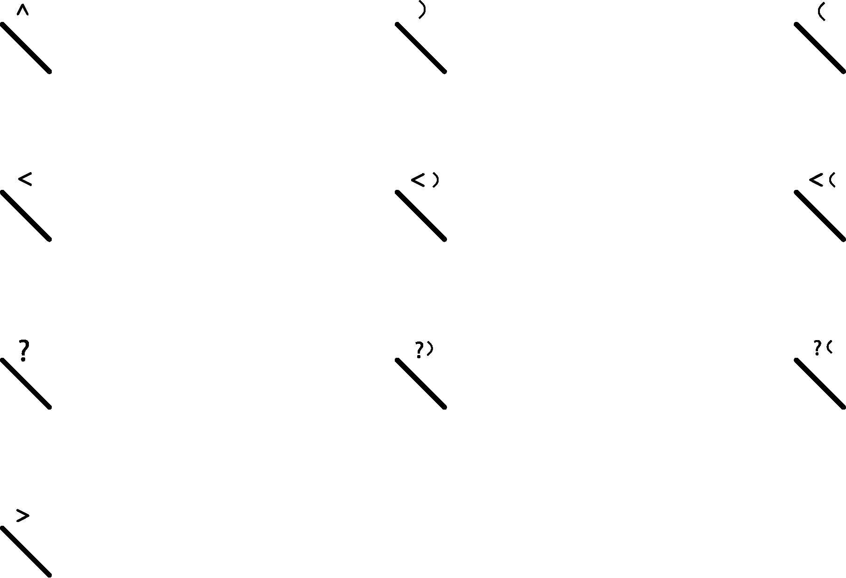
Examples
writes
wrote
will write
is written
was written
will be written
would write
would have written
would write (in future)
writes (transitive)
Notes:
Continuing with the verb forms represented in Blissymbolics.

Slide 26

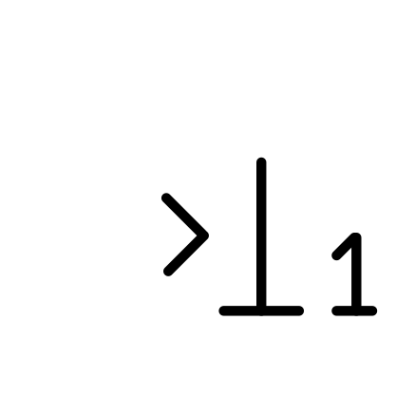

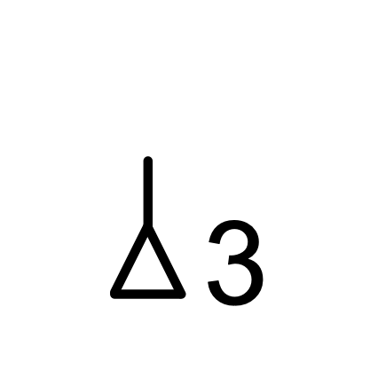
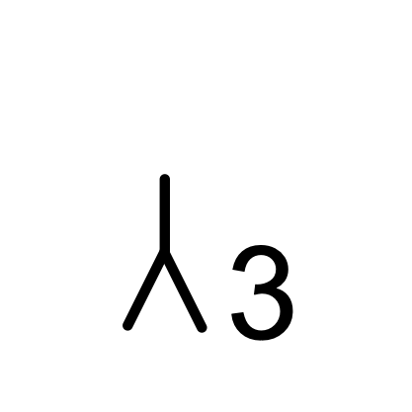
First, second and third person provide the reference for Bliss pronouns!
ME
YOU
SHE
HE
Notes:
Here are the singular pronouns.
For the plural forms, the plural indicator is added.

Slide 27


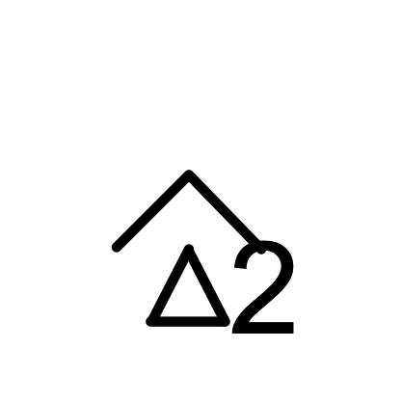

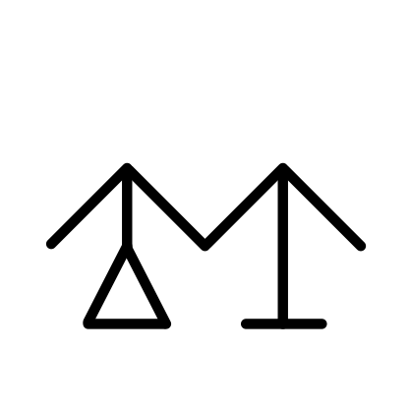
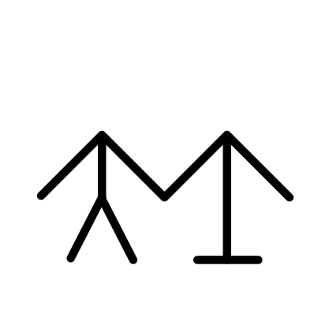
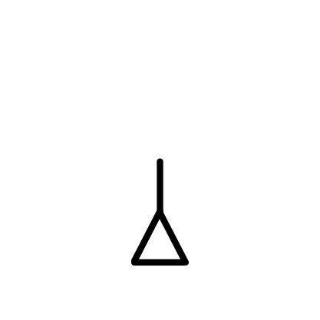





Mother and other family members
MOTHER
FATHER
SISTER
BROTHER
GRANDMOTHER
GRANDFATHER
They are all derived from the Bliss-characters …
protection
woman
man
parent
creation
action
Notes:
Relationships like in this small example of family members can be identified throughout the authorized vocabulary of over 6,000 Bliss-words that appear in the Authorized vocabulary.
There are many other examples of relationships like these in the Training programs available online.
See the BCI website.

Slide 28
In addition to the grammar capabilities in Blissymbolics,
here are Bliss strategies that enable the user to expand their vocabulary.
Notes:
In addition to spoken language grammar strategies, there are Blissymbol strategies that were identified as the children learned and communicated in a group with Bliss.

Slide 29


The two most frequently used strategies are:
Opposite meaning
Combine strategy to
produce a new Bliss-word
Notes:
In the Formative Evaluation Study, 1974-1976, conducted by Dr Harry Silverman, Shirley McNaughton and Barbara Kates, the ‘opposite meaning’ strategy and the ‘combine strategy’ were identified as being used most frequently.

Slide 30


Examples of Opposite Meaning strategy
Opposite of happy = sad
Opposite of sad = happy
Notes:
The Opposite Meaning strategy is demonstrated with ‘happy’ and ‘sad’. Use of this strategy enables the user to gain additional spaces on their communication display.

Slide 31


Example of Combine Strategy
Period of time in which you have happiness = fun
Notes:
Here is an example of the ‘Combine strategy’. A new vocabulary item has been created by the Bliss-user to be able to express a meaning not appearing on their display.

Slide 32
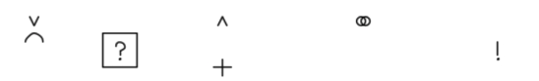
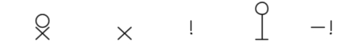

Grammar
abstract
answer
belongs with
combine (indicator)
command
generalization
group of
intensity
metaphor
not
opposite
meaning
rhymes (with)
same
similar sound
similar (to)
type
Notes:
There are many strategies that the advancing Bliss user can use.

Slide 33


Making Bliss Words
Yuck!
AND
Wow!
Or whatever words YOU wish to give these symbols!
Notes:
Before leaving our short preview of Blissymbolics, here are two Bliss-words that can be helpful in expressing one’s feelings. There can be as many exclamation marks as one desires.

Slide 34
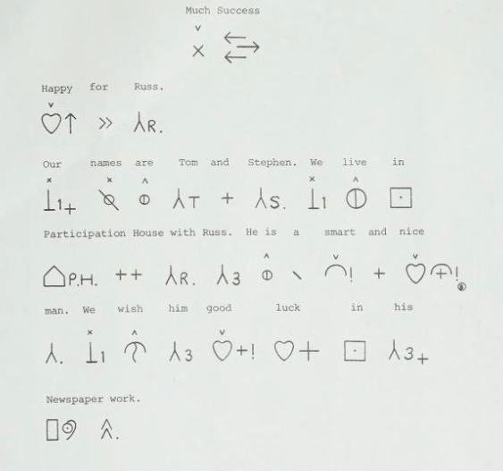
Image Description:
Demonstrates Blissymbols sequenced into sentences.
Notes:
This slide provides an example of Blissymbols as they appeared in a newsletter produced by a friend of Bliss users, Russell Ceccini. The newsletter is available in the digital archives.

Slide 35
Question 2
Can you please elaborate more on the transition/evolution from low tech (e.g. Bliss boards) to high tech (e.g. VOCA or digital systems) technologies?

Slide 36
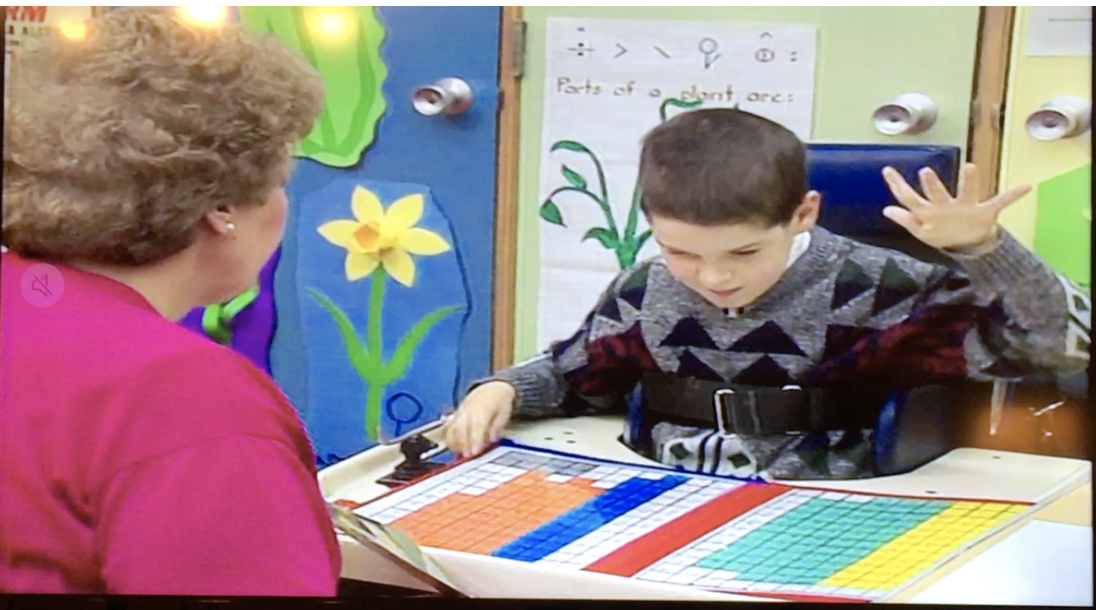
Image Description: This demonstrates a Bliss user communicating with his teacher using his display.
Notes:
Barbara Rush, a Bliss Teacher in Hamilton Ontario communicating with Sean.
The early displays in Canada were produced as standard displays - 100 symbols, 200 Blissymbols, 340 Blissymbols, 400 Blissymbols. These were preceded by flashcards for smaller arrays. By the third year, Blissymbol stamps applied to blank grids were introduced, so the displays could be individualized to meet the needs - both cognitive and physical - of the Bliss user.

Slide 37
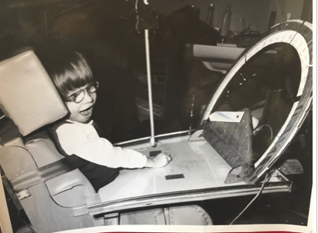
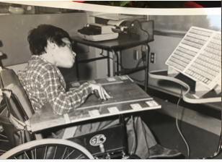
Image Description: Two examples of early technology prototypes for Bliss users.
Notes:
Many types of technology were explored.

Slide 38
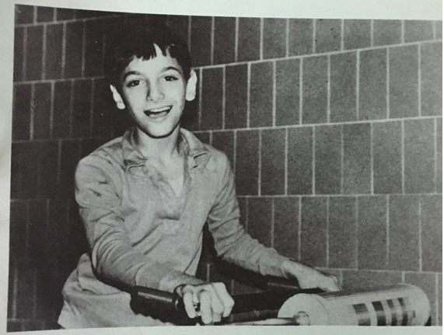
Image Description:
This is another prototype technology for Bliss users. This was designed for an ambulatory student.
Notes:
Here is a ‘roller’ display attached to a walker.

Slide 39
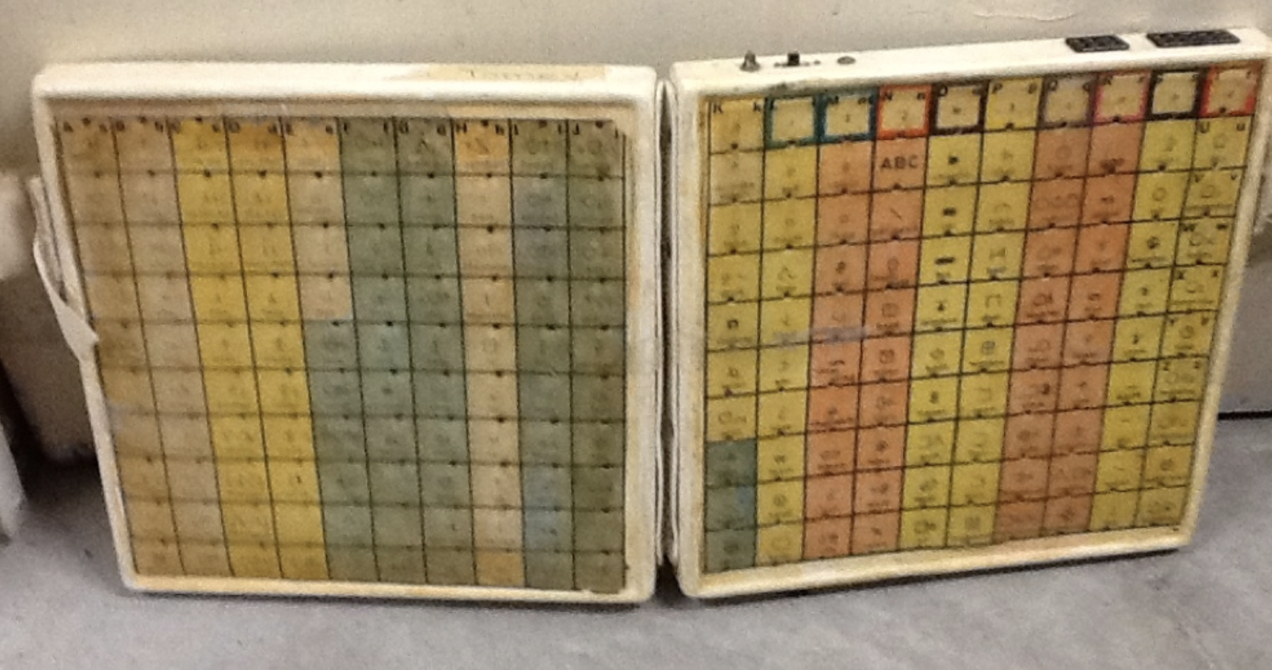
Image Description: An early prototype with 200 Blissymbols. This includes a Light Emitting Diodes (LEDs).
Notes:
Here is an early version of a 200-symbol display used by a Bliss user who scans the grid to produce a sequence of Blissymbols.

Slide 40
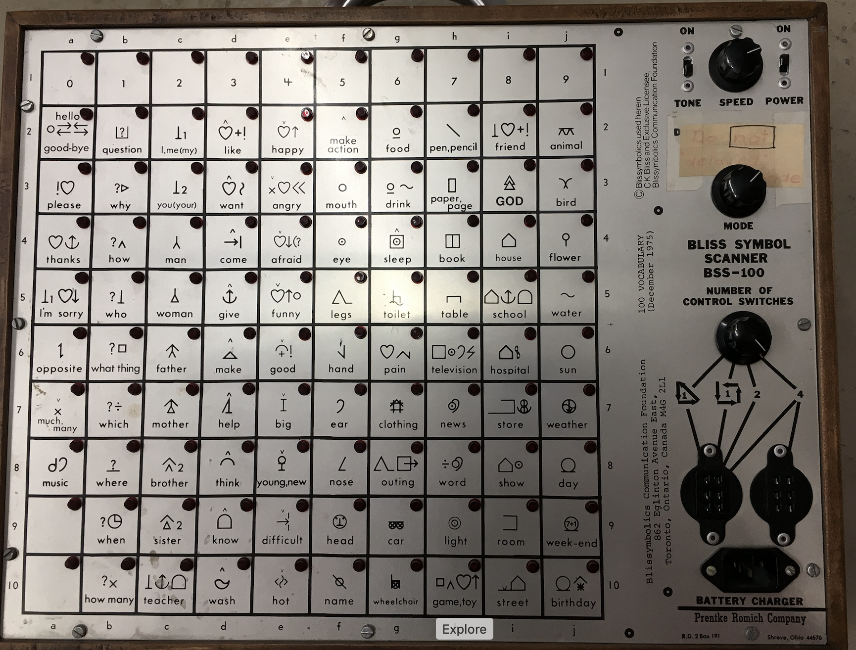
Image Description:
An example of an early manufactured Bliss display. It was manufactured by Prentke Romich Company in 1975.
Notes:
Here is an early display produced by the Prentke Romich Company. It contains 100 Blissymbols.

Slide 41
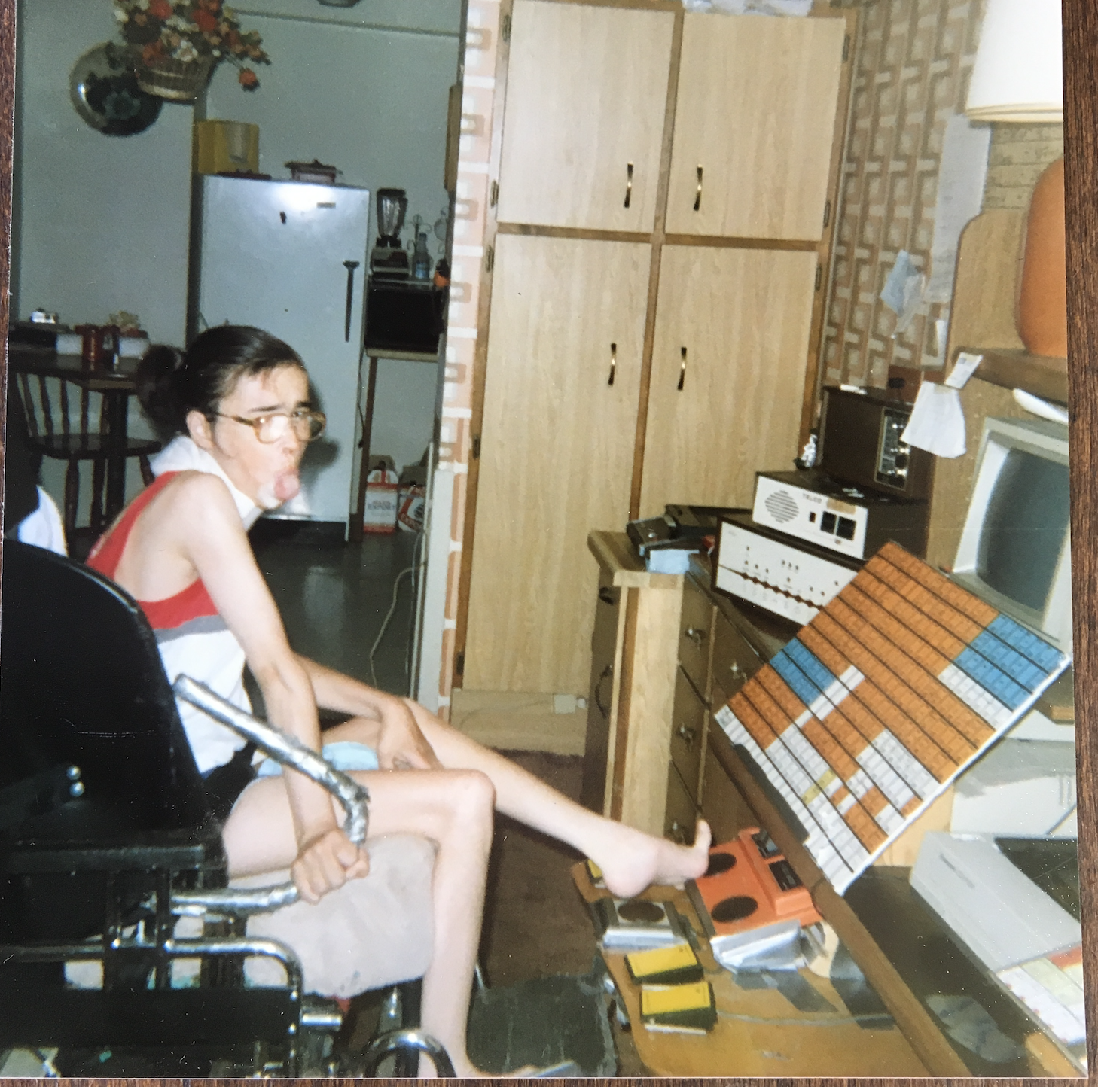
Image Description:
A personalized exploratory technology “system” for Sue Odell, one of the Adult Bliss Students.
Notes:
Here we see Susan Odell in the 80’s, always willing to explore new possibilities.

Slide 42
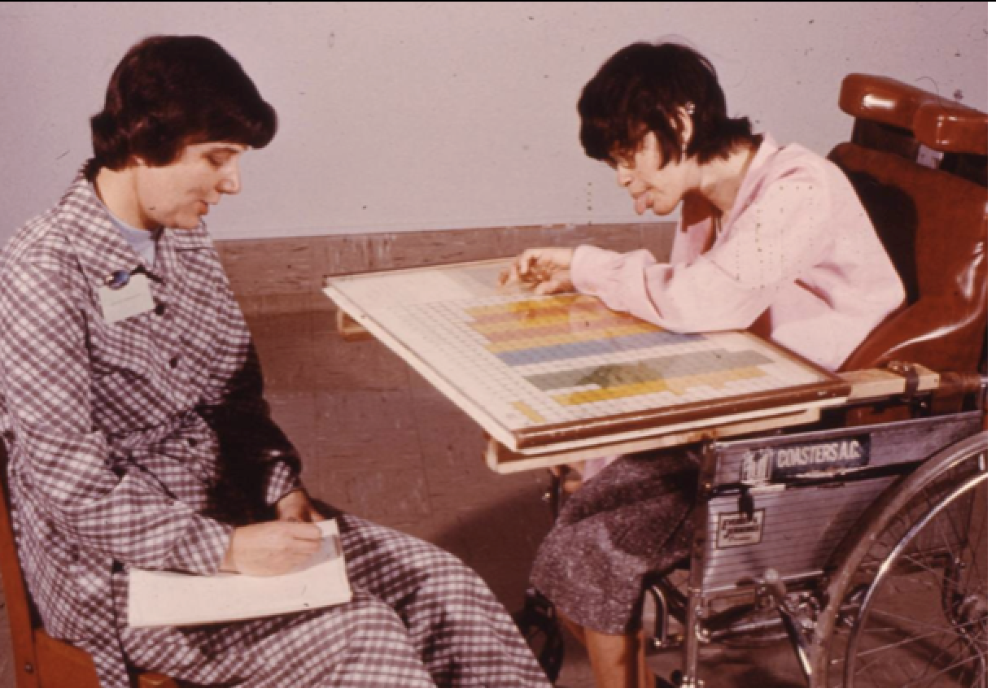
Image Description: Sue Odell communicating with a display producing very lengthy sentences.
Notes:
Here is Susan communicating with Shirley. Her Bliss-sentences could be up to 13 Bliss-words long. Shirley needed to record them, in order to process the full and long sentences.

Slide 43
History of BMW
This is a program I designed back in the early 90’s.
It relied on 3 approaches to access Bliss-words:
Blissymbolics supported by BCI
Minspeak developed by Bruce Baker
Words Strategy developed by Bruce Baker
Notes:
In the late 1980’s, the BMW was developed by myself, working with Sue Odell and Lee Mehrlich - both proficient Bliss users, and Annalu Waller, at the beginning of her career in Assistive Technology. The BMW incorporated the strengths of Blissymbolics, Minspeak and Words Strategy.
You’ve already had a glimpse of the strategies available in Bliss. Minspeak and Words Strategy, developed by Bruce Baker, provided additional approaches to word retrieval.

Slide 44
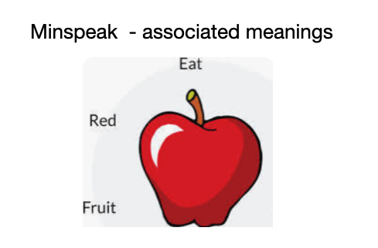
BMW - Minspeak
Image Description: Example of a Minspeak icon.
Notes:
The ‘apple’ is a Minspeak Icon to which you can bring any associations you wish. In the BMW the Minspeak icons were replaced by Blissymbols, but the principle of free and personal associations was applied.

Slide 45
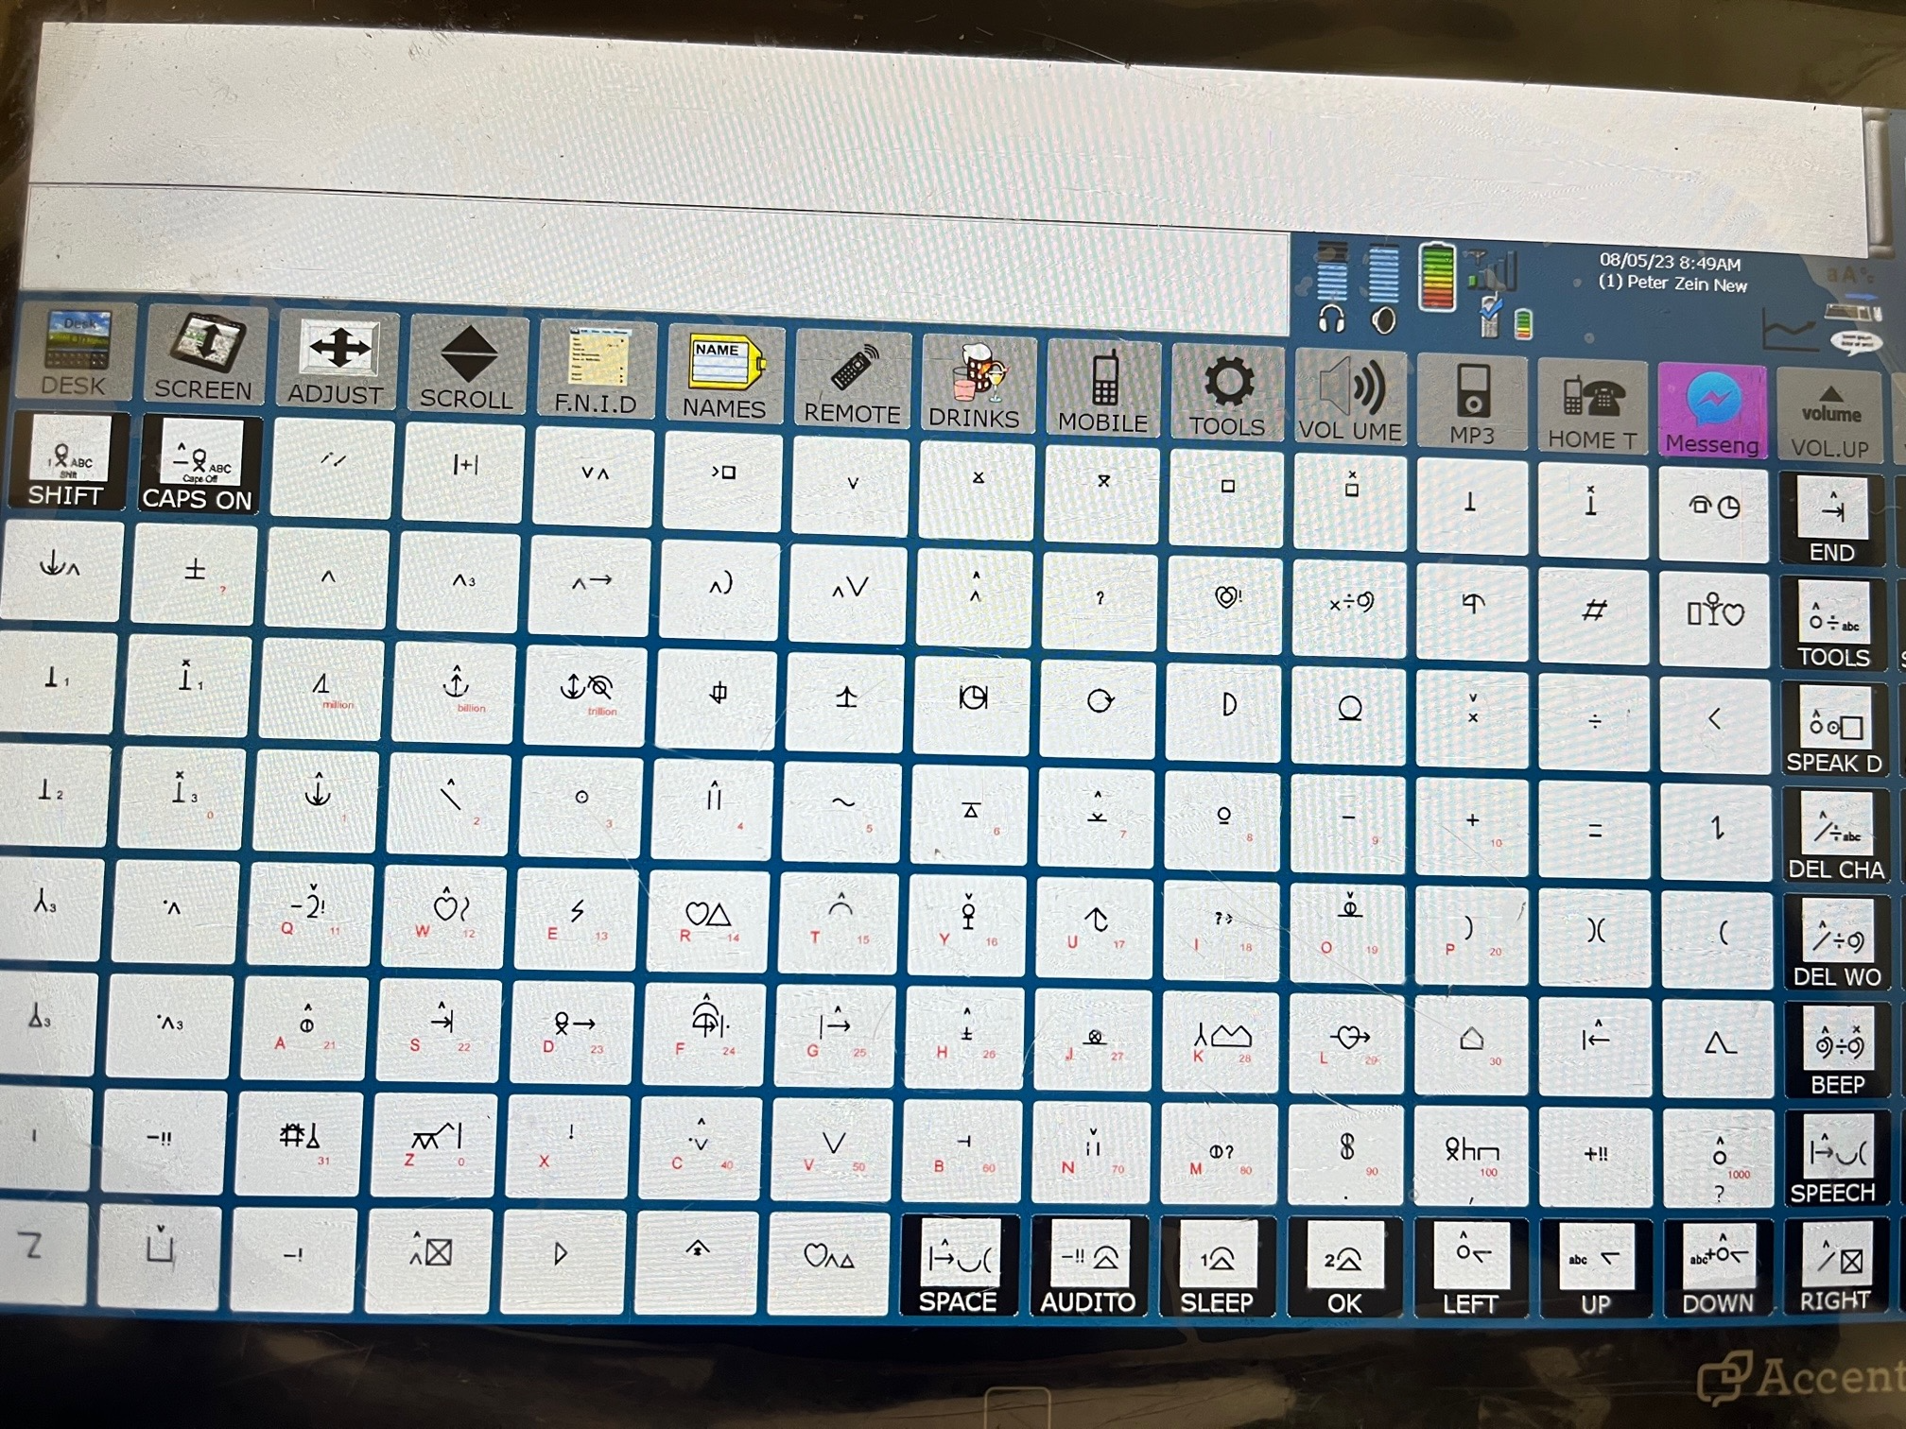
Image Description:
Example of a BMW Display. This display was used by Lee Mehrlich.
Notes:
Here is the BMW display. The Blissymbols are added to the qwerty keyboard layout, to provide a set of Blissymbols that could be utilized in 3-symbol codes to access an unlimited vocabulary. It was designed with and for proficient Bliss users. Today, the BMW is used by Peter Zein of England. Pete is contributing his expertise to the Baby Bliss Project. He plays a strong advocacy role in the Augmentative and Alternative Communication field.
While the coding required in BMW with the technology available in the 90’s, is no longer relevant today, the principles underlying vocabulary retrieval have relevance for today’s AAC technology - Blissymbol language strategies, free association, and the grammar of spoken language of the AAC user’s community.

Slide 46
Question 3
Are there any advances in Bliss in different parts of the world which you would like to highlight? And what is the current state of Bliss in Canada?
46

Slide 47
The unique capability of Blissymbolics
Begin with Communication And you get additional support for :
Language Development
Cognitive Development
Literacy Acquisition
Notes:
In closing, like to look for a moment at the power of Blissymbolics in literacy, language, cognitive and social development.

Slide 48
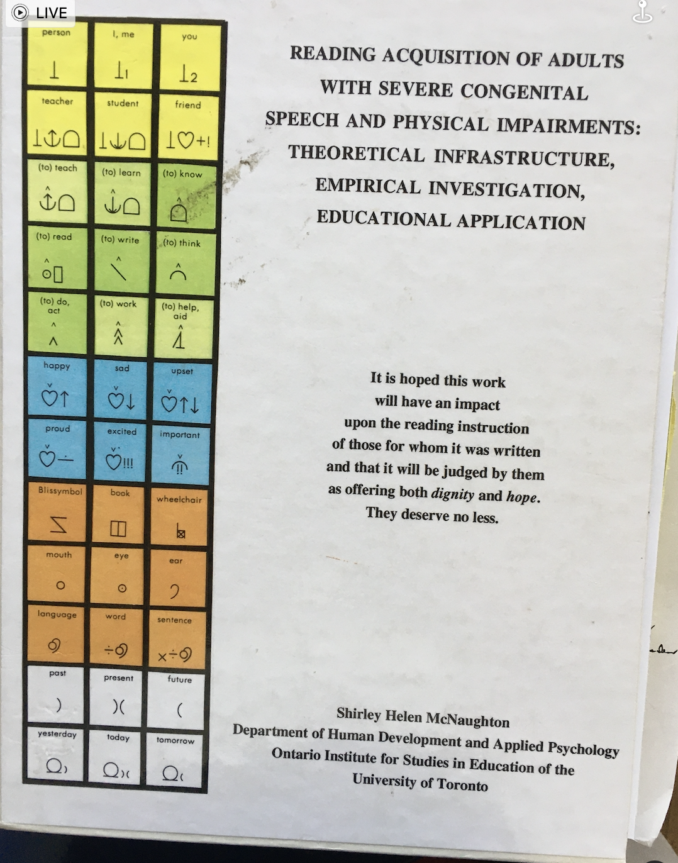
Image Description:
Shirley McNaughton’s Doctoral Thesis (1998).
Notes:
Literacy acquisition is the area that has interested me the most
Thesis
Blissymbolics prepares for print reading beyond sight words through providing analytic experience while reading, writing and spelling with Bliss-words.

Slide 49
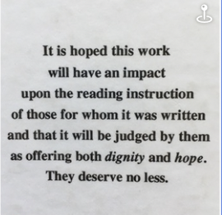
Image Description: The dedication of Shirley’s Doctoral Thesis.
Notes:
For the BBB project I would expand this hope.
To have an impact upon the communication, literacy and inclusion of those for whom the BBB project is taking place.
A few examples:
Today…new applications for Bliss are being explored:
In South Africa, Louisa Alberts is using Bliss to teach reading in English to speaking children from many different spoken language environments
In Norway , Bliss vocabulary is being developed to match the picture vocabulary appearing on technology
In Iceland, Bliss users are meeting with AAC users from Norway and Lithuania, sharing best practices.
In USA Ken Hackbarth has developed an application of Bliss for those with a visual impairment using the 3D printer.
In Sweden In addition to serving as the home of BCI, two programs for producing Blissymbols have been produced - Blissonline and Blissary
In the United Kingdom support is given to Michael Everson in his development of a Blissymbolics unicode character set
In Canada - support is given to the Bliss alumni community through music, vocabulary development meetings and sharing of special events.
In Italy, Blissymbolics is being taught in a University Master’s degree program.

Slide 50
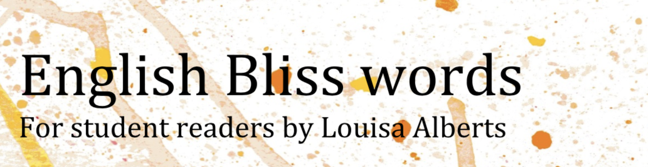
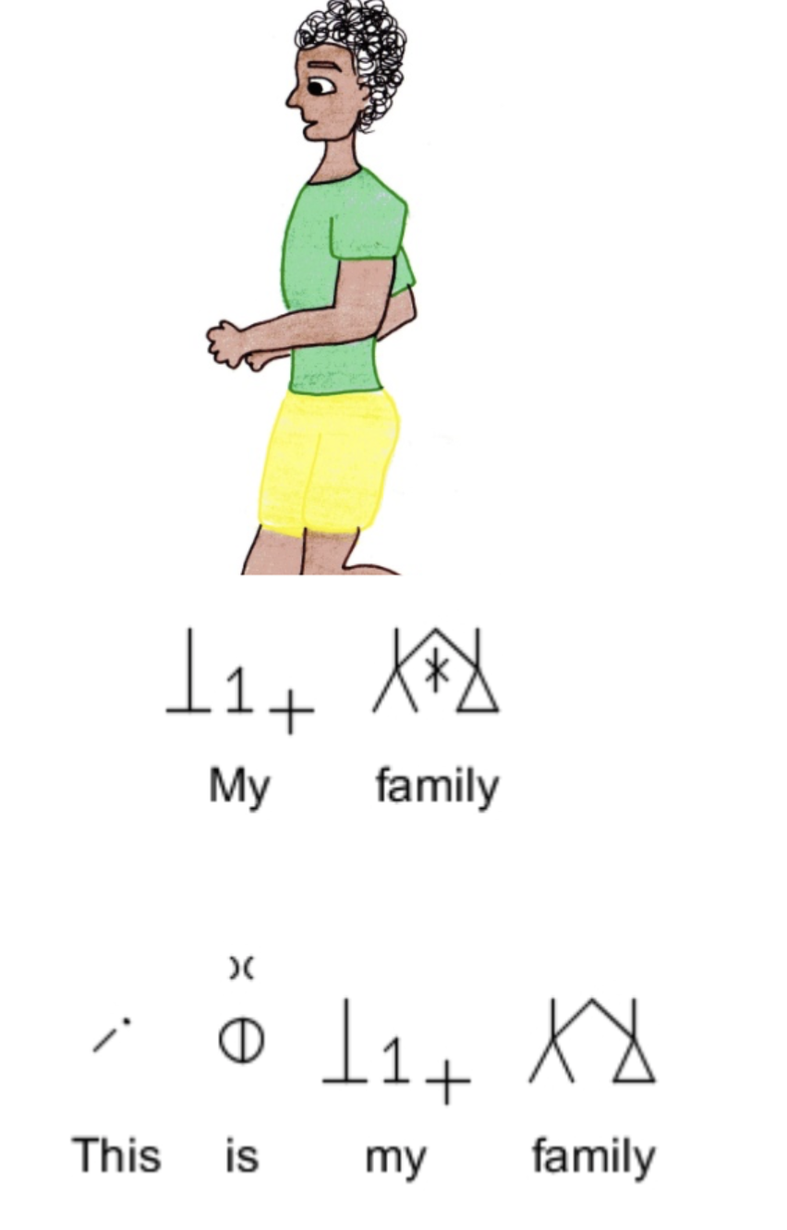
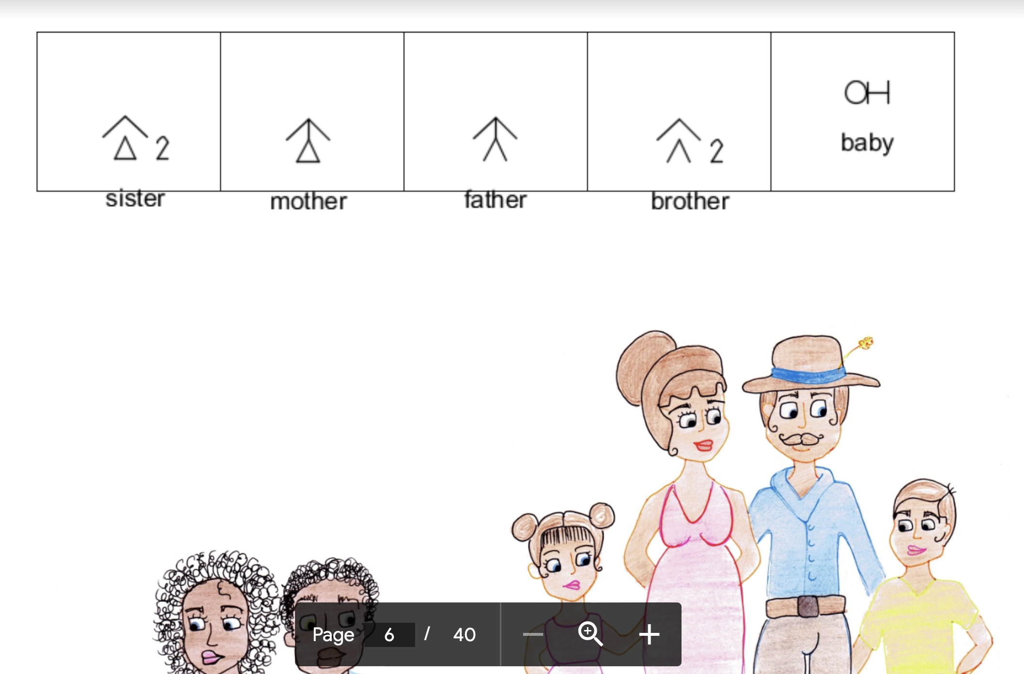
Teaching in Blissymbols
Notes:
A current application of Bliss for literacy that is demonstrating its effectiveness for speaking children is being undertaken by Louisa Alberts in South Africa

Slide 51
Valuable Features of Blissymbolics
Two valuable features of Blissymbolics. For the AAC user:
Bliss words are composed of semantic Bliss characters
A range of strategies can be used to locate and expand vocabulary
Gives the AAC user control & agency !
Notes:
From my perspective the three most valuable features of Bliss….
It is a full language!
There is a semantic foundation for every Bliss-word.
Bliss strategies can be applied to producing new Bliss-words.
Through these capabilities, Blissymbolics supports control and enables agency by the AAC user.

Slide 52
With Blissymbolics language proficiency in one’s spoken language environment, one gains the foundation and opportunity to learn International Blissymbolics and communicate with others in an international community of Bliss users if one wishes.
Notes:
The great importance of Blissymbolics being a comprehensive language in its own right, thus providing the AAC user with a rich language experience… It offers not only a resource for the application of Bliss in AAC, but also the opportunity to participate in an international use of Bliss when one has gained proficiency in communicating within one’s immediate environment.

Slide 53
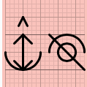













Design for Communication Companion
Kevin
David
Rebecca
Olga
New
acquaintance
Kevin
Notes:
My dream for the future with AI supporting the AAC use of Blissymbols … providing the best communication companion AI can offer
I am using circles, just as one possible way of conceptualizing the future individualized, dynamic arrangement and means of selecting and producing vocabulary. BBB is exploring many different ways.
One proceeds through providing context and a set of strategies, choosing the beginning question, refining one’s meaning… COMMUNICATING!
As Jutta Treviranus would say… “the mad escape from The Grid”
AI has the potential for many positive benefits to the AAC user. We need to guard against the possible negative effects.
By giving time to the positive support as the Baby Bliss Bot is doing, AI offers the potential for being a consistent personalized communication companion for those who are non-speaking and require AAC to achieve communication competence..
AI can retain and apply past experience.
AI can grow, guided by the user and assuring them agency.
AI can be personalized.
AI can remain with and grow with the individual throughout their life.
The role of human support is critical, to ensuring AI provides the positive! We need to remember a song made popular by Bing Crosby, many decades before we had AAC, AI or inclusive design!
You got to ac-cent-tchu-ate the positive
E-lim-i-nate the negative
And latch on to the affirmative
Don't mess with Mr. In-between
You got to spread joy up to the maximum
Bring gloom down to the minimum
And have faith, or pandemonium
Liable to walk upon the scene

Slide 54
If you want to learn more about Blissymbolics, you can go to:
https://archive.org/details/blissymbolics,
blissymbolics.org
blissymbolics.ca
Mr. Symbol Man (YouTube)
Celebrating 50 Years of Bliss (YouTube)
Prelude to ISAAC (YouTube)

Slide 55

THANK YOU

