Slide 1
Collaboration Skills and Strategies for Accessibility
Lainey Feingold | LFLegal.com
Accessible Canada - Accessible World Gathering
Streams: Inclusive decision-making | Innovation in standards and policy | Accessible and equitable communications
May 27-28, 2024

Slide 2

Why Collaboration?
Room for | focus on disabled voices
Development of accessibility regulations, plans, statements
Relationship building for long term implementation
Dismantle fear | Build trust
Accessible procurement

Slide 3
Structured Negotiation
Disability Rights Collaboration in the United States

Slide 4
Cooperation…without lawsuits or regulations
Talking ATMs
Accessible websites
Accessible mobile apps
Accessible pedestrian signals
Accessible prescription labels
Audio description
Rights of incarcerated disabled people
Resources:
LFLegal.com
Book: Structured Negotiation, a Winning Alternative to Lawsuits (2nd edition 2021)

Slide 5
How does it work?

Slide 6
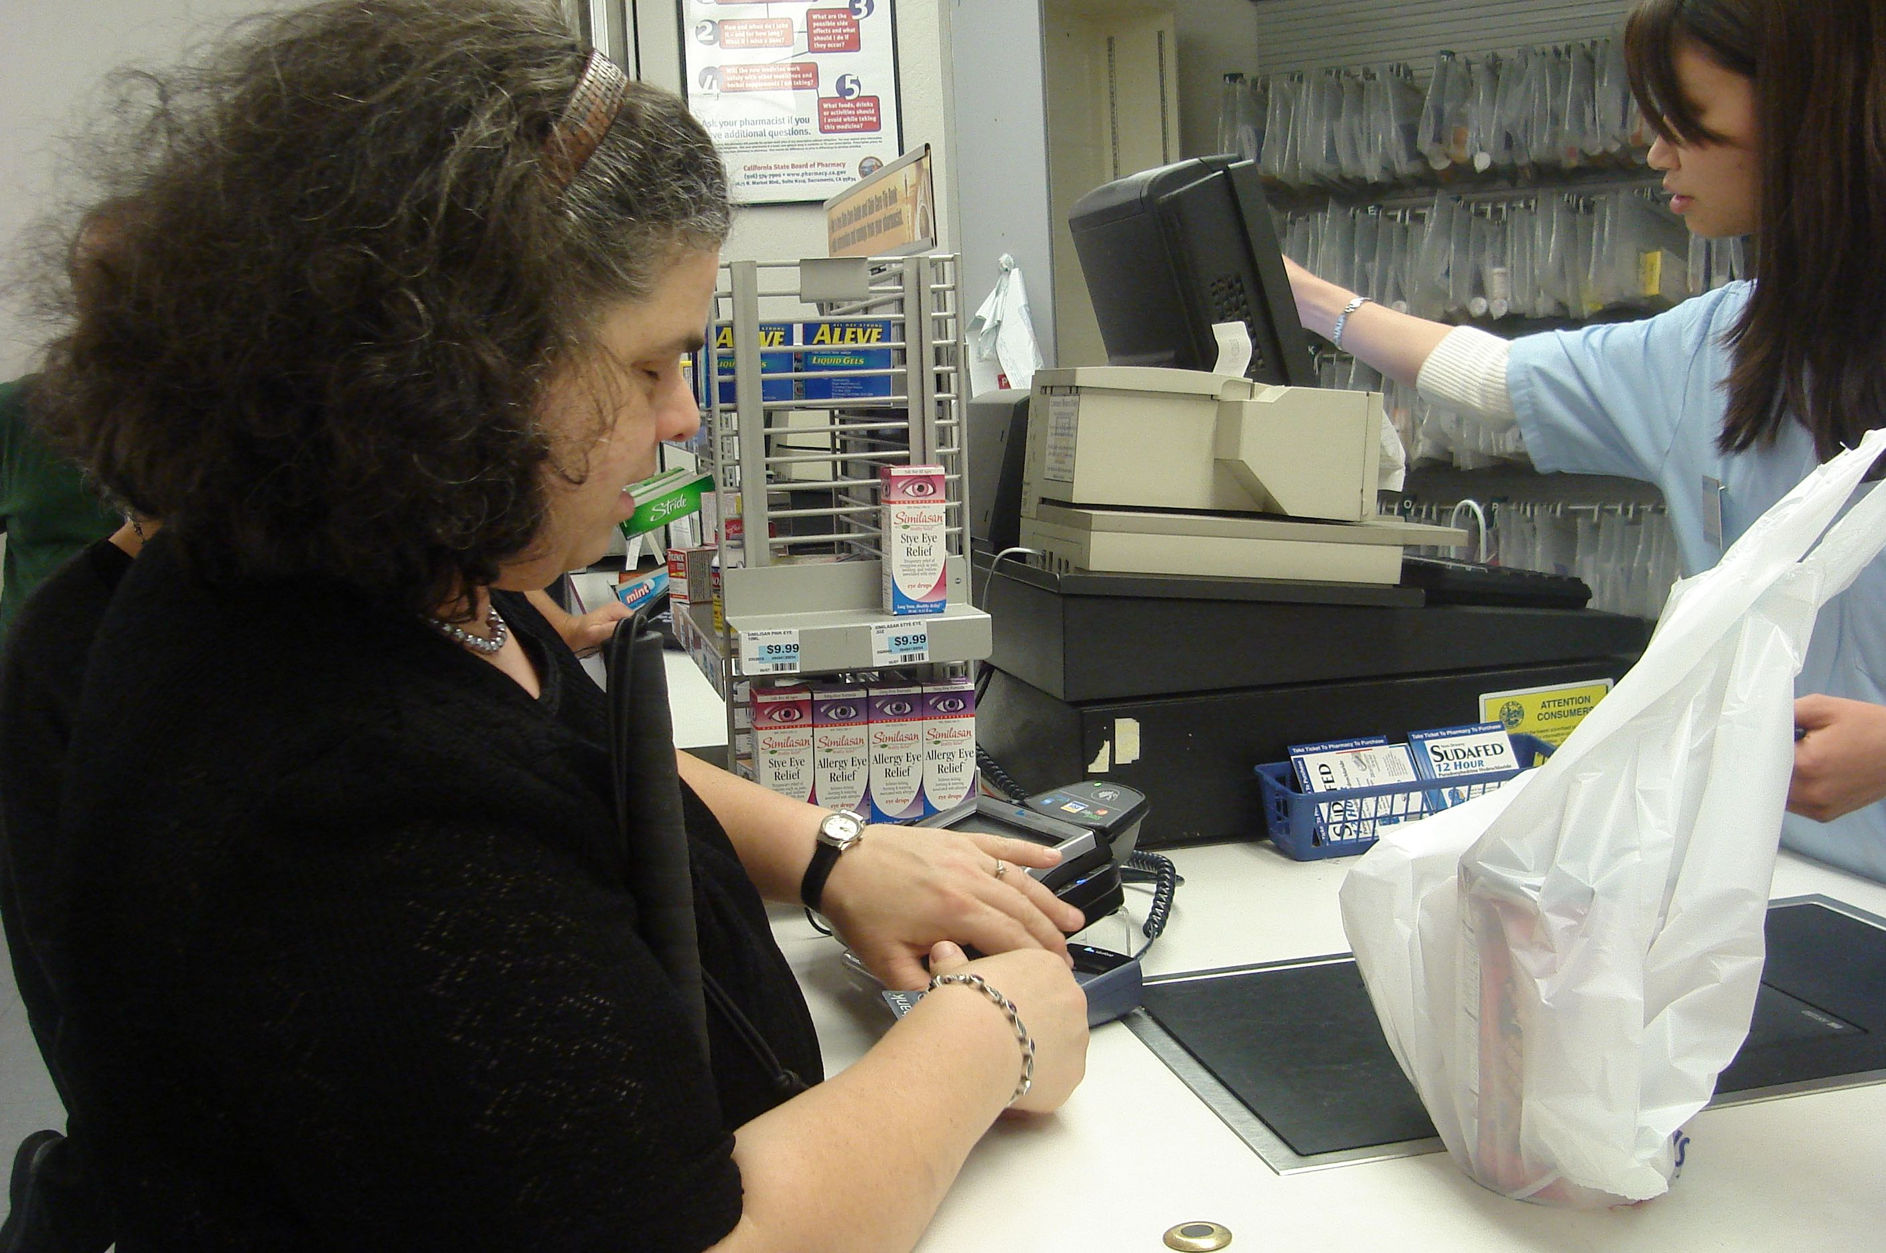
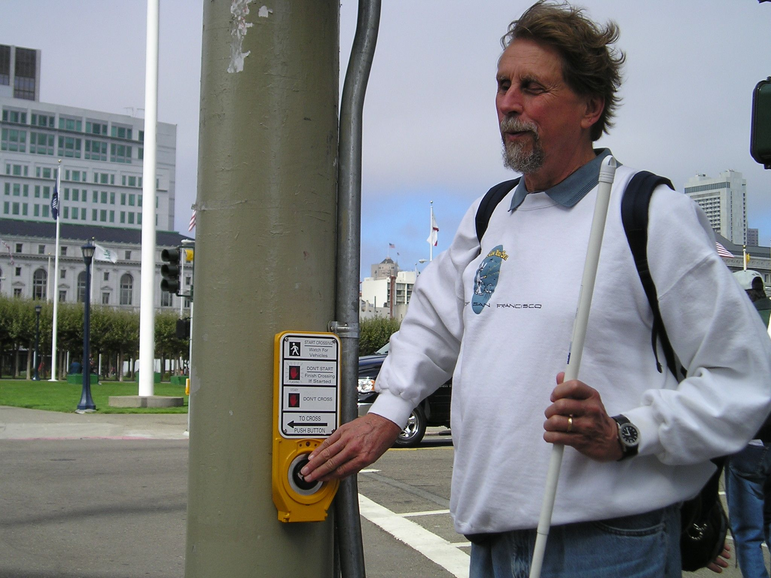
Disabled people are involved

Slide 7
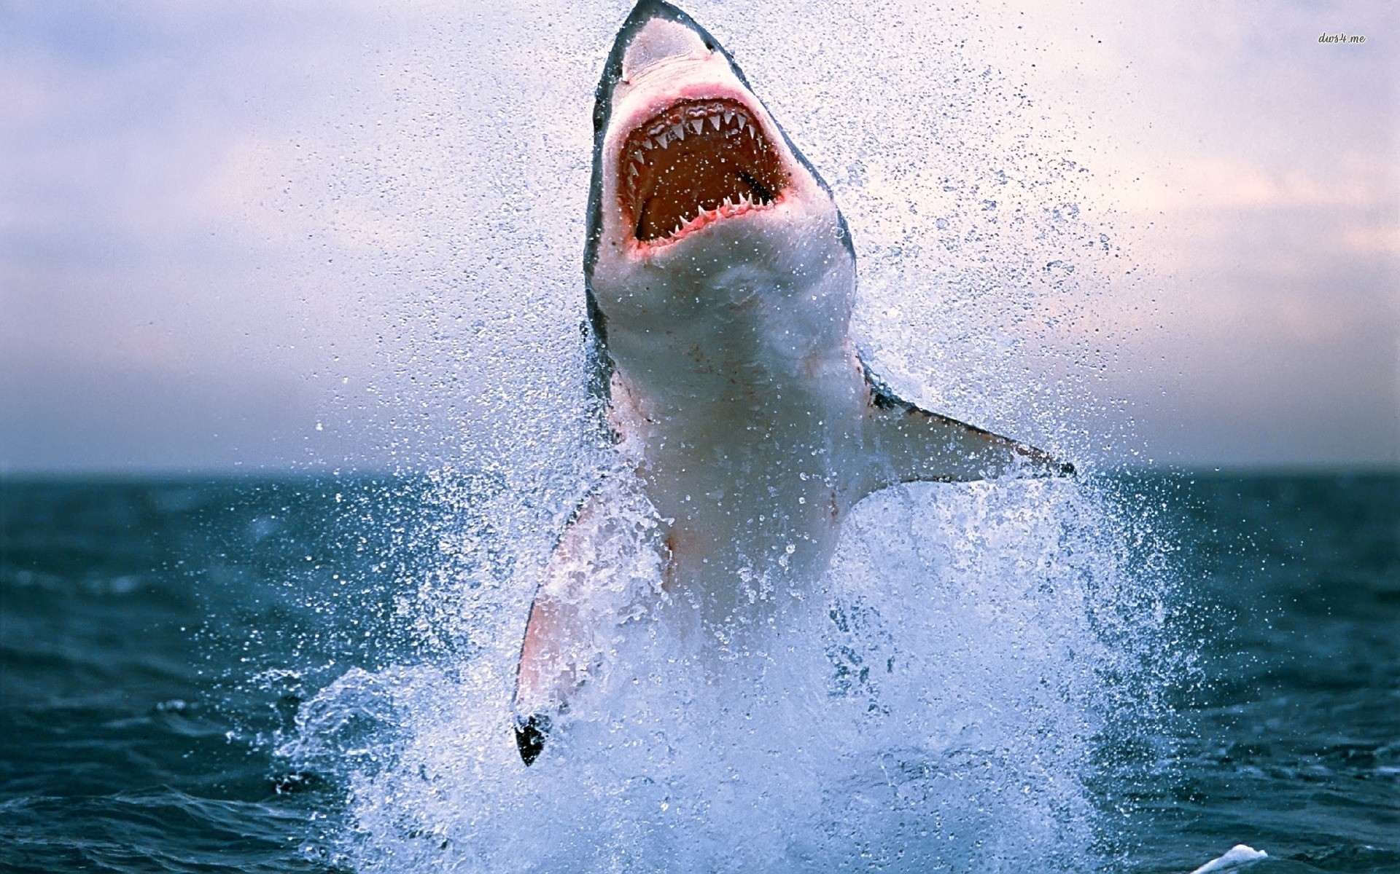

Attitude (Mindset) is Crucial
x
Don’t be a Shark

Slide 8
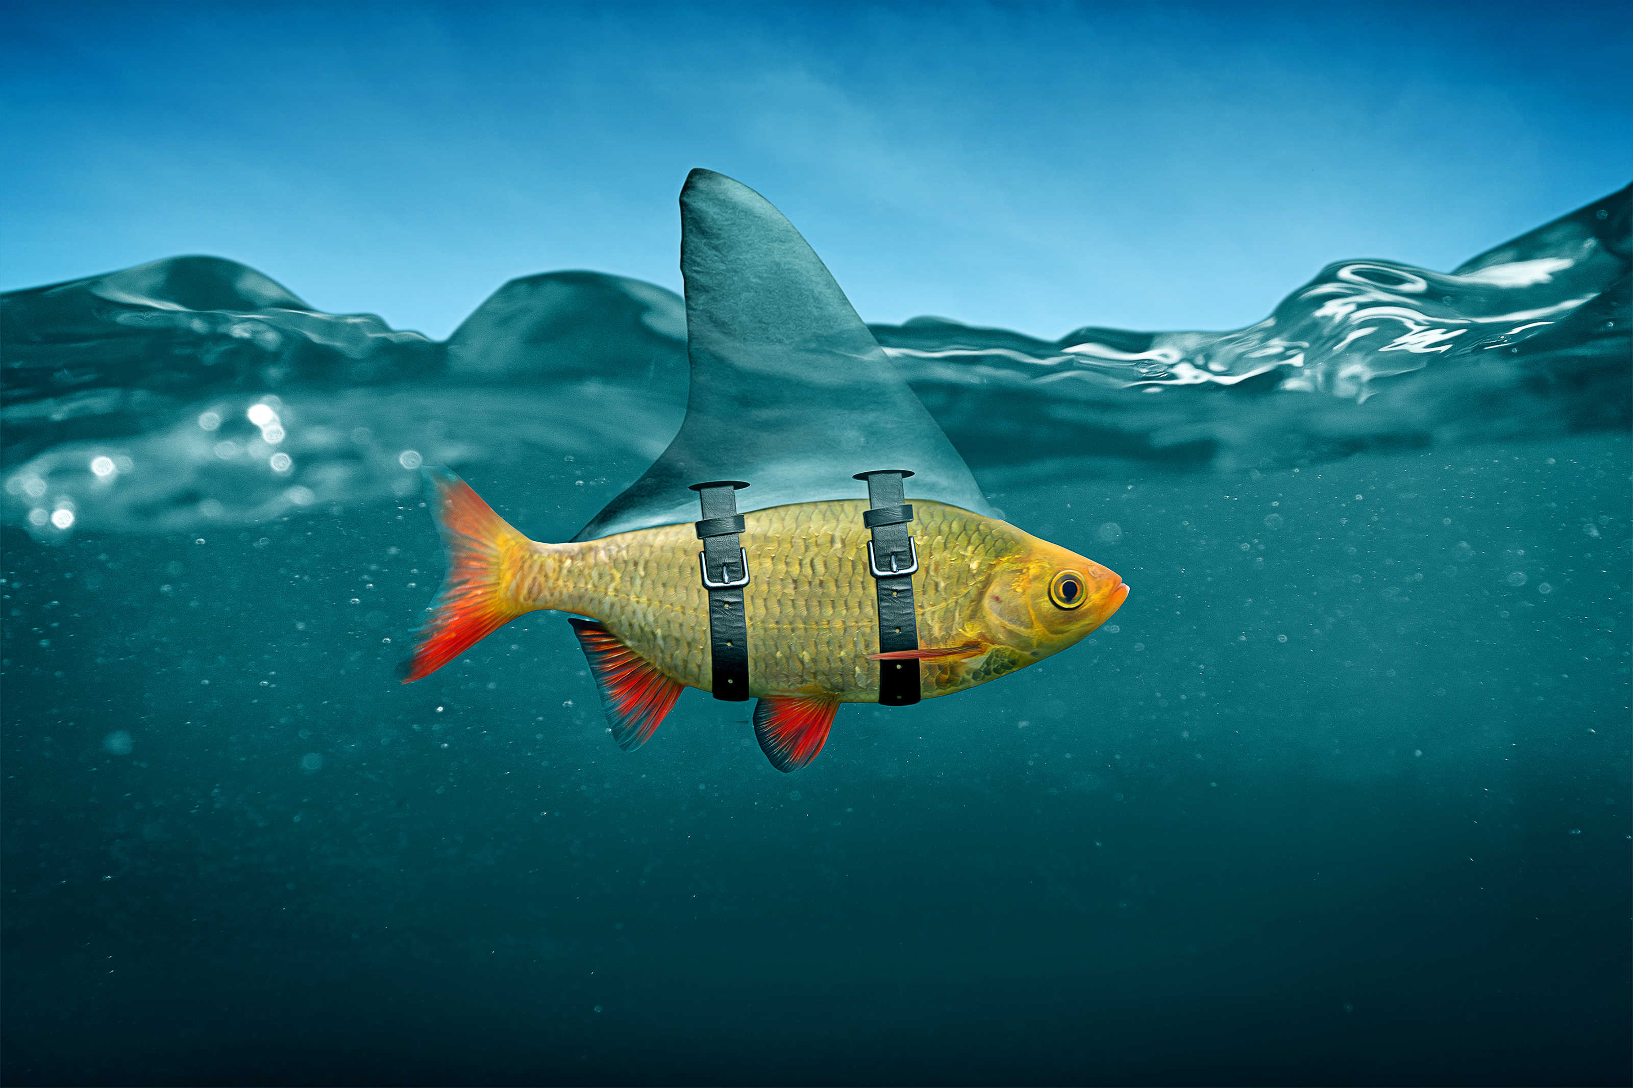
You don't need to act like a shark
x

Slide 9
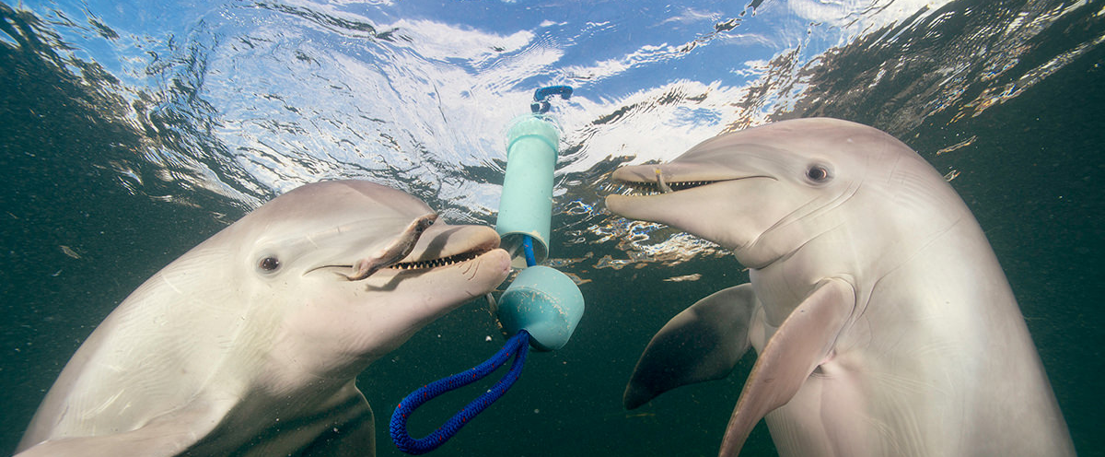
Be a dolphin instead

Slide 10
What are Dolphin Skills?

Slide 11
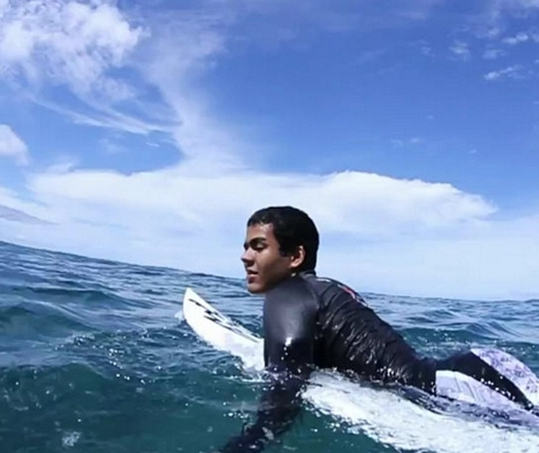
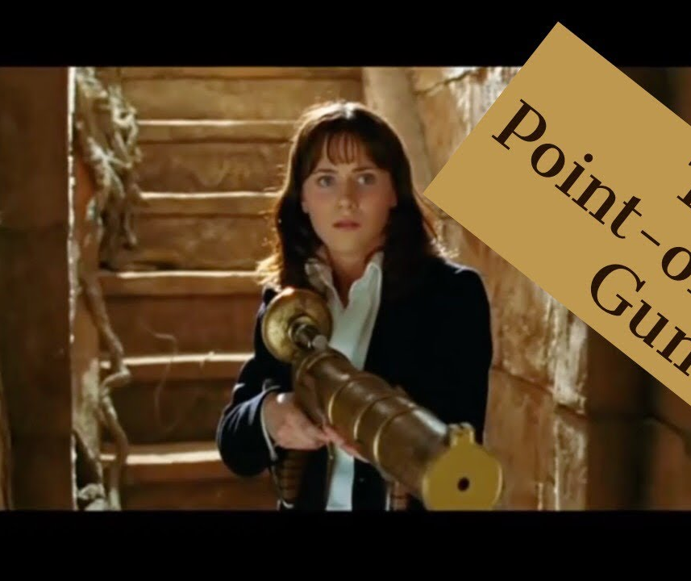
Active patience | empathy

Slide 12


Don't make assumptions | Explore fear
Notes:
"Fear is the path to the Dark Side. Fear leads to anger, anger leads to hate, hate leads to suffering.”
-- Yoda (The Phantom Menace)

Slide 13
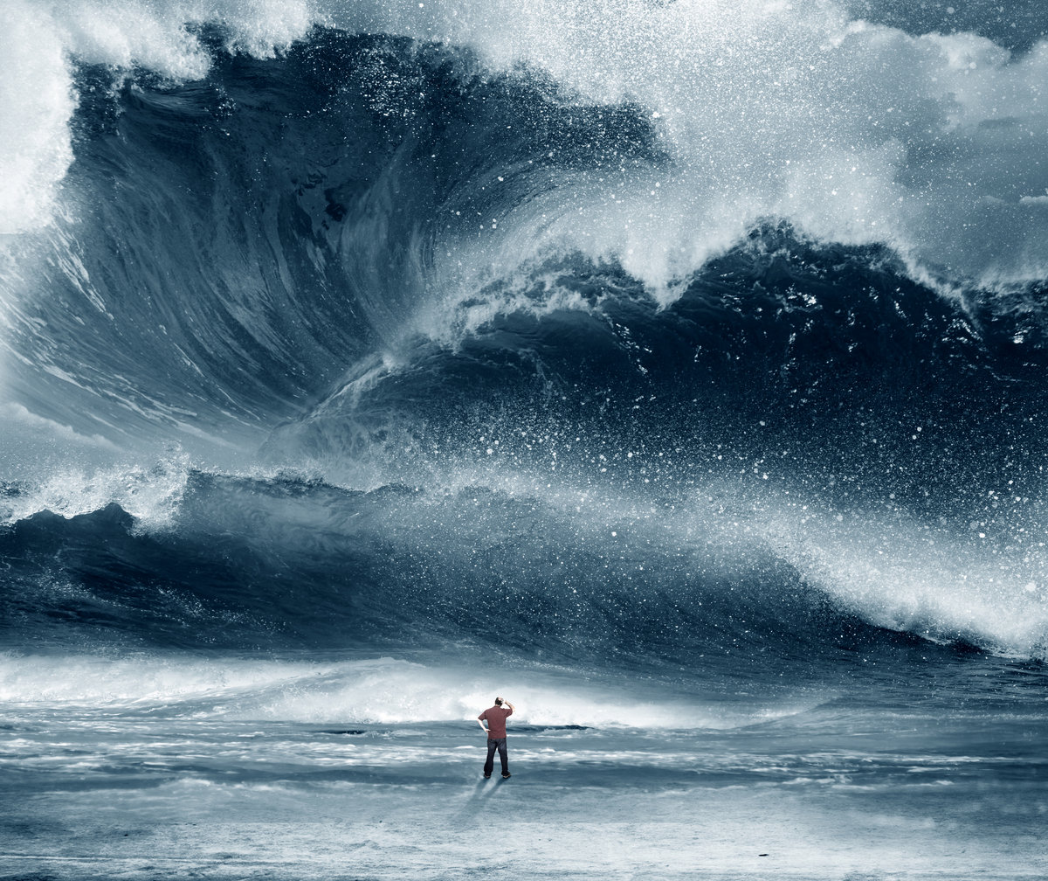
Find the "yes” | Practice equanimity
"I stood on a mountain of no for one yes”
--B. Smith
13
Notes:
"I stood on a mountain of no for one yes”
--B. Smith

Slide 14

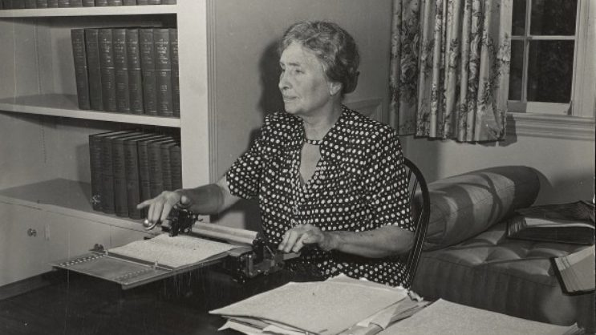
Listen Well | Practice Grounded Optimism
“Optimism is the faith that leads to achievement. Nothing can be done without hope and Confidence.”
----Helen Keller

Slide 15

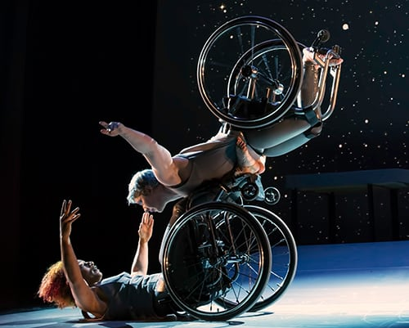
Be Kind, Curious, and Flexible
Notes:
Two wheelchair dancers in motion; one woman on the floor and another with her body on top of the wheels on the floor. Image is a still from Alice Sheppard & Kinetic Light’s performance titled Descent

Slide 16
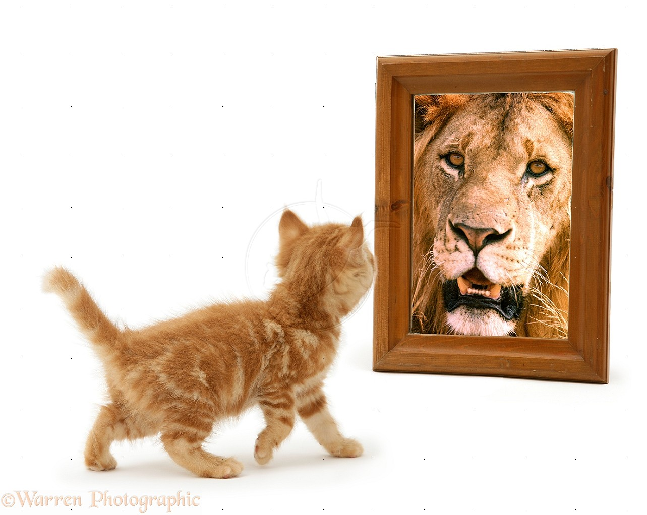
Find the Lion
Who are you talking to?
How are you speaking to their needs?
  Hint: you don’t have to agree!
How are you building trust + relationship?
How are you moving to your goals?

Slide 17
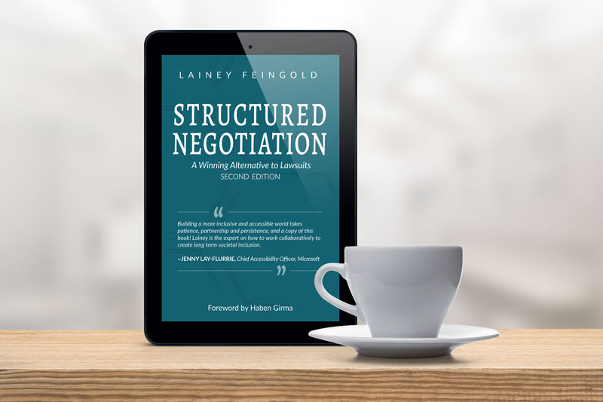
Stay in Touch!
Lainey Feingold
LFLegal.com
LF@LFLegal.com

