Slide 1

Welcome Everyone

Slide 2
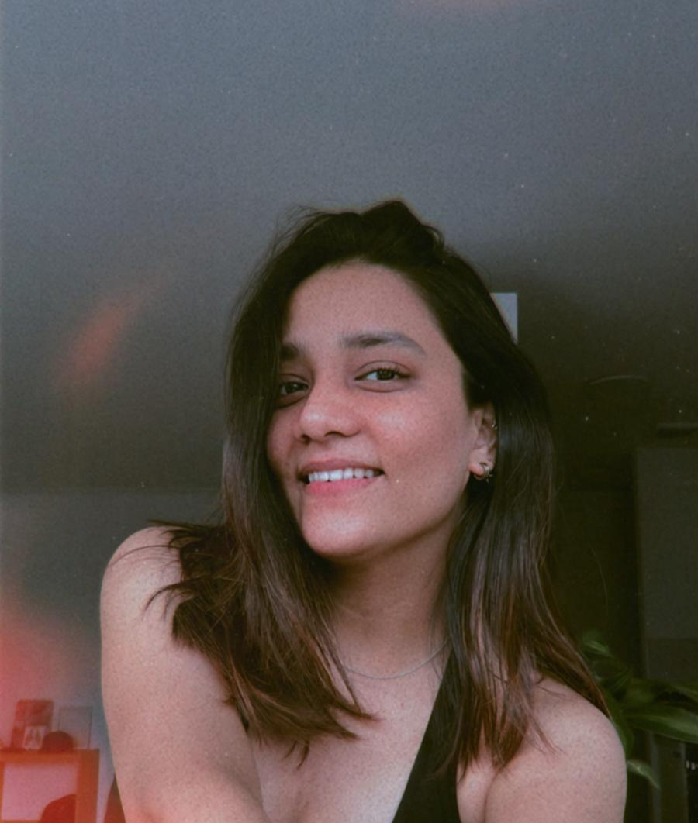
About ME
SAEE S. TIPNIS
I am a Graphic Designer & Illustrator from India.
Interested in: Illustration, Co-Design, Accessibility
Master's Student at Ontario College of Art & Design University (OCAD)

Slide 3

“Life is a journey not to miss,
I am reaching out and following my bliss”

Slide 4
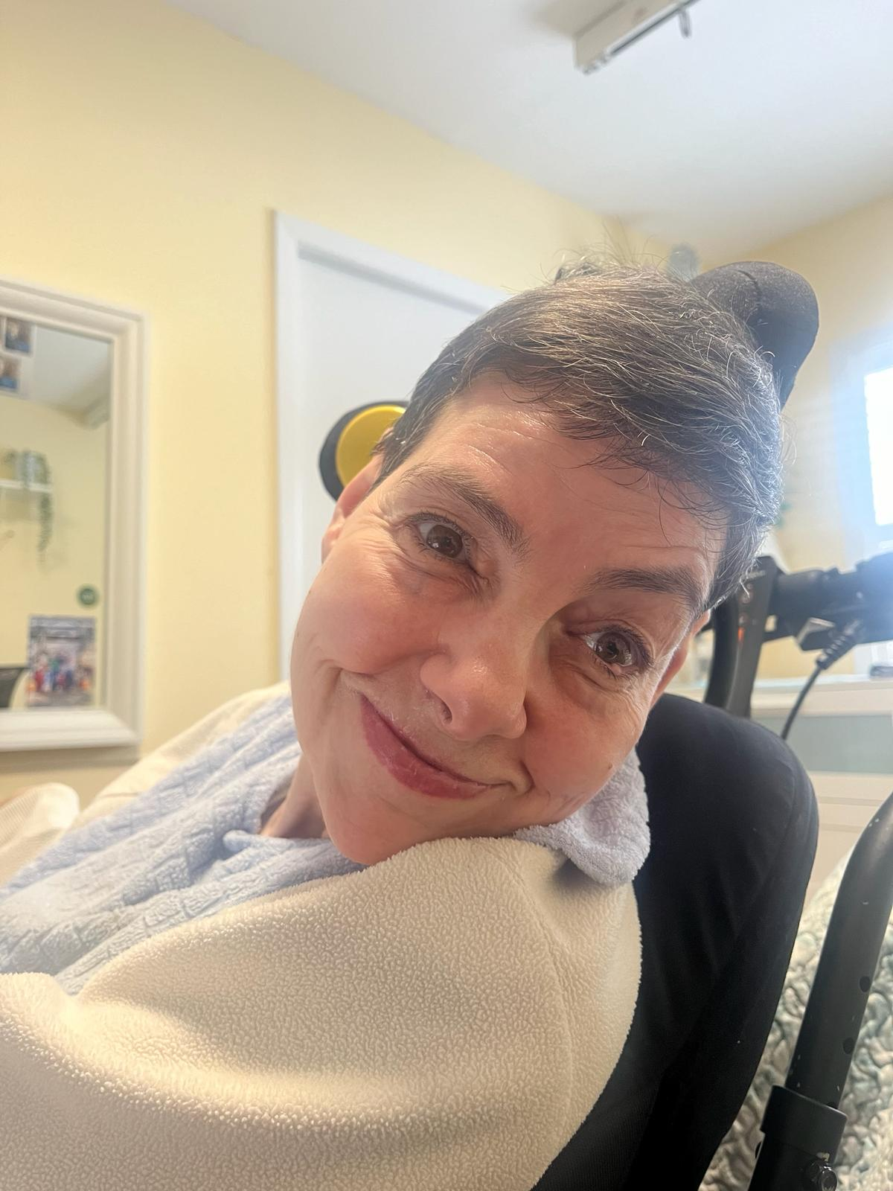
Christine Jeminez
From Hamilton, Canada
Loves to watch television drama
A fan of Bobby McFerrin’s song,
“Don’t Worry, Be Happy”

Slide 5

Bliss I-Band
Blissymbolics
The Bliss I-Band is a group of adults
with physical disabilities who get
together weekly to explore the
possibilities of making music with
virtual instruments.
Bliss I-Band
Welcome Everyone

Slide 6

Cerebral Palsy
It is the most common motor disability
in childhood.
It is caused by abnormal brain development or damage to the developing brain.
The management is multidisciplinary
involving the treating physician working with a team of rehabilitation-, orthopedic-, psychologic-, and social care- providers.
“A group of disorders that affect a person’s ability to move and maintain balance and posture.”
(Centers for Disease Control and Prevention)

Slide 7
Major Research Project
Exploring the Power of Co-Design :
From Music-making to Achieving a Sense of Agency
Primary Advisor : Jutta Treviranus

Slide 8
Music &
Cerebral Palsy
In intervention studies involving persons with
mobility limitation it was observed that the
use of music and rhythm programs :
Activated the motor and auditory system,
Improved balance and tactile sensations,
Enhanced mental health conditions.

Slide 9
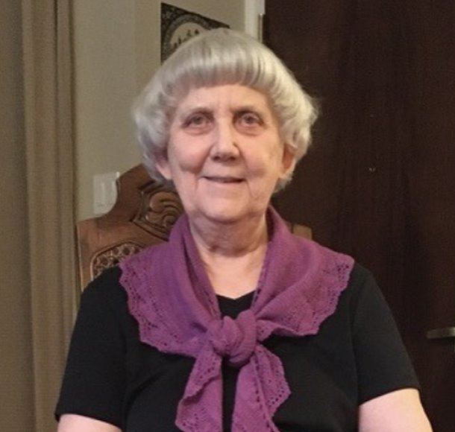
Shirley
McNaughton
Shirley is a special educator who has been
teaching, first children and then
adults with cerebral palsy since 1968.
In 2014, Shirley extended the use of i-Pads
to adults with disabilities and served as
music director in Year One to the Bliss I-Band.
Purpose :
Increase community awareness with respect
to the abilities of these individuals through
demonstrating their musical accomplishments!

Slide 10
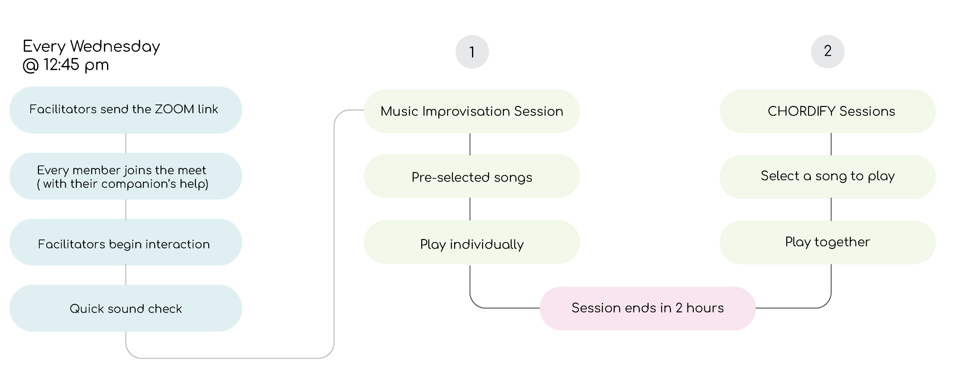
Weekly Music Sessions

Slide 11
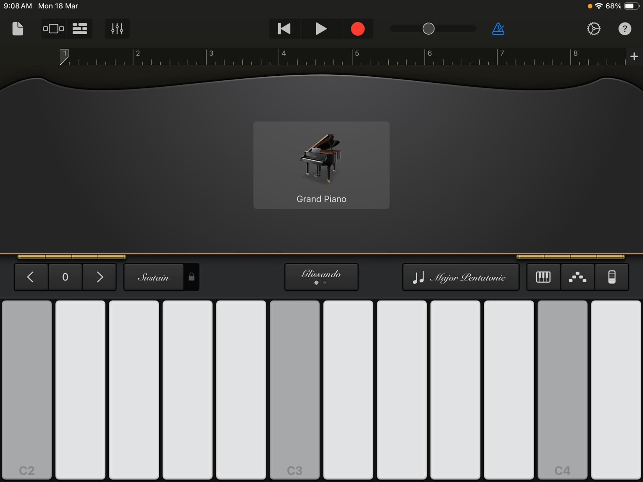
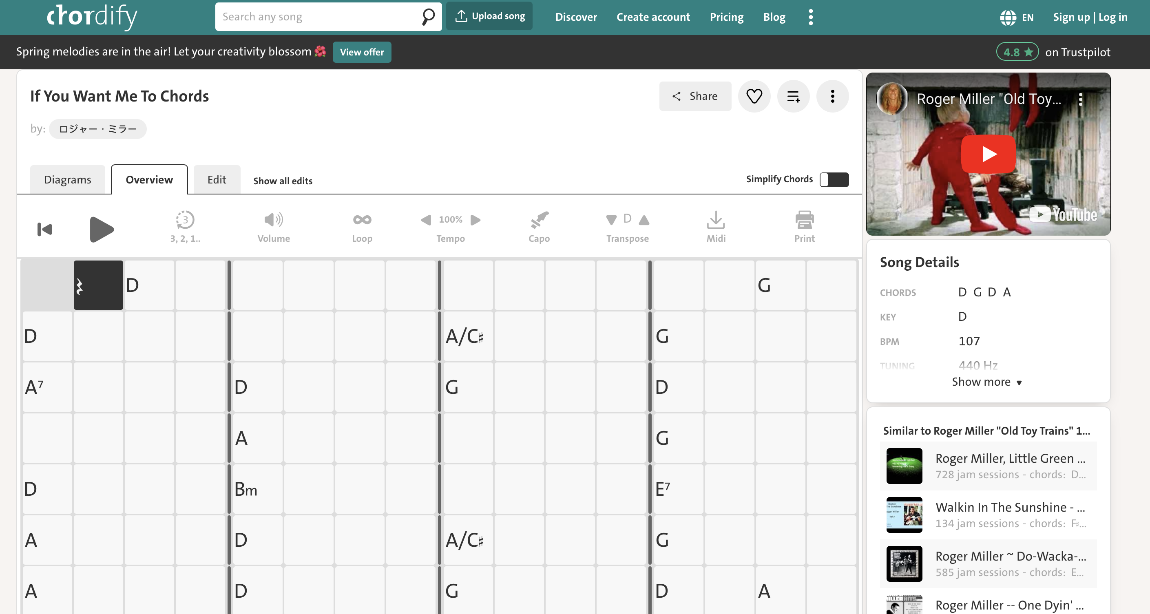
Interface Use
Chordify Screen
GarageBand Interface

Slide 12
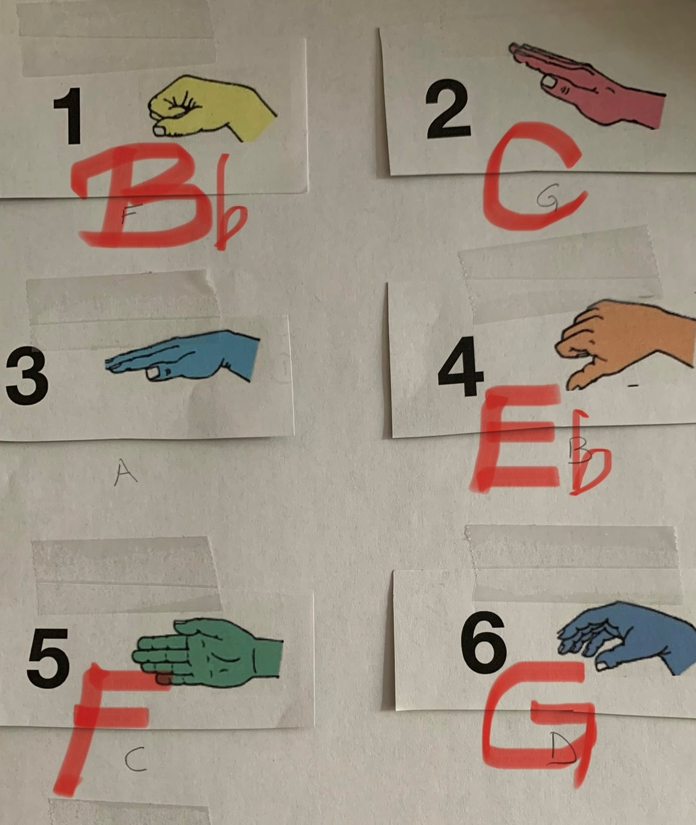
Signing Sheet
To the left is a Signing Sheet.
It has all the chords of a song written below the signs and numbers.
For example: The chord number 1 has Bb (Chord of B flat) with the hand illustration of the sign, " DO"

Slide 13
Identifying Gaps
Through an observer’s lenses
No previous experience of care giving
Challenges faced while training
Being Over-helpful
Fear of Miscommunication

Slide 14
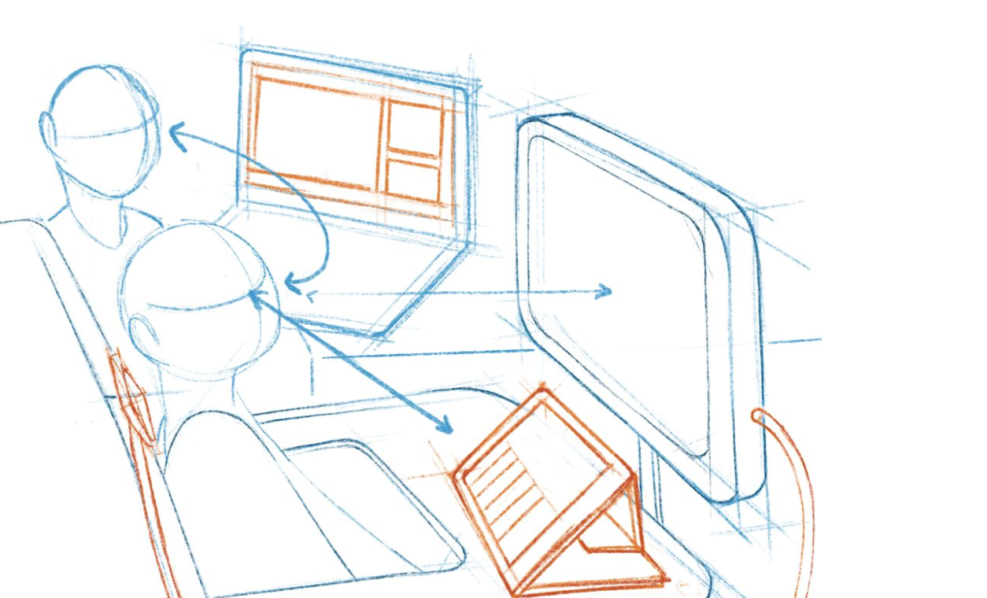
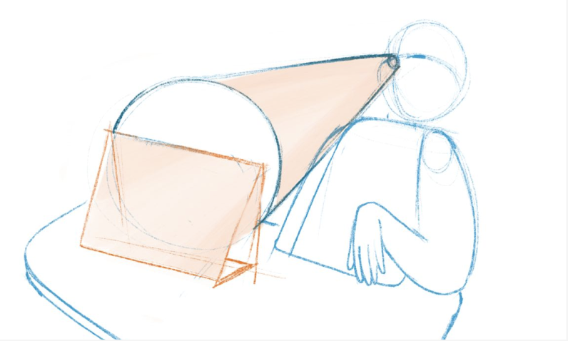
Factors Hindering Agency
Christine's Cone of Vision is limited to her i-pad screen.
Sketch of Christine's Musical Setup.

Slide 15

Addressing Challenges
TECHNOLOGICAL
Co- Design with the I-Band member,
facilitators and other music companions
to make the process of music making more accessible.
Cultivate within the I-Band members, the
importance of having a Sense of Agency.
STRUCTURAL
COMMUNICATIVE

Slide 16
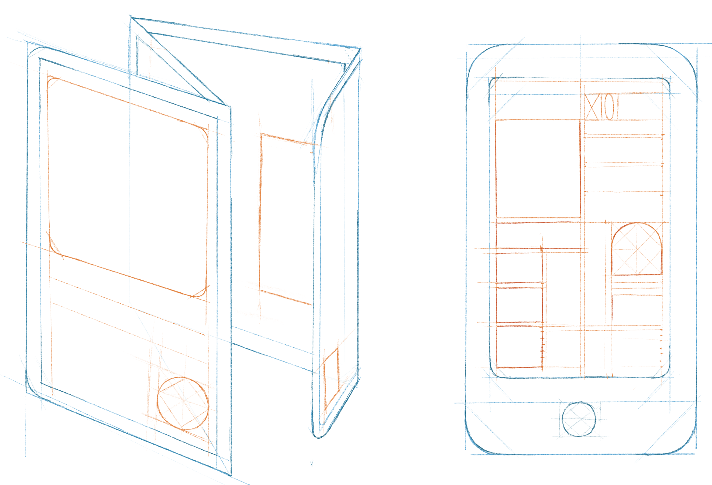
Infographic Guide
AIM: To provide present / future companions with the basics of Chord Signing, GarageBand, Chordify. Give ways in which they can support the I-Band members in this musical journey.
APPROACH: Inclusive Design Approach, Co-design with the I-Band members, facilitators, companions
All participants are Co-designers
METHODS: Observation, One-on-one Interviews
Co-design sessions
Sketch of the infographic in print and digital format.

Slide 17


Design Process
Icon Set Inspired from Musical Notes
Iconography
I-Band Members - Play music
Facilitators - conduct every I-Band session
Companions - support I-band members
Universal Icon for Persons with Disabilities.
Icon representing persons with Cerebral Palsy.

Slide 18
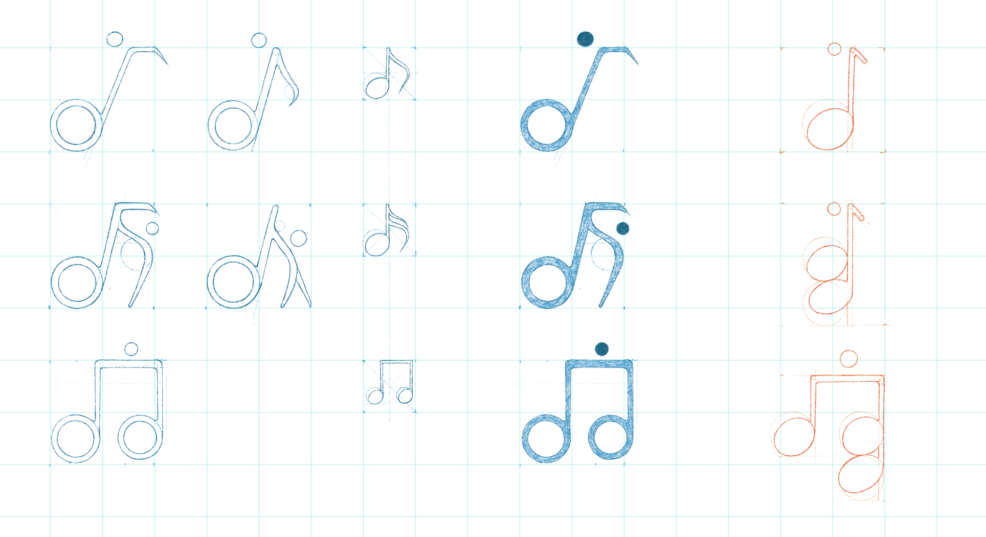
In process sketches

Slide 19
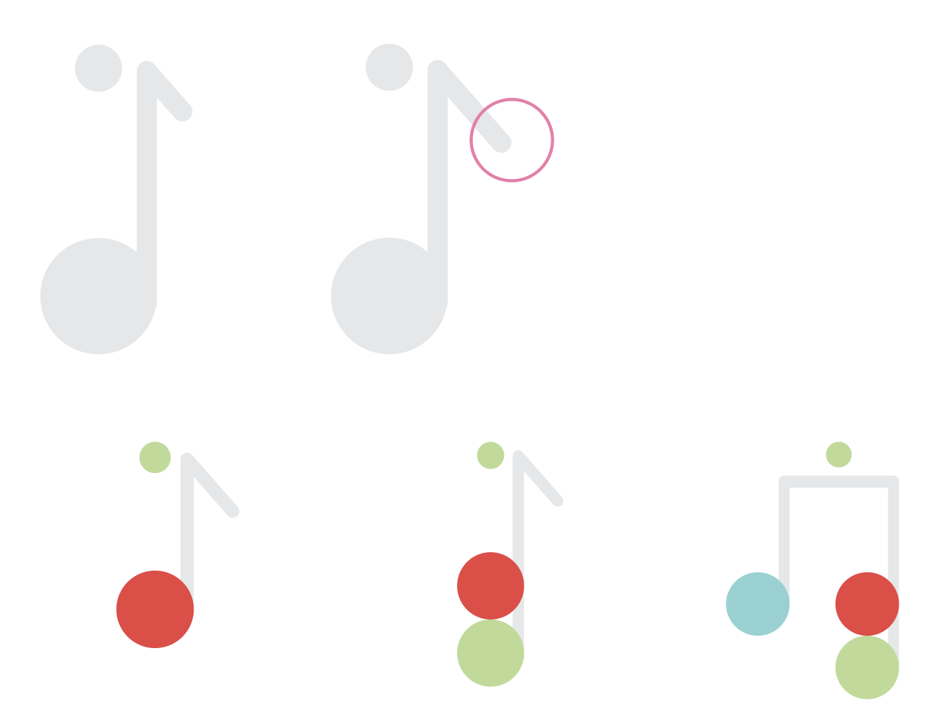
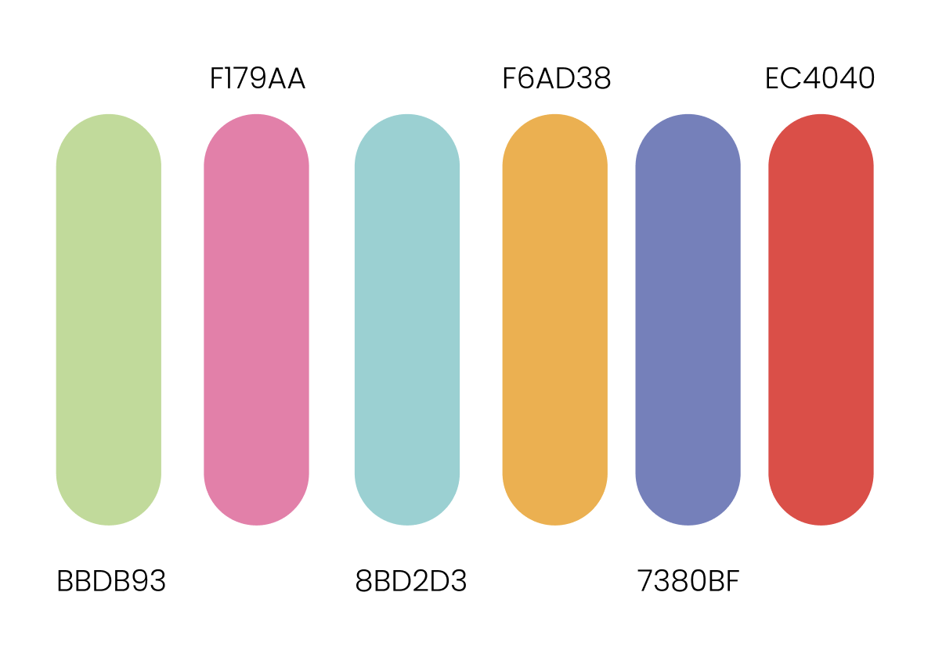
Digital Renders and Colours
Choice of Colour Palette :
Some individuals may be more sensitive to colour. This is because they have increased sensory responses, stronger visual processing abilities and differentiated cognition pathways.
Icon for : I-Band Member, Companion and Facilitator

Slide 20
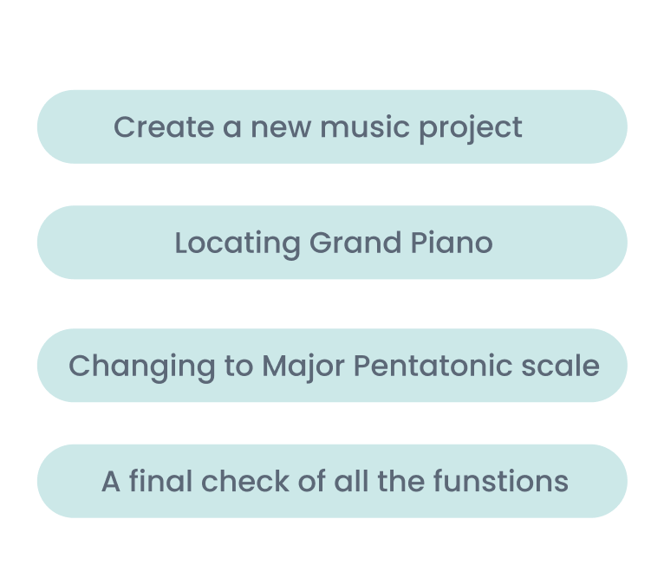
Simplifying Process
Setting a virtual musical instrument
(Grand Piano) on GarageBand

Slide 21
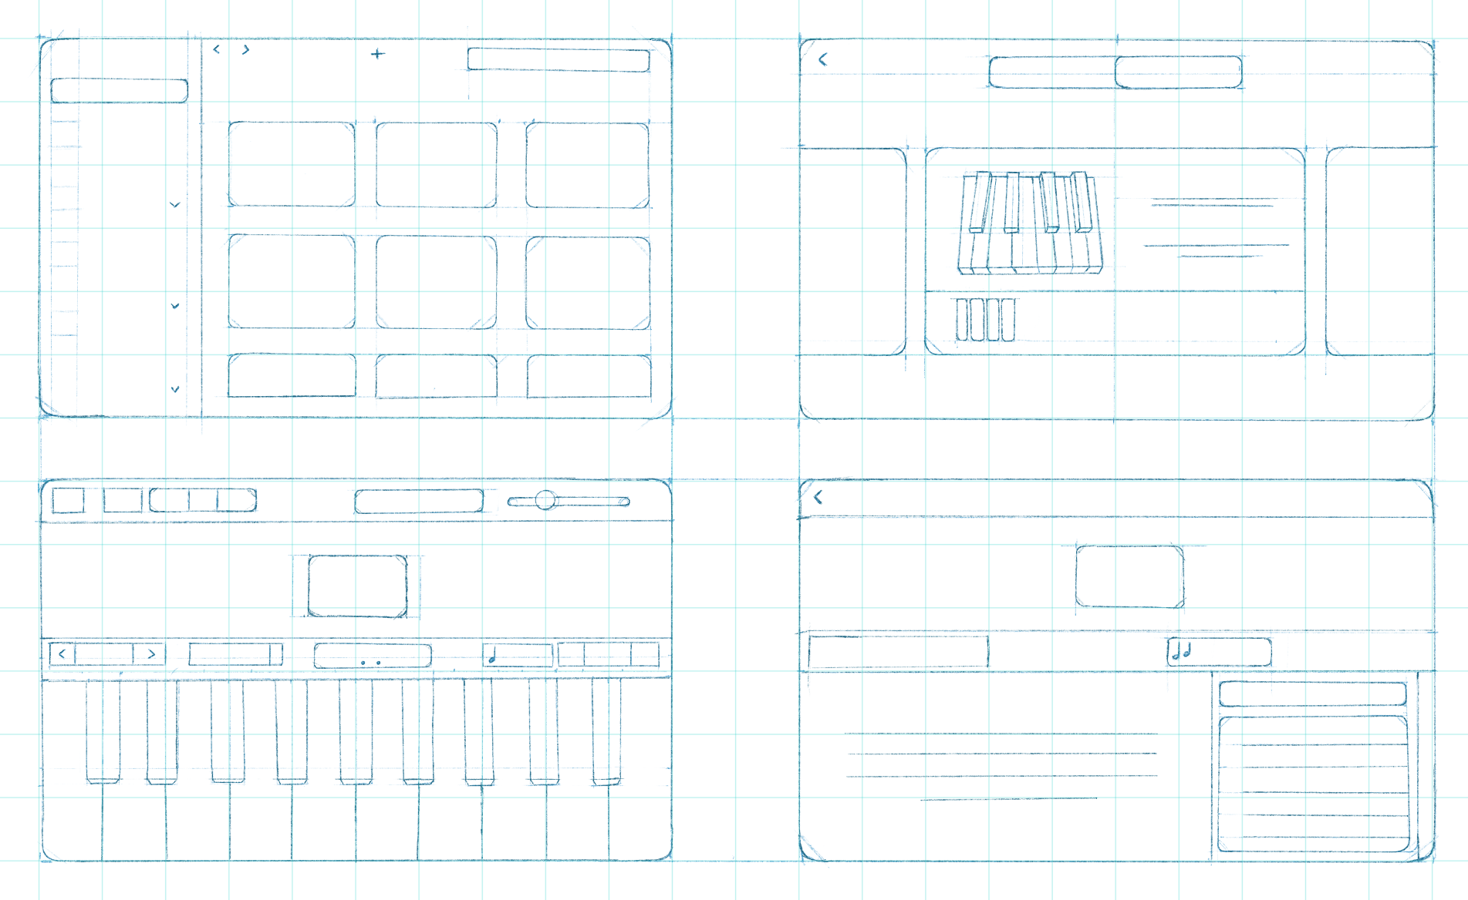
Sketches

Slide 22

Step 1: Make a new 'Music Project' on Garage Band.

Slide 23
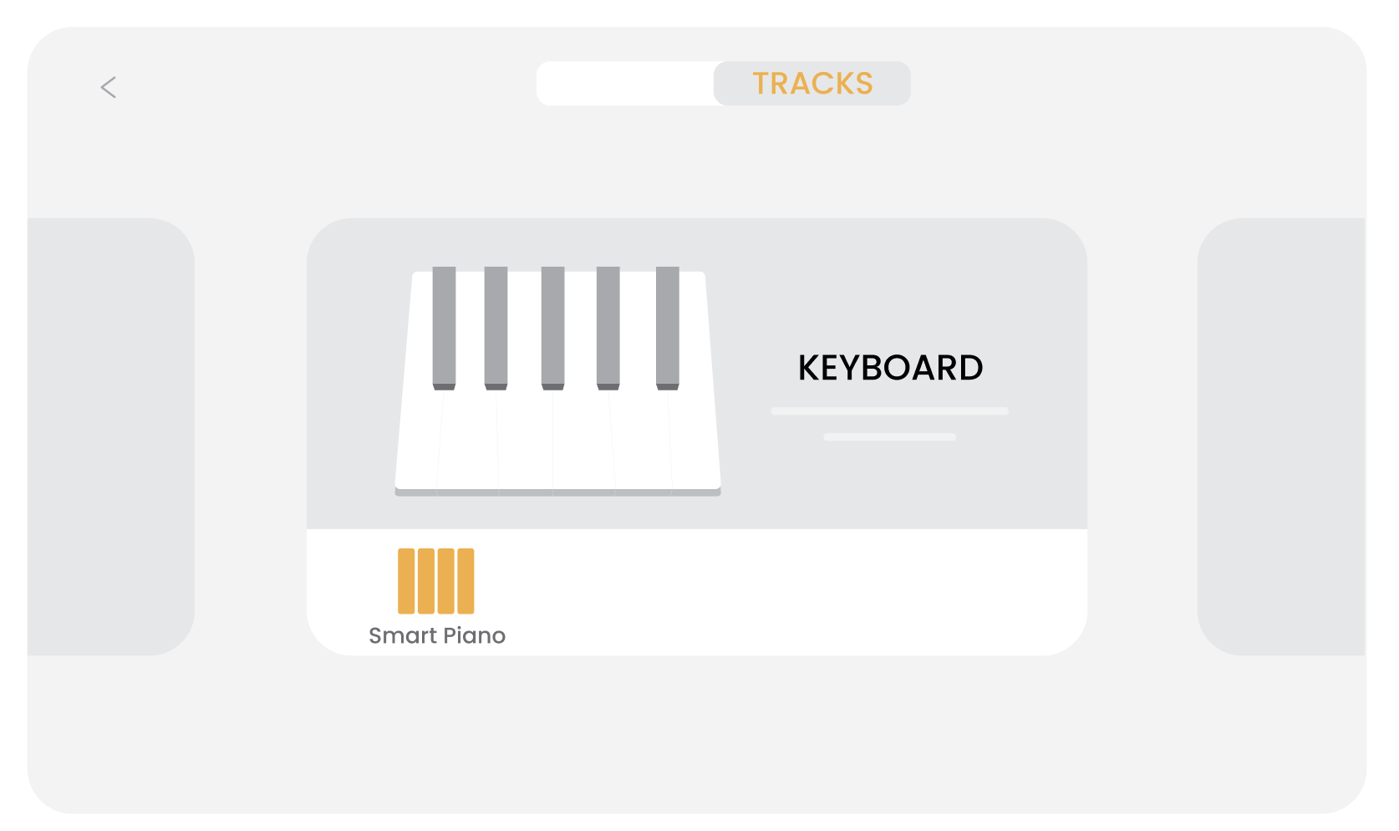
STEP 2 : Selecting the Grand Piano

Slide 24
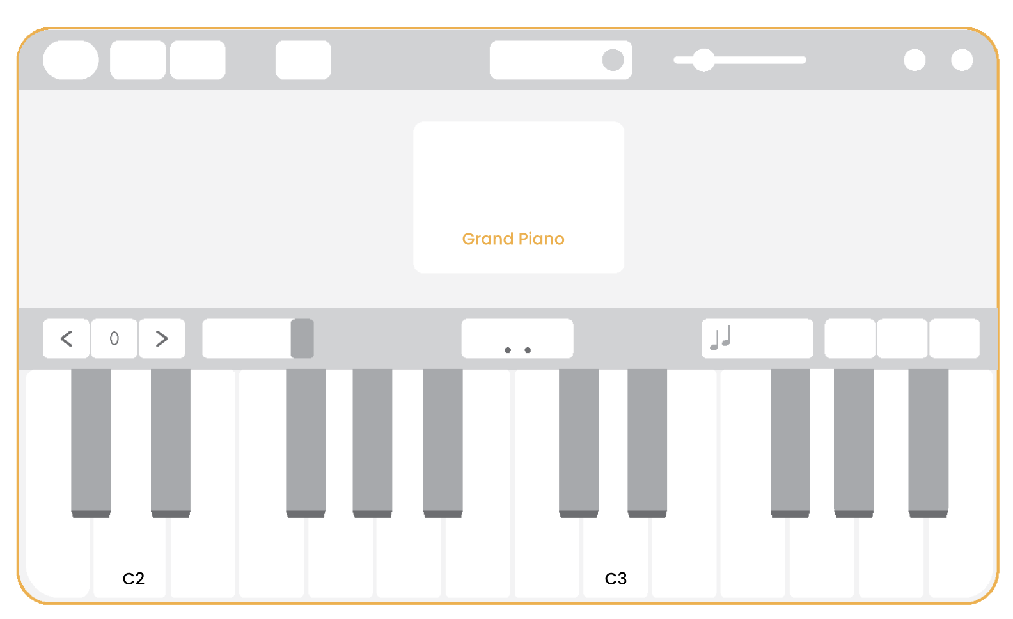
STEP 3 : Interface of a Grand Piano with keys

Slide 25
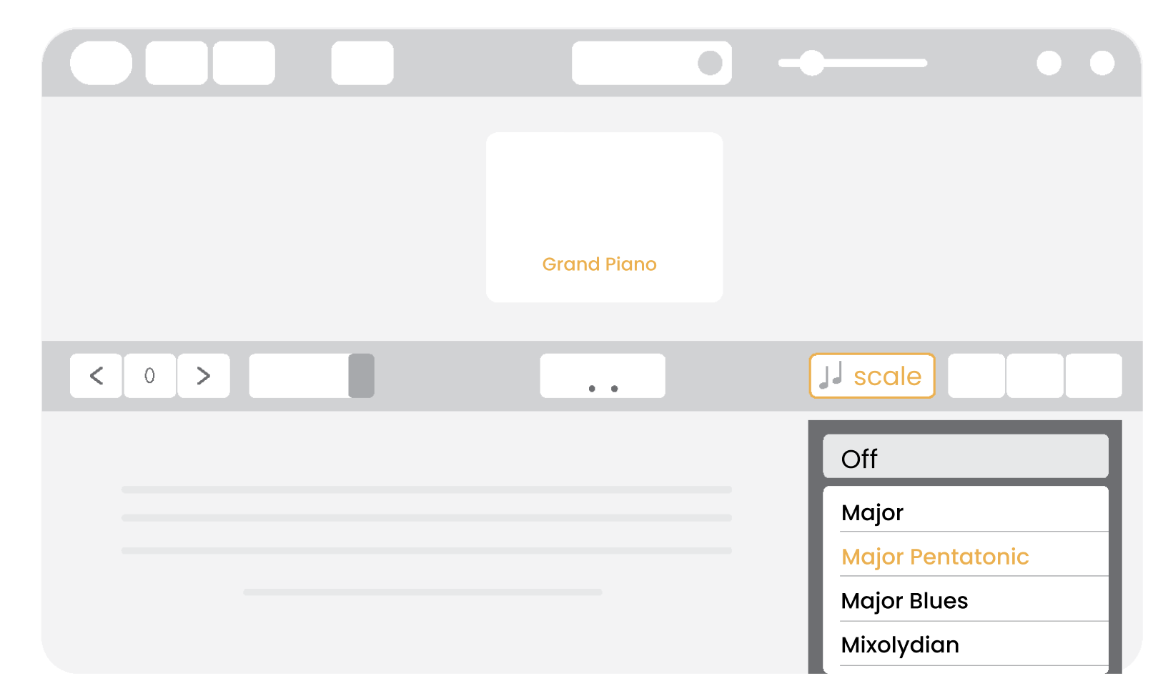
STEP 4 : Changing to ‘Major Pentatonic’ Scale for music improvisation

Slide 26
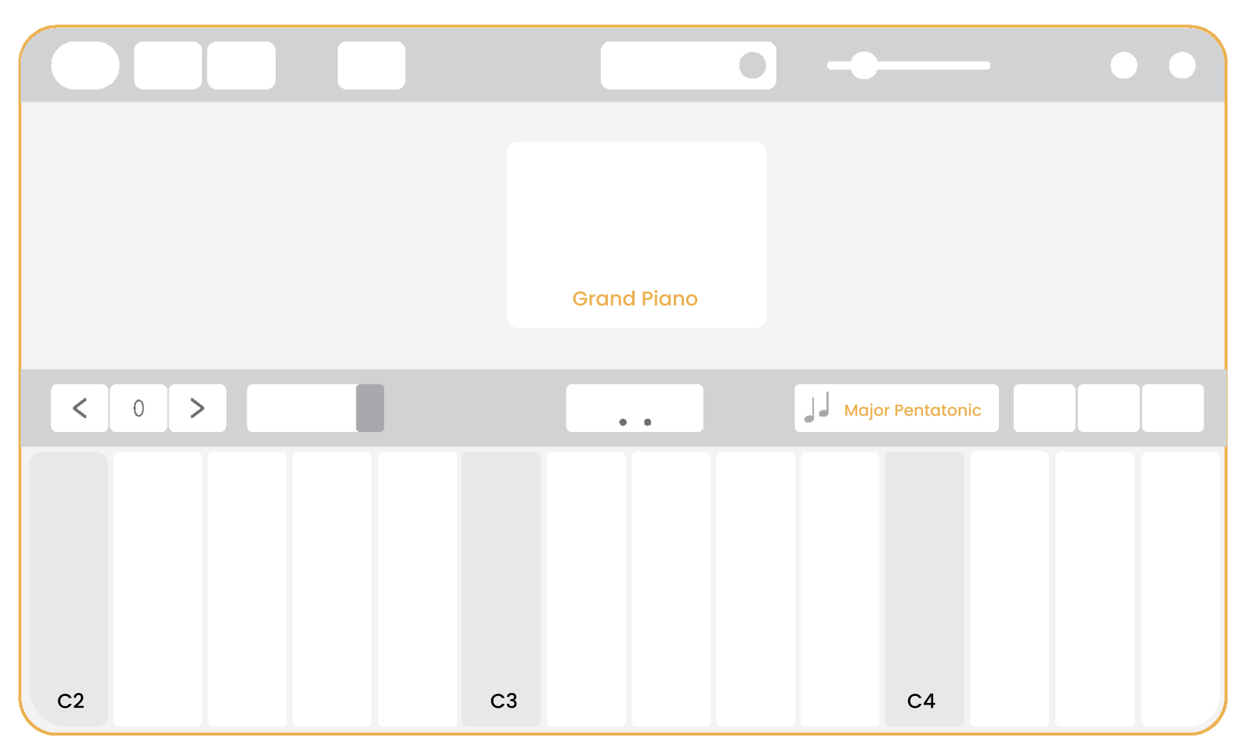
STEP 5 : Interface required for music improvisation

Slide 27
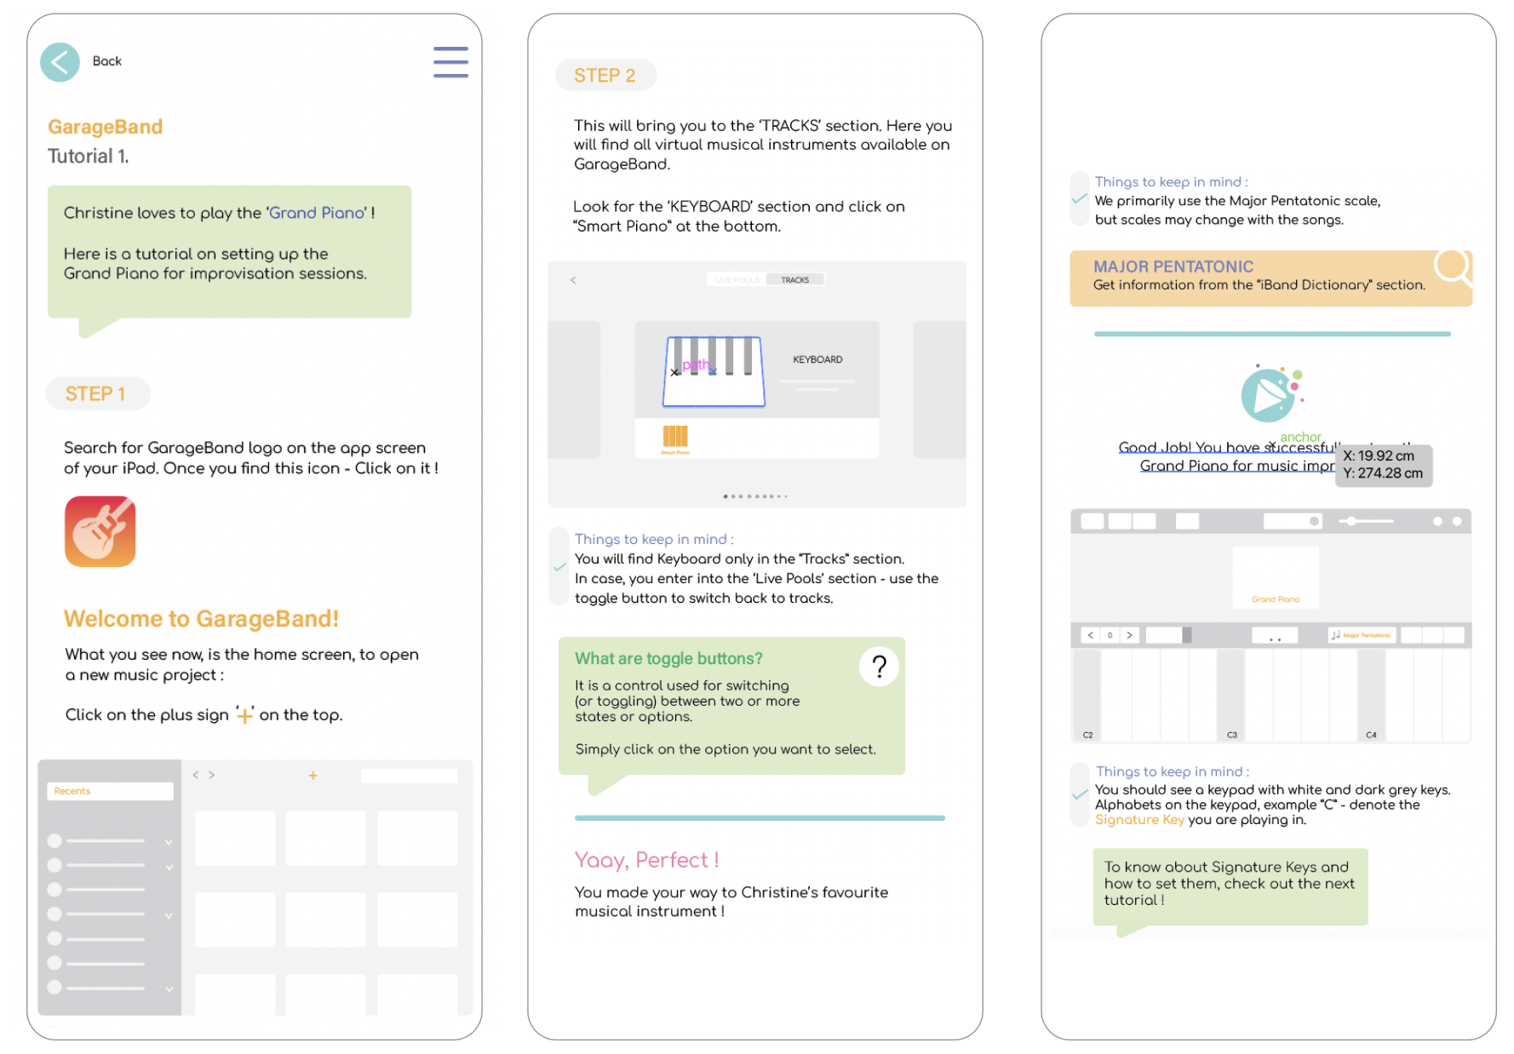
Prototypes in Process

Slide 28
IMPACT
Infographic Guide has potential benefits to :
Companions
Support with increased confidence
Bliss I-Band Members
Give opportunity to I-Band members
in having maximum control, musically
Facilitators
Help in training future volunteers efficiently
Bring more volunteers to support Bliss I-Band

Slide 29
Thank You
Get in Touch!
Email : tipnis.saee@gmail.com

