Slide 1

Barriers to accessing augmentative and alternative communication (AAC) technology in Canada: A Scoping Review
ACAW Conference Presentation
By: Jillian Henderson1, Tracy Shepherd2, Beata Batorowicz2, Shane D. Pinder2, T. Claire Davies1
f
1Mechanical and Materials Engineering, Queen’s University; 2Rehabilitation Therapy, Queen’s University, Kingston, Ontario, Canada
May 27/28, 2024

Slide 2




Presentation Overview
Methods
Results & Discussion
Introduction
Conclusion
Acknowledgements

Slide 3
Introduction
Background information, objective and significance

Slide 4
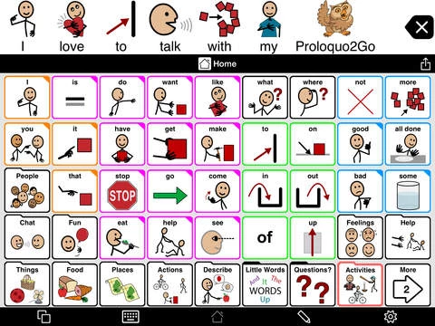
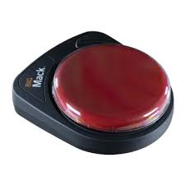
What is Augmentative and Alternative Communication (AAC)?
Definition: All forms of communication that can augment, complement, or replace speech for individuals with complex communication needs [1]
AAC System
^ Ex. Switch/button
< Ex. Text to speech soft ware
/ Speech generating device

Slide 5
Why is Accessing AAC Technology Important?
AAC promotes independence, facilitates development of social relationships, and enhances educational opportunities [2, 3]
j
YET
j
Individuals who require AAC, caregivers and experts have expressed concern that there are many barriers to access it [3,4,5]

Slide 6
Objective & Research Questions
Determine if there are barriers present for individuals in obtaining access to AAC systems in Canada.
1.
What are the barriers to gaining access to augmentative and alternative communication (AAC) technology in Canada?
2.
Is there literature on barriers preventing access to obtaining communication systems that is specific to Canada?

Slide 7
Significance
The Canadian Survey on Disability (CSD) removed communication/speech disabilities from its list of disabilities in 2007
  The CSD is the official source of data on persons with disabilities in Canada [6], meaning the most recent (and only) information available regarding people with communication disabilities in Canada and any barriers they may face was collected in 2006
Accessible Canada Act (ACA) – meeting its criteria by 2040 [7]
  To attain the goal of identifying barriers experienced by Canadians with disabilities, Statistics Canada developed a new survey, however its participants were identified through their participation in 2017 CSD national survey [8].
  Canada cannot meet its barrier prevention objectives while using data neglecting an entire population by virtue of not being identified.
Once the barriers specific to people in Canada with communication disabilities are determined, focused solutions can be created ensuring a more accessible Canada, increasing the likelihood of meeting the ACAs 2040 goal.

Slide 8
Methods
Search Strategy, Inclusion & Exclusion Criteria, Analysis

Slide 9










Scoping Review Overview

Slide 10

Search Strategy
12 Databases: Academic Search Complete, ERIC, Education Source, Engineering Village, JSTOR, Medline, ProQuest, PubMed, PsycINFO, Scopus, The Lens and Web of Science
3 Search Term Categories: AAC technology, barrier, and Canada
  AAC & barrier = synonyms such as “communication device” or “obstacle(s)”
  Canada = each province and territory as well as “Canadian”
Boolean Search Strategy: Terms within each category were connected using “OR” while “AND” connected each category

Slide 11
Inclusion & Exclusion Criteria
Inclusion
English or French
Exclusion
About barriers to using the AAC technology
Barriers accessing AAC in Hospitals exclusively
Barriers accessing recreational/ leisure equipment
Based in and about Canada
Barriers in gaining access to AAC technology for everyday use
Published between 1980-2022
Research articles, perspective articles, dissertations, reports*
Not Canadian
Scoping/ Literary reviews*
*References for scoping, systematic and literature reviews with relevant abstracts were revised for potential inclusions

Slide 12






Article Review
3 programs were used during article review:
Title and abstract review
Full text (FT) review
Custom critical review forms (CRF) created for data extraction
Track and review reference lists

Slide 13
Analysis
CRFs uploaded into NVivo
Each CRF coded for themes
Code list analyzed for overarching themes
Codes & themes exported into Excel for quantitative analysis

Slide 14
Results
Article Identification, Content Analysis, Barriers Reviewed

Slide 15
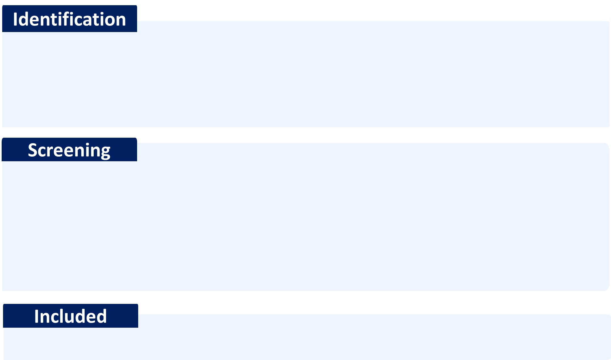
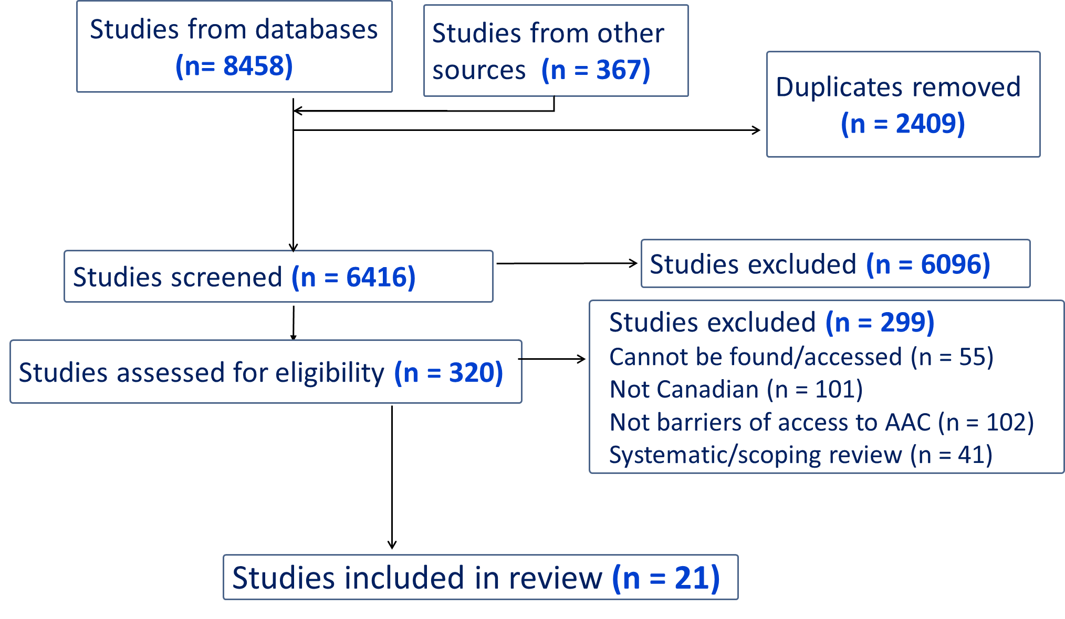
Identification of Relevant Studies

Slide 16
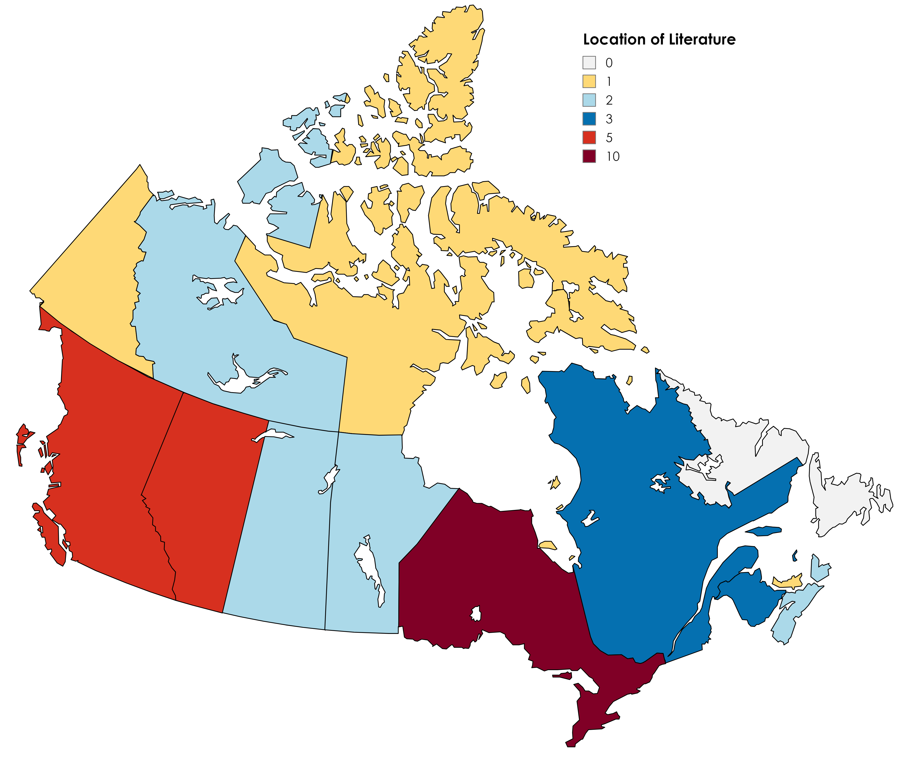


Location of Research
0
1
2
3
5
10
# Included Texts:
6 FT - Canada Wide (CW)
  4 - No specific mention of provinces/ territories
  1 - Includes all provinces and territories
  1 - States specific provinces and territories (not all)
16 FT - Provinces
  10 - Single province
  5 - Multiple provinces
  2 - Did not specify
2 FT - Territories
YT (1)
NWT (2)
NU (1)
BC
(5)
NL (0)
AB
(5)
MB
(2)
SK
(2)
ON
(10)
QU
(3)
PEI (1)
NS (2)
NB
(3)

Slide 17

Types of Literature
Type | #FT
Thesis | 2
Research Article | 13
Report | 4
Perspective | 2
Total | 21
Thesis
Research
Report
Perspective

Slide 18
Study Data Collection

Slide 19
Participants
Participant | # Participants | % | #FT
People with Disabilities* | 165 | 13 | 5
Parents/ Caregivers | 37 | 3 | 4
Speech Language Pathologists (SLP) | 102 | 8 | 3
Occupational Therapists (OT) | 411 | 31 | 3
Teachers | 518 | 39 | 2
Policy Makers | 16 | 1 | 1
Stakeholders** | 16 | 1 | 1
Other*** | 58 | 4 | 3
*Does not include the FTs that use participants from national survey database (N =105,454 if including, 8 FT)
**7 Charity, 6 Non-profit, 2 For profit, 1 hospital/academia (Wang, 2022)
*** 31 “communication assistants, life-skills workers, and personal attendants.” (Collier, 2012);
11 vendors, industry representatives and people from relevant government offices (Gordon, 2007);
16 citizens (Mattison, 2017)

Slide 20
Overarching Themes
Data reported as # of full text articles/total # of full text articles included
Funding
Information
Using the System
Time
Eligibility
Geography
Access

Slide 21
Funding

Slide 22
Funding Barriers – 20/21(#FT/Total)
#FT | Codes
16 | Lack of Funding
10 | For Technology
5 | For Services
3 | For Older adults
3 | For Family and Caregivers
1 | For Transportation
14 | High Cost of Technology
“Device funding from the government for communication, vision and hearing issues is inconsistent across provincial and territorial programs, ranging from full funding to none at all” (Schreiber, 2017)
“Others stated that funding for ATs for family and paid caregivers are neglected.” (Wang, 2022)
“Indeed, most health care providers mentioned that the cost of a device: 'can be a problem for families’. The cut-off may be earning more than that and not for ACSD (benefits) is about $60,000 family income and in (this urban area) that doesn’t go very far for a whole family. Families qualify but not have the means to easily purchase the system’ (#8, speech language pathologist).” (Lindsay, 2010)
"Many of the devices and equipment used to support disabled children are expensive and when mother P-04 ..'that's another thing I'd like to bring up, is that a lot of people who have special needs, they can't afford what's out there (…) say you come up with something and (daughter's name A) can use it and it's at three thousand dollars, well, do you think health care is going to fund that? Will the government fund that? I highly doubt that" (Diep, 2015)

Slide 23
Funding Barriers - Part 2
#FT | Codes
10 | Government Funding
1 | Accountability
1 | Does not have funding
1 | Loss of benefits
2 | Poor allocation of funds
6 | Protective of Gov funds
6 | Resistance to provide funds
“Given the variability in service availability and lack of service universality across Canada, one participant stated that it would be important to examine accountability to the federal government with respect to how provinces (and territories) spend federally-transferred funds for healthcare services (P14).” (Wang, 2022)
“Another clinician similarly said, ‘I’m more cautious than some others I think in getting to the stage where you have to prescribe a high-tech device. So I tend to look at low tech displays first’ (#8, speech language pathologist). Some of the clinicians seemed fearful of the prescription review process required for high-tech devices, and thus, were reluctant to prescribe high-tech devices altogether.” (Lindsay, 2010)
“Another participant observed that funding for disability services across Canada is being reduced… Twelve participants discussed the slow pace of government bureaucracy as not keeping up with technology changes. A common perspective for this lag was because of cost, or as one participant described, “the government’s afraid that this is a money pit” (P29).” (Wang, 2022)
“Concerns were expressed about trying to ensure that the programme is not taken advantage of by including many rules that can in effect limit user autonomy. “ (Wang,2022)

Slide 24
Funding Barriers – Part 3
#FT | Codes
7 | Discrepancy across Canada
6 | Discrepancy between disabilities
5 | High cost of System
“Device funding from the government for communication, vision and hearing issues is inconsistent across provincial and territorial programs, ranging from full funding to none at all” Pg 14 (Schreiber, 2017)
“The system is costly to administer both provincially and locally. Provincially, the government must process considerable documentation relative to clinic levels, authorized equipment, individual prescriptions and ongoing… cost. Locally, clinics must devise a system to deal with large inventories for which they are responsible, most of which are located remote from the facility. The administrative and accounting procedures necessary to implement and maintain leasing and maintenance portions of the program are extremely time consuming.” (Parnes, 1988)
“Most of the children that these providers dealt with had multiple complex health problems creating difficulties in prescribing a device. Often physical functional needs took top priority and learning how to communicate comes later” (Lindsay, 2010)
“Funding disparities were reported for people with cognitive or communication disabilities, with resources allocated primarily to people with physical disabilities.” (Wang, 2022)

Slide 25
Information

Slide 26
Information Barriers – 18/21
#FT | Codes
15 | Lack of information
1 | About the program
5 | Application process
2 | For employers
12 | Technology
3 | Lack of Device Transparency
7 | Resources to learn about it
4 | What technology is available
3 | Where to get it
3 | To prescribe device
7 | To refer or inform
"the informants expressed a need for enhanced communication support and greater access to AAC resources on behalf of the participant they supported" (Hamm, 2006)
“a lot of people don’t know where to go, so they go without.” (Mattison, 2017)
“There was also considerable variation between the disability types for people who did not know where to get the assistive device they needed. People who reported communication, agility and learning limitations were the most likely to be unsure where to obtain their assistive devices (20.0%, 16.2%, and 14.6% respectively) while people with mobility limitations were far more likely to know where to obtain their aids with only 5.9% unsure where to obtain them.” (Statistic Canada, 2007)
“It is important to educate professionals who may be responsible for the initial identification of communication disabilities amenable to AAC intervention and referral to appropriate agencies. This is a particular problem with respect to service delivery for older adults, because AAC is a relatively new discipline.” (Hirdes, 1993)

Slide 27
Information Barriers - Part 2
“Parents can acquire these skills by getting information either from product literature or from professionals. Literature provided with the SGD is not always available in languages other than English, and, even when it is, the technical terms might still present a challenge to many parents. In those cases, parents depend on professionals and company representatives as their main sources of information.”
(Valiquette, 2008)
#FT | Codes
9 | Language
5 | Only English
4 | Overcomplicated
3 | Inaccessible format
"youth who speak English as their first language were more likely (3.92 times for 15–19 year-olds; and 3.94 for 20–24 year-olds) to use a communication device than youth whose first language is not English.” (Linday, 2011)
"Some identified the need for documents in alternate formats, such as large fonts, paper documents without staples, and emailed documents that are compatible with screen reader“ (Collier, 2012)
"the very individuals impacted by the advancements in BMI technology are not speaking the same language as policy makers.“ (Diep, 2015)
“Participants also emphasized the need to provide information in accessible language that is easy to understand.” (Mattison, 2017)

Slide 28
Information Barriers - Part 3
#FT | Codes
3 | Not Reliable
2 | Inaccurate
2 | Outdated
1 | Updating
1 | Want a neutral source
1 | Not Relevant
“Participants expressed preferences for access to reliable information” (Mattison, 2017)
“The ADP (assistive devices policy) manual is over 10 years old so there are great gaps. The ADP policies that are written down are old and some of the policies are not formally written. So most people don’t actually know what the policies of ADP actually are’ (#6, speech language pathologist)” (Lindsay, 2010)
“over 30% of respondents identifying a lack of relevant information in their workplace, as well as sufficient and necessary technical, financial, and administrative support to assume their responsibilities associated with ICT”
(Aboujaoude, 2021)
“During the data collection and verification phases it was noted that programs were updated and some even became inactive, as such, carrying out the same procedures later in time likely will yield different findings.” Pg 16”
(Schreiber, 2017)

Slide 29
Eligibility

Slide 30
Eligibility Barriers – 14/21
“Most provincial funding programs produce lists of the assistive devices which are eligible for funding. However, there are many devices that, although needed by persons with disabilities, are not included on such lists. The lists of devices eligible for provincial funding are often out of date, and do not keep up with new technologies. Consumers therefore, may be prohibited from choosing a newer, safer product because it has not yet been added to the list of acceptable products eligible for provincial funding.” (Gordon, 2007)
#FT | Codes
6 | Device Eligibility
3 | Inconsistent
6 | Restrictive
1 | Importance of Strict Eligibility
“The eligibility criteria to receive device funding and services for similar technologies addressing similar limitations or disabilities were highly variable between jurisdictions and programs” (Schreiber, 2017)
“Even when funding was not considered the primary barrier, programmes can have eligibility criteria aimed at reinforcing the programme’s objectives, which according to one participant group may not address users’ identified needs: “We have to be very careful that we’re true to our eligibility criteria. I think that’s the number one pressure that we have” (P25–28)….. One participant summarized that for many, rigid and exclusive eligibility criteria for AT funding is like a “little box and the person’s request has to fit in that box” (P9).” (Wang,2022)
“One participant reported that programmes in their jurisdiction rely on uncoordinated eligibility guidelines and charity programmes serve specific populations, resulting in certain groups receiving less coverage compared to others” (Wang, 2022)

Slide 31
Eligibility Barriers - Part 2
“Given the restrictions of provincial government programs, consumers must often look to non-government sources of funding for assistance in paying their portion of the cost of a device, or for assistance for payment of devices that are not covered by government funding programs.” (Gordon, 2007)
#FT | Codes
12 | Individuals Eligibility
1 | Inconsistent
9 | Restrictive
5 | Age
7 | Disability
1 | Employment
Some participants specifically discussed not being able to access publicly funded assistive technologies because they did not meet the age criteria, despite having a need for the technology.” (Mattison, 2017)
“Participants mention the lack of professional resources as an obstacle 52 times, prevalent in all sectors, but particularly in school settings and intellectual disability rehabilitation centers. Many individuals without motor difficulties associated with intellectual disabilities do not receive services because they are not eligible for rehabilitation centers” (Valiquette, 2010)
“it is problematic for AT access to be restricted to the goal of achieving employment to generate income to be self-sufficient. This focus, as explained by the participant, “puts a lot of hurdles between an individual who has a disability and is struggling… to reach their full potential…(and) we unnecessarily throw an awful lot of barriers up between that individual who simply wants to be included” (P23).” (Wang, 2022)
“ADP funding is restricted to persons with physical disabilities requiring the use of an assistive device for six months or longer. The applicant must have a primary diagnosis other than a learning disorder.” (Gordon, 2007)

Slide 32
Access

Slide 33
Access to Services – 13/21
"Overall the findings showed a lack of sufficient services in even the most advanced settings" (Alm, 1995)
#FT | Codes
9 | Lack of Services Available
3 | For adults
6 | Not enough clinicians
3 | SLPs
"As Dianne’s mother stated, ‘‘You don’t teach somebody something and then take it away’’ – referring to the fact that her daughter had received a communication device in school but was not provided with AAC supports after graduation.” (Hamm, 2006)
“Some parents hired SLPs and other professionals from the private sector to compensate this lack of services.” (Valiquette, 2008)
“Current obstacles being encountered in Ontario focus on one major problem, that being the lack of appropriately trained personnel across all the involved disciplines in augmentative communication (speech-language pathology, occupational therapy, special education, pediatric medicine and technology development)” (Parnes, 1988)

Slide 34
Access to Services - Part 2
We have to be very careful that we’re true to our eligibility criteria. I think that’s the number one pressure that we have” (P25–28). These participants reinforced the challenge of differentiating eligibility criteria for “needs” versus “wants”, where technologies such as computers or scooters are considered needs by users, they are not considered so by the programme” (Wang,2022)
#FT | Codes
7 | Willingness from Professionals
2 | Employers
3 | Teachers
4 | ‘They’ know better mentality
3 | They being clinicians
1 | They being government
1 | They being programs
5 | To inform or refer
3 | To prescribe AAC
"Some (teachers) are simply not interested, clinicians reported. So kids are not even being referred on to obtain a device in the first place. Others reported that teachers are not making the referrals and are not interested in putting in the time it requires to program and train students to use their device. ‘One teacher told me; maybe next year he’ll find a teacher who is more interested’ (#11, SLP).” (Lindsay, 2010)
“These participants reinforced the challenge of differentiating eligibility criteria for “needs” versus “wants”, where technologies such as computers or scooters are considered needs by users, they are not considered so by the programme.” (Wang, 2022)
“Another clinician similarly said, ‘I’m more cautious than some others I think in getting to the stage where you have to prescribe a high-tech device. So I tend to look at low tech displays first’ (#8, speech language pathologist). Some of the clinicians seemed fearful of the prescription review process required for high-tech devices, and thus, were reluctant to prescribe high-tech devices altogether.” (Lindsay, 2010)
“the most useful devices are often the least expensive and “do 20 different things” (P13), but are not funded because they are commonly available … The participant stated that these are the new basic technologies that should be covered, giving the rationale that they are “a lot less expensive than what governments fund that are single purpose devices that are archaic and useless” (Wang, 2022)

Slide 35
Accessing the System – 13/21
"selection of AAC devices is conditioned by the motivation and competence of the partners, access to professional resources, and the availability of distributors. All participants consider the motivation of at least one partner as a prerequisite for recommending an AAC device. However, participants' opinions differ regarding the absolute necessity of family involvement in the process." (Valiquette, 2010)
#FT | Codes
3 | Willingness from Parents
3 | No Internet access
2 | No Computer access
2 | Telephone Requirement
"The two respondent groups agreed that individuals should have an option to meet face-to-face rather than be required to communicate on the phone“ (Collier, 2012)
“Seeking information through web-based resources is restricted because many residents do not have Internet and computer access” (Wang, 2022)
“People with disabilities are also less likely than people without disabilities to have an Internet connection at home, to access the Internet elsewhere, or use a cell phone " (D’Aubin, 2007)

Slide 36
Using the system

Slide 37
Using the System – 15/21
“In the case of Canada, the report was difficult to read, and showed a national system which is not well coordinated, with provincial variation in access to services.” (Smith, 2019)
#FT | Codes
8 | Complex Nature of System
7 | Lack of Coordination
11 | Between government and services
5 | Between government departments/ ministries
2 | Other
6 | Lack of Guidelines
6 | Application Process
1 | Approval and review process
5 | Complicated
2 | Policies not formally written
6 | Structureless
3 | Vague
“a child may not receive a device depending on the inconsistent guidelines of the prescription review panel. The majority greed that ‘There’s no protocol on how a prescription review is run and on a lot of things.’ They reported that ‘it has to be consistent for all clinicians, the procedure in how it’s done because there doesn’t seem to be that procedure in place’ (#6, speech pathologist). The inconsistent and arguably inefficient prescription review process was a great hurdle for clinicians to overcome in being able to provide children the AAC devices they could benefit from. They felt that their hands were tied and that there was little they could do to change or improve the process.” (Lindsay, 2010)
“Overall, the prescription guidelines are vague and are very outdated, which means that children are often using dated technology by the time that it actually gets into their hands.“ (Lindsay, 2010)

Slide 38
Using the System - Part 2
#FT | Codes
5 | Bureaucratic
4 | Not Comprehensive
4 | Navigation
2 | Application Process
2 | Delivery System
4 | No central location
3 | Too many locations
3 | Lots of Paperwork
3 | Outdated System and Programs
3 | Use of Medical Model
“Consumers face significant informational hurdles in accessing the assistive devices that they need. They report that programs providing funding for assistive devices are bureaucratic, confusing, and require significant self-advocacy skills. In addition, assistive devices are regulated by an overwhelming system that spans across various levels of government.” (Gordon, 2007)
Participants in all the panels also identified system navigation as a main concern. In particular, participants agreed that access to assistive technologies is fragmented, and there are many access points in the health system. Many indicated that this makes it hard to know where to go to access publicly funded assistive technologies, and others noted that it is very complicated for those with complex and/or multiple conditions (i.e., those fitting in multiple eligibility ‘boxes’). (Mattison, 2017)
"Participants (SLPs) also complain about having to fill out numerous forms, manage AAC device breakdowns, and often deal with administrative burdens in certain institutions” (Valiquette, 2010)

Slide 39
Time

Slide 40

Time – 10/21
“How many times do I have to prove that I have a disability to someone at the government?” (Mattison, 2017)
#FT | Codes
4 | Lack of Timely Services
3 | Required for Programs
6 | Time Wasted
3 | Bc of Lack of coordination
3 | Person with Disability’ time
4 | Clinician’s time
1 | Purposefully wasting time
2 | Unaware of Process Timeline
5 | Waitlist
Participants noted long processing times because of the high volume of applications. One participant stated that their programme receives thousands of claims per week, causing them concern over government service efficiency and the accuracy and speed of application processing. Healthcare providers, such as occupational therapists, were reported to spend a lot of time coordinating and completing paperwork for AT funding, which is not remunerated, causing one participant to wonder “as a system overall, is that really the best place to put a highly skilled clinician’s time?” (P8).” (Wang, 2022)
“One participant remarked that funding conditions lead to a two-tiered system as choices are afforded to those with financial resources since, “people who can afford (AT) sometimes will jump the queue and buy it full price themselves…people who have money can access it sooner and quicker” (P21–22). Another participant expressed anger that people with no funding or who experience long waiting periods have to rely on charities or private fundraising measures: “they’re begging their family, their friends, corporations. They’re going to…(name of corporation charity) to get access to vans and other devices, right, because the programmes are just not here.” (P24).” (Wang 2022)

Slide 41
Geography

Slide 42
Geography – 7/21
#FT | Codes
4 | Required to Travel
3 | Lack of Local Services
2 | Technology not available locally
1 | Treated Differently
1 | Fewer Resources
"about 36 percent of clients travelled at least 100 kilometres. This indicates that a substantial proportion of the clinic's clientele come from outside of the region and suggests that their needs are not being adequately met in their area.” (Ellis-Hales, 1992)
“First, most agreed that differences in assistive technologies programs and services within and between provinces means that Canadians are treated differently based on where they live, especially those in remote communities.” (Mattison, 2017)
“Participants remarked that living in rural/remote areas results in long process times for acquiring ATs, with some cases taking up to 1 year. One reason cited for delays is the need for and long wait times to access authorisers, such as physicians, who are short in numbers or transient in rural/remote communities. Being in a smaller or rural/remote community means fewer resources such as “a store to look at devices” (P7), and therefore, fewer opportunities to learn about ATs.” (Wang, 2022)
“The assistive technologies have advanced, but it’s not readily available (in my province).” (Mattison, 2017)

Slide 43
Discussion

Slide 44
Barriers are Present – Let’s Discuss
As the conference is following a flipped model approach, instead of typical discussion slides, the next few slides contain the following question prompts, with potential points of discussion from segments of the included literature.
What is “the System”?
Who is responsible for “the System”?
Where/How should “the System” be accessed?

Slide 45
What is the System?
“The system is costly to administer both provincially and locally. Provincially, the government must process considerable documentation relative to clinic levels, authorized equipment, individual prescriptions and ongoing… cost. Locally, clinics must devise a system to deal with large inventories for which they are responsible, most of which are located remote from the facility. The administrative and accounting procedures necessary to implement and maintain leasing and maintenance portions of the program are extremely time consuming.” (Parnes, 1988)
“assistive devices are regulated by an overwhelming system that spans across various levels of government” (Gordon, 2007)
“One participant remarked that funding conditions lead to a two-tiered system as choices are afforded to those with financial resources since, “people who can afford (AT) sometimes will jump the queue and buy it full price themselves…people who have money can access it sooner and quicker” (P21–22). Another participant expressed anger that people with no funding or who experience long waiting periods have to rely on charities or private fundraising measures: “they’re begging their family, their friends, corporations. They’re going to…(name of corporation charity) to get access to vans and other devices, right, because the programmes are just not here.” (P24).” (Wang 2022)
“a child may not receive a device depending on the inconsistent guidelines of the prescription review panel. The majority agreed that ‘There’s no protocol on how a prescription review is run and on a lot of things.’ They reported that ‘it has to be consistent for all clinicians, the procedure in how it’s done because there doesn’t seem to be that procedure in place’ (#6, speech pathologist). The inconsistent and arguably inefficient prescription review process was a great hurdle for clinicians to overcome in being able to provide children the AAC devices they could benefit from. They felt that their hands were tied and that there was little they could do to change or improve the process.” (Lindsay, 2010)
Participants noted long processing times because of the high volume of applications. One participant stated that their program receives thousands of claims per week, causing them concern over government service efficiency and the accuracy and speed of application processing. Healthcare providers, such as occupational therapists, were reported to spend a lot of time coordinating and completing paperwork for AT funding, which is not remunerated, causing one participant to wonder “as a system overall, is that really the best place to put a highly skilled clinician’s time?” (P8).” (Wang, 2022)

Slide 46
Who is responsible for the system?
Responsibility to fund and inform, or to lead and hold accountable.
“Another participant observed that funding for disability services across Canada is being reduced… Twelve participants discussed the slow pace of government bureaucracy as not keeping up with technology changes. A common perspective for this lag was because of cost, or as one participant described, “the government’s afraid that this is a money pit” (P29).” (Wang, 2022)
“Given the variability in service availability and lack of service universality across Canada, one participant stated that it would be important to examine accountability to the federal government with respect to how provinces (and territories) spend federally-transferred funds for healthcare services (P14).” (Wang, 2022)
“It is important to educate professionals who may be responsible for the initial identification of communication disabilities amenable to AAC intervention and referral to appropriate agencies.” (Hirdes, 1993)
“Overall, the prescription guidelines are vague and are very outdated, which means that children are often using dated technology by the time that it actually gets into their hands.“ (Lindsay, 2010)
"the informants expressed a need for enhanced communication support and greater access to AAC resources on behalf of the participant they supported" (Hamm, 2006)
“Finally, several participants discussed the role of charitable organizations in providing assistive technologies that are not publicly financed. Specifically, participants were concerned with the sustainability of charities providing assistive technologies in areas they thought should be the government’s responsibility.” (Mattison, 2017)
“Thirteen participants indicated a lack of national leadership concerning AT access and an absence of federal legislation or policy direction for AT programmes and services that can promote system coordination, equity of access, or standards in programmes and services across the country.” (Wang, 2022)

Slide 47
Where/ How should the system be accessed?
“Participants in all the panels also identified system navigation as a main concern. In particular, participants agreed that access to assistive technologies is fragmented, and there are many access points in the health system. Many indicated that this makes it hard to know where to go to access publicly funded assistive technologies, and others noted that it is very complicated for those with complex and/or multiple conditions (i.e., those fitting in multiple eligibility ‘boxes’). For example, some participants noted that while there are many programs that provide assistive technologies (e.g., federal programs, publicly funded provincial programs, municipal programs, charitable organizations, private insurance and employment-based benefits), the landscape is very complicated from a user perspective. Adding to this, it was noted that there is a lack of coordination between agencies and inconsistencies between them in terms of what and how much is covered. Moreover, participants expressed significant frustration related to the lack of information to support system navigation across this complicated landscape of programs.” (Mattison, 2017)
“In addition, participants were concerned with the burden placed on primary-care providers to be able to accurately direct patients to the variety of programs and services offering assistive technologies.” (Mattison, 2017)
“There are complex and overlapping regulatory regimes. This “quagmire of bureaucracy” can be overwhelming to persons forced to navigate the system, including persons with disabilities. Also complicating is that different provinces and territories have different funding regimes and, as a result, there is uneven access to assistive devices by consumers across the country.” (Gordon, 2007)
"In school settings, support measures are also available to provide disabled students with communication tools that can support their learning and participation. Some participants [SLPs] have used these measures to provide equipment to students, but some seemed unfamiliar with the allocation rules and had never benefited from them.” (Valiquette, 2010)
“Given the restrictions of provincial government programs, consumers must often look to non-government sources … for assistance for payment of devices that are not covered by government funding programs.” (Gordon, 2007)

Slide 48
Conclusion

Slide 49

Conclusion
Barriers are present in Canada for individuals who require access to AAC Systems
Territories are significantly underrepresented in research
There are many barriers preventing access to necessary services
Application process for funding programs restrict access to equipment
More barriers to obtain high tech than light tech AAC technology in terms of high cost and willingness from clinicians to prescribe the technology
Funding has been a primary barrier since 1987 in Canada and while more assistance options exist, funding continues to prevent Canadians from accessing AAC in 2022

Slide 50
Acknowledgements

Slide 51




Acknowledgements

Slide 52
Thank you for reviewing!
Barriers to accessing augmentative and alternative communication (AAC) technology in Canada: A Scoping Review
May 28th, 2024

Slide 53
References
[1] Schultz, R. E., Pereira, R., & Silva, L., “Mobile Interaction for Augmentative and Alternative Communication: a Systematic Mapping”. SBC Journal on Interactive Systems, vol. 9, no. 2, pp. 105-118, 2018.
[2] Baxter, S., Enderby, P., & Judge, P. E., “Barriers and facilitators to the use of high-technology augmentative and alternative communication devices: a systematic review and qualitative synthesis”. International Journal of Language & Communication Disorders, vol. 47, no. 2, pp. 115-129, 2012.
[3] P. Gordon, L. Kerzner, T. Sheldon and E. Hansen, "ASSISTIVE DEVICES IN CANADA: ENSURING INCLUSION AND INDEPENDENCE," ARCH DISABILITY LAW CENTRE, Toronto, ON, June 2007.
[4] S. Lindsay, "Perceptions of health care workers prescribing augmentative and alternative communication devices to children," Disability and Rehabilitation: Assistive Technology, vol. 5, no. 3, pp. 209-222, 2010.
[5] D. Schreiber., R. Wang., “Access to Assistive Technology in Canada: A Jurisdictional Scan of Programs”, AGEWELL NCE, June 2017.
[6] Statistics Canada, "Canadian Survey on Disability (CSD)," Statistics Canada, Employment and Social Development Canada, 2023. (Online). Available: https://www23.statcan.gc.ca/imdb/p2SV.pl?Function=getSurvey&amp;SDDS=3251.
[7] Government of Canada, "Accessible Canada Act," Justice Laws Website, 30 11 2023. (Online). Available: https://laws-lois.justice.gc.ca/eng/acts/A-0.6/FullText.html.
[8] Statistics Canada, "The accessibility experiences of Canadians with disabilities, difficulties or long-term conditions within federal sector organizations, 2021," 18 08 2021. (Online). Available: https://www150.statcan.gc.ca/n1/daily-quotidien/210818/dq210818b-eng.htm.

Slide 54
Included Articles
Year | Author | Title
1988 | Parnes | Section 2: Adaptive Technology: Funding for Assistive Device Programs and Equipment
1992 | Ellis-Hale | The Prevalence, Client Characteristics and Service Delivery Implications of Communication Impairments Among Older Adults
1993 | Hirdes | Prevalence and policy implications of communication disabilities among adults
1995 | Alm | Augmentative and alternative communication: Past, Present and Future
1995 | Laine | Computer Applications for Special Needs Students: What Canadian Teachers Use and Need
2006 | Hamm | Post-school quality of life for individuals with developmental disabilities who use AAC
2007 | Statistics Canada | Participation and Activity Limitation Survey of 2006: A Profile of Assistive Technology for People with Disabilities
2007 | D'Aubin | Working for Barrier Removal in the ICT Area: Creating a More Accessible and Inclusive Canada
2007 | Gordon | Assistive Devices in Canada: Ensuring Inclusion and Independence
2008 | Valiquette | The involvement of families in the use of SGDs by youths with an intellectual disability
2010 | Lindsay | Perceptions of health care workers prescribing augmentative and alternative communication devices to children
2010 | Valiquette | Speech-language pathology practices in Québec with individuals who have an intellectual disability and use a speech-generating device (SGD) to communicate
2011 | Lindsay | Predictors of unmet needs for communication and mobility assistive devices among youth with a disability: The role of socio-cultural factors
2012 | Collier | Communication access to businesses and organizations for people with complex communication needs
2013 | Diep | Who needs to fit in? Who gets to stand out? Communication technologies including brain-machine interfaces revealed from the perspectives of special education school teachers through an ableism lens
2015 | Diep | Perceptions of Brain-Machine Interface Technology among Mothers of Disabled Children
2017 | Mattison | Panel Summary: Enhancing Equitable Access to Assistive Technologies in Canada
2017 | Schreiber | Access to Assistive Technology in Canada: A Jurisdictional Scan of Programs
2019 | Smith | Assistive Technology content in United Nations Convention on the Rights of Persons with Disabilities reports by states parties – Published in the Global perspectives on assistive technology Proceedings of the GReAT Consultation 2019
2021 | Aboujaoude | Canadian Occupational Therapists' Use of Technology With Older Adults: A Nationwide Survey
2022 | Wang | Policymaker and stakeholder perspectives on access to assistive technologies in Canada: challenges and proposed solutions for enhancing equitable access

