Slide 1
Delay Plagues U.S. Accessibility Regulations. Can Canada Do Better?
Lainey Feingold | LFLegal.com
Accessible Canada - Accessible World Gathering
Streams: Innovation in standards and policy
May 27-28, 2024

Slide 2

Lingo
ANPRM
  Advanced Notice of Proposed Rulemaking
NPRM
  Notice of Proposed Rulemaking
Final Rule
DOJ
  US Department of Justice
Access Board
OMB and OIRA
  Office of Management + Budget | Office of Information + Regulatory Affairs

Slide 3
Examples of U.S. Delays

Slide 4
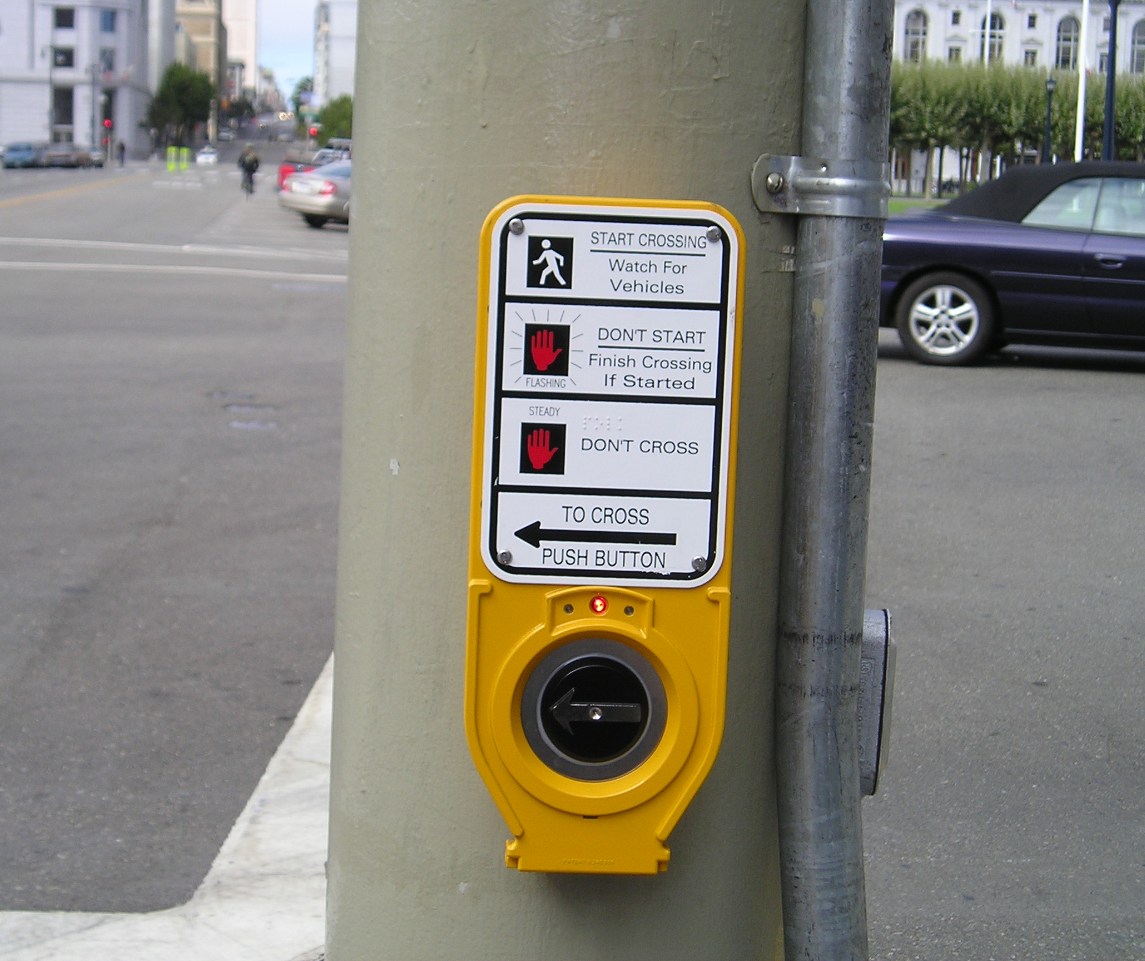
Pedestrian Accessibility (Safety!)
What
  Accessible ped signals; curb ramps, sidewalks ++
Timing
  1999 Advisory Committee
  2013 Draft guidelines
  2023 Final Rule by Access Board
  Still needed: Proposed and Final Rule by Department of Justice
access-board.gov/prowag/

Slide 5
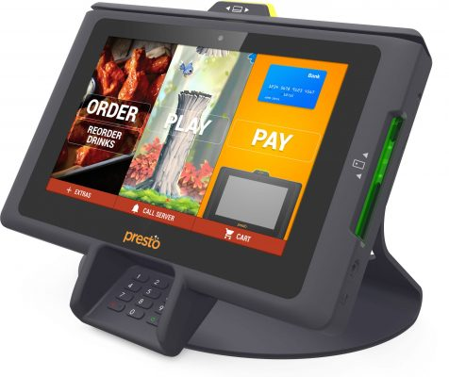
Kiosks (Self-service transaction machines)
What
  Accessible kiosks (healthcare, restaurants, retail ++)
Timing
  2010: DOJ and Access Board Advanced Notice of Proposed Rulemaking
  2022 Again! Access Board Advanced Notice of Proposed Rulemaking
Still needed
  Final Rule by Access Board
  Rule making by DOJ
bit.ly/accessible-kiosk

Slide 6
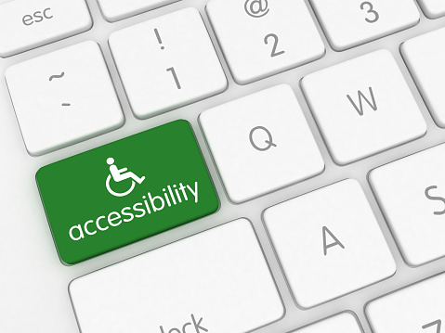
Web + Mobile Accessibility (ADA)
What
  Accessibility of websites + mobile applications (technical)
Timing
  2010: DOJ ANPRM for web access (private + pubic sector)
  2017: Freeze on all pending regulations
  2022: intent to issue regulations
  2023 DOJ NPRM for public sector only
  April 2024 Final Rule for public sector
  Still needed: rulemaking for private sector
bit.ly/accessible-web

Slide 7

Similar stories with. . .
Accessible medical diagnostic equipment
  2010 – 2017 (partial) - not done yet
Movie theater captioning and audio description
  2010-2016
Section 508 “Refresh”
  2006 – 2017 (2 ANPRMs + 1 NPRM before final)
Section 504 “Refresh”
Don’t Wait!

Slide 8
How can Canada do Better?

Slide 9
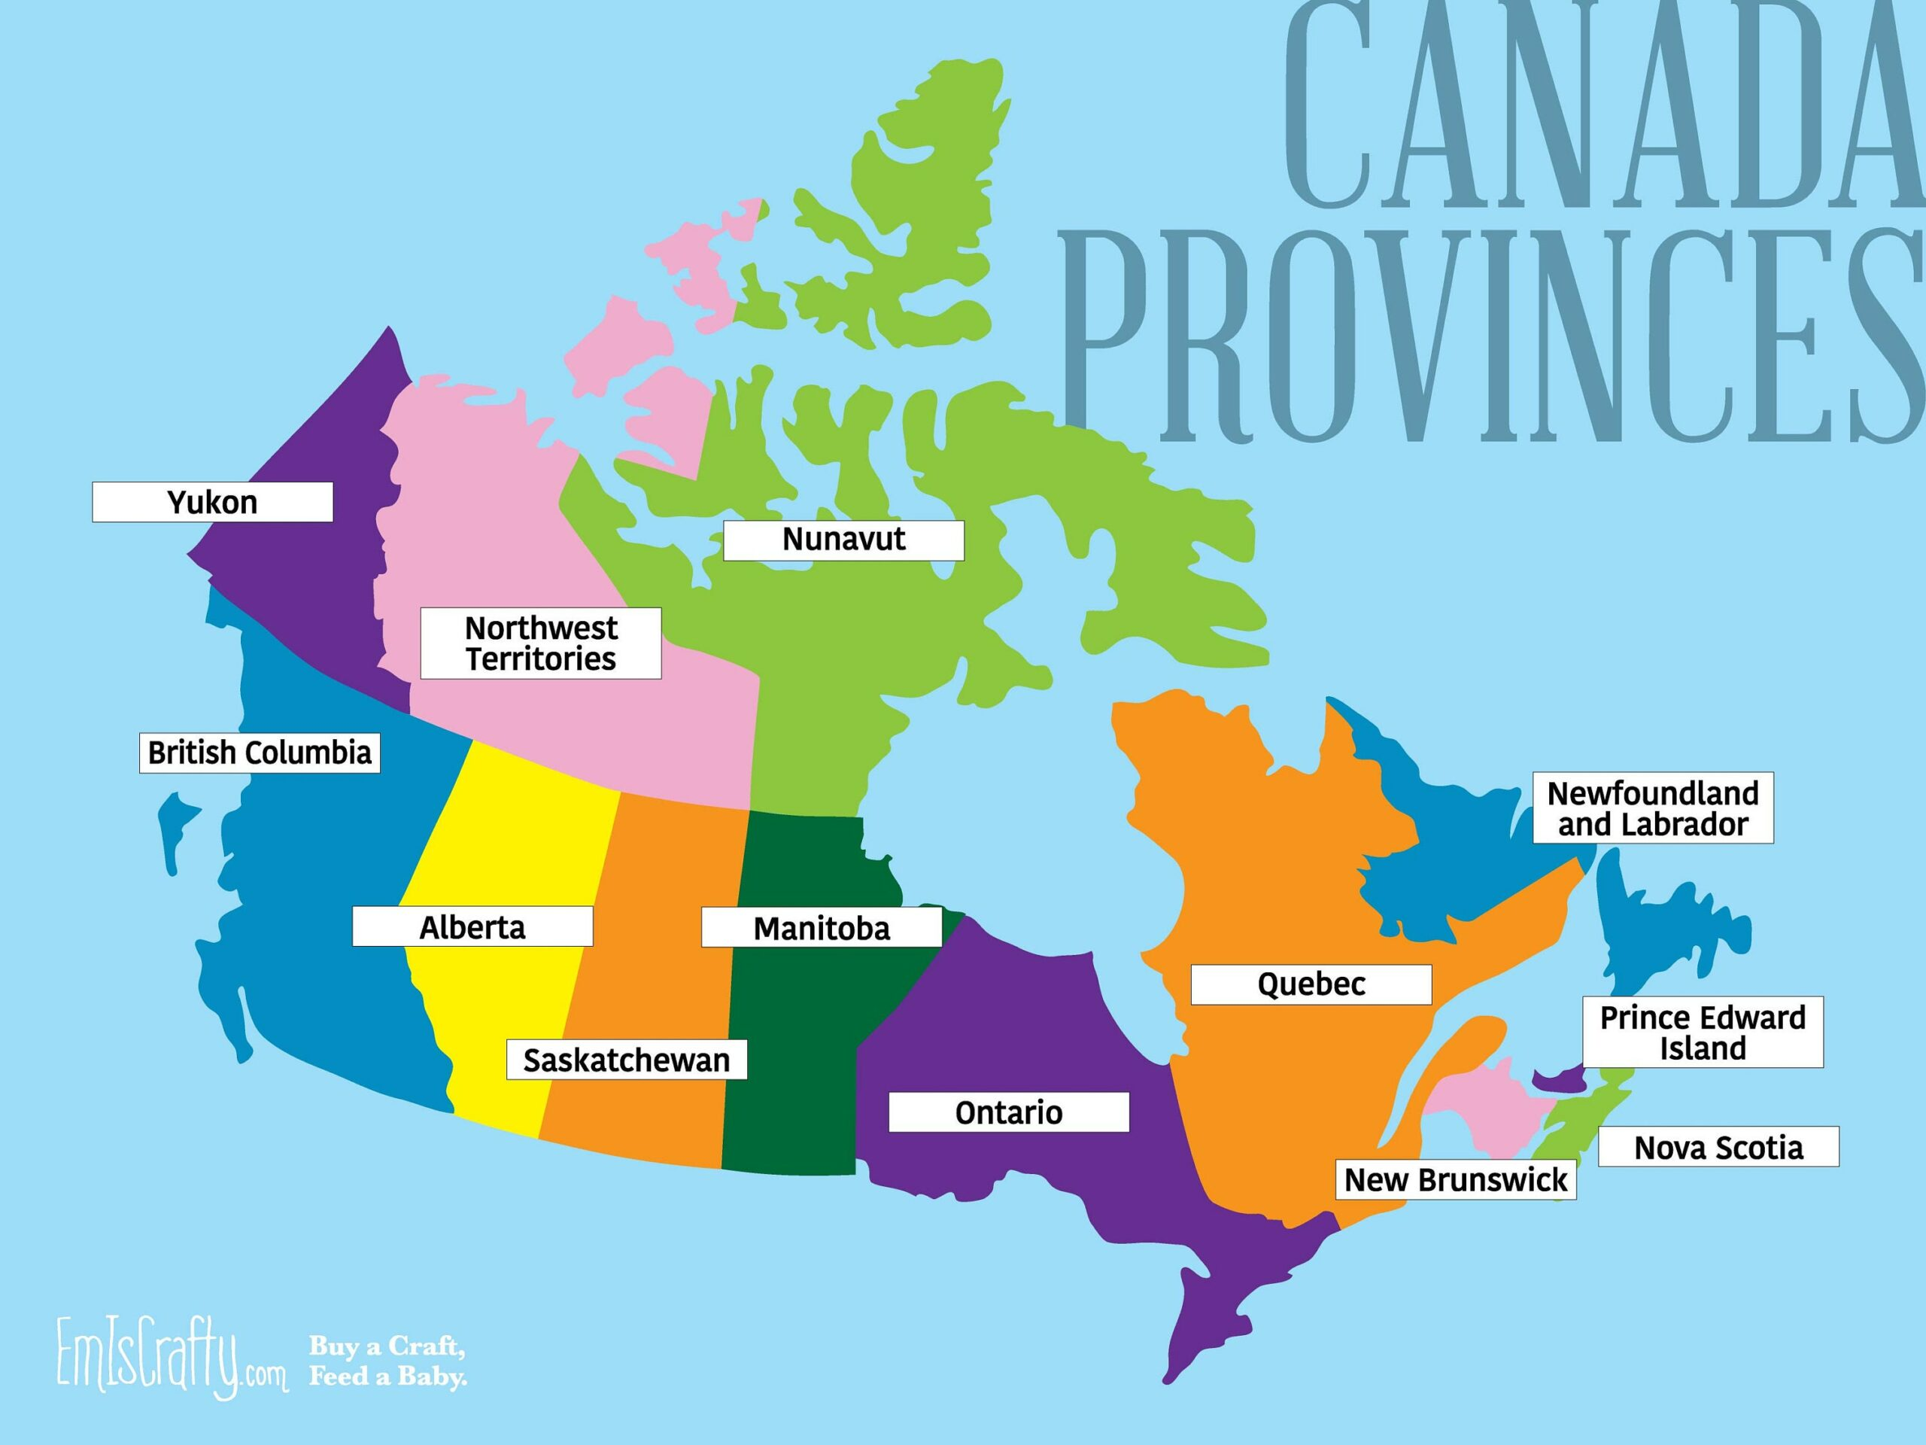
Ideas for avoiding regulation delay
Impose deadlines at all stages
Streamline agency review
Aim for “evergreen” language (especially for tech)
Avoid politics (possible?)
Your idea here!

Slide 10

Stay in Touch!
Lainey Feingold
LFLegal.com
Follow on LinkedIn for US regulation updates
Global Digital Accessibility Page

