Slide 1
Inclusive by Design:
Sharing results knowledge, and wisdom for mutual benefit
Anne Barker
ACAW 2024
Notes:
The National Research Council Canada (NRC) is committed to prioritizing inclusive innovation. I would like to provide some considerations for how your organization could also do so, and provide some examples about how NRC is seeking to build inclusive research partnerships with Indigenous organizations and aging populations.

Slide 2
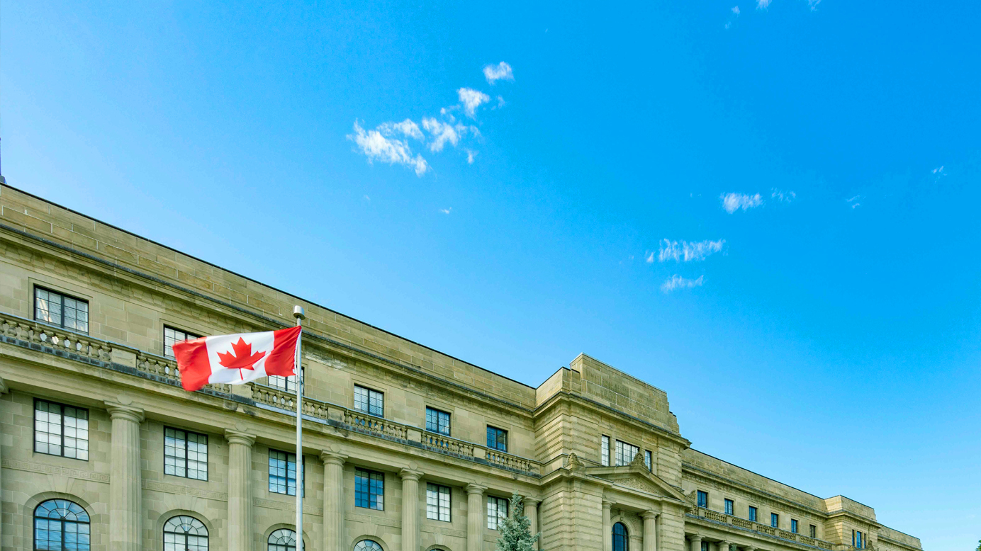

THE NATIONAL RESEARCH COUNCIL OF CANADA
Resources:
2400 research personnel
$1.6B budget
Mandates for research :
Supporting federal policy mandates
Advancing scientific and technical knowledge
Business innovation
Areas of Engagement:
Research projects and research collaboration programs
Technical and advisory services
Licensing opportunities
Industrial Research Assistance Program (IRAP)
Notes:
First, a bit about the National Research Council of Canada.

Slide 3



Collaboration Programs: Challenge Programs
CHALLENGE PROGRAMS
Address current and emerging government priorities
Mission-oriented programs across industries
3 NEW PROGRAMS
launched
EVERY 3 YEARS
ANNUAL BASELINE BUDGET
$27M
Outcome focused
Multi-disciplinary
Up to 7 years in duration
Researchers and facilities from across 12 research centres partner with academic and industry partners
https://nrc.canada.ca/en/research-development/research-collaboration/programs/challenge-programs
Notes:
Not all research at NRC is carried out under programs. For the research that is, it is part of our Collaborative Science, Technology and Innovation Program. This program provides research grants and contributions for collaborators across Canada and around the world to partner with NRC research staff, working together to catalyze scientific discoveries and technological breakthroughs.

Slide 4
Criteria for Challenge Programs
When identifying potential challenge areas, NRC considers:
    Government’s overall public policy direction
    NRC’s priority areas and where it is well positioned to deliver
    Opportunities for advancement of transformative, new and arising science and/or technologies that address priority areas for Canada
    Where NRC adds value through leadership, convener and catalyst roles.
  However, there are other factors to be considered once a research subject area has been selected. This presentation steps through examples of those considerations, in the context of two of NRC’s challenge programs: the Arctic and Northern and Aging in Place research programs.

Slide 5


Building research partnerships with Indigenous Organizations
SAMPLE OF PICTURE WITH CAPTION SLIDE
Building inclusive research partnerships
Notes:
What can building research partnerships look like in a federal research context? Let's examine some considerations, from design through research execution.
Core message: Building research partnerships with Indigenous organizations can be done through building relationships for relevant research, considering respect, responsibility and reciprocity.
Promise: I am going to help you to understand how that can be done, and how to implement this in your program and project design.

Slide 6
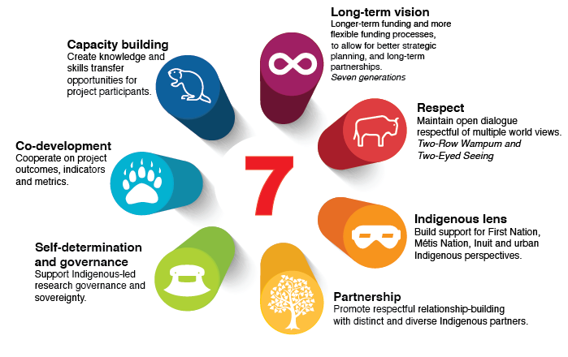
7 Pillars of Successful Programming
  Source: Government of Canada Indigenous STEM (I-STEM) Cluster
Notes:
But beyond financial support, what other determinants play a role in effectively supporting indigenous communities? One way to find out about what those determinants might be is to ask for feedback from those for whom research programs purport to be supporting.
Audits conducted by Indigenous communities and organizations of Government of Canada research programmes highlighted 7 pillars of successful programming; concepts that when thoughtfully included in the design of funding opportunities, will support better outcomes and impacts post-programme. While the audits were conducted at a programme level, I believe that there are take-aways here for project design too. So that is one way of thinking about the overall development of a partnership opportunity itself. Who is sitting around the table, developing the partnership opportunity? Who has a role in the governance of it? Is there a longer-term vision for the outcomes of that research?

Slide 7
Beyond the funding amount
Broad eligibility
Cultural competency training
Development grants
Funding
Diverse approaches
Distinctions Approach
Allow smaller projects
Be flexible
Notes:
As funders and researchers, we can also think about how we enable partnership. How to can you implement an advocacy approach that promotes multiplicity, inclusion, and the creation of space into the research enterprise to support strengths-based research and amplify the voices of indigenous communities? How can funding organizations better recognize and appreciate the value of indigenous knowledge, and what strategies can they employ to increase funding accessibility for indigenous projects and initiatives?
A first step is to think about who is even eligible to apply for your research funds? Is it limited to a very narrow definition of who, in the eyes of your terms and conditions, is allowed to conduct research and their associated qualifications? Broad eligibility, including non-profit organizations, land claims corporations, in line with calls from Indigenous organizations.
And how do you choose to bring Indigenous organizations into the ideation stage of research? One way could be to implement development grants or similar – opportunities to establish networks, consult with communities about their priorities, and support being on-site, in communities to develop those relationships. Like we are doing here, for example. Because frankly why are we participating in this event? It boils down to networking, seeking opportunities, learning, and disseminating what research we have been doing. Clearly we, and our respective organizations that approved some travel budgets to get to these events, believe that that is worthwhile investment of travel costs and time, to forge what? Collaborations.
We can think about the scale of the research to be carried out. The research program I lead focuses on the Arctic, where costs are high. There seems to be a tendency to put forth bigger and bigger financial research packages, and there is certainly a need for this, to enable big dreams and big thinking. What about those organizations that are new to research, or have different types of innovation priorities? Is a multi-million dollar program right for them? Do they want to manage such funds? Can your funding package accommodate smaller requests without diminishing a community’s priorities (that’s too small for us to bother with the paperwork)? Does your organization recognize that “transformational technologies” and “breakthrough innovation” may look differently in different areas of the world, and may require a mind-shift for your executives?
How flexible is your organization’s thinking? Are you willing to go to the top to ask for changes, to look for ways to screen Indigenous research priorities in and not out? There is a great word in French, La paperasserie, which generally translates as a degrogatory version of paperwork – papers that get pushed around. Is your organization putting la paperasserie ahead of action?
We can think about who is doing the research, and what knowledge they bring to the table. For example, Inuit Qaujimajatuqangit (IQ) (khow-yee-ma-yuu-tu-khaug-iit) is the term used to describe Inuit epistemology or the Indigenous knowledge of the Inuit. The term translates directly as “that which Inuit have always known to be true.” It is the foundation upon which social, emotional, spiritual, cognitive and physical well-being is built. Differences, however, are also important to note, and can be very beneficial to a research environment. We need to be mindful that there is no one-size-fits-all approach. Distinctions exist across all Indigenous Peoples, communities, regions and organizations. That means that relationships are paramount, to understand different priorities and needs. Balance funding across factors including geography and Indigenous communities (i.e., Inuit, Métis and First Nations).
And we can also think about ourselves, and our role as a collaborator, versus a more transactional relationship. Our Indigenous partnerships lead to complimentary competencies coming together for added value. working to ensure that it has the skills and competency to engage with Indigenous partners in science co-development to achieve mutually beneficial organizational results and outcomes. And this doesn’t just apply to researchers. This applies to those who provide the funds too. Funders need to be better educated to understand the relevance of indigenous knowledge within specific fields and ensure that it is integrated effectively into research initiatives. Each organization needs to account for that in the professional development plans of its employees.

Slide 8
Beyond the funding amount (continued)
Effort
What are your terms and conditions?
Equipment
Principle investigator salary, students, honoraria, contracting of Elders and knowledge keepers
Research equipment and also data storage and long-term access, communications tools (wifi, phones)
Closely examine funding terms and conditions. Put in the effort to seek changes at the highest levels to make the funding work for the applicants.
Overhead
Training
Travel
Training locally, legacy workshops/ courses with local educational orgs, knowledge economy!
It exists and it’s a lot. Acknowledge clearly how much can be covered.
Be present and insist on it for research dissemination.
Translation
It is easier to understand research without having to translate it first.
Notes:
And what are you funding?
For those that hold budgetary authority, we can think differently about what we can fund. Can you plan for travel budgets, to get you to a project site with your partners regularly, and them to co-present with you at an event? Have you budgeted for translation costs? Can you think about equipment purchases, and whether at the end of a project, can that equipment remain permanently with your partners? Can you think about capacity building, hiring local technicians or co-developing a training module to be delivered by a local school or college as legacy of your project? Does project funding only cover direct research activities, or has it considered the importance of eligible activities like ongoing community consultation, data storage and access and knowledge mobilization post-project final report?

Slide 9

Leading to…Research Outcomes and Impacts
IMMEDIATE OUTCOMES
Implementation of research, pilot and demonstration activities leading to best practices and technological innovation, adopted and deployed by communities
INTERMEDIATE OUTCOMES
Technologies, tools and infrastructure that reflect Inuit, First Nations and Métis needs; Cost reductions for construction, operations, maintenance
What does success look like?
Determined by external review and criteria, not only internal metrics
LONG-TERM OUTCOMES
Capacity building across communities; Indigenous self-determination in research; Climate resiliency including improved design life, and adaptation capacity
IMPACTS
Quality of life improvements for northern residents; Local economic diversification; Knowledge economy in Canada’s north
Notes:
And finally, we can take time to sit with partners to discuss and evaluate the research outcomes and potential impacts. We all have metrics in our organizations; let’s make them meaningful. We can look back to our 7 pillars of successful programming and develop metrics that speak to those.
By doing so, one can see the benefits that could be apparent, in both research outcomes and impacts. So starting to think of these facets early, at an ideation stage, can lead to better research at the end of project or programme.

Slide 10

Arctic and Northern Challenge Program:
Guiding Principles
Foster Indigenous self-determination
Uphold data sovereignty and research ethics
Nurture collaboration
Explicitly respect and include Traditional Knowledge
Encourage sustained benefits
Strengthen diversity and equity
Notes:
So once this planning is complete, what can advancing the research look like? For the Arctic and Northern Challenge program at NRC, this research program was developed over a number of years, intentionally taking time for thoughtful engagement. This included 22 virtual sessions across the north, online surveys, conversations with other government departments and very deliberate Indigenous leadership input. The latter included an external program review committee, made up exclusively of northern representation, whose first task was to work collaboratively with NRC to shape the guiding principles of the research program, shown here, which infuse every decision that we make.
To enable the program to move forward in a good way, the program also has a Program Advisory Committee that provides strategic advice and reviews the project portfolio of the Arctic and Northern Challenge Program. The committee is made up of members chosen from among Canada’s Northern and Indigenous organizations and communities, and provides strategic advice on the ANCP, reviews and assesses projects at the discretion of the Program Management Board and supports overall strategic direction, while helping ensure these remain aligned with the NRC’s results areas of supporting business innovation, supporting government policy decisions and advancing scientific knowledge.

Slide 11







Arctic and Northern Challenge Program: Research Areas
Vision: Guided by Northerners, the daily lives of Arctic and Northern peoples will be improved through applied technology and innovation.
Housing
Health
Food
Water
Research Themes and Cross-Cutting Areas
Capacity building
Indigenous Knowledge
Notes:
Through this engagement, NRC developed this program differently. Rather than choosing a research priority area internally, looking around for partners to work with on that research topic, instead, we flipped the conversation to say “here is the expertise that NRC can offer to solve your priority areas – how can we help?” This led to the vision shown here, and to NRC being given 4 thematic priority areas to address, with two cross-cutting areas to support those.
And the Program outcomes are different too. They are not about the development of a particular technology or research outcome, rather, they are outcomes that are about how the research gets done:
Arctic and Northern peoples participate in the design, governance, delivery and dissemination of applied research to address challenges identified by them
Increase Northern R&D capacity (individual, organizational and community) to solve pressing issues confronting Arctic and Northern peoples

Slide 12



Aging in Place Challenge program: Technology and innovation to support safe and healthy aging

Slide 13
Vision: older Canadians and their caregivers enjoy safe, healthy and socially-connected lives within their homes and communities of choice
Objective: develop technology and innovation that can be utilized as appropriate by individuals to support their choice to age in place
Notes:
The Aging in Place Program has a mandate to support addressing this public policy challenge. The program was officially launched a year ago and is part of the second round of the NRC challenge programs. The Vision of the program is that older Canadians and their caregivers enjoy safe, healthy and socially-connected lives within their homes and communities of choice. Its objective is to develop technology and innovation that can be utilized as appropriate by individuals to support their choice to age in place. And the program’s challenge statement is that by the end of the program, its research has led to a 20% increase in the number of older adults who are living in homes and communities of their choice by 2031, through innovative technologies that support safe, healthy and socially connected living.
A gap analysis allowed us to identify the 4 pillars that must be addressed to meet the program objectives.
Safety, health, Connection and Standards.
Safety and Health looking at what can be done inside the homes; The connection pillar is for what happens outside of homes and finally Standards will look at how to inform federal and provincial policy decisions by contributing to the development of evidence based standards and guidelines
(2031 is the year corresponding to the first wave of baby boomers reaching the age of 85)

Slide 14
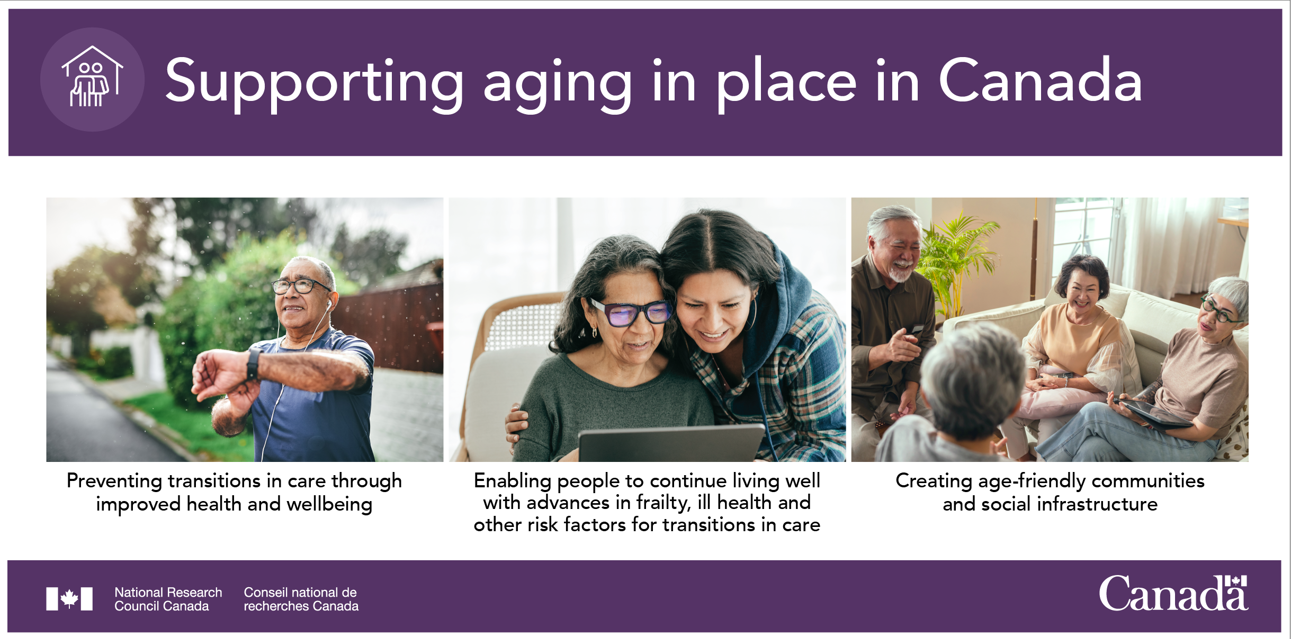
Aging in Place: Program plan & Focus areas
Supporting again in place in Canada

Slide 15
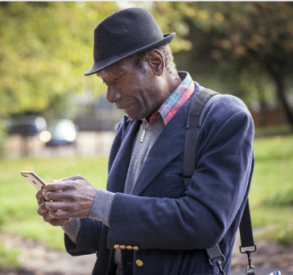
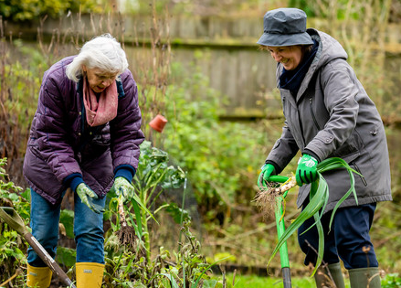

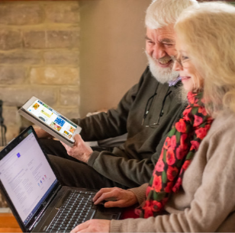
Experts by Experience
Public engagement for meaningful participation of experts by experience (EBE) in research through co-development
EBE are older adults and caregivers with lived experience of aging in Canada
They help the program understand the experiences of older adults
They ensure our research meets the needs of the community, that the technology developed answers a need, will be usable and has higher chances of being adopted
Notes:
To do meet our challenge, we rely on Experts by Experience to ensure we are on the right track towards achieving our impact. We know that when it comes to research on aging, it is best practice to meaningfully involve those who have first hand experiences. More than just a best practice, it is essential to ensure that the technology developed answers a need, will be usable and has higher chances of being adopted.
We have 3 levels of public engagement:
At the program level though an advisory panel composed of 10 to 15 older adults from across Canada and from diverse groups
At the project level, we have set a mandatory requirement to have at least one advisor per collaborative project. I want to pause here and reiterate the importance of that requirement. Aging in place is something that is very concrete for many Canadians and I’d like you all to think about how the technology you are working on may concretely affect these people because it is really key.
And finally we have community members, around 150 now, who are individuals who have expressed an interest to receive information and potentially participate in the research.

Slide 16

Respect, Relevance, Reciprocity, Responsibility, Relationships
Notes:
Being inclusive by design incorporates respect, relevance, reciprocity, and responsibility for and with the relationships that we develop in Canada and globally. What can you do in your organization, and how you conduct research?

Slide 17
Thank you
NRC.AgingInPlace-VieillirChezSoi.CNRC@nrc-cnrc.gc.ca
https://nrc.canada.ca/en/research-development/research-collaboration/programs/aging-place-challenge-program
NRC.Arctic&Northern-Arctique&Nord.CNRC@nrc-cnrc.gc.ca
https://nrc.canada.ca/en/research-development/research-collaboration/programs/arctic-northern-challenge-program
Notes:
Thank you.

