Slide 1
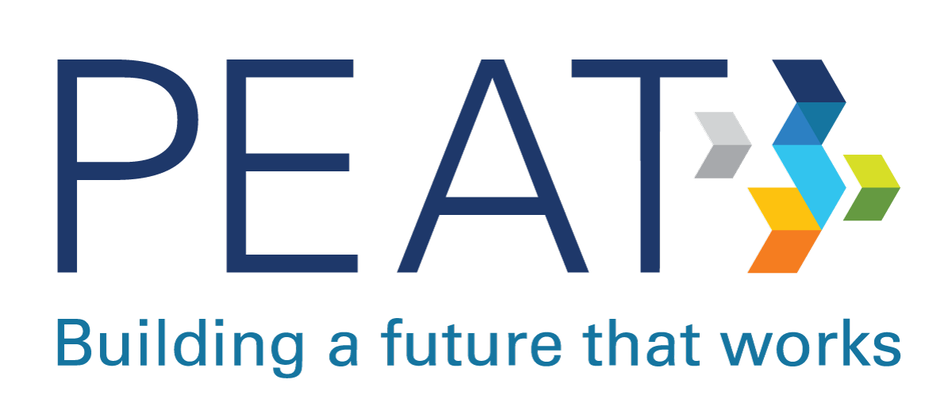
Artificial Intelligence in the Workplace:
Barriers and Benefits
2024

Slide 2


Welcome!
The Partnership on Employment & Accessible Technology (PEAT)
We are funded by the U.S. Department of Labor’s Office of Disability Employment Policy (ODEP).
We foster collaborations in the technology space that build inclusive workplaces for people with disabilities.
Our mission is to build a future where new and emerging technologies are accessible to the workforce by design.
Josh Christianson
PEAT
2

Slide 3

Topics
The ROI of Disability Inclusion
Background on AI in the Workplace
Spotlight on AI in Hiring Tech
Learn More

Slide 4
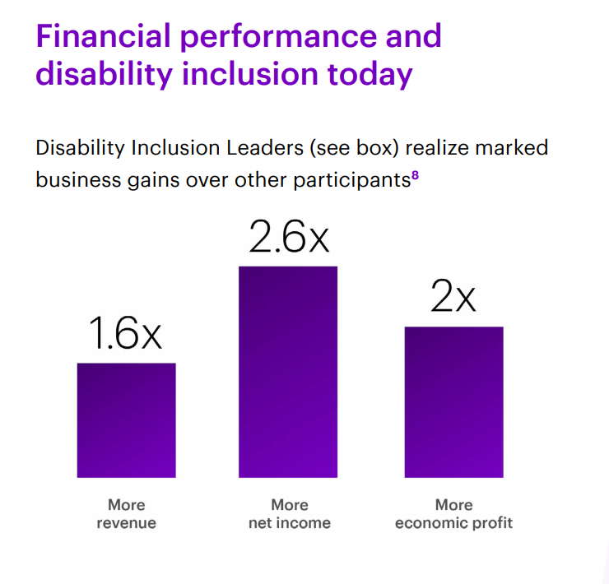
The ROI of Disability Inclusion
“Specifically, companies that have led on key disability inclusion criteria during that time have realized: 1.6x more revenue, 2.6x more net income, and 2x more economic profit than other participants in Disability:IN’s annual benchmark survey.” – Accenture.
Source: The Disability Inclusion Imperative (accenture.com)

Slide 5
Background on AI in the Workplace

Slide 6

The Fast Pace of AI Adoption
The speed of AI adoption has outpaced clear guidelines, standards, and regulatory structures on equitable technology design and implementations.
AI workplace tools are already in the market without having met independent testing criteria—despite clear risks that researchers have identified.
Tools not designed with equity in mind can lead to discriminatory practices against people with disabilities and other underrepresented groups.

Slide 7
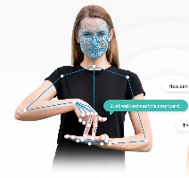
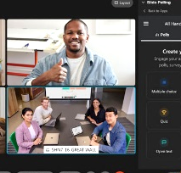

AI in the Workplace: AI for Human Assistance
Communication
Speech recognition, transcription, note taking
Translating between speech, text, sign language
Collaboration
Smaller/larger settings, in-person/hybrid/virtual
Collaborative notes, comments, follow-ups
Meeting tools with digital assistants
Assistive Technologies
Workplace accommodations, Computer vision (e.g. Seeing AI)
Multimodal communication tools
AI can be used to assist humans but can also be used to assess humans.
Regardless, AI can open new possibilities, but can also exacerbate or introduce new risks or harms.

Slide 8



AI in the Workplace: AI for Human Assessment
Recruiting & Hiring
Job matching and resume screening
Algorithmic interviews and applicant testing
Surveillance
Productivity tracking
Ability-based monitoring (e.g., keyboard tracking, gaze tracking, etc.)
Training
Completing documentation
Job simulation (e.g., virtual reality)
Training personalization
Career development

Slide 9
Discussion: Using AI-Enabled Tools
Do you use any AI-enabled tools at work?
What benefits do they bring?

Slide 10
Spotlight on AI in Hiring Technologies
Notes:
Everyone

Slide 11

Highlighting Hiring Bias
The data available on employees is usually flawed.
AI takes shortcuts whenever possible.
  It looks for easy correlations in data and can quickly become more biased than its training data.
AI reflects implicit biases of people who design it.
Many vendors consider the inner workings of their technology to be proprietary; it can be impossible to know how an AI is making decisions.

Slide 12
Key Takeaways from PEAT’s Inclusive AI in Hiring Think Tank (April 2023)
Involve people with disabilities in technology design and use. We must ensure people with diverse lived experiences are in the loop at every stage to provide human oversight, while always considering who is not in the room and working to include them.
Share risk management duties across organizations. We cannot expect one group of vendors, employers, or policymakers to handle all risk management responsibilities on their own.
Notify end users about AI tools and hold organizations accountable. Offering plain language notices can help end users learn how AI tools work, speak up about potential harms, and choose whether to opt out.
Staff at all levels need to support a culture of AI fairness. When they adopt AI hiring tools, organizations cannot simply check a box and consider them inclusive. Instead, leadership and staff need to champion fairness by establishing processes to continually evaluate their use.
PEAT Think Tank to Apply NIST AI RMF to Inclusive Hiring (April 2023)

Slide 13
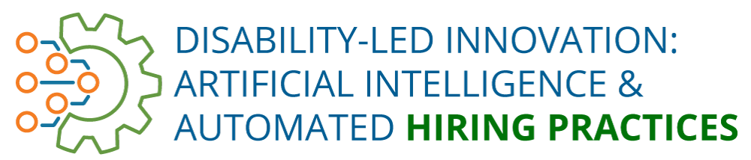

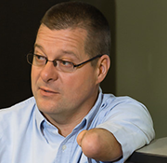



Disability-Led Innovation
We amplify the voices and work of disabled innovators
who build inclusive AI-enabled workplace technologies.
John Robinson
Our Ability
Guy Tonye
Zammo.ai
Ross Barchacky
Inclusively
Jhillika Kumar
Mentra

Slide 14
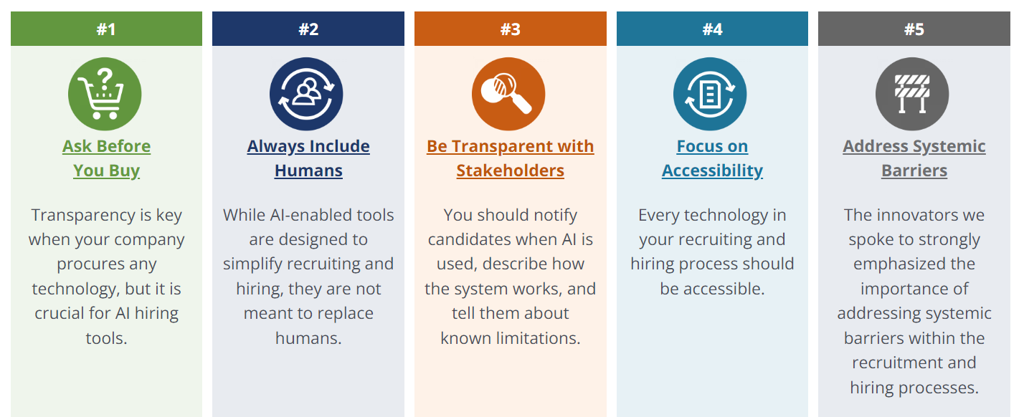
How to Mitigate Bias in AI Hiring Tools
www.peatworks.org/disability-led-innovation-report/

Slide 15
U.S. Federal Policy, Regulatory & Standards Related to Nondiscrimination AI in Hiring Technology
White House Office of Science & Technology Policy
  Blueprint for an AI Bill of Rights & Fact Sheet (Oct 2022)
  RFI on Worker Surveillance (May 2023)
  Executive Order on the Safe, Secure & Trustworthy Development and Use of AI (Oct 2023)
  OMB Memo: Advancing Governance, Innovation & Risk Mmgtt for Agency Use of AI (Mar 2024)
Federal Agencies
  EEOC Guidance on the ADA and AI Hiring Tech (May 2022) and on AI and Title VII (May 2023)
  Joint Statement: Enforcement Efforts Against Discrimination & Bias in Automated Systems (Apr 2023)
  Joint Statement on Enforcement of Civil Rights, Fair Competition, Consumer Protection & Equal Opportunity Laws in Automated Systems (Apr 2024)
National Institute of Standards & Technology (NIST) & National Telecommunications & Information Administration (NTIA)
  NIST SP 1270: Towards a Standard for Identifying and Managing Bias in AI (2021)
  NIST AI Risk Management Framework (RMF) & Playbook (Jan. 2023)
  NTIA – AI Accountability Policy Report (Mar 2024)

Slide 16

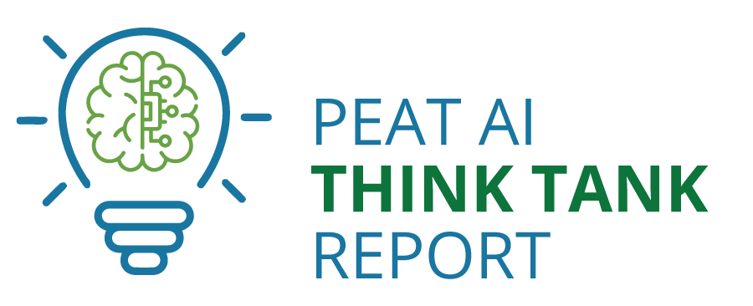
PEAT’s Collaboration with NIST on an AI RMF Profile on Inclusive Hiring
On April 17, 2023, PEAT hosted a virtual Think Tank on the use of AI tools in hiring in collaboration with NIST.
PEAT is now leading a community effort to create an AI Hiring Technologies use case profile based on the NIST AI Risk Management Framework (AI RMF).
Profile will be published on PEAT’s website this summer.
It will serve as a policy framework that employers who adopt the NIST AI RMF can use to manage risk and help ensure fairness when they deploy AI hiring technologies.
Read the PEAT AI Think Tank Report.

Slide 17
Learn More

Slide 18
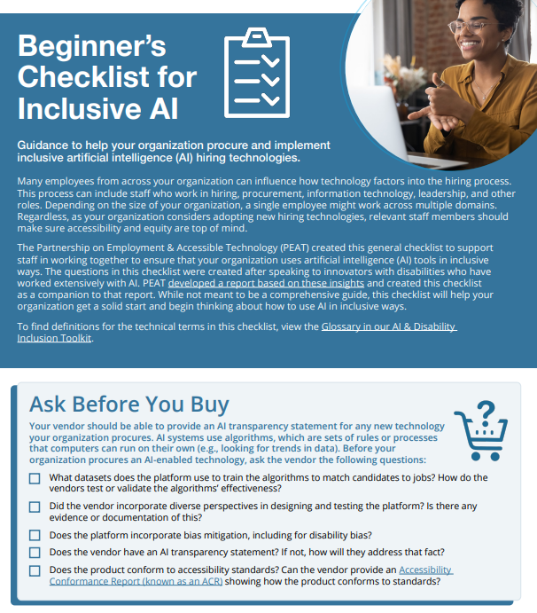
PEAT’s AI Resources
Beginner’s Checklist for Inclusive AI
PEAT AI Think Tank Report
Podcast: DEIA Driven by AI
Reduce Bias & Increase Inclusion in Your AI Hiring Technology Blog Post
Artificial Intelligence (AI) Resource Library

Slide 19
Reach Out to PEAT
Sign up for our newsletter: https://www.peatworks.org/enews/
Follow us on Twitter: @PEATWorks
Follow us on LinkedIn: https://www.linkedin.com/company/partnership-on-employment-accessible-technology/
Send us a message: https://www.peatworks.org/contact/

Slide 20
Thank you!

