Slide 1
EMOTIONS
A personal narrative of a dyslexic adult
Notes:
My research project focuses on creating an interactive and accessible digital experience consisting of personal stories of a dyslexic adult with late detection.

Slide 2
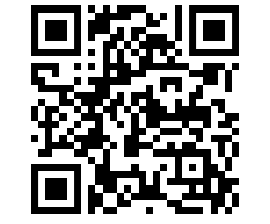
Scan QR Code
to Join The Experience
URL - https://www.dyslexiaemotions.com

Slide 3
Research Questions
Primary research question
How might I create an interactive and inclusive digital experience of my narrative of being a dyslexic adult with a late diagnosis that is relatable, educational, and accessible?
Secondary research question
How might I create strategies that foster other dyslexic individuals to engage and dialogue with my digital narrative?

Slide 4
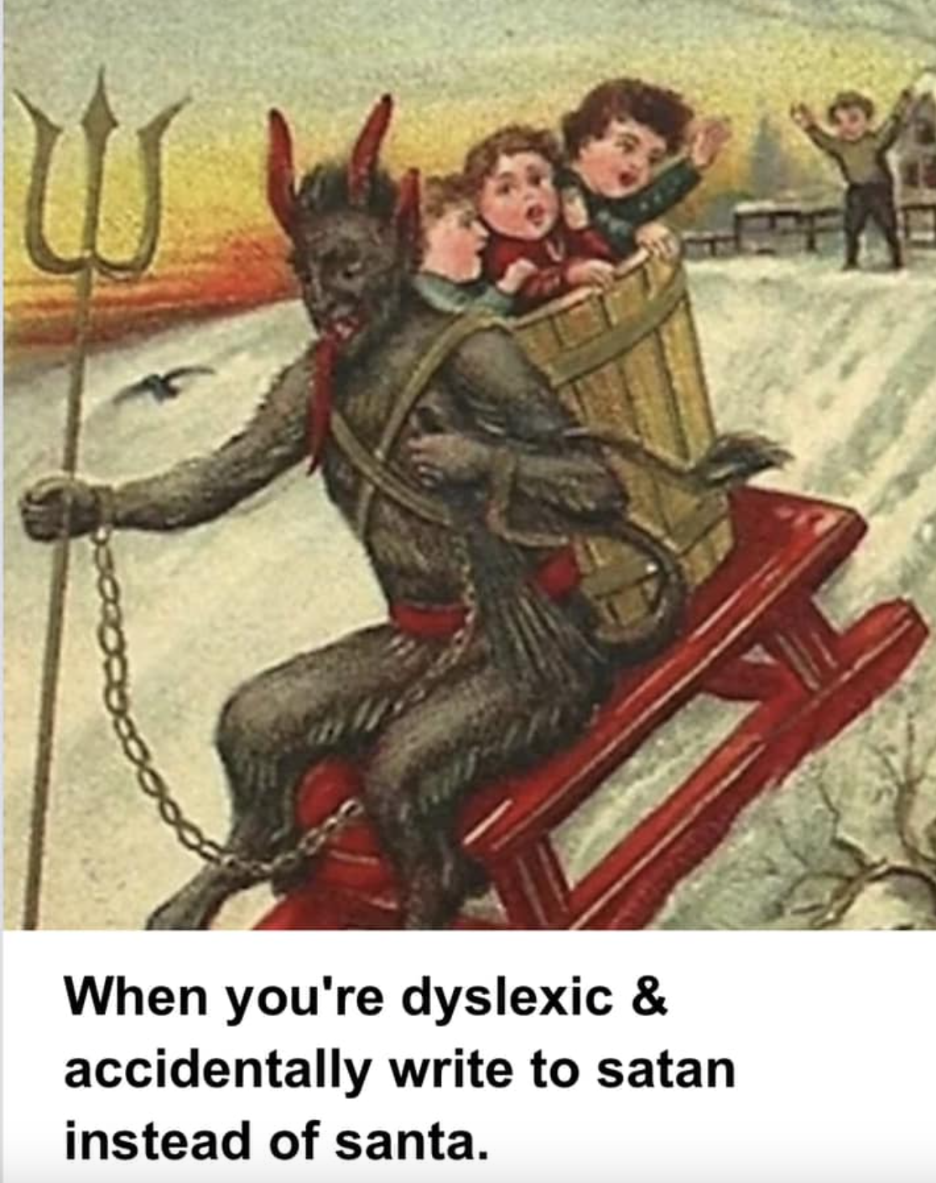
Why this project?
Discovering my dyslexia was a great puzzle missing in my life
Lack of support and resources was such a pain point
I wanted to eliminate that feeling of less support and feeling lost
I began my search on dyslexia in adulthood and began to find books, podcasts, videos, and community groups.
I also began to record my own stories and experience naturally after consuming the stories and drawing connections.
I reached a conclusion to generate a resource of my stories, and my discovery to add the richness as well as support the community.
Notes:
Self-reflections and discoveries are essential to understanding one’s capabilities and enabling the feeling of being in charge of every aspect of a dyslexic life.^{[1]}
embracing the diversity and differences among individuals, which is their greatest asset. The uniqueness of the individuals’ differences allows them to be an expert on their differences, creating innovative and generative explorations.

Slide 5
What did I learn from my research?
Dyslexia in adulthood
Inclusive design approach
Interactive documentary and narratives
Web accessibilities and benefits of digital media
Information visualisation

Slide 6
Aspects of Dyslexia in Adulthood
Dyslexia in adulthood
Late diagnosis implications
Current pathological and society portrayal
Understanding Dyslexia in Adults and myself
Implications in different context/environment
Impact on behaviours and emotions of adults
Interventions strategies mapping
Positive attributes

Slide 7
Inclusive design approach
Human difference and variability
Inclusive Co-design process
Designing in complex adaptive system in flux
Connectedness with Autoethnography
Notes:
1st dimension - Self-reflections and discoveries are essential to understanding one’s capabilities and enabling the feeling of being in charge of every aspect of a dyslexic life.^{[1]}
embracing the diversity and differences among individuals, which is their greatest asset.
The uniqueness of the individuals’ differences allows them to be an expert on their differences, creating innovative and generative explorations.
2nd dimension - I have been co-creating each process thoroughly in the project.
Another aspect of my reflections highlighted the usage of a hybrid version of interventions for me due to my late diagnosis.
The co-creation of personal interventions and existing standard interventions together have developed an adaptive and effective structure for me
3rd dimension - complex system with multiple layers nested within, influencing it.
I decoded the layers of my influences: my stories and emotions, education- university and school, workplace- employer and culture, home- family, social- friends, personal struggles, and interventions, standardized interventions, and the dyslexia community, medical approach, society
autoethnography and reflexivity have enabled me to understand each layer and address it in depth to understand their influence on each othe

Slide 8
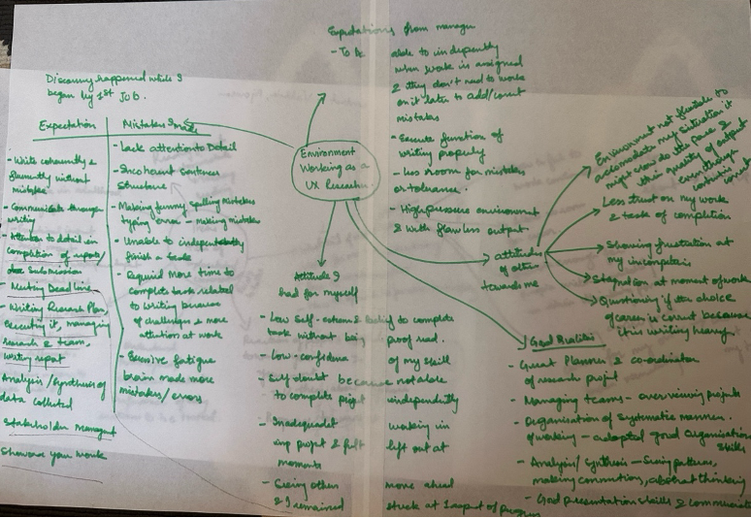
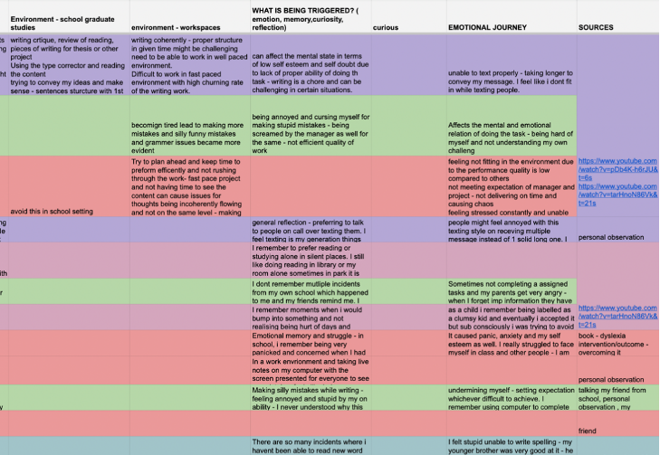
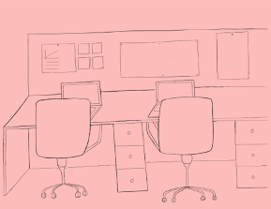
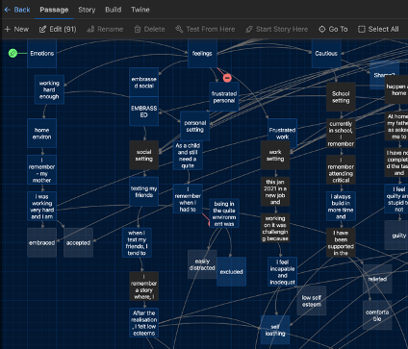
How I generated and collected my data?
Tables and spreadsheets
Mindmapping
Illustrations
Storytelling
Notes:
Mindmapping
- Collecting my stories
- Speaking with my friends and family about me
- Resources and knowledge about dyslexia in adulthood
Tables
Organising the chaos of all the mindmap and information
Difference, intervention, emotion, stories, resources connections
With this proper tabular format, I could see similar or repetitive information, which enabled me to analyse the data accordingly.
The process of data analysis provided me with insights about my struggles with dyslexia and their impact on me.
Illustrations
Data generation and analysis were followed by visualisation and creation.
I started illustrating my stories to give the audience a visual context of my incidents.
Emotions and character development
Storytelling
Narrative structure- understand to showcases overlaps between stories and explore branching structures and non linear structure of storytelling
Used twine to explore and understand the overlaps visualise between stories.
How i could connect different stories and loop them with overlapping emotions.

Slide 9
How did I communicate the data collected?
Defined guidelines
Drawing inspiration and studying narrative structures, media, visualization styles
Using Design research method to understand each step of the research in the project and creating a design guidelines for the project
Web accessibilities and W3G benchmarks
Interactive documentary and narratives
Information visualisation
Notes:
Defined accessible guidelines from w3g and book by regina who mentioned several basic guidelines to ensure inclusivity - font, size, line spacing, color contrast,
Viewing multiple interactive documentaries and narrative structures examples through thoroughly studying the prison valley, after strom and vimy- to understand the narrative and idea for visualisation
Yesterday , today tomorrow project - showcased representation of data with emotions and visualisation using color and shapes to convey large chunk of data
Design research methodology - supported defining goal, increased understanding about the goal, creation of specific design guidelines with all the research and conducting some testing

Slide 10
Design guidelines
Put the user in control
Give users choice
Design with familiarity
Use of interactive format to share information
Notes:
which is an amalgamation of inclusive web accessibilities for dyslexics (ref- 2.3.5) and interactive documentary and narrative (ref-2.4). I have been drawing deep inspiration for the designing process using these guidelines to create efficient design that is inclusive for the individuals from the community
Anchoring my project design and decision making upon these principles and along with w3g guidelines

Slide 11
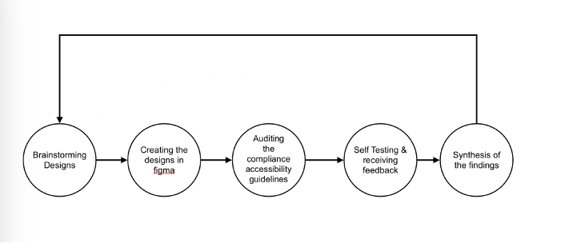
How did I make the digital experience?
Use of iterative design method to develop the design and the entire prototyping process
Notes:
Iterative cycle for the development of the characters and design was a continuous process
My iteration cycle was generating and refining the design on Figma (software web/mobile). With each cycle, I became more aware of the usability, purpose, navigation, information visualisation, and accessibility issues.

Slide 12

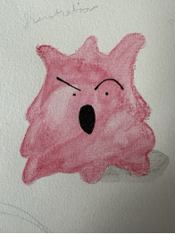


Creating the characters
Color and emotion mapping
Character development
Notes:
Use of color and shapes are very strong visual points for the dyslexic individuals -
I map the emotions with colour - using paul ekman - emotions are resultant to each situation and a important aspect
I chose to work with five primary emotions – anger, sadness, fear, disgust, and joy
Each emotion impacts distinctive signals, physiologies, and timelines.
I began to unpack the physical impact , expression, body gestures and feeling for each of them
To further develop the character
These character went through multiple iteration and correction - exploring with limbs, static vs moving and expression
Studying the anime, cartoon characters to understand how to expression exaggerated movement and expressions

Slide 13
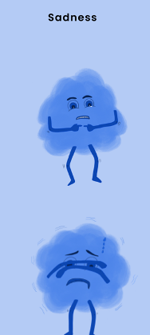
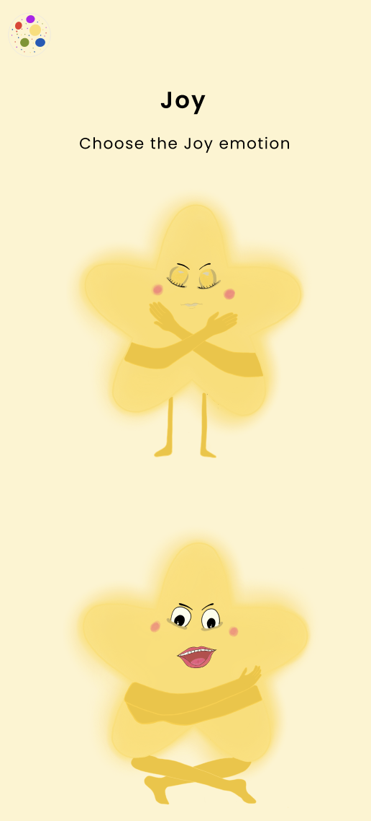
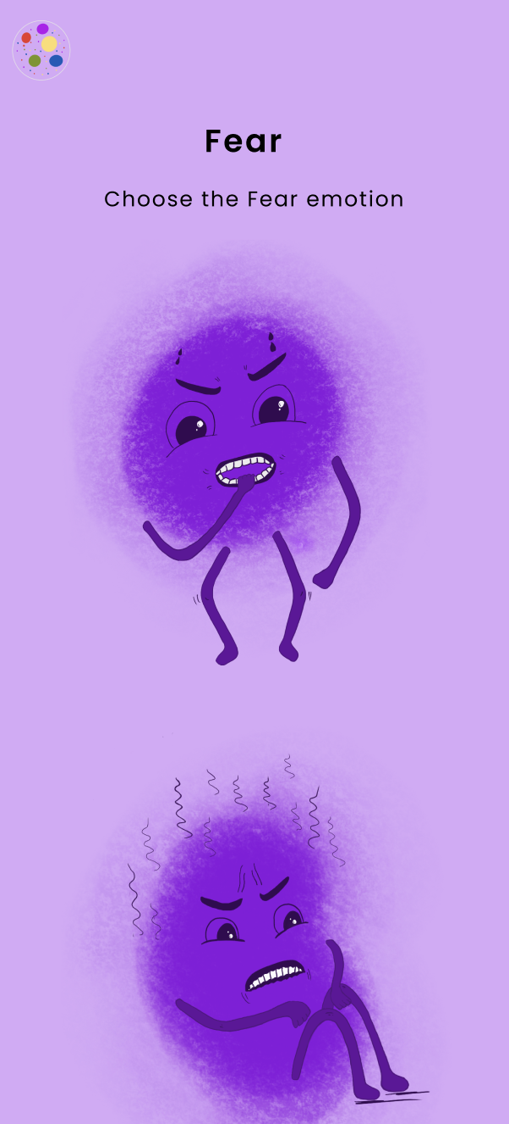
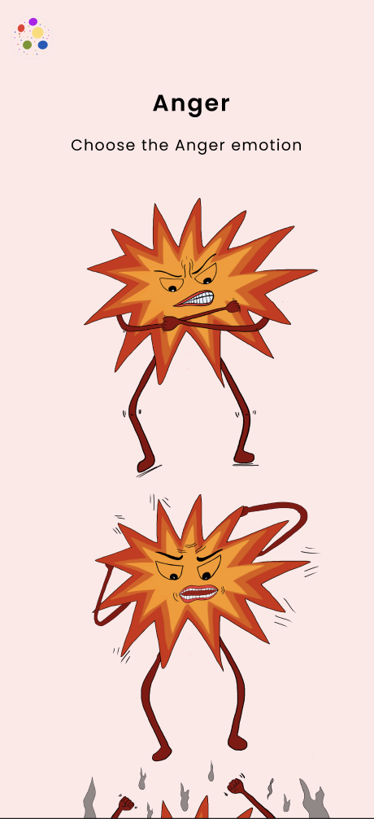
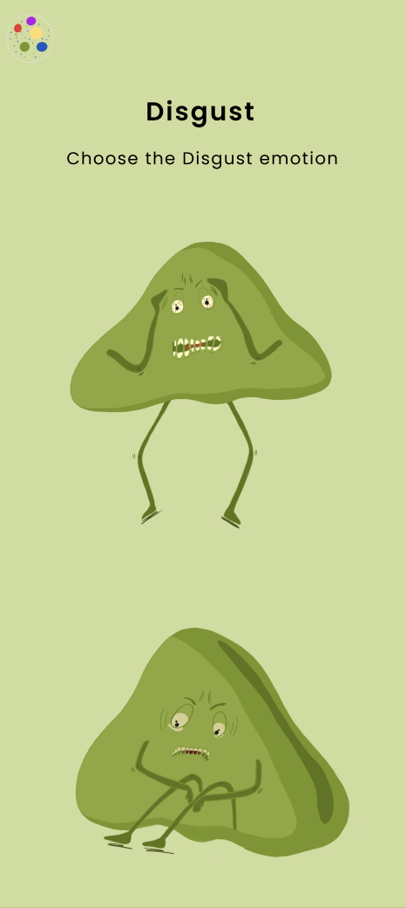
Emotions Characters
Notes:
Use of color and shapes are very strong visual points for the dyslexic individuals -
I map the emotions with colour - using paul ekman - emotions are resultant to each situation and a important aspect
I chose to work with five primary emotions – anger, sadness, fear, disgust, and joy
Each emotion impacts distinctive signals, physiologies, and timelines.
I began to unpack the physical impact , expression, body gestures and feeling for each of them
To further develop the character
These character went through multiple iteration and correction - exploring with limbs, static vs moving and expression
Studying the anime, cartoon characters to understand how to expression exaggerated movement and expressions

Slide 14
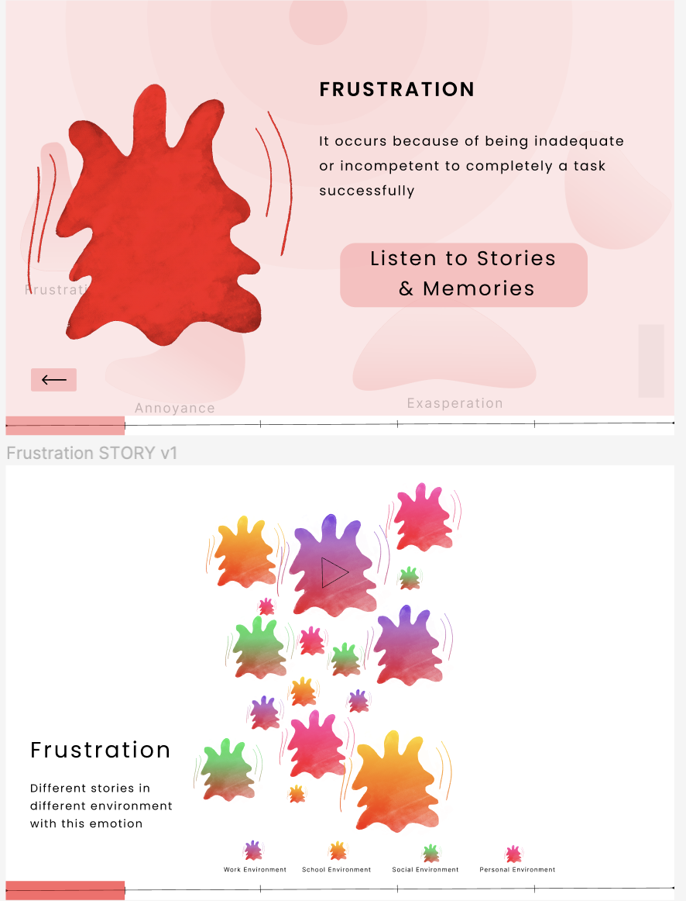
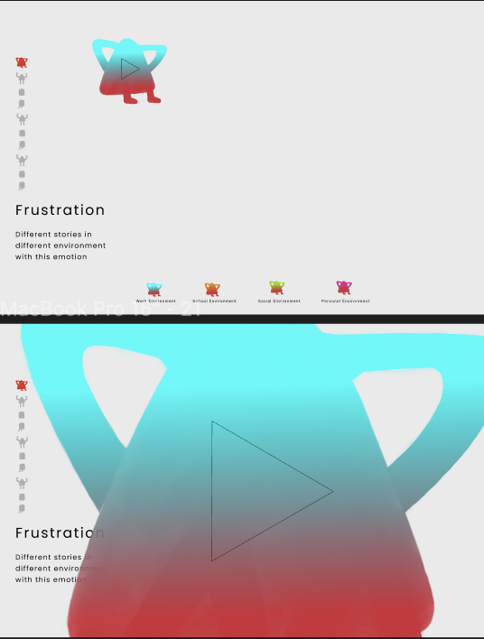
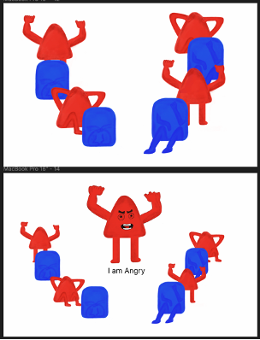
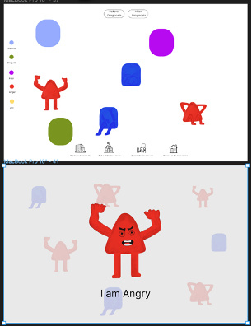
Creating the Web experience
1st prototype
2nd prototype
Notes:
Follow the design guidelines and web accessbilties requirement from w3g was a constant in the design process
1st prototype - The first version focused on creating the base structure and flow of the digital experience.
Inspired - These were projects with narrative structures, information architecture, engagement, navigation, thematic designing and detailing, and interaction with different elements,
Once the structure began to stablise - accessbilities rules were applied- font size, font type, minimal text and simple text, readability, audio - visual based format to communicate information as dyslexic prefer less reading based content, providing more customisation with the experience, subtitle of the stories and immersive reader
2nd prototype - After feedback and some testing - focused on developing the introduction, homepage and interactions details - how to maintain the intrigue for the audience?
Constantly developing different features and testing them in the process of creation and iteration
Developing different type of use cases of users to avoid friction or trouble using the experience

Slide 15
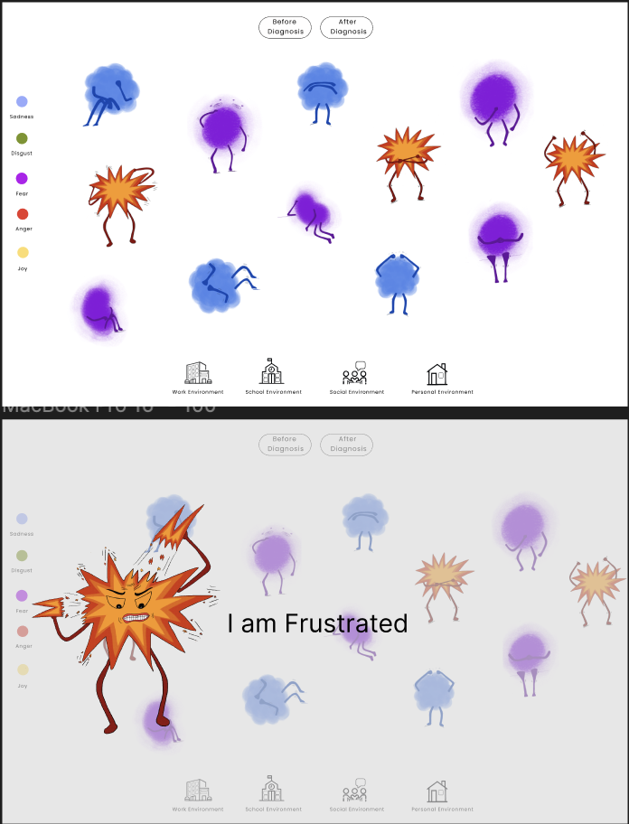
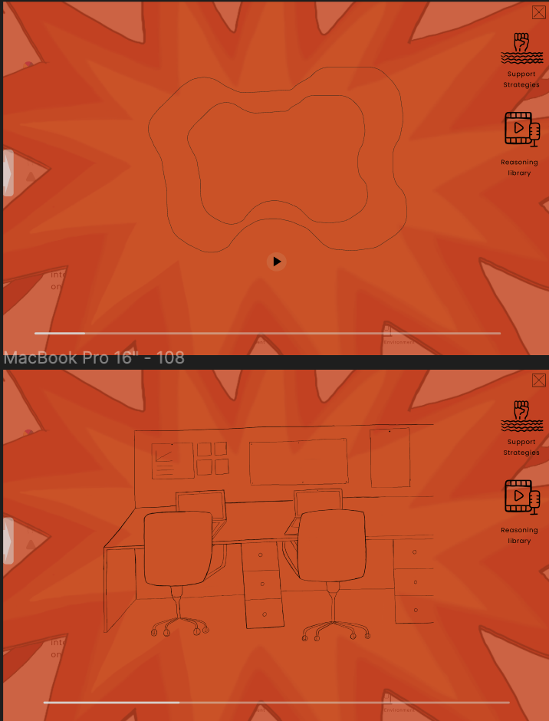


Creating the Web experience – with more prototype
3rd prototype
4th prototype
Notes:
After the initial cycle established majorit of the structure but the refinmeent an detailing happened in the 3th and 4th prototype cycles
Giving more control to the audience - adding buttons and more context
Better navigation - ensuring it is seamless and not broken in the journey
Ensuring familiarity in the design and establishing a space for navigation bar
Doing contrast check and audio visual features
Adding timeline
Adding uniformity in the design through icons, forms, locations

Slide 16
Creating the Web experience with more prototypes
3rd prototype
4th prototype
Notes:
After the initial cycle established majorit of the structure but the refinmeent an detailing happened in the 3th and 4th prototype cycles
Giving more control to the audience - adding buttons and more context
Better navigation - ensuring it is seamless and not broken in the journey
Ensuring familiarity in the design and establishing a space for navigation bar
Doing contrast check and audio visual features
Adding timeline
Adding uniformity in the design through icons, forms, locations

Slide 17
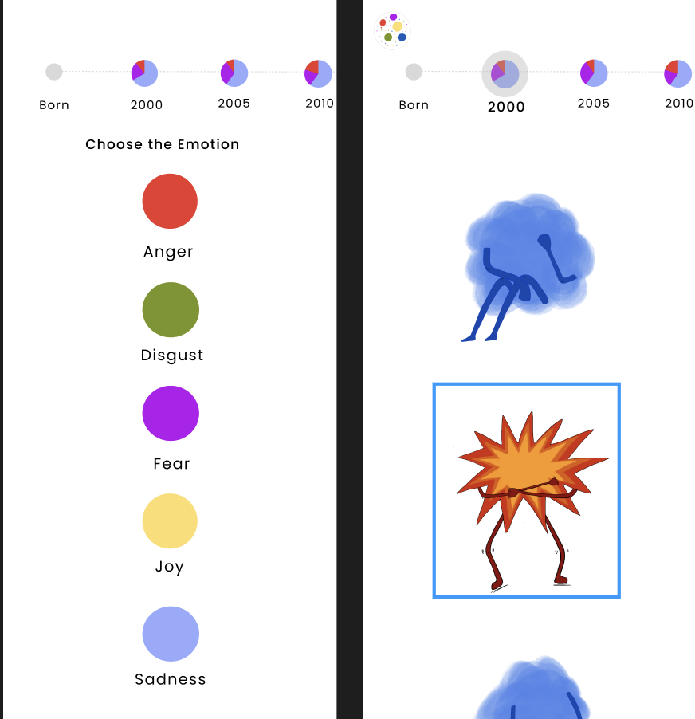
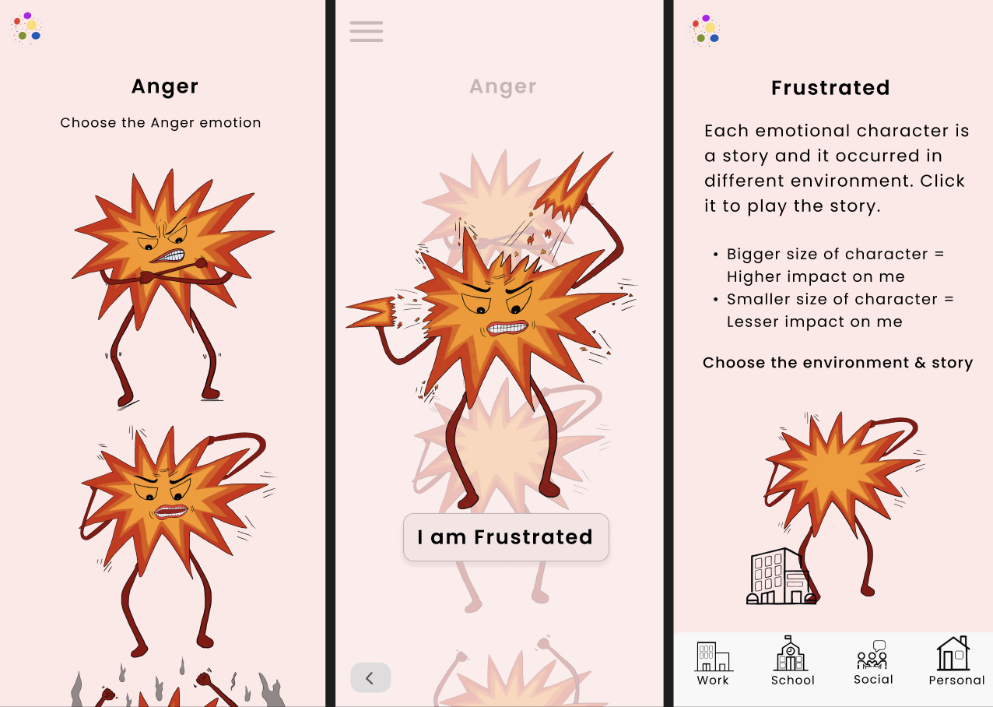
Creating Mobile experience
Notes:
create a mobile wireframe that maintained the same visual language of the web experience
navigation for mobile phones had to be different because of the touch-based interaction, which limited the gestures
content should be decluttered and minimal, reducing any visual disruptions and facilitating ease of navigation
redesigned some screens to visualise usability and cohesion
The interactions required more detail as the transitions between the screens were limited to touch and click
Auditing the experience with accessibility - readability, size of text, control and choice being provided - constantly testing in that regard

Slide 18
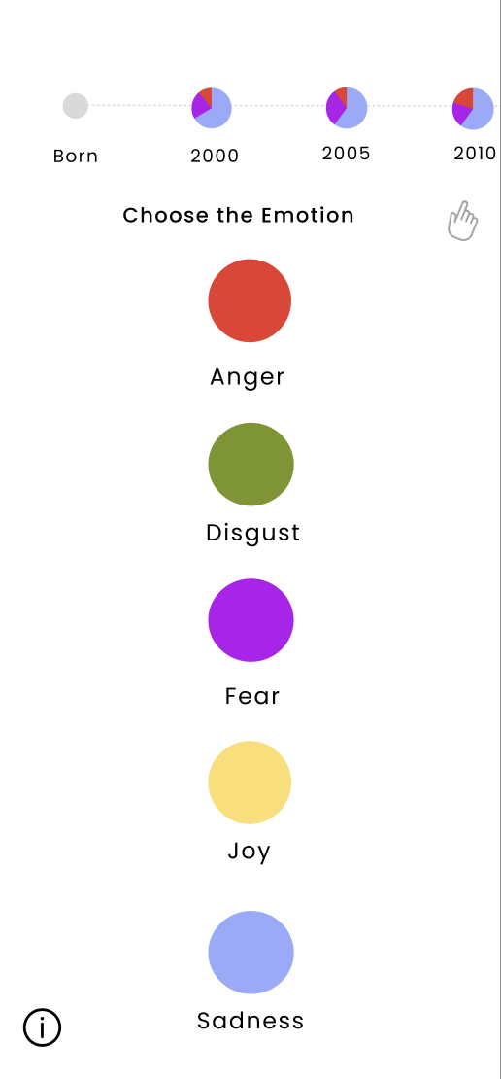
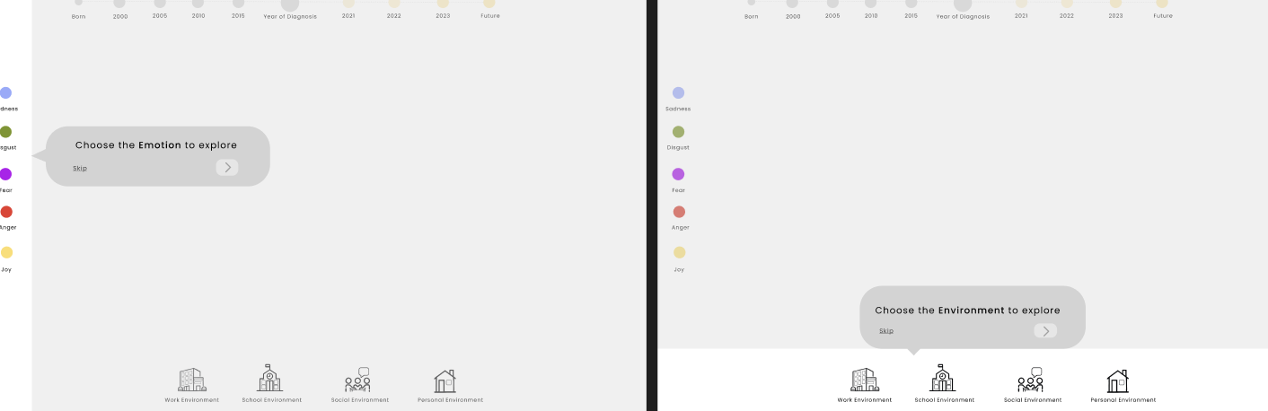
Testing the digital experience
Notes:
participants grasp the concept of the website/mobile experience
if participants are seamlessly able to navigate through the experience
6 participants mix of neuro diverse and neuro typical folks in the testing to ensure everyone feels comfortable in the experience
Testing learning
Great representation and characters were enjoyable
Audio stories were relatable and visuals support - for the neuro diverse folks
Support and library button add value
The neurotypical participants were intrigued by the stories and recognized the depth of emotions
Highlighted issues like - navigational issues in the phone
Need for tutorial in the web experience - making these addition help in user experience

Slide 19
Building and coding
Worked with technical team to support in coding the experience
Revising the designs due to the technical capabilities without compromising on the user experience
A lot of changes and decisions had to be made in the process of completing the project
Involved negotiation with the programmer constantly

Slide 20
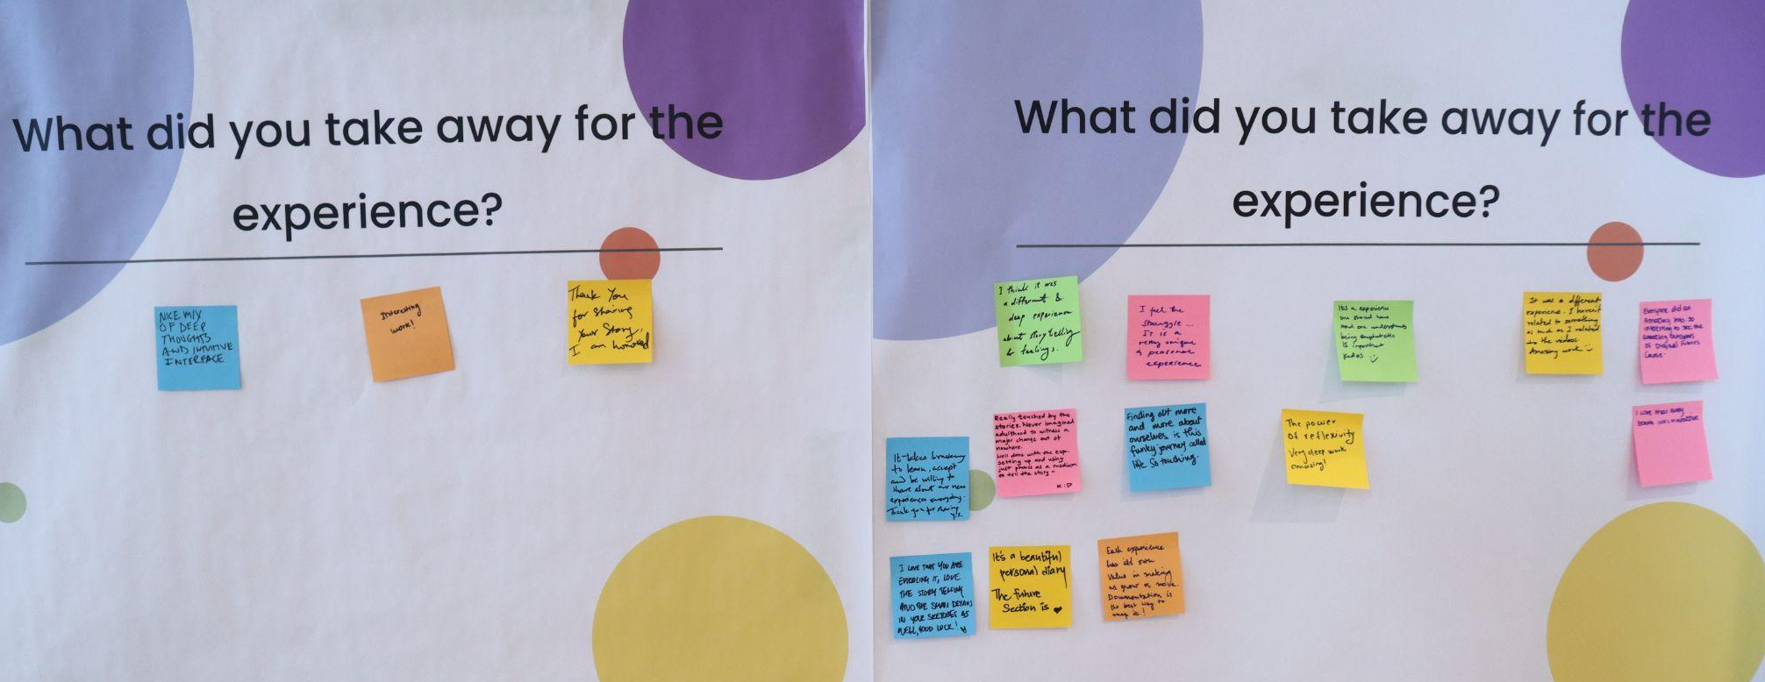
Exhibition response
Notes:
Look and feel of the experience was enjoyable - characters , interactivity of the experience, storytelling, details in drawing,
Relatability and connections with themselves
Empathy for the dyslexic and their daily struggles, deep reflection and experience sharing is valuable
Bravery for me to share such vulnerable stories with the world
Use of phone as the medium of storytelling
Appreciation for the documentation of the stories and reflection
Feeling less alone

Slide 21
Scan QR Code
to Join The Experience #
URL - https://www.dyslexiaemotions.com

