Slide 1
EMOTIONS
Récit personnel d'un adulte dyslexique
Notes:
My research project focuses on creating an interactive and accessible digital experience consisting of personal stories of a dyslexic adult with late detection.

Slide 2
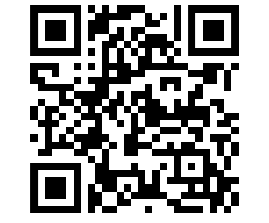
Scannez le code QR pour participer à l'expérience
URL - https://www.dyslexiaemotions.com

Slide 3
Questions de recherche
Question principale de la recherche
Comment puis-je créer une expérience numérique interactive et inclusive de mon récit d'adulte dyslexique ayant reçu un diagnostic tardif, qui soit racontable, éducative et accessible ?
Question de recherche secondaire
Comment puis-je créer des stratégies qui encouragent d'autres personnes dyslexiques à s'engager et à dialoguer avec mon récit numérique ?

Slide 4
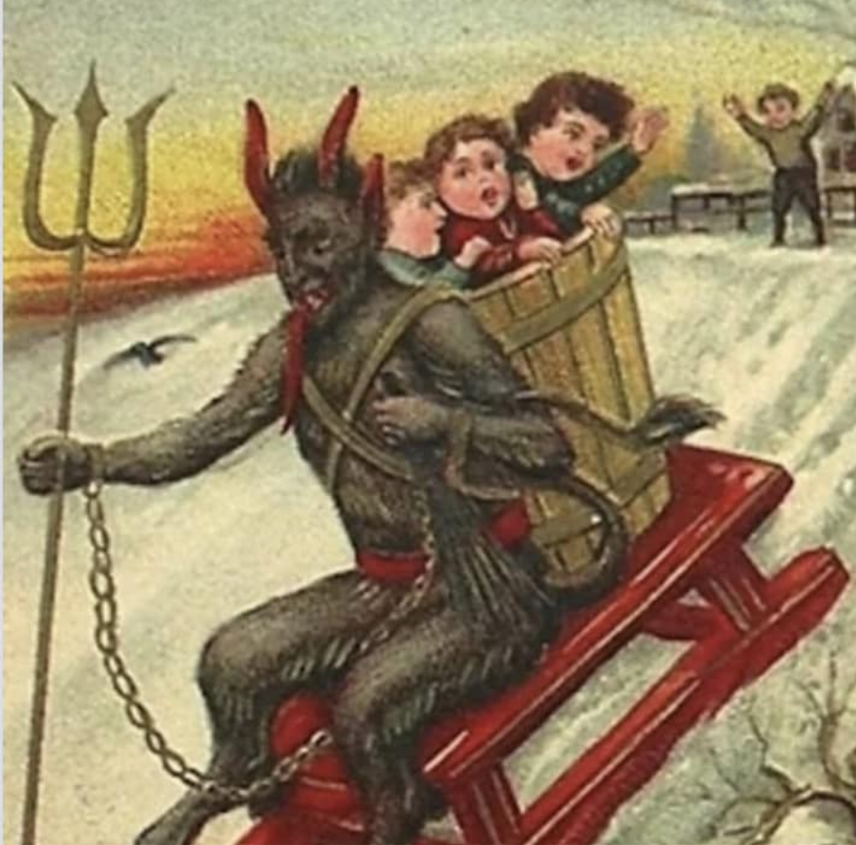
Pourquoi ce projet ?
La découverte de ma dyslexie a été un grand puzzle qui manquait à ma vie.
Le manque de soutien et de ressources était une véritable plaie.Je voulais éliminer ce sentiment de manque de soutien et d'égarement.
J'ai commencé mes recherches sur la dyslexie à l'âge adulte et j'ai commencé à trouver des livres, des podcasts, des vidéos et des groupes communautaires.
J'ai également commencé à enregistrer mes propres histoires et mes expériences naturellement après avoir consommé les histoires et établi des liens.
J'en suis arrivée à la conclusion qu'il fallait créer une ressource à partir de mes histoires et de mes découvertes afin d'enrichir et de soutenir la communauté.
When you are dyslexic and accidentally write to satan instead of santa.
Notes:
Self-reflections and discoveries are essential to understanding one’s capabilities and enabling the feeling of being in charge of every aspect of a dyslexic life.^{[1]}
embracing the diversity and differences among individuals, which is their greatest asset. The uniqueness of the individuals’ differences allows them to be an expert on their differences, creating innovative and generative explorations.

Slide 5
Qu'ai-je appris de mes recherches ?
La dyslexie à l'âge adulte
Approche inclusive de la conception
Documentaires et récits interactifs
Accès au web et avantages des médias numériques
Visualisation de l'information

Slide 6
Aspects de la dyslexie à l'âge adulte
La dyslexie à l'âge adulte
Implications d'un diagnostic tardif
Représentation actuelle de la pathologie et de la société
Comprendre la dyslexie chez les adultes et moi-même
Impact sur les comportements et les émotions des adultes
Implications dans un contexte/environnement différent
Attributs positifs
Cartographie des stratégies d'intervention

Slide 7
Approche inclusive de la conception
Différence et variabilité humaines
Processus de co-conception inclusive
Concevoir dans un système adaptatif complexe en mouvement
Liens avec l'autoethnographie
Notes:
1st dimension - Self-reflections and discoveries are essential to understanding one’s capabilities and enabling the feeling of being in charge of every aspect of a dyslexic life.^{[1]}
embracing the diversity and differences among individuals, which is their greatest asset.
The uniqueness of the individuals’ differences allows them to be an expert on their differences, creating innovative and generative explorations.
2nd dimension - I have been co-creating each process thoroughly in the project.
Another aspect of my reflections highlighted the usage of a hybrid version of interventions for me due to my late diagnosis.
The co-creation of personal interventions and existing standard interventions together have developed an adaptive and effective structure for me
3rd dimension - complex system with multiple layers nested within, influencing it.
I decoded the layers of my influences: my stories and emotions, education- university and school, workplace- employer and culture, home- family, social- friends, personal struggles, and interventions, standardized interventions, and the dyslexia community, medical approach, society
autoethnography and reflexivity have enabled me to understand each layer and address it in depth to understand their influence on each othe

Slide 8
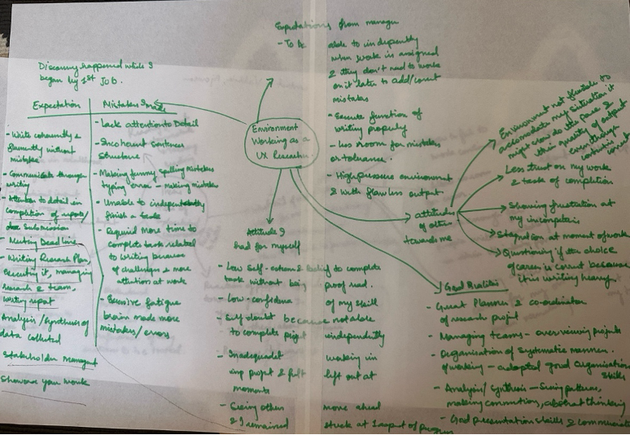
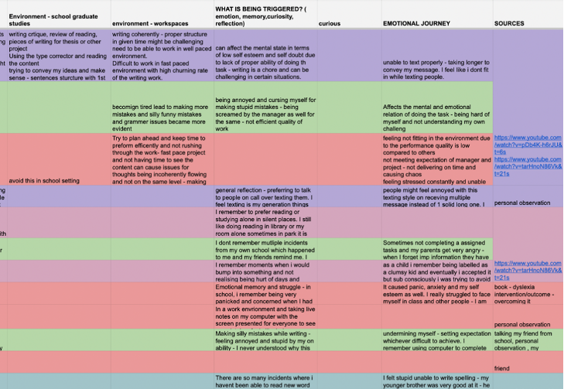
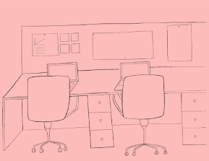
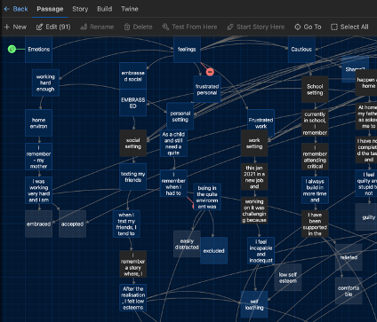
Comment ai-je généré et collecté mes données ?
Tableaux et feuilles de calcul
Récit de l'histoire
Mindmapping
Illustrations
Notes:
Mindmapping
- Collecting my stories
- Speaking with my friends and family about me
- Resources and knowledge about dyslexia in adulthood
Tables
Organising the chaos of all the mindmap and information
Difference, intervention, emotion, stories, resources connections
With this proper tabular format, I could see similar or repetitive information, which enabled me to analyse the data accordingly.
The process of data analysis provided me with insights about my struggles with dyslexia and their impact on me.
Illustrations
Data generation and analysis were followed by visualisation and creation.
I started illustrating my stories to give the audience a visual context of my incidents.
Emotions and character development
Storytelling
Narrative structure- understand to showcases overlaps between stories and explore branching structures and non linear structure of storytelling
Used twine to explore and understand the overlaps visualise between stories.
How i could connect different stories and loop them with overlapping emotions.

Slide 9
Comment ai-je communiqué les données recueillies ?
Lignes directrices définies
S'inspirer et étudier les structures narratives, les médias et les styles de visualisation
Utilisation de la méthode de recherche conceptuelle pour comprendre chaque étape de la recherche dans le projet et création de lignes directrices pour la conception du projet.
Accessibilité du Web et critères de référence W3G
Documentaires et récits interactifs
Visualisation de l'information
Notes:
Defined accessible guidelines from w3g and book by regina who mentioned several basic guidelines to ensure inclusivity - font, size, line spacing, color contrast,
Viewing multiple interactive documentaries and narrative structures examples through thoroughly studying the prison valley, after strom and vimy- to understand the narrative and idea for visualisation
Yesterday , today tomorrow project - showcased representation of data with emotions and visualisation using color and shapes to convey large chunk of data
Design research methodology - supported defining goal, increased understanding about the goal, creation of specific design guidelines with all the research and conducting some testing

Slide 10
Lignes directrices pour la conception
Donner le contrôle à l'utilisateur
Donner le choix aux utilisateurs
Concevoir avec familiarité
Utilisation d'un format interactif pour partager l'information
Notes:
which is an amalgamation of inclusive web accessibilities for dyslexics (ref- 2.3.5) and interactive documentary and narrative (ref-2.4). I have been drawing deep inspiration for the designing process using these guidelines to create efficient design that is inclusive for the individuals from the community
Anchoring my project design and decision making upon these principles and along with w3g guidelines

Slide 11
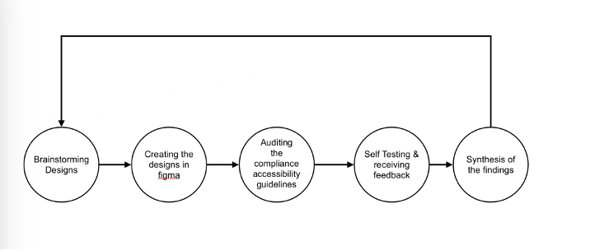
Comment ai-je rendu l'expérience numérique ?
Utilisation d'une méthode de conception itérative pour développer la conception et l'ensemble du processus de prototypage
Notes:
Iterative cycle for the development of the characters and design was a continuous process
My iteration cycle was generating and refining the design on Figma (software web/mobile). With each cycle, I became more aware of the usability, purpose, navigation, information visualisation, and accessibility issues.

Slide 12

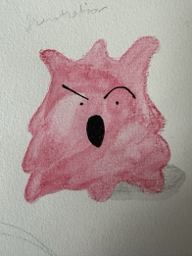


Creating the characters
Création des personnages
Développement du caractère
Notes:
Use of color and shapes are very strong visual points for the dyslexic individuals -
I map the emotions with colour - using paul ekman - emotions are resultant to each situation and a important aspect
I chose to work with five primary emotions – anger, sadness, fear, disgust, and joy
Each emotion impacts distinctive signals, physiologies, and timelines.
I began to unpack the physical impact , expression, body gestures and feeling for each of them
To further develop the character
These character went through multiple iteration and correction - exploring with limbs, static vs moving and expression
Studying the anime, cartoon characters to understand how to expression exaggerated movement and expressions

Slide 13
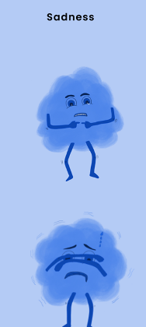
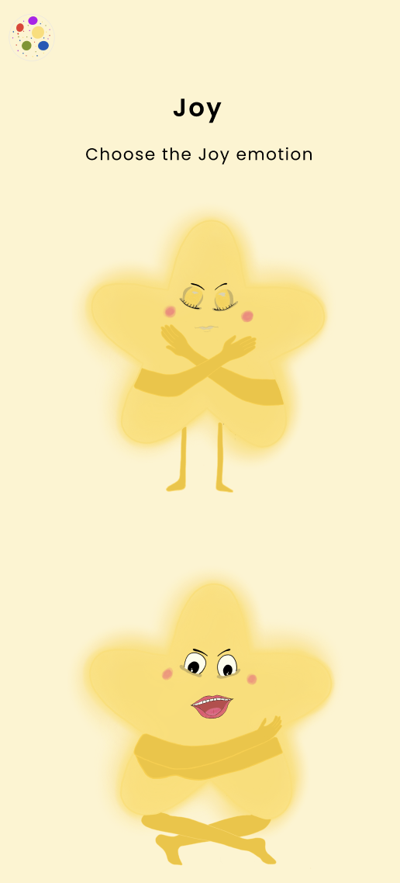
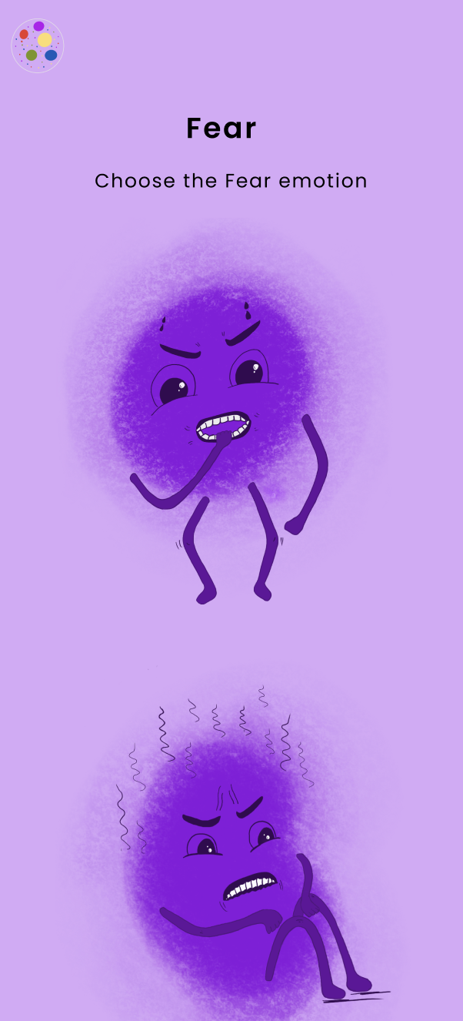
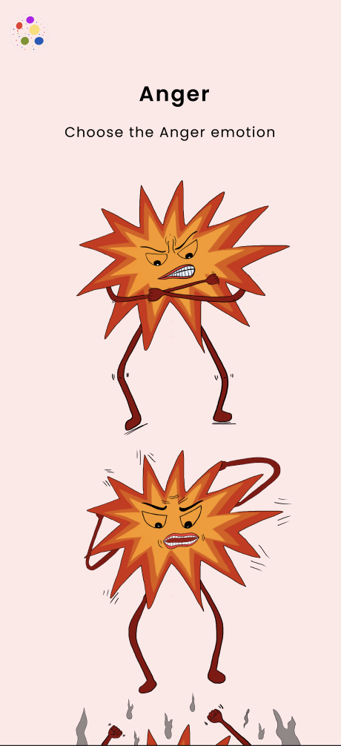
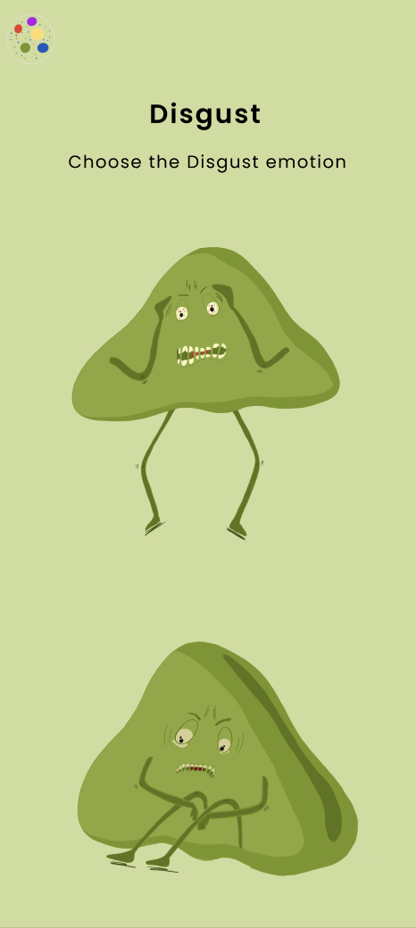
Caractères des émotions
Notes:
Use of color and shapes are very strong visual points for the dyslexic individuals -
I map the emotions with colour - using paul ekman - emotions are resultant to each situation and a important aspect
I chose to work with five primary emotions – anger, sadness, fear, disgust, and joy
Each emotion impacts distinctive signals, physiologies, and timelines.
I began to unpack the physical impact , expression, body gestures and feeling for each of them
To further develop the character
These character went through multiple iteration and correction - exploring with limbs, static vs moving and expression
Studying the anime, cartoon characters to understand how to expression exaggerated movement and expressions

Slide 14
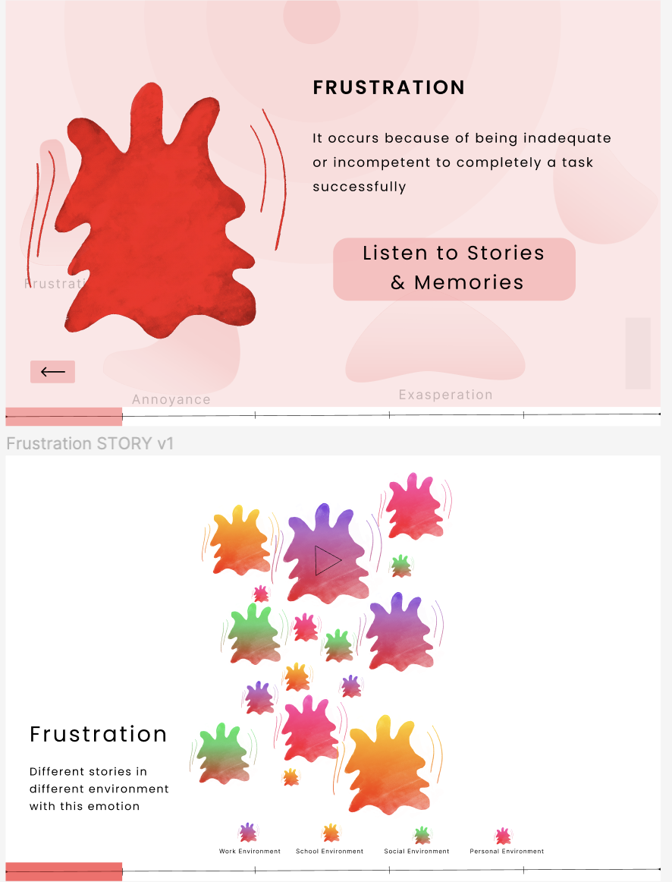
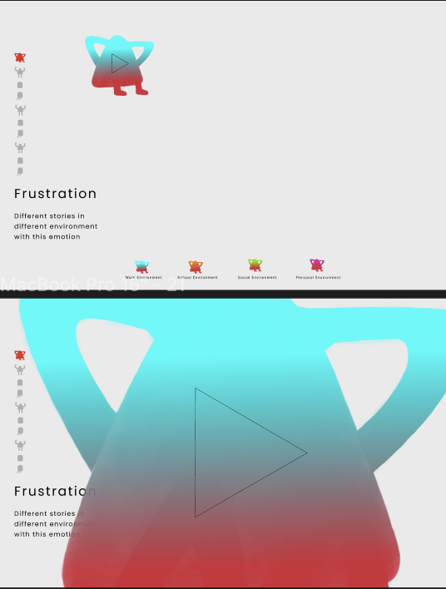
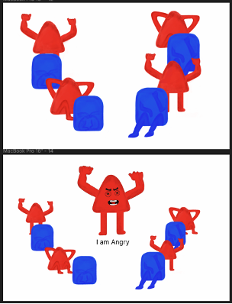
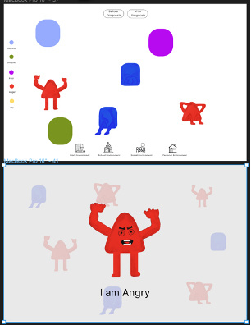
Créer l'expérience Web
1er prototype
2ème prototype
Notes:
Follow the design guidelines and web accessbilties requirement from w3g was a constant in the design process
1st prototype - The first version focused on creating the base structure and flow of the digital experience.
Inspired - These were projects with narrative structures, information architecture, engagement, navigation, thematic designing and detailing, and interaction with different elements,
Once the structure began to stablise - accessbilities rules were applied- font size, font type, minimal text and simple text, readability, audio - visual based format to communicate information as dyslexic prefer less reading based content, providing more customisation with the experience, subtitle of the stories and immersive reader
2nd prototype - After feedback and some testing - focused on developing the introduction, homepage and interactions details - how to maintain the intrigue for the audience?
Constantly developing different features and testing them in the process of creation and iteration
Developing different type of use cases of users to avoid friction or trouble using the experience

Slide 15
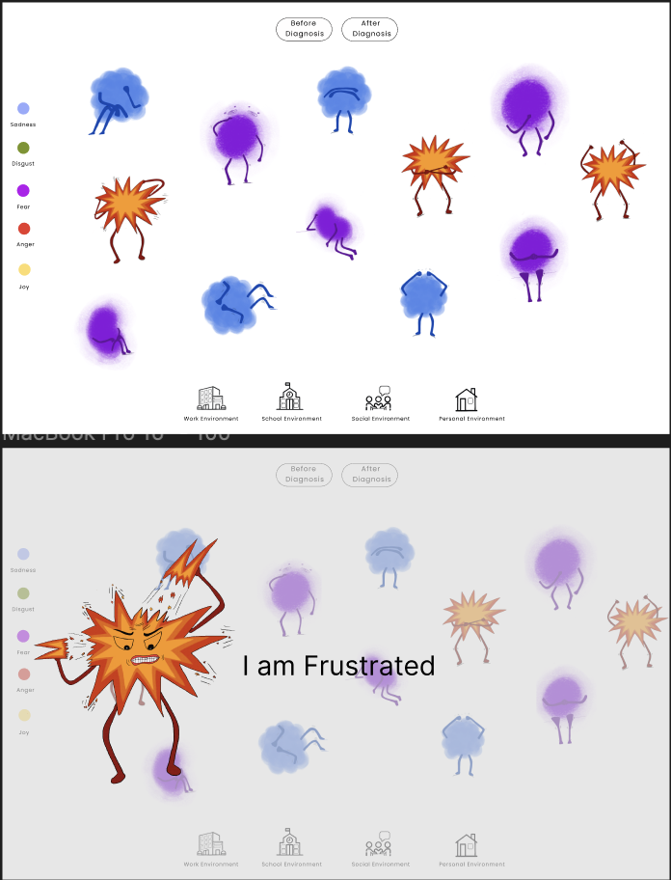
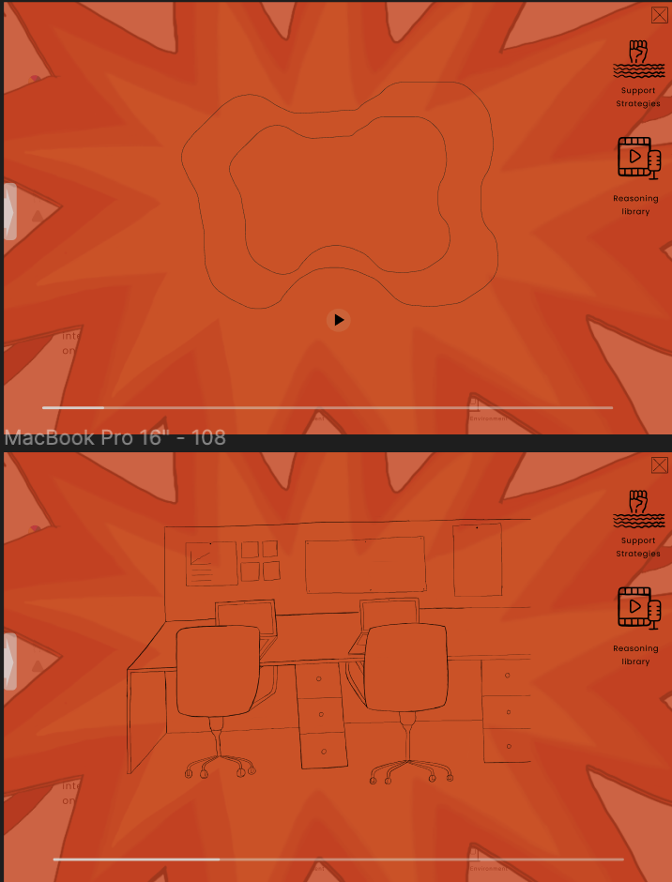


Créer l'expérience Web - avec plus de prototypes
3ème prototype
4ème prototype
Notes:
After the initial cycle established majorit of the structure but the refinmeent an detailing happened in the 3th and 4th prototype cycles
Giving more control to the audience - adding buttons and more context
Better navigation - ensuring it is seamless and not broken in the journey
Ensuring familiarity in the design and establishing a space for navigation bar
Doing contrast check and audio visual features
Adding timeline
Adding uniformity in the design through icons, forms, locations

Slide 16
Créer l'expérience Web avec plus de prototypes
3ème prototype
4ème prototype
Notes:
After the initial cycle established majorit of the structure but the refinmeent an detailing happened in the 3th and 4th prototype cycles
Giving more control to the audience - adding buttons and more context
Better navigation - ensuring it is seamless and not broken in the journey
Ensuring familiarity in the design and establishing a space for navigation bar
Doing contrast check and audio visual features
Adding timeline
Adding uniformity in the design through icons, forms, locations

Slide 17
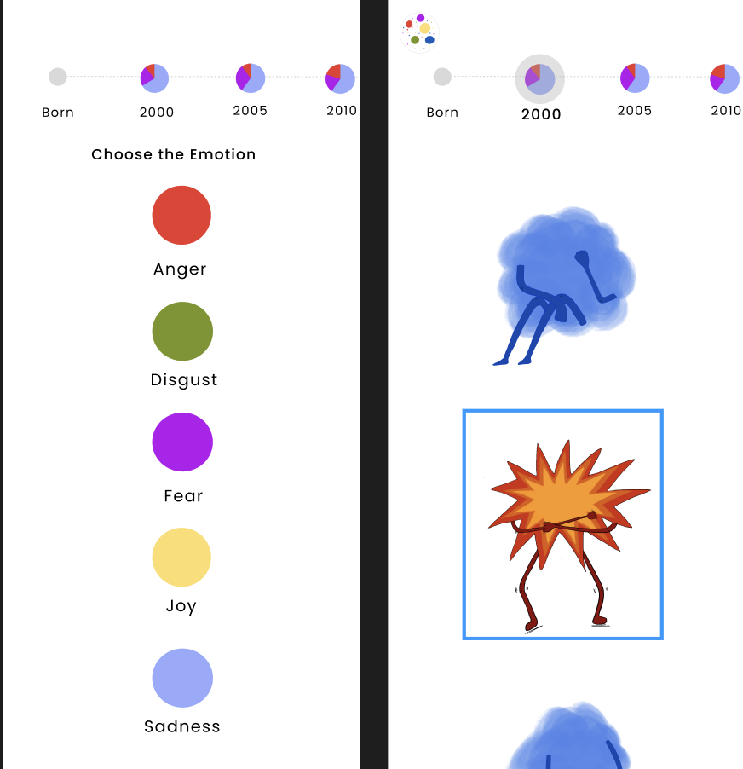
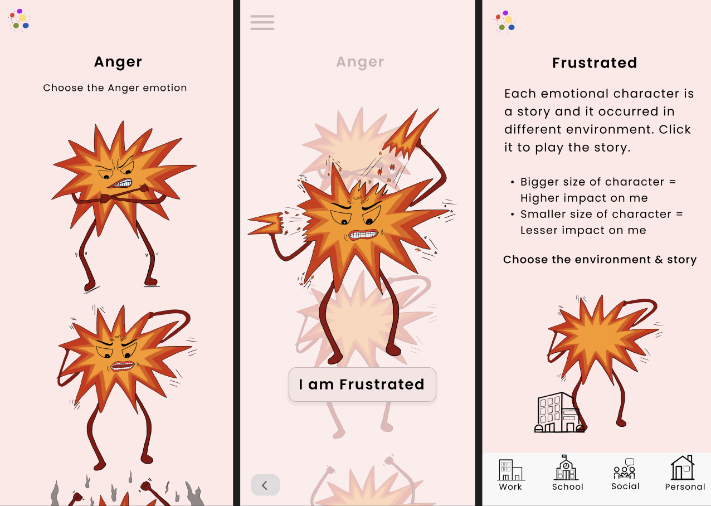
Créer une expérience mobile
Notes:
create a mobile wireframe that maintained the same visual language of the web experience
navigation for mobile phones had to be different because of the touch-based interaction, which limited the gestures
content should be decluttered and minimal, reducing any visual disruptions and facilitating ease of navigation
redesigned some screens to visualise usability and cohesion
The interactions required more detail as the transitions between the screens were limited to touch and click
Auditing the experience with accessibility - readability, size of text, control and choice being provided - constantly testing in that regard

Slide 18
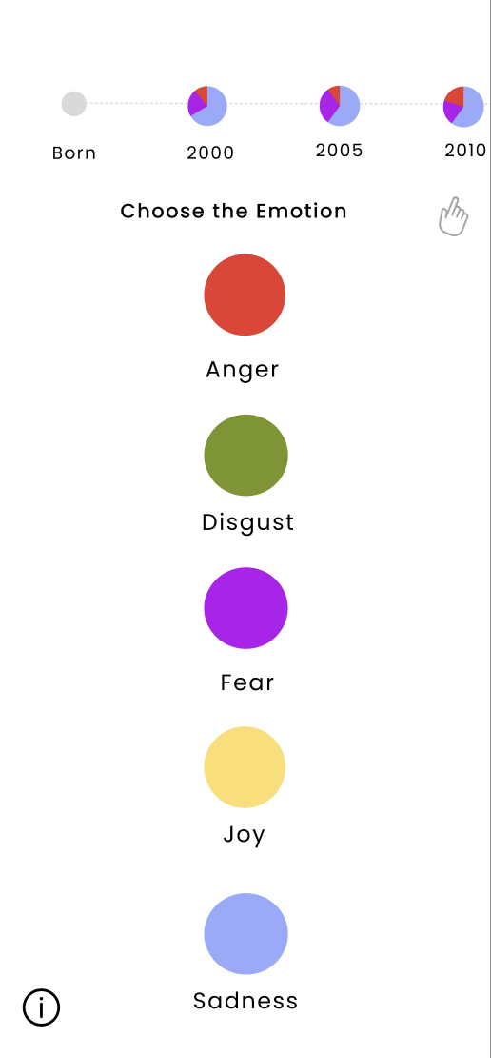
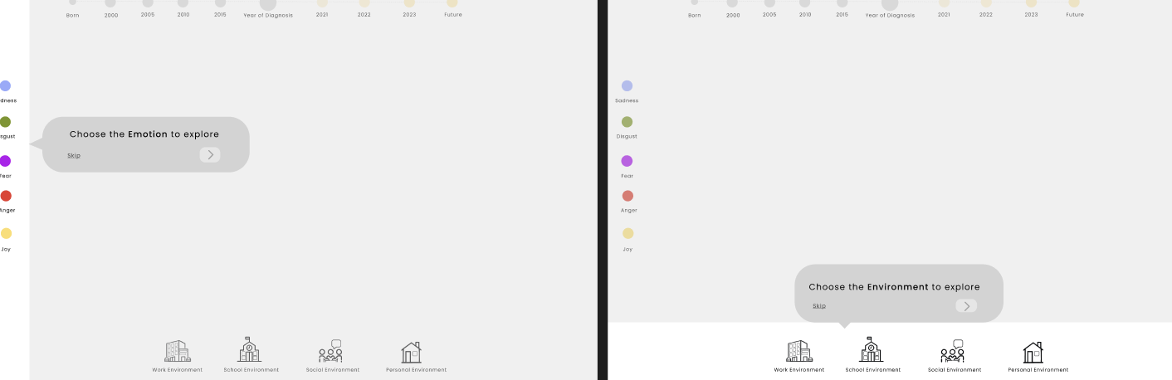
Tester l'expérience numérique
Notes:
participants grasp the concept of the website/mobile experience
if participants are seamlessly able to navigate through the experience
6 participants mix of neuro diverse and neuro typical folks in the testing to ensure everyone feels comfortable in the experience
Testing learning
Great representation and characters were enjoyable
Audio stories were relatable and visuals support - for the neuro diverse folks
Support and library button add value
The neurotypical participants were intrigued by the stories and recognized the depth of emotions
Highlighted issues like - navigational issues in the phone
Need for tutorial in the web experience - making these addition help in user experience

Slide 19
Construction et codage
Collaboration avec l'équipe technique pour aider au codage de l'expérience
Réviser les conceptions en fonction des capacités techniques sans compromettre l'expérience de l'utilisateur
De nombreux changements et décisions ont dû être pris au cours du processus de réalisation du projet.
Négociation permanente avec le programmeur

Slide 20
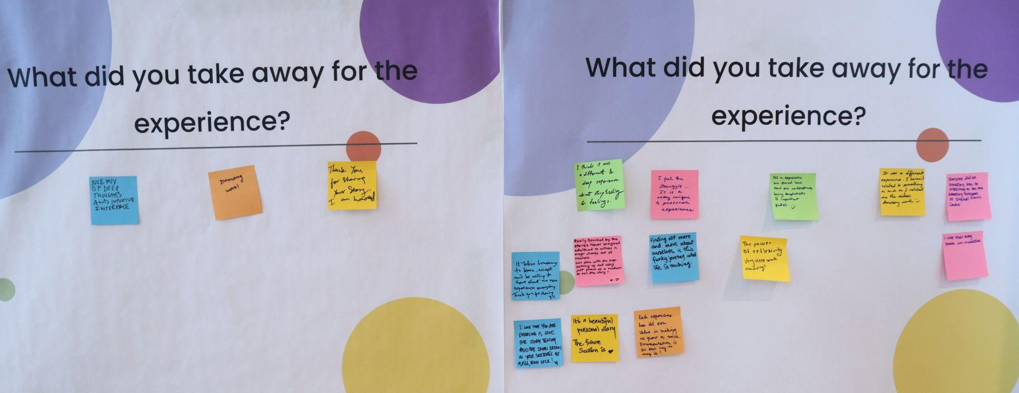
Réponse à l'exposition
Notes:
Look and feel of the experience was enjoyable - characters , interactivity of the experience, storytelling, details in drawing,
Relatability and connections with themselves
Empathy for the dyslexic and their daily struggles, deep reflection and experience sharing is valuable
Bravery for me to share such vulnerable stories with the world
Use of phone as the medium of storytelling
Appreciation for the documentation of the stories and reflection
Feeling less alone

Slide 21
Scanner le code QR pour rejoindre l'expérience #
URL - https://www.dyslexiaemotions.com

