Slide 1
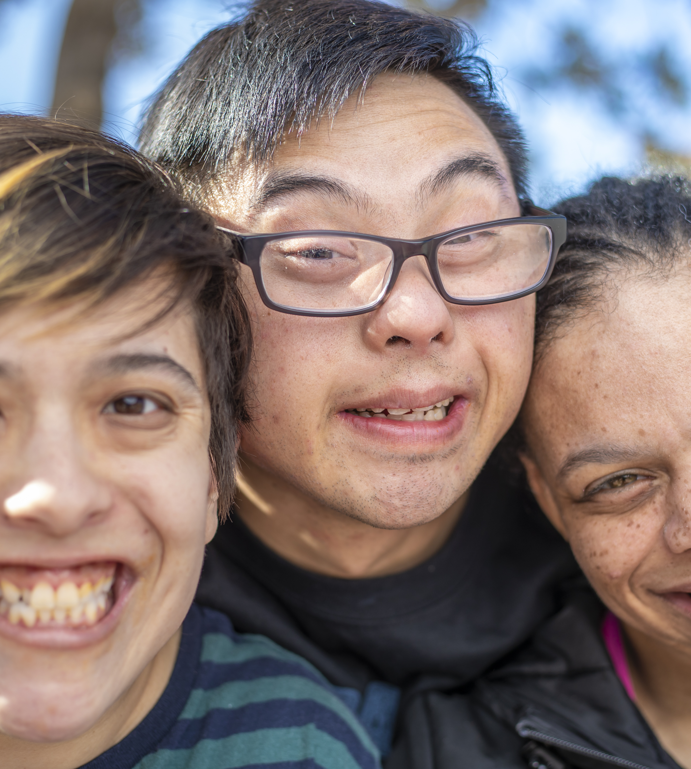

Who and what are we missing?
An introduction to cognitive accessibility
© 2024 Open Collaboration for Cognitive Accessibility. All rights reserved.
Notes:
In conversations about accessibility, there is one group that is often missing: persons with cognitive disabilities. This video will present an introduction to cognitive accessibility and highlight why it’s an essential consideration in accessibility discussions.

Slide 2

The people at the centre of this conversation
Attention
Executive functions
Social cognition
Learning and memory
Language
Perceptual motor skills
© 2024 Open Collaboration for Cognitive Accessibility. All rights reserved.
Notes:
The people at the centre of this conversation are those who experience challenges with (1) attention (for example sustained attention and processing speed, (2) executive functions (such as planning and problem solving) (3) learning and memory (such as ability to recall information) (4) language (such as fluency, grammar or complex language) (5) perceptual motor skills (such as coordination of movements) (6) social cognitions (such as recognizing emotions or introspection).
People with cognitive disabilities form a diverse group with a range of co-existing cognitive strengths and limitations that can change over time. Some experience life-long disability and others temporary disability. They experience less difficulties when the environment is adapted to meet their needs.

Slide 3
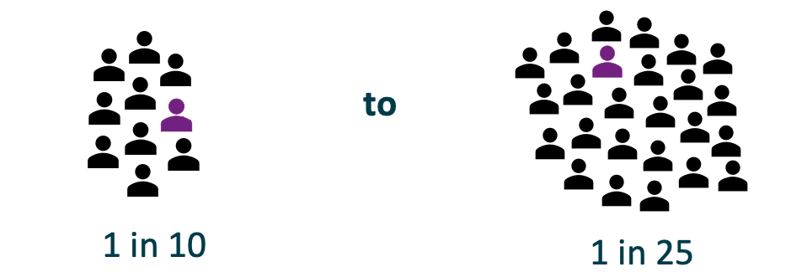
Prevalence of cognitive disabilities
© 2024 Open Collaboration for Cognitive Accessibility. All rights reserved.
Notes:
The prevalence of cognitive disabilities is estimated to be between 1 in 10 or 1 in 25. This is difficult to determine because there is no formal definition of cognitive disability.

Slide 4
Cognitive accessibility barriers
Complex signage and wayfinding
Cluttered websites with too many options
Forms and documents with complex language
Information not being available in accessible language
© 2024 Open Collaboration for Cognitive Accessibility. All rights reserved.
Notes:
Examples of cognitive accessibility barriers include:
Complex signage and wayfinding
Cluttered websites with too many options
Forms and documents with complex language
Information not being available in accessible language

Slide 5
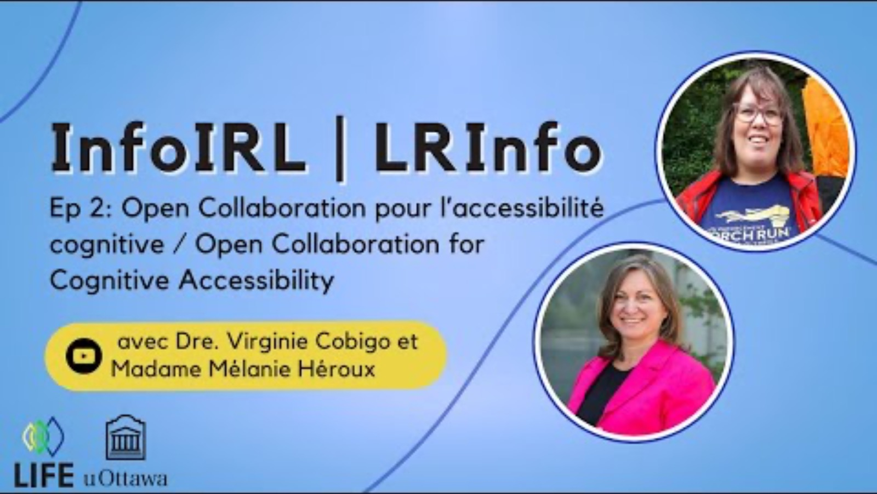
Notes:
Let’s watch a video interview with Virginie Cobigo, the executive director of Open Collaboration for Cognitive Accessibility, and Melanie Heroux, an Advisor with lived experience with cognitive disabilities, who works with Open. Open is a social enterprise that champions the lived experience of persons with cognitive disabilities. It provides a research infrastructure to support researchers, business developers, tech companies and other stakeholders in mitigating cognitive accessibility barriers and meaningfully engaging with persons with cognitive disabilities using inclusive methods.
The interview was conducted by Dr. Nafissa Ismail at the Life Institute at the University of Ottawa, highlighting lifespan research.

Slide 6
Cognitive accessibility defined
Making the environment easy to use regardless of the way people think, learn, speak or memorize.
Building cognitive ramps for accessibility
One essential cognitive ramp is accessible language
© 2024 Open Collaboration for Cognitive Accessibility. All rights reserved.
Notes:
Cognitive accessibility can be defined as making the environment easy to use regardless of the way people think, learn, speak or memorize. Just as we would build ramps for physical accessibility, building cognitive ramps for accessibility is important. One essential cognitive ramp is accessible language.

Slide 7

Open Collaboration for Cognitive Accessibility
Informed by lived experiences of 40+ Advisors
info@OpenAccessibility.ca
OpenAccessibility.ca
© 2024 Open Collaboration for Cognitive Accessibility. All rights reserved.
Notes:
Open works with a team of more than 40 Advisors with lived experience. Check out the website at OpenAccessibility.ca for more information about Open’s work.

